Slide 1


Python for AI
Notes:
Hello and welcome to this Practicum AI recording.
I’m Dan Maxwell. And I work as an AI Trainer for Research Computing, here at the university of Florida.
In this short briefing, I’m going to introduce you to Python functions.
[NEXT SLIDE]

Slide 2

Functions quote
“You can think of a function as a small program inside a program. The basic idea of a function is that we write a sequence of statements and give that sequence a name. The instructions can then be executed at any point in the program by referring to the function name…
When a function is subsequently used in a program, we say that the definition is called or invoked.”
John Zelle
Notes:
So, what exactly is a function? I like this quote by computer science educator John Zelle. Zelle is the author of the bestselling textbook, Python Programming: An Introduction to Computer Science. Zelle writes, “The basic idea of a function is that we write a sequence of statements and give that sequence a name. The instructions can then be executed at any point in another program by referring to the function’s name.”
[NEXT SLIDE]

Slide 3
A function is a self-contained block of code…
It may accept inputs (parameters)
It will output (return) one or more results. Sometimes, the returned value is nothing! (None)
Can contain any statements found in a normal program
We've already encountered functions: i.e., int(), float(), range(), and many more – these are "built-in functions". The functions we write ourselves are "user-defined" functions
Source: Randy Switt – University of Florida (Pythonista)
Notes:
Let’s unpack that definition just a bit...
[NEXT SLIDE]

Slide 4
Why use Functions?
Main Program
Module-M1
Module-M2
Module-M3
Module-M4
Module-M5
Module-M6
Source: Randy Switt – University of Florida (Pythonista)
Notes:
So why are functions a good idea? Why do we use them? When designed properly, a function performs a single, specific task. This, in turn, allows us to design modular programs. Imagine a box of Lego bricks that snap together. In computer science, the bricks (or functions) are said to be reusable. And because they are reusable, we can build just about anything with them.
[NEXT SLIDE]

Slide 5
Advantages of Functions
Code Reuse
Simplicity
Flexibility
Ease of Testing
Improved Collaboration
Notes:
Reusable functions offer many advantages:
Code reuse: Reusable functions can be used repeatedly in different parts of a program or in different programs altogether. This leads to less code duplication and ease of maintenance.
Simplicity: Reusable functions designed to perform a specific task are easier to understand and work with. Developers can focus on the individual parts of a program, rather than the entire codebase.
Flexibility: Reusable functions can be modified and adapted to suit different scenarios and requirements. In other words, the same function can be used in different contexts, reducing the need for new code.
Ease of testing: Reusable functions are easier to test since they can be tested independently of the rest of the program. This helps us quickly identify and fix bugs. The result is reliable, stable software.
Improved collaboration: When functions are modular and reusable, multiple developers can work on different parts of a program simultaneously. The result is efficient collaboration and faster development.
[NEXT SLIDE]

Slide 6
Don’t repeat yourself
Thou shalt not repeat thyself
Thou shalt not repeat thyself
Thou shalt not repeat thyself
Thou shalt not repeat thyself
Notes:
One of the cardinal rules of good programming is stated here: Thou shalt not Repeat Thyself. In other words, "Every piece of knowledge or logic must have a single, unambiguous representation within a system." All that to say, if you want to do the same thing multiple times in your code, write a function, and call it wherever it is needed.
[NEXT SLIDE]

Slide 7
Syntax for Creating a Function
def <name>():
<statements>
return <values>
def hello():
print(‘Hello!')
Source: Randy Switt – University of Florida (Pythonista)
Notes:
Alright, let’s look at how you create a Python function…
This is the syntax as you might see it in support documentation.
def – keyword indicating a function
<name> - name of the function. The same rules we learned about for naming variables also apply here.
return – optional statement to return value(s) to the calling program
And here’s a small block of code to create a function called “Hello”
[NEXT SLIDE]

Slide 8
Syntax for Calling a Function
<function_name>()
def hello():
print('Hello!')
hello()
Hello!
Source: Randy Switt – University of Florida (Pythonista)
Notes:
And now, we call our newly created function, and it prints “Hello!” to the output. A couple key points:
A function can only be called after it is defined. Thus, order matters in Python.
A function can be (and usually is!) called many times. That’s the power of reusability!
[NEXT SLIDE]

Slide 9
Function Parameters and Arguments
def <function_name>(param1, param2, . . .)
Source: Randy Switt – University of Florida (Pythonista)
Notes:
At this point, I need to clarify some vocabulary. Parameters and Arguments.
Function parameters are input variables defined ("declared") in the function definition. A function can have 0 to many parameters.
But when you call a function, you must provide arguments for each required parameter.
[NEXT SLIDE]

Slide 10
Parameters vs Arguments
Parameter
def hello(name):
print(f'Hello {name}!')
myName = input('Name? ')
hello(myName)
Argument
Source: Randy Switt – University of Florida (Pythonista)
Notes:
Although I provide a technical definition here, these two terms are often used interchangeably in real life.
Parameter = "Placeholder"
Defined by the function
the "place" where values are assigned when the function is called
Argument = "Actual values"
specified when calling the function
specifies actual values or variables that will be used as inputs
[NEXT SLIDE]

Slide 11
Returning Values
return <value1>,<value2>, . . .
def hello(name):
print(f'Hello {name}!’)
return True
myName = input('Name? ')
status = hello(myName)
print(status)
Name? Randy
Hello Randy!
True
Source: Randy Switt – University of Florida (Pythonista)
Notes:
Now in an earlier slide, I mentioned that functions can – and usually do – return values. To specify return values, we use the reserved word "return" followed by one or more values or variables. Let’s run this block of code and see what we get… First, the program asks for our name and assigns that value to the myName variable. It then passes the myName variable to the hello() function. The hello() function, in turn, prints “Hello <name>” and returns True. And finally, the return value is assigned to the status variable and printed. Note: It is good form to have a function return a status and assign that to a variable, as we do here.
[NEXT SLIDE]

Slide 12
Call by Position or Keyword
def hello(name):
print(f'Hello {name}!')
myName = input('Name? ')
# Call by position
hello(myName)
# Call by keyword
hello(name = myName)
Notes:
When calling a function and passing arguments to it, you can do so in two ways – by position or by keyword. My personal preference is to pass arguments by KEYWORD. When passing by keyword, you explicitly specify the parameters receiving each of your arguments. Here we see that the name parameter will receive the myName argument. The beautiful thing about this approach is that you know exactly what's being passed to what. And your code becomes self-documenting. This is important when you come back to a piece of code after a long time. Write code for the future you!
[NEXT SLIDE]

Slide 13
Software Specifications and Design
Notes:
Hello and welcome to this Practicum AI recording.
I’m Dan Maxwell. And I work as an AI Trainer for Research Computing, here at the university of Florida.
In this short briefing, I’m going to introduce you to software specifications and design.
[NEXT SLIDE]

Slide 14
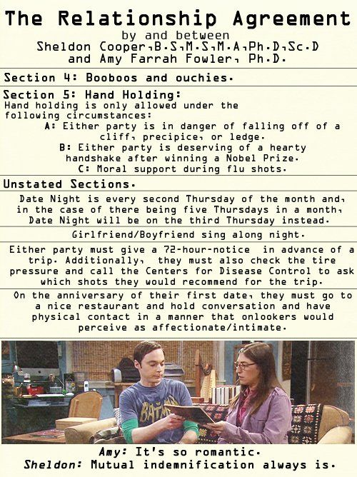
Python Functions are like Contracts
Image Credit: Lorre, C., Prady, B., & Reynolds, J. (Writers), & Cendrowski, M. (Director). (2011, November 17). The Flaming Spittoon Acquisition (Season 5, Episode 10) [TV series episode]. In (Executive Producer), The Big Bang Theory. Warner Bros. Television
Notes:
Let’s begin with a fundamental idea – the idea of a contract.
In the TV series “The Big Bang Theory”, the resident genius - Sheldon Cooper - enjoys creating legally-binding agreements that specify the particulars of any relationship he is in. His romance with Amy, for example, is regulated by a relationship agreement – shown here.
Python Functions
Just as Sheldon's relationship agreement ensures that he and Amy will act in regular and predictable ways, so too the interface to a function is like a contract. If a call to a function passes the correct arguments by key word or in the correct order, the function responds in a predictable way, providing the promised output.
Counterintuitively, the first step in creating a function is to define what it will do. I say "counterintuitively" because most programmers simply dive right in and start writing code. This strategy works well for small and rather simple programs. However, you'll quickly run into trouble when the complexity begins to increase. For that reason, seasoned software developers usually begin by writing a specification (spec). This is a document that spells out the terms of the contract. A well-written spec typically includes interface documentation as well as a clear statement in plain English of the steps to be taken to accomplish the function's task, often called pseudo-code.
[NEXT SLIDE]

Slide 15
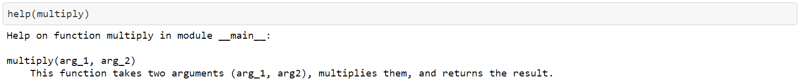
Specification
The multiply() function takes two arguments
(arg_1, arg_2), multiplies them, and returns the result.
def multiply(arg_1, arg_2):
’ ’ ’This function takes two arguments (arg_1, arg2), multiplies them, and returns the result.
’ ‘ ’
return(arg_1 * arg_2)
# end multiply()
help(multiply)
Notes:
Let's illustrate this process by writing a spec for a simple function called multiply. And here's the initial specification. Not much to it, is there?
Because this function is so simple, we won't bother writing the pseudocode for it. For more complex functions, however, pseudocode is strongly recommended as it helps you understand the flow and logic of your program before you start coding. With all that said, here’s what the code looks like.
This is a straightforward function, if there ever was one. Even so, a couple points need to be highlighted. Consider, for example, the documentation (doc) string immediately following the function definition. As you can see, this string is enclosed by three single quotes '‘’. This information displays whenever you run help() on this function. And here’s what that looks like.
The last thing I want to point out is the final line of code which begins with a # sign. The pound sign (#) indicates that anything following it is a comment. So, in this example, we mark the end of the multiply function with a comment. When developing a module containing many functions, best practice encourages the placement of comments at the end of each function. This helps you to clearly see where one function ends and another begins. And finally, don’t be afraid of comments. Use them liberally to document your code.
=====
In his wonderful book, Python without Fear, Brian Overland makes the following points about doc strings (p. 322). You'll want to keep these in mind as you create doc strings for your functions.
The doc string must be the first statement after the beginning (header) of the function definition.
Normal indentation rules apply. The doc string must be indented under the heading of the definition, just as any statement.
The indentation requirement applies only to the first physical line. However, the cleanest style is to continue the indentation of the first line.
You can use any kind of quotation marks. However, the literal quote marks (''') enable you to write doc strings that span any number of physical lines.
[NEXT SLIDE]

Slide 16
Pseudocode
Organize everything together;
Plug in kettle;
Put teabag in cup;
Put water into kettle;
Wait for kettle to boil;
Add water to cup;
Remove teabag with spoon/fork;
Add milk and/or sugar;
Serve;
Source: https://www.devopsschool.com/blog/complete-tutorial-for-pseudocode/
Notes:
Because we have not yet seen what pseudocode and flowcharts look like, I end this briefing with examples of both. First, here’s the pseudocode for creating a cup of tea. With pseudocode, you want to concisely state what each step of your program will do. How that is accomplished, however, is written in code.
[NEXT SLIDE]

Slide 17
Flowcharts
Start
Read input from
pin 13 Arduino
Is
the input
HIGH?
No
Yes
Send HIGH output
to pin 11 Arduino
Delete the image
Capture the image
Get a confirmation
from user
Is it
True?
No
Yes
Send output to
pin 12 Arduino
End
Notes:
Flowcharts are another great way to think through the underlying logic of your program. All that to say, flowcharts and pseudocode are your friends. But the hardest part is forcing yourself to sit down and think through your program. Most people dive right into the coding. But as my friend and mentor – Dr. Clay Shepherd – once said, “The first to code is always the last to finish.”
[NEXT SLIDE]

Slide 18
Slide intentionally left blank

