Slide 1

Python for AI

Slide 2
What is Data Wrangling?
Data Wrangling is the process of gathering, collecting, and transforming raw data into another format for better understanding, decision-making, accessing, and analysis in less time.
Discovery
Structuring
Cleaning
Publishing
Validating
Enriching
Steps in data wrangling
Sources: A Handy Guide to Data Wrangling and Importing CSV in Python (turing.com)
Notes:
There are 6 broad steps in data wrangling, which are:
Step 1 Discovery: Understanding the data.
Step 2 Structuring: Structuring different data types into standardized formats.
Step 3 Cleaning: Eliminating redundant and incomplete data.
Step 4 Enriching: Enhancing data by supplementing it with data from internal/external sources.
Step 5 Validating: Checking for accuracy and data quality.
Step 6 Publishing: Releasing data for analytics.
=====
https://www.turing.com/kb/data-wrangling-and-importing-csv-in-python

Slide 3
Importance of Data Wrangling
20%
80%
Data Exploration and Modeling
Data Wrangling
Notes:
Did you know, data professionals spend almost 80% of their time wrangling the data, leaving a mere 20% for exploration and modeling?
Some may question if the amount of work and time devoted to data wrangling is worth the effort.
A simple analogy will help you understand. The foundation of a skyscraper is expensive and time-consuming before the above-ground structure starts. Still, this solid foundation is extremely valuable for the building to stand tall and serve its purpose for decades. Similarly, once the code and infrastructure foundation are gathered for data handling, it will deliver immediate results (sometimes almost instantly) for as long as the process is relevant.
However, skipping necessary data-wrangling steps will lead to significant downfalls, missed opportunities, and erroneous models that damage the reputation of analysis within the organization.
====
https://www.simplilearn.com/data-wrangling-article

Slide 4





Data
Duplicates
Missing
Outliers
Data
data
formatting
errors
Common Data Wrangling Challenges
Sources: Taming the Data Beast: The Art of Efficient Data Wrangling (capellasolutions.com)
Notes:
Here are some common challenges that data wranglers face:
Data quality issues: Data may be incomplete, inconsistent, or inaccurate, which can lead to errors in analysis.
Data format issues: Data may be in different formats, such as CSV, JSON, or XML, and may require conversion to a unified format for analysis.
Data size issues: As data volumes continue to grow, processing and analyzing large datasets can become a significant challenge.
Data integration issues: Combining data from different sources can be difficult, especially if the data has different structures or uses different identifiers.
====
https://www.capellasolutions.com/blog/taming-the-data-beast-the-art-of-efficient-data-wrangling

Slide 5
Data Wrangling Techniques
Cleaning
Removing or correcting data that is incorrect, incomplete, or irrelevant.
Parsing
Breaking down complex data structures into simpler, more manageable forms.
Aggregating
Joining
Filtering
Selecting a subset of the data based on specific criteria, such as data ranges or numerical values.
Combining data from multiple sources into a single, unified dataset.
Summarizing data into groups or categories, such as calculating averages or counts.
Sources: Taming the Data Beast: The Art of Efficient Data Wrangling (capellasolutions.com)
Notes:
To overcome challenges, data wranglers need to use a combination of tools, techniques, and best practices.
Data-wrangling techniques are diverse, encompassing processes such as Data Cleaning, Data Parsing, Data Filtering, Data joining, and Data Aggregating. It is important to note that this list is not exhaustive, as there are many other data-wrangling techniques available.

Slide 6

Data Wrangling Best Practices
Test your work
Document your work
Keep the original data
Plan ahead
Automate where possible
Sources: Taming the Data Beast: The Art of Efficient Data Wrangling (capellasolutions.com)
Notes:
To ensure a successful and efficient data-wrangling process, here are some practices you can implement.
Plan: Define the objectives of your data-wrangling project and plan out the necessary steps and tools to achieve your goals.
Documentation: Keep track of the data-wrangling process and document any changes made to the data, enabling others to understand your work and reproduce your results.
Test: Test your data-wrangling processes on a small subset of the data before applying them to the full dataset to ensure they're functioning as intended.
Preservation: Always keep a copy of the original data in case you need to revisit and make changes or corrections later.
Automate: Use tools and techniques to automate repetitive or complex data-wrangling tasks, such as writing scripts or macros.

Slide 7
Data Wrangling Python libraries

Slide 8





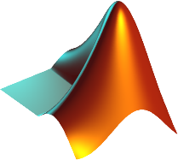
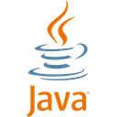

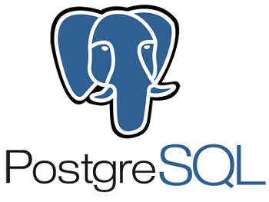
Why Python?
Notes:
There are many programming languages and tools for data wrangling, such as R, MATLAB, Java/JavaScript, C/C++, and SQL, why do we use Python?
Python is an open-source object-oriented high-level language with tons of libraries. The language is full of benefits, e.g.
Simplicity. Python’s straightforward and simple syntax is something that makes beginners want to learn this scripting language.
A powerful toolbox. Inherently, Python programs are text files containing instructions for the interpreter and are written in a text editor or IDE.
Development speed. Python is a dynamic scripting language, so it isn’t intended for writing applications from scratch but primarily for plugging together components.
Flexibility. Although Python puts emphasis on code simplicity and readability rather than flexibility, the language still has it. Python is usable across different projects. It allows developers to choose between object-oriented and procedural programming modes.
Portability. Python is designed to be portable. Its programs are supported on any modern computer OS.
A strong community. Python has a rapidly growing user base and is representative of what a strong community is.
====
https://vilmate.com/blog/python-vs-other-programming-languages/

Slide 9
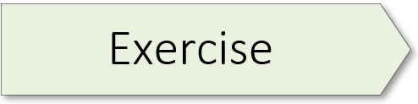

03.1_numpy_scipy.ipynb
Notes:
NumPy is a library for the Python programming language, which adds support for large, multi-dimensional arrays and matrices, along with a large collection of high-level mathematical functions to operate on these arrays.
Latest version: 1.24.2
Release date: Feb 05, 2023

Slide 10

03.1_numpy_scipy.ipynb
Notes:
SciPy is a free and open-source Python library used for scientific computing and technical computing. SciPy contains modules for optimization, linear algebra, integration, interpolation, special functions, FFT, signal and image processing, ODE solvers, and other tasks common in science and engineering.
Latest version: 1.10.1
Release date: Feb 29, 2023

Slide 11

03.2_pandas.ipynb
Notes:
pandas is a fast, powerful, flexible, and easy-to-use open-source data analysis and manipulation tool, built on top of the Python programming language.
Latest version: 2.0.0
Release date: Apr 03, 2023

Slide 12

03.3_rapids_cudf.ipynb
Notes:
The NVIDIA RAPIDS™ suite of software libraries, built on NVIDIA AI, gives you the freedom to execute end-to-end data science and analytics pipelines entirely on GPUs. It relies on NVIDIA® CUDA® primitives for low-level compute optimization but exposes GPU parallelism and high-bandwidth memory speed through user-friendly Python interfaces.
cuDF is a Python GPU data frame for loading, joining, aggregating, filtering, and otherwise manipulating data. cuDF also provides a pandas-like API that will be familiar to data engineers & data scientists, so they can use it to easily accelerate their workflows without going into the details of CUDA programming
====
Getting Started Cheat Sheet: GPU Accelerated DataFrames in Python (nvidia.com)
RAPIDS · GitHub

Slide 13
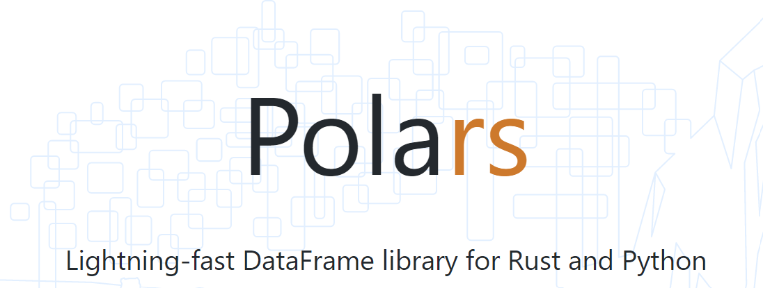

03.3_polars.ipynb
Notes:
Polars is a lightning-fast Data Frame library/in-memory query engine. Its embarrassingly parallel execution, cache-efficient algorithms, and expressive API make it perfect for efficient data wrangling, data pipelines, snappy APIs and so much more.

Slide 14
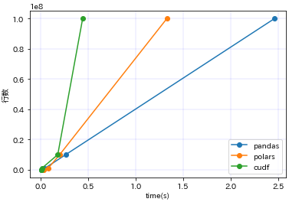
pandas vs Polars vs cuDF
Environment:
CPU : Ryzen 7 3700X
GPU : RTX3090
OS : Windows11 / WLS2(Ubuntu 20.04)
Performance comparison for groupby
# Code
df.groupby(['Category']).mean()
columns | pandas | polars | cudf
10000 | 0.002895 | 0.003179 | 0.005933
100000 | 0.012538 | 0.018462 | 0.006192
1000000 | 0.040214 | 0.075114 | 0.008816
10000000 | 0.260392 | 0.196927 | 0.176728
100000000 | 2.463650 | 1.327975 | 0.439283
If GPU memory isn't enough: Polars
If GPU memory is sufficient: cuDF
Others? : pandas
Sources: https://zakopilo.hatenablog.jp/entry/2023/02/04/220552
Notes:
====
https://zakopilo.hatenablog.jp/entry/2023/02/04/220552

