Slide 1

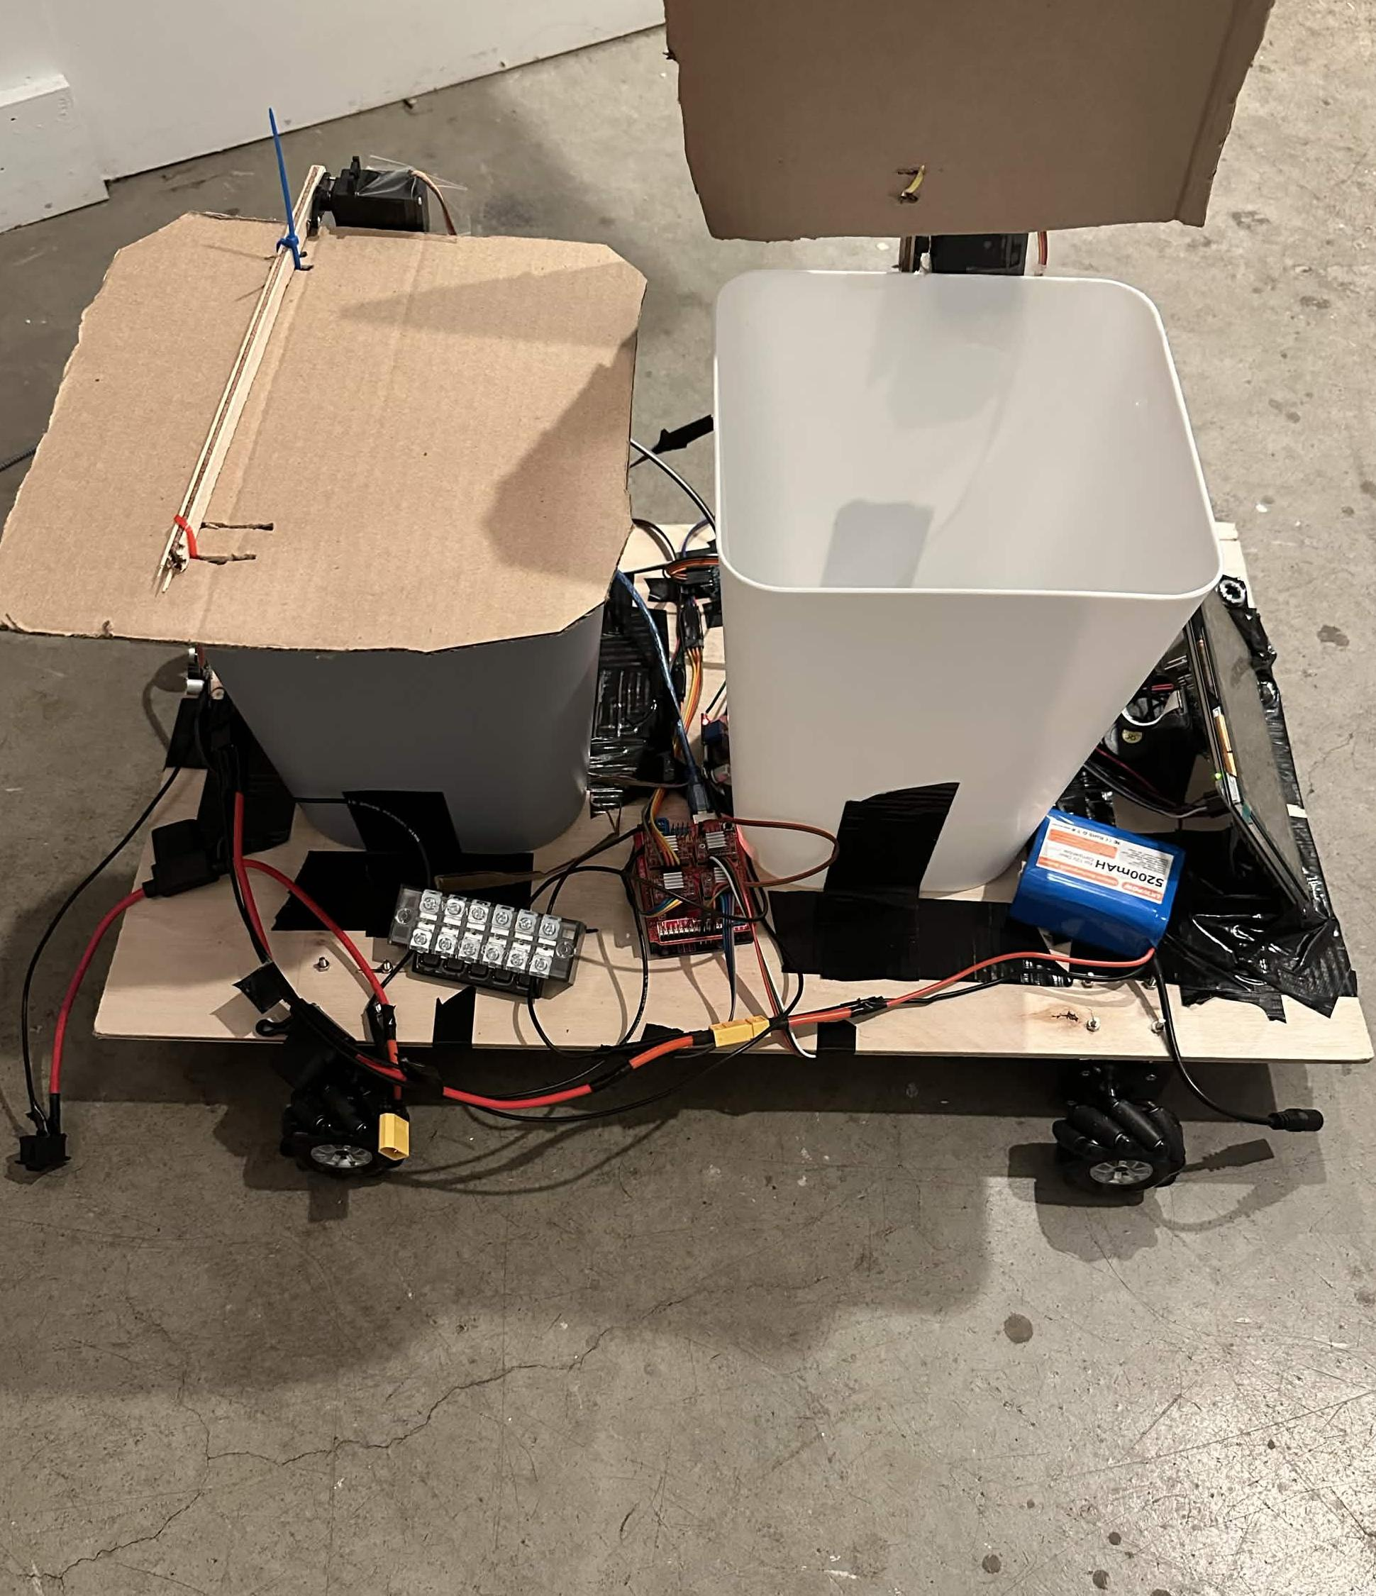
Recognize.
Sort.
Connect.
A mobile trash-sorting rover
with local vision and a shared dashboard.
HACKATHON BUILD
01
Notes:
Project overview. Sources: README.md; docs/hardware.md; docs/architecture.md. Hardware photograph: Media/IMG_3596.jpg. Photo preserves the actual prototype.

Slide 2
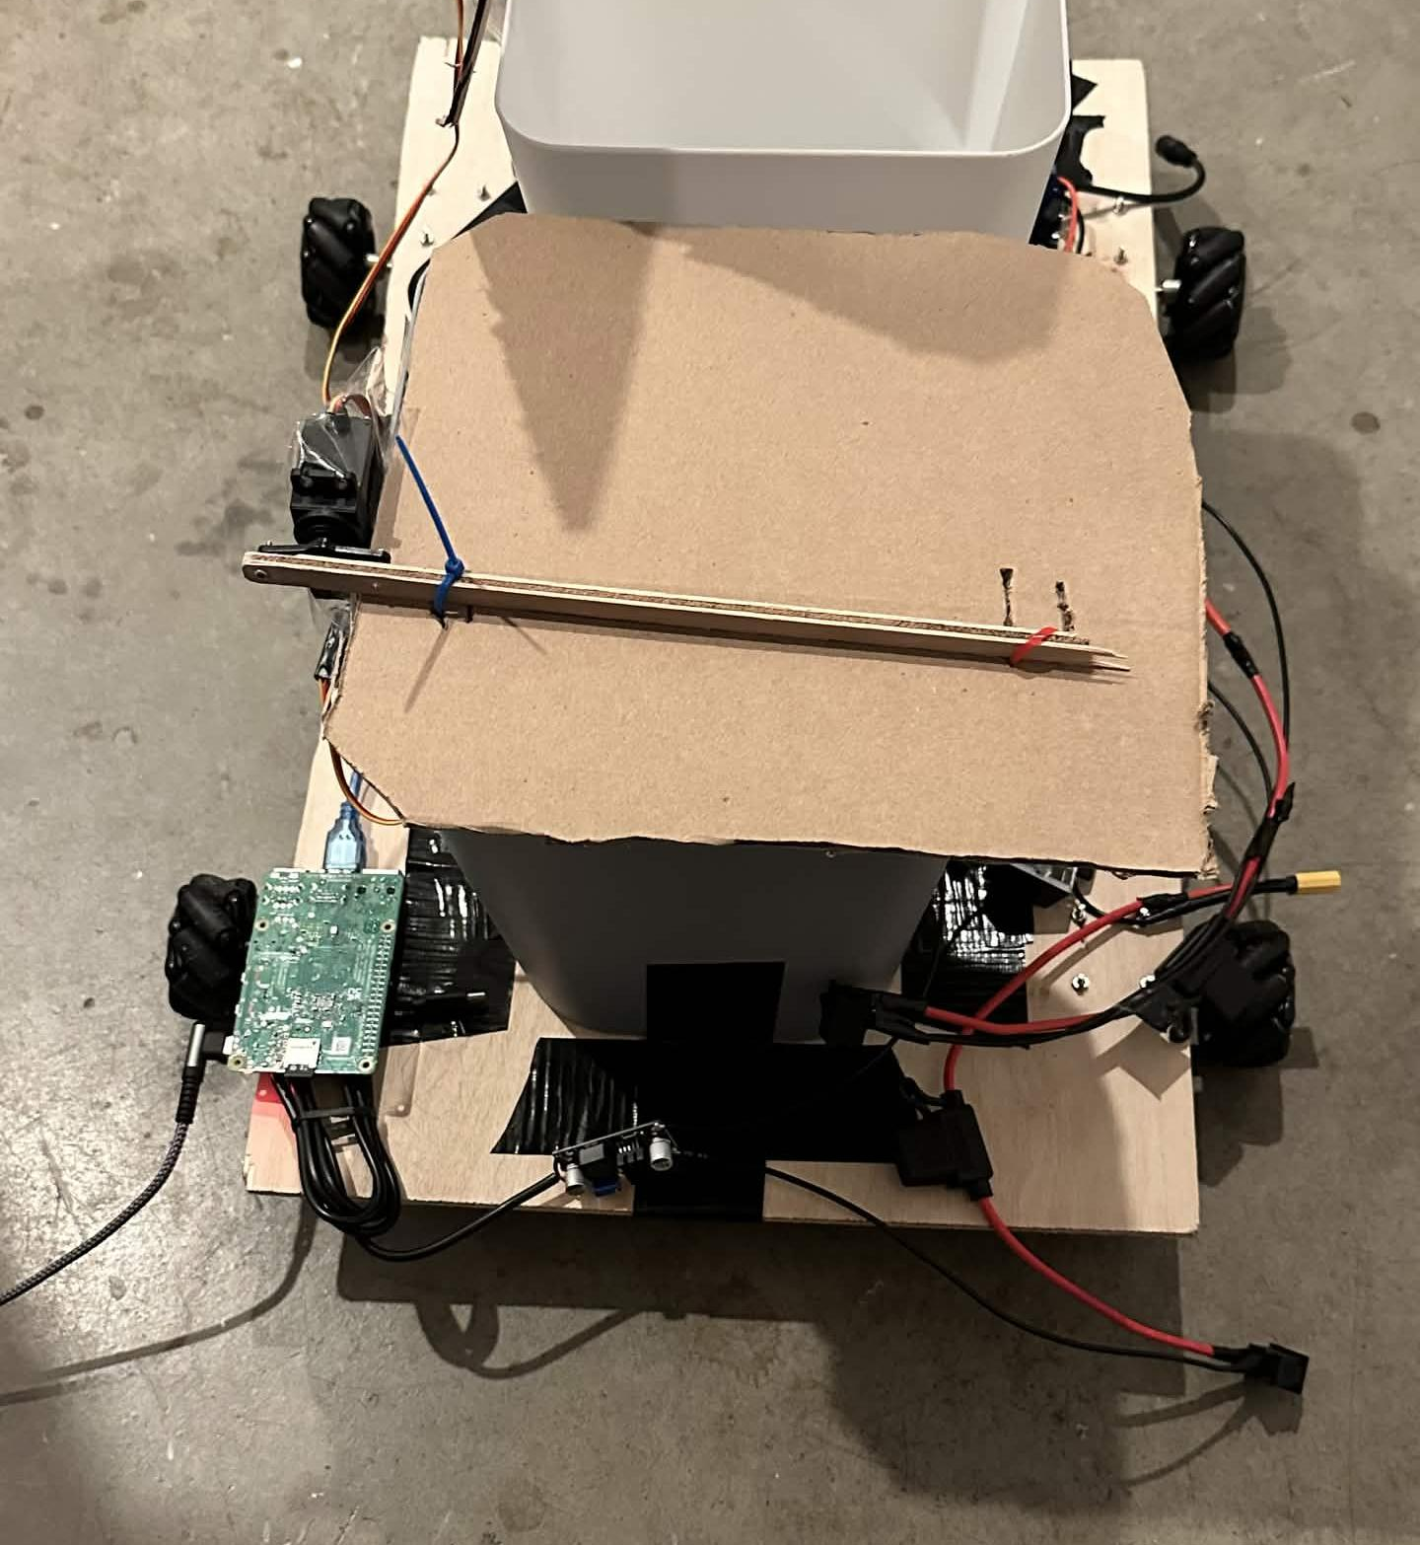
The software and hardware
LAPTOP
Flask serves the dashboard.
CLIP runs inference on the laptop.
TWO RASPBERRY PIS
One relays drive commands.
The other streams the camera and moves lids.
ARDUINO + CNC SHIELD
USB serial reaches the motor controller.
Four steppers drive the mecanum wheels.
HACKATHON BUILD
02
Notes:
Sources: docs/architecture.md, especially Two Pis in practice; docs/hardware.md; web_server.py; BRH_Test/rover_bridge.py; BRH_Test/driveController/driveController.ino. The laptop hosts Flask and CLIP. Separate Pi processes handle drive and camera/lids. TigerData is a remote PostgreSQL service. Hardware photo: Media/IMG_3597.jpg.

Slide 3
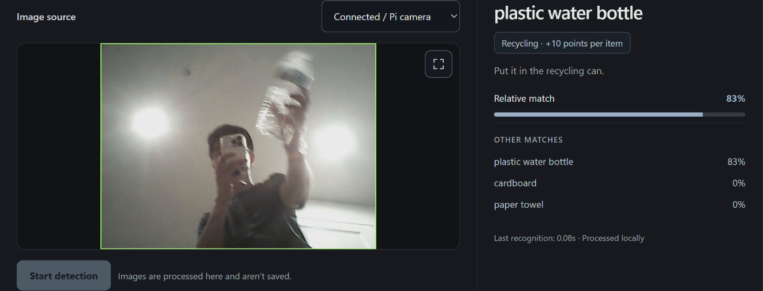
Local CLIP recognition
The laptop compares camera
frames with text labels.
CLIP ViT-L/14
RECYCLING
Bottle and cardboard
TRASH
Paper towel and chip bag
Three readings over at least 0.5 seconds
produce a stable item lock.
Other labels return no supported item. Match scores compare candidates.
HACKATHON BUILD
03
Notes:
Sources: classifier.py MODEL_ID, TARGETS, Classifier.predict; classifier_service.py ItemLock.READINGS and LOCK_SECONDS. Default model is openai/clip-vit-large-patch14. The model compares the whole frame with text candidates, including non-target labels. Only four item families are reported. Three or more readings spanning at least 0.5 seconds form a lock. Relative scores are candidate comparisons, not accuracy probabilities. Screenshot: source recording at 167.5 seconds, actual bottle and recycling result.

Slide 4
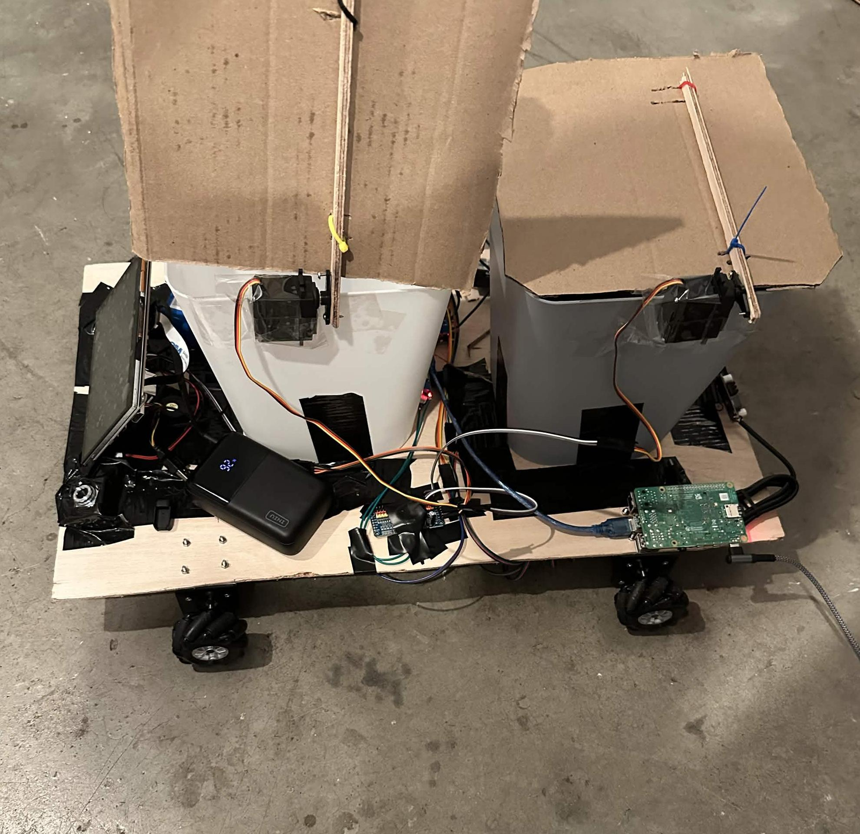
A detection opens the matching lid
LIVE ITEM LOCK
The laptop sends the bin command
over Wi-Fi UDP to the lid Pi.
CALIBRATED SERVO LIDS
The Pi drives the PCA9685 over I²C.
Each bin has its own servo channel.
AUTOMATIC CLOSE
The lid stays open for about 5 seconds
after the last matching reading.
Automatic lids use live scans when enabled. Photo uploads do not open lids.
HACKATHON BUILD
04
Notes:
Sources: classifier_service.py Service.track; lid.py RemoteLid and Lid; lid_server.py; docs/hardware.md. Live locked readings trigger open Trash or open Recyclable through UDP 5006. The lid Pi controls PCA9685 over I2C, channel 0 trash and channel 3 recycling. HOLD_SECONDS=5 after the last reading. Lid automation must be enabled. Photos do not open lids. Image: Media/IMG_3595.jpg.

Slide 5
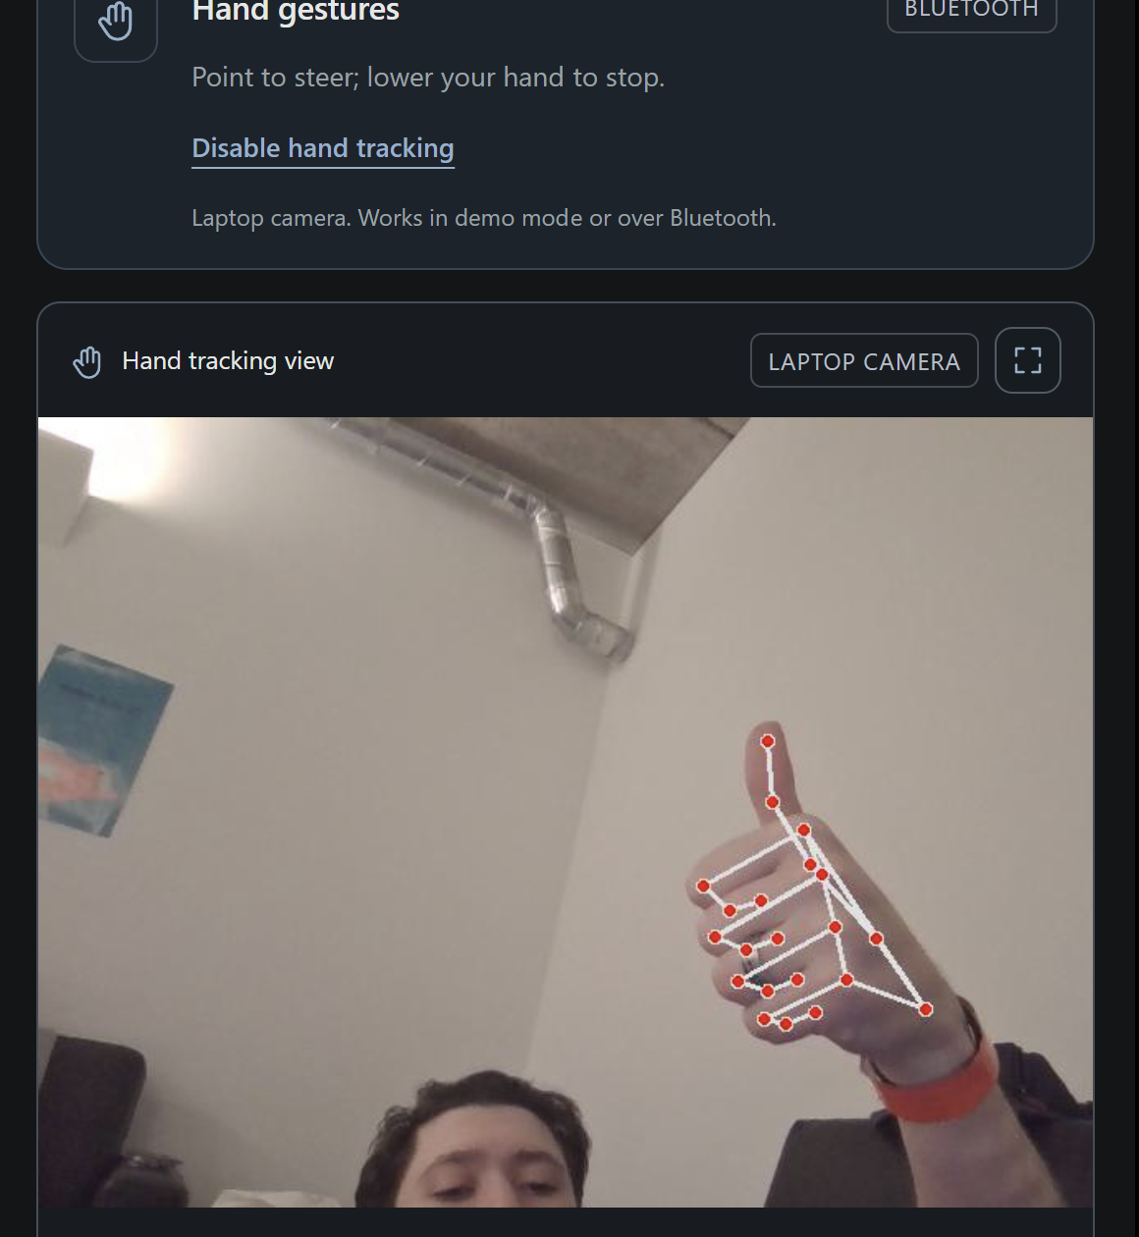
Website, voice and hand controls
WEBSITE CONTROLS
Direction buttons and throttle
send commands through the rover bridge.
GROK VOICE
Spoken directions call a drive tool.
The bridge sends the motor command.
MEDIAPIPE HAND TRACKING
Wrist-to-fingertip angle sets direction.
Bluetooth carries the angle to the rover.
One driving browser at a time. A missing heartbeat stops the rover after 1.5 seconds.
HACKATHON BUILD
05
Notes:
Sources: BRH_Test/rover_bridge.py set_mode, _camera_loop, _watchdog; BRH_Test/voice_control.py DRIVE_TOOL and DIRECTION_TO_CMD; docs/hardware.md. Website directions support keyboard, touch/mouse. Grok voice uses xAI realtime WebSocket and invokes drive_rover. MediaPipe runs locally; wrist-to-index-tip angle is rounded to five degrees and sent over Bluetooth. Wi-Fi receiver supports WASD, not angles. One driving session at a time. Heartbeat loss beyond 1.5 seconds stops/releases rover. Hand image: Media/HandGuestureProof.png.

Slide 6
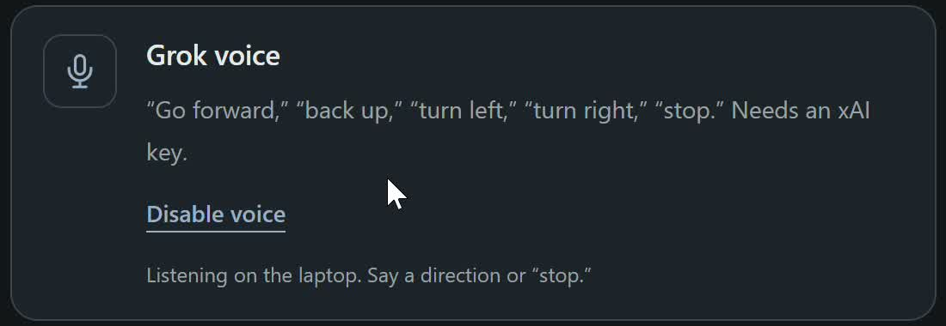
Grok voice control
LAPTOP MICROPHONE
Audio streams to xAI’s realtime API
when voice control is enabled.
GROK TOOL CALL
Grok interprets the spoken request and
calls drive_rover with a direction.
SPOKEN DIRECTIONS
“Go forward.”
“Turn left.”
“Stop.”
ROBOT COMMAND
The bridge sends motion or stop through
the drive Pi to the Arduino.
Voice uses cloud AI. The CLIP item classifier runs locally.
HACKATHON BUILD
06
Notes:
Sources: BRH_Test/voice_control.py SAMPLE_RATE, REALTIME_URL, DRIVE_TOOL, DIRECTION_TO_CMD, VoiceDrive._session and _apply_drive; BRH_Test/rover_bridge.py set_mode, _assisted_command and _send; docs/hardware.md. Voice captures the laptop microphone at 24 kHz PCM16 and streams it to the xAI realtime WebSocket, with model grok-voice-latest. A drive_rover function call maps forward/backward/left/right/stop to w/s/a/d/x. Left and right spin the rover in place. Commands pass through the existing bridge and drive Pi to the Arduino, using Bluetooth serial or Wi-Fi UDP. A requested duration schedules a stop. The bridge checks the driving owner, current voice mode and heartbeat, and gives recent manual input priority. Cloud voice is separate from local CLIP recognition. Screenshot: output/video/assets/voice-reference.jpg, cropped to the actual voice interface. This recorded UI uses demo mode; the screenshot shows the listening controls, not evidence of hardware movement.

Slide 7
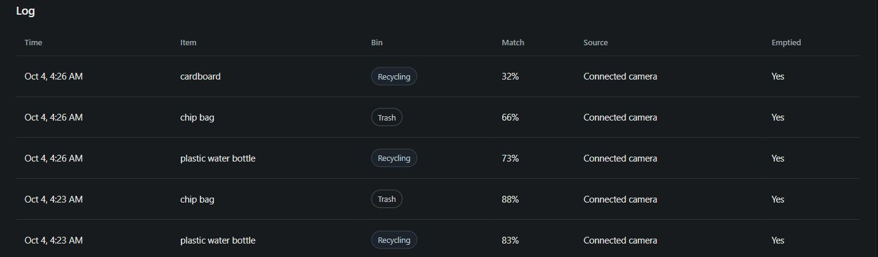
Every detection has a record
TigerData PostgreSQL
Computers and phones access the same history
through the dashboard.
One scan ID prevents repeat frames from creating duplicate records.
The ledger stores metadata, not camera images. Lid openings record collection events.
HACKATHON BUILD
07
Notes:
Sources: BRH_Test/database.py initialize, add_detection, add_collection, bin_contents, empty_bin; dashboard_classifier.py log_detection and auto_recorded; docs/architecture.md Logging and points. Each locked live scan and each photo records item, bin, score, source, time. Unique scan_id avoids duplicate rows as frames repeat. With configured DATABASE_URL the backend uses TigerData PostgreSQL, otherwise SQLite. Lids opening auto-records one collection event per locked scan. The camera does not verify a physical deposit. Photos and disabled lids require manual confirmation. No images stored in the ledger. Screenshot: output/video/assets/live-log-site.png. README.md manual-confirmation wording is older than the current automatic collection implementation.

Slide 8
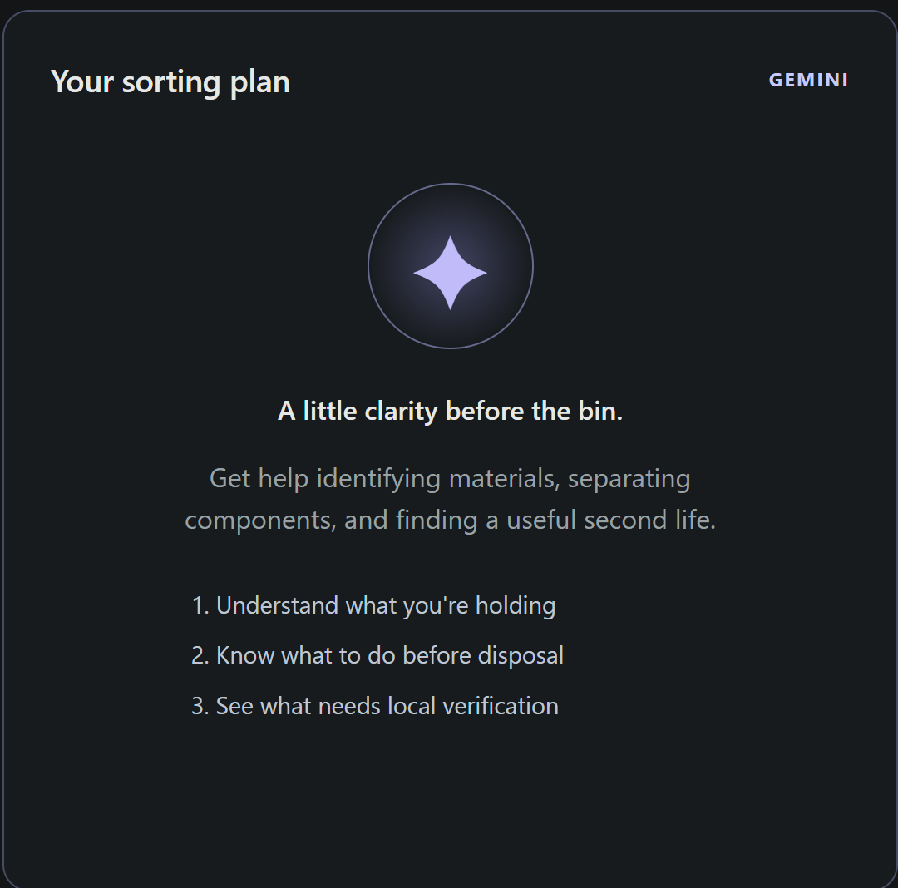
Gemini guidance for unfamiliar items
Upload a photo or ask about
an unfamiliar item.
Material guidance
Preparation steps
Reuse ideas
Advice stays separate from local CLIP
recognition and rover control.
Gemini processes submitted content in the cloud. The guide does not record drops.
HACKATHON BUILD
08
Notes:
Sources: BRH_Test/GEMINI.md; BRH_Test/gemini_guide.py; web/gemini.js. Guide accepts question, optional location and selected photo. Photos are decoded, resized and stripped of EXIF. Submitted content goes to Google Gemini. It is a separate advisory flow with no drive, lid or ledger tools and no live municipal-rule lookup. Screenshot: Media/Gemini-Integration.png.

Slide 9
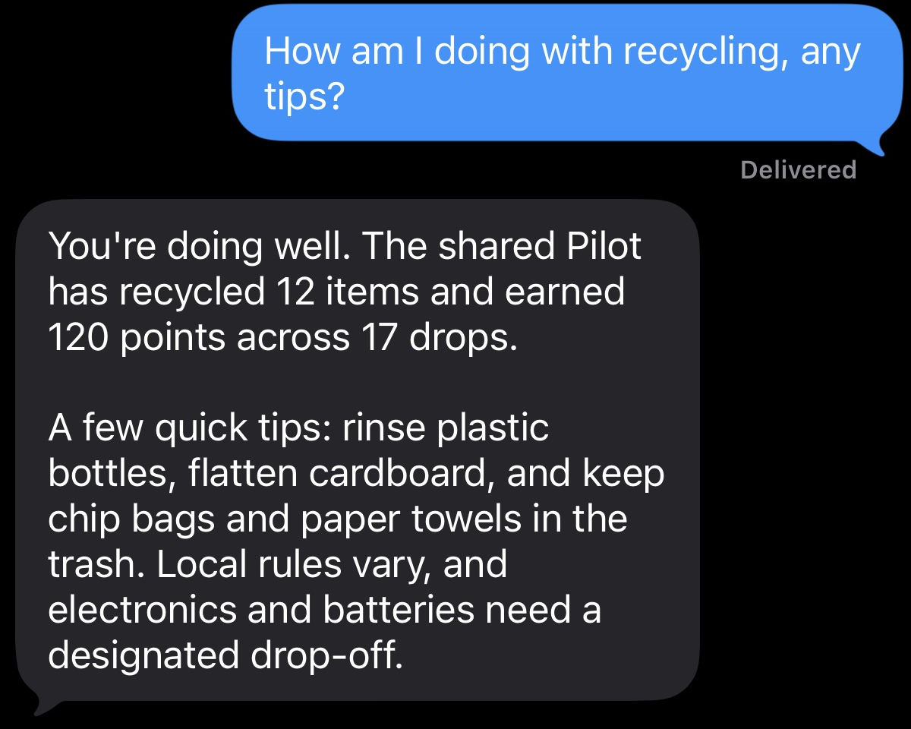
Photon messaging companion
iMessage, Telegram and dashboard chat
SHARED PROGRESS
Reads the same Pilot history
as the dashboard.
SORTING ADVICE
Answers item questions with
recycling context.
CONFIRMED DROPS
A five-minute code confirms
a proposed collection record.
Actual iMessage conversation
Driving stays with the dashboard controls.
HACKATHON BUILD
09
Notes:
Sources: spectrum/README.md; BRH_Test/companion.py Companion.command and Companion.advice; spectrum/src/index.ts. Photon Spectrum transports iMessage or Telegram messages to the authenticated Python bridge. Dashboard chat shares the same companion. All interfaces read the shared Pilot records. Advice uses xAI with local fallback. Manual collections require an exact confirmation code within five minutes and duplicate request IDs cannot award points twice. The model has no hardware or write tools. Screenshot: user-supplied C:/Users/John/Downloads/Photon.png, cropped to the question and reply. Shown progress counts are from that recorded conversation, not current totals.

Slide 10

Recognize.
Sort.
Connect.
Local vision. Automatic lids.
Shared recycling history.
HACKATHON BUILD
10
Notes:
Closing brand slide. User-supplied original mascot: C:/Users/John/Downloads/literarlytrash.png, cropped only to transparent bounds. Project sources: docs/architecture.md; classifier_service.py; lid.py; BRH_Test/database.py.

