Slide 1
Book1
File created on: 25/03/2019 23:44:19

Slide 2
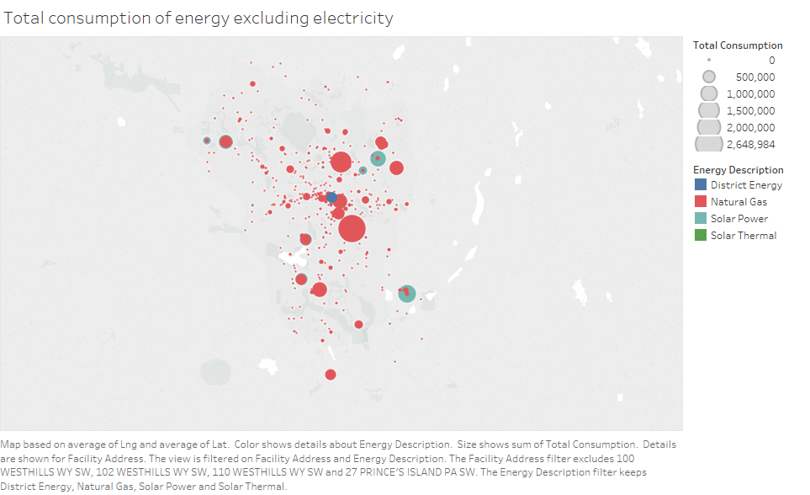

Slide 3
