Slide 1
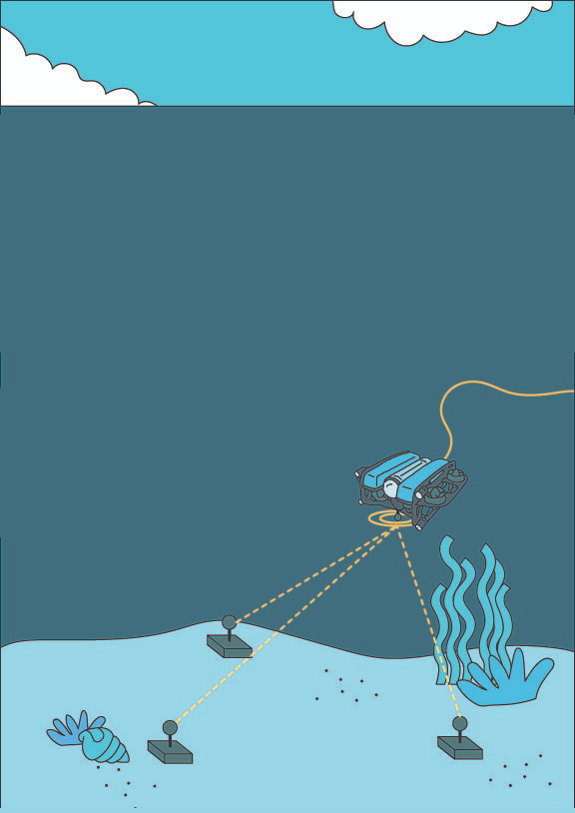



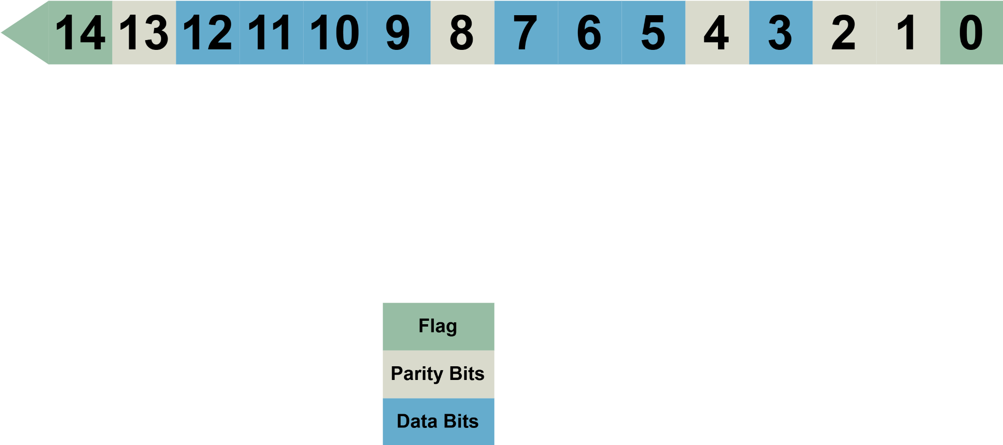




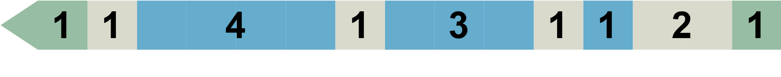
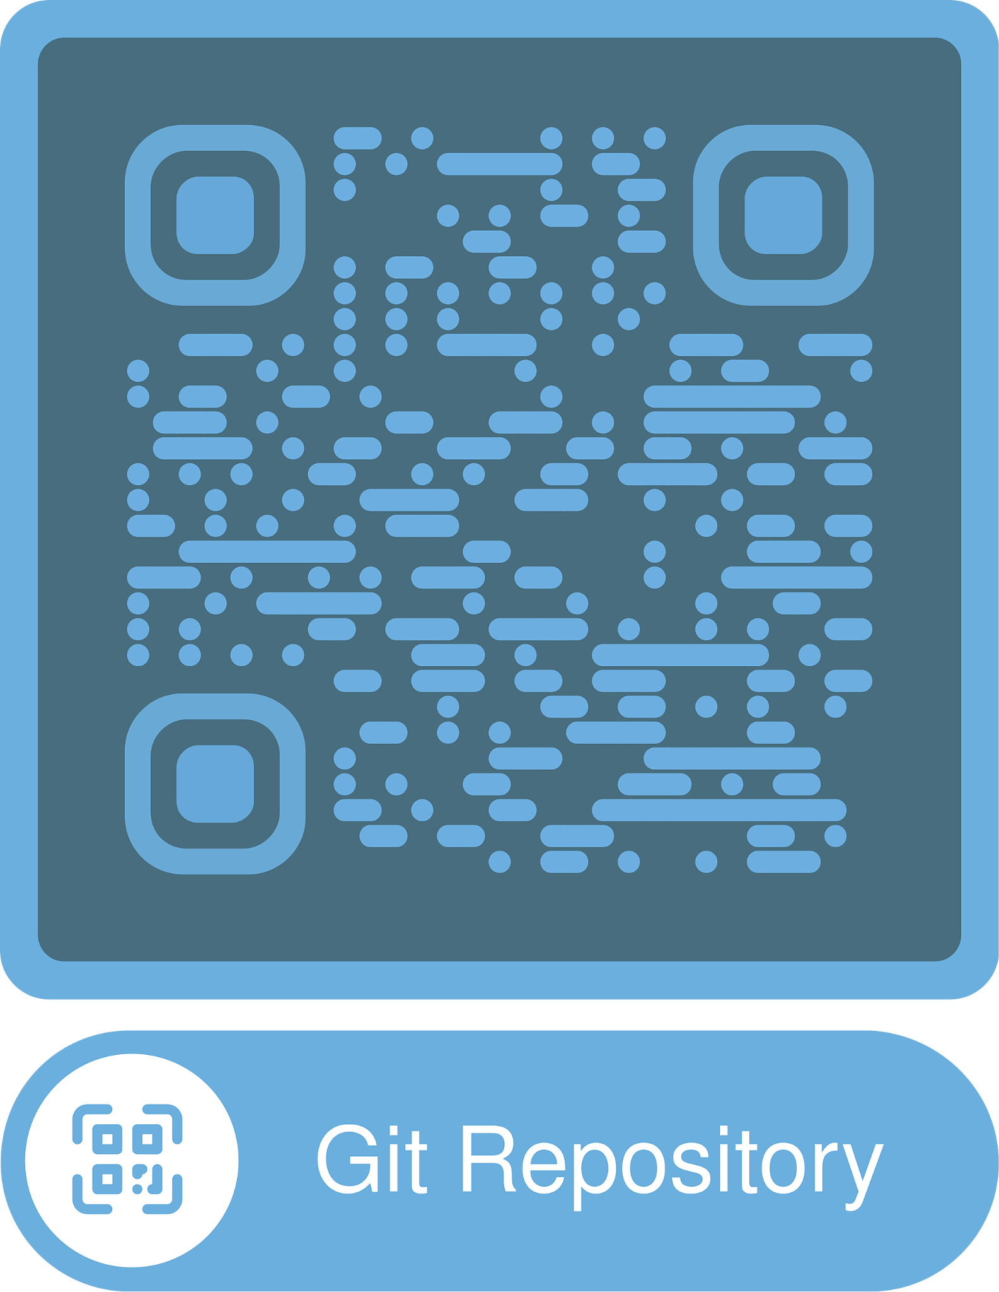
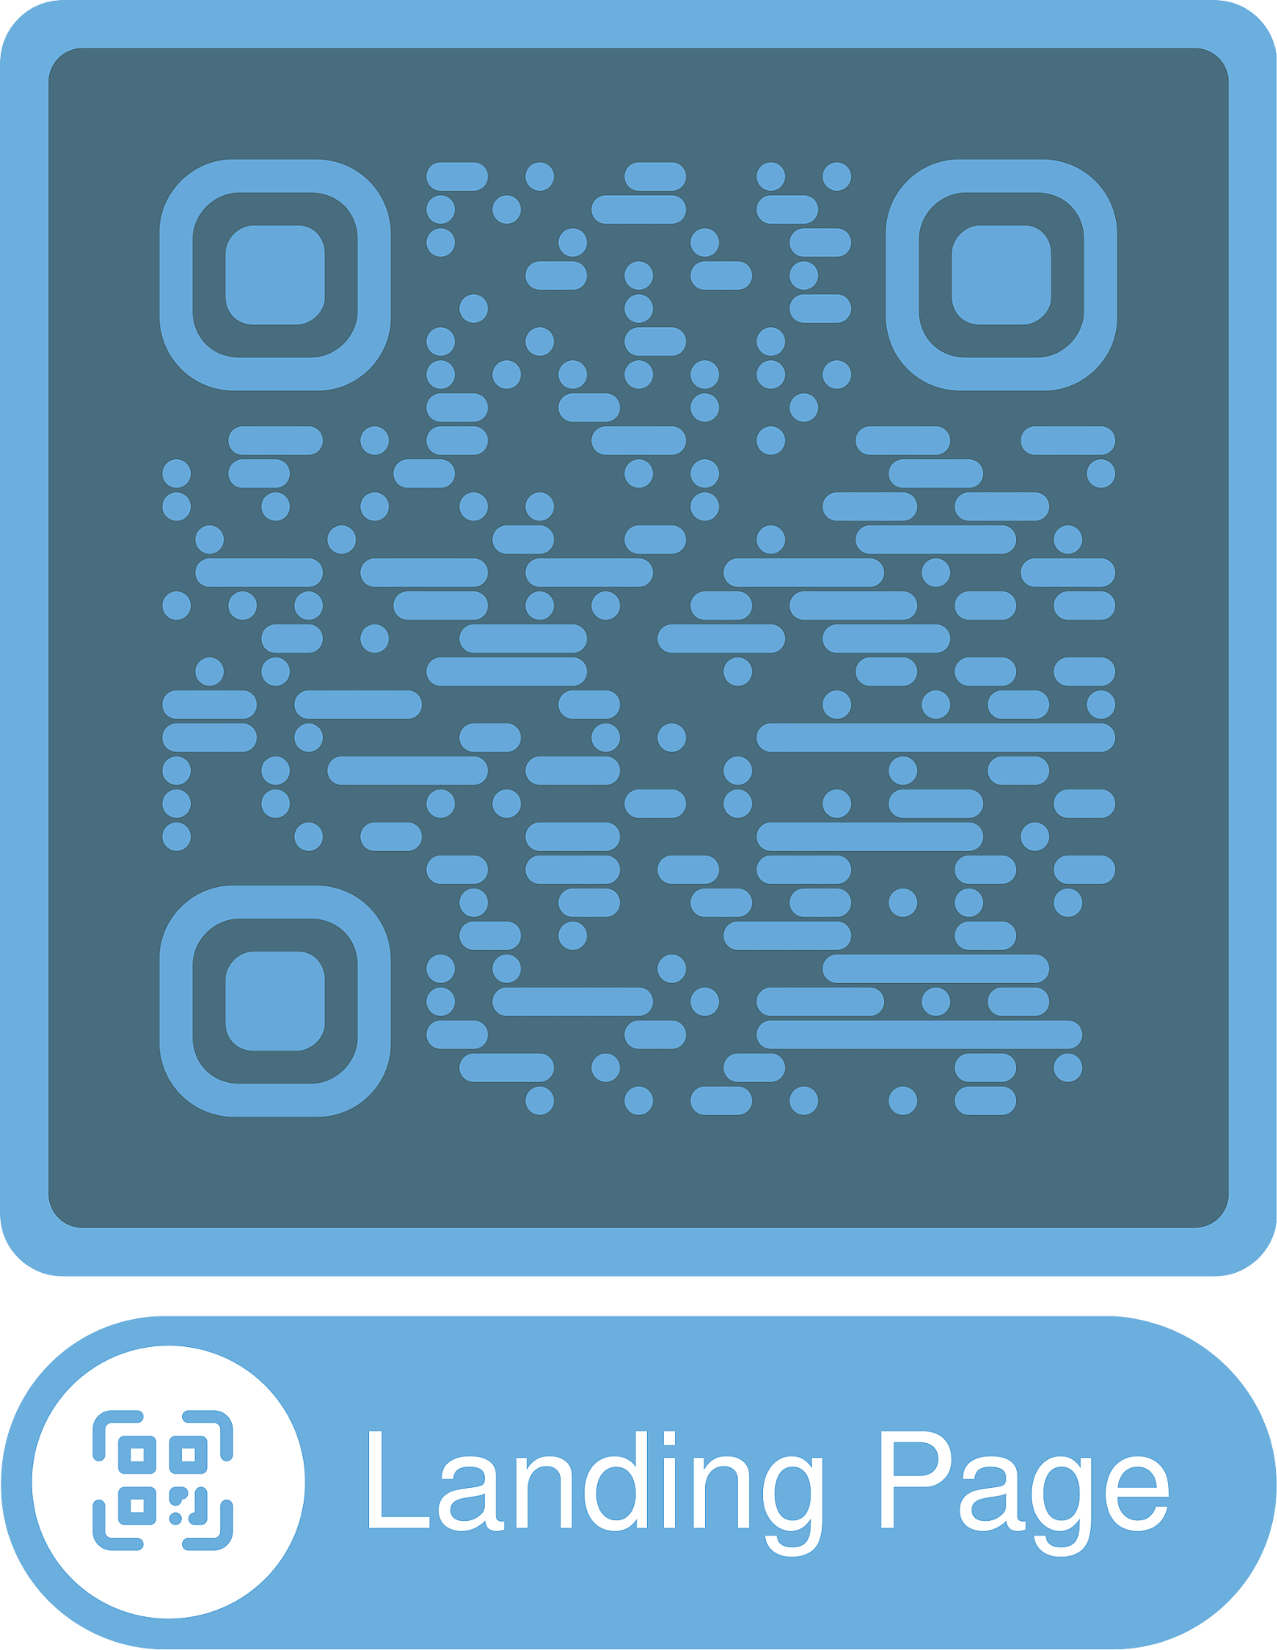
Multi-beacon Ranging System
Our programmed beacons helps robotic engineers to locate the underwater robot with multiple customized beacons and sonar based communications.
ENGN8170 S1 - 2025
Brian Ma, Yoyo Lam, Xingyu Luan, Xu Ben, Xiang Peng, Xinyu Qiao,Yifan Wu
The problem
Traditional positioning methods are either too expensive or unusable underwater.
Existing sonar systems only support single-beacon ranging, limiting accurate positioning for underwater robots.
Our solution
A master-slave sonar system that sends unique ID-encoded data packets, allowing each beacon to respond individually without collision.
Integrate GPS and IMU, validate full system in real environments, and compile a complete technical package.
Project Roadmap
Phase 1: Previous developer of the project Managed to
measure the distance between 2 beacons.
Phase 2: Our team established the data transmission protocol
from a master beacon to 3 minor beacons and a coordinate measurement system based on the
distance from the master beacon to
3 minor beacons.
Phase 3: Compensate the locomotion of the
master beacon to make the
coordinate more accurate.
Master Beacon
Data Structure
Data Packet

