Slide 1


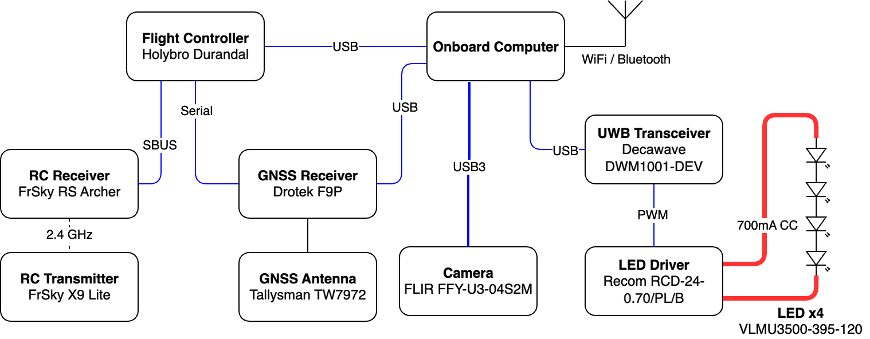
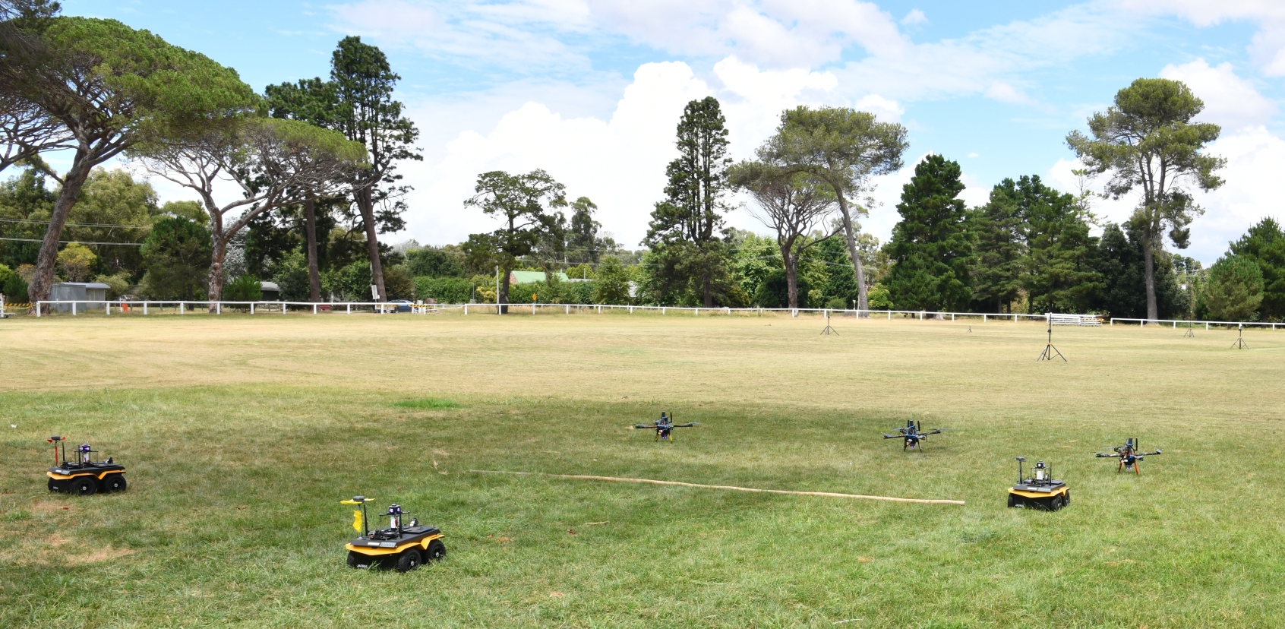




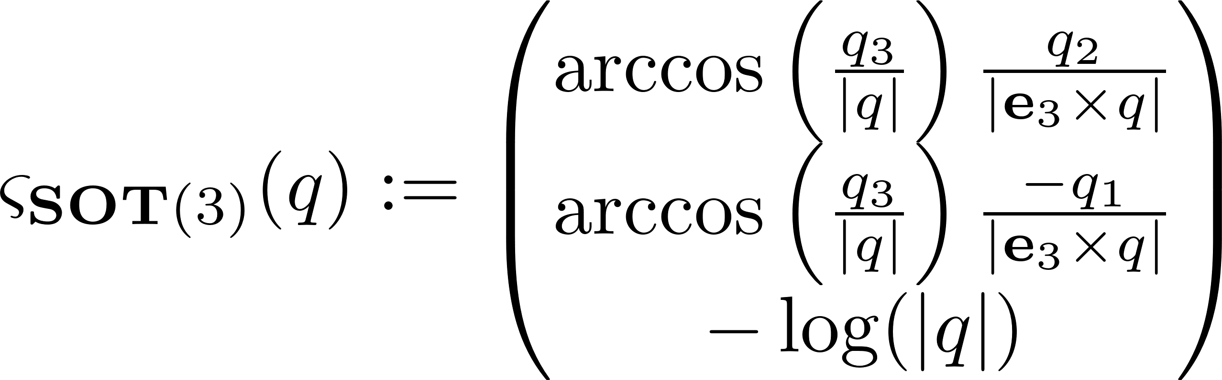
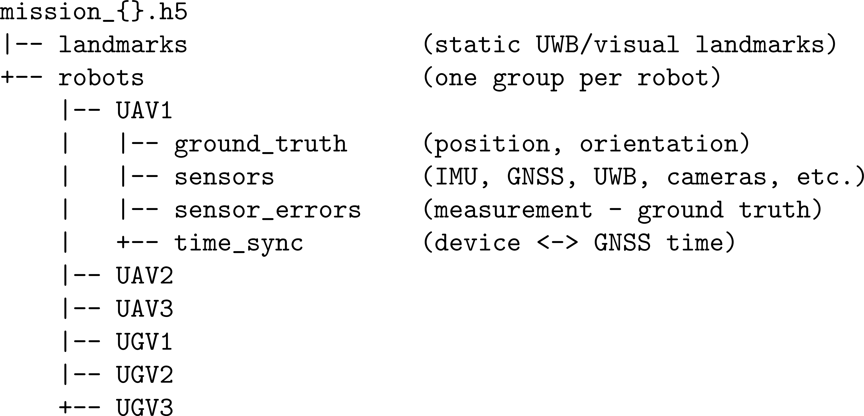
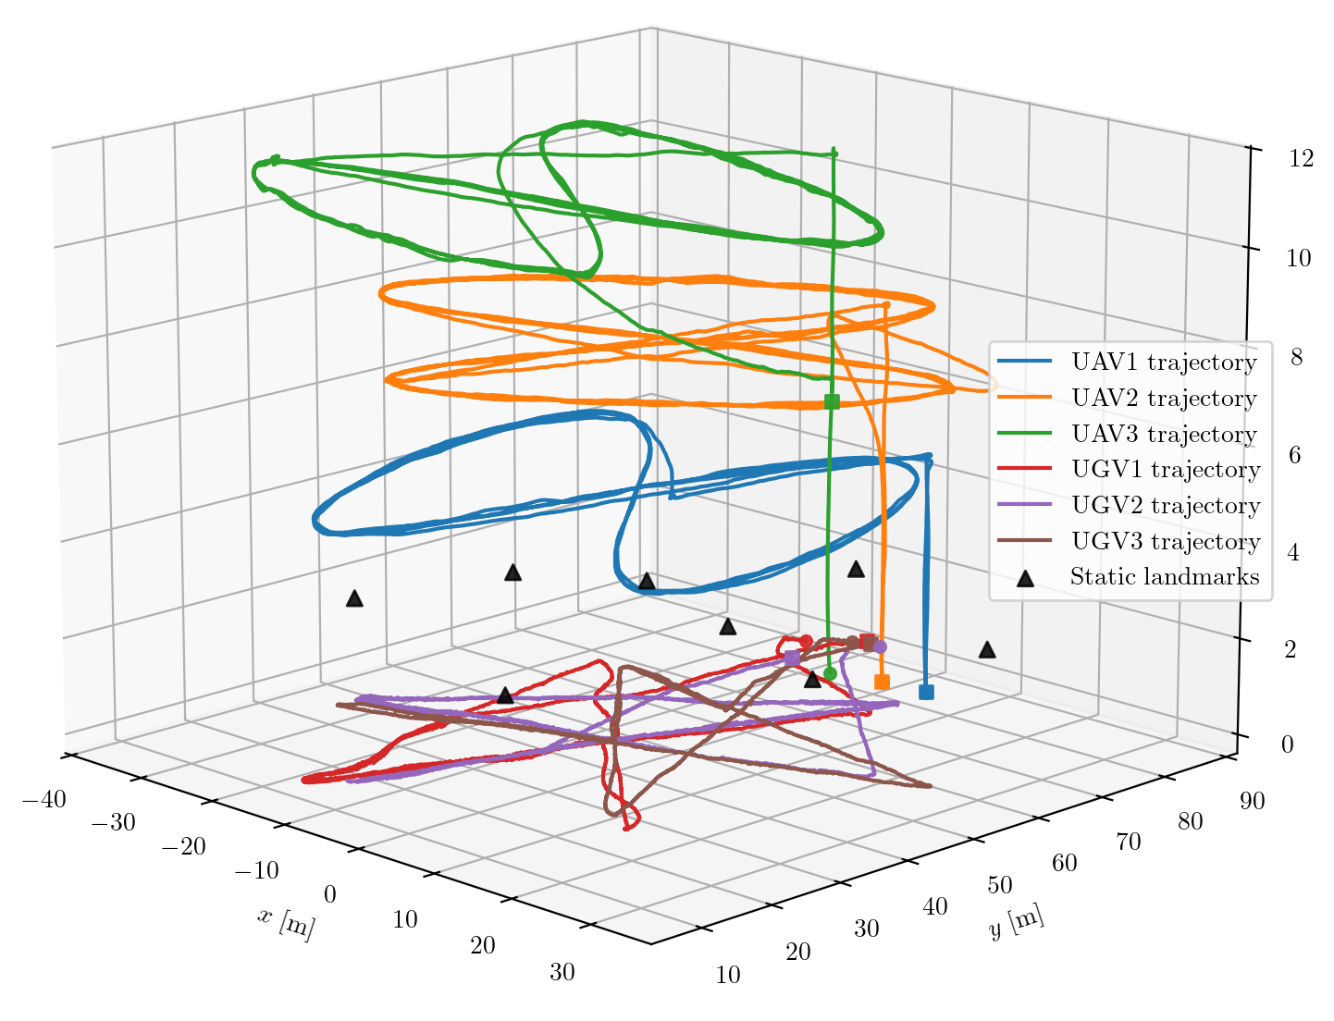
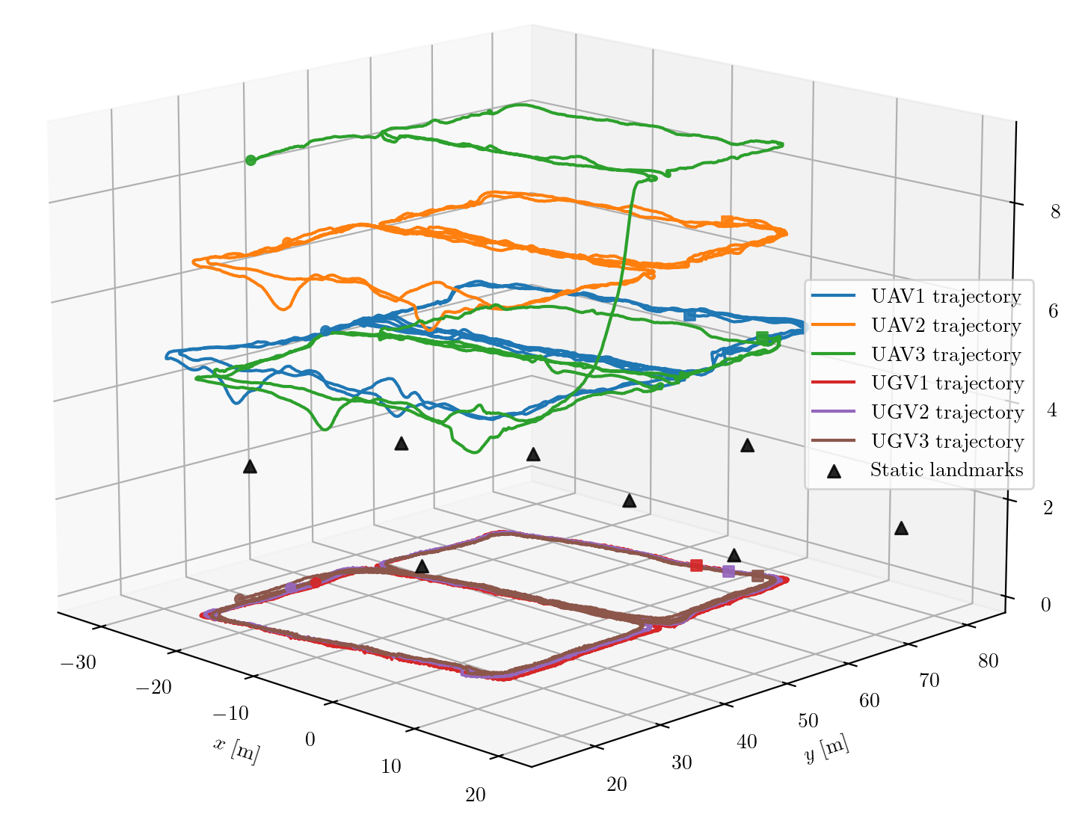
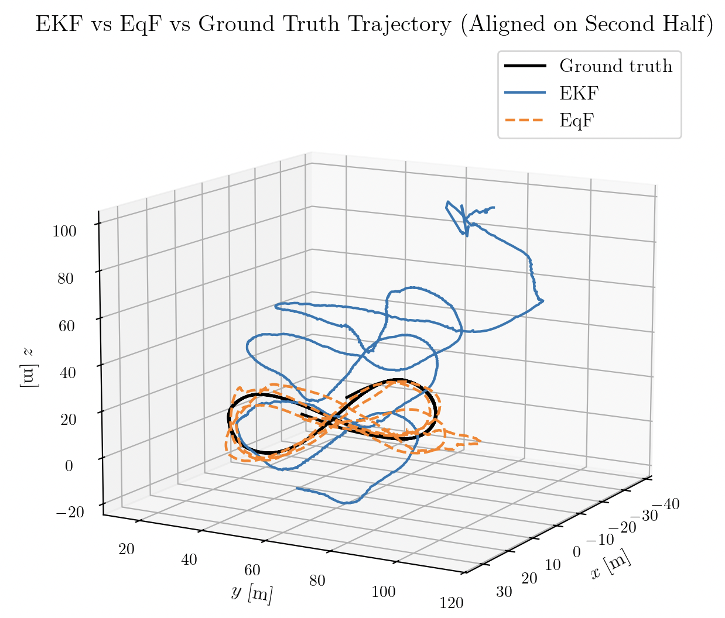
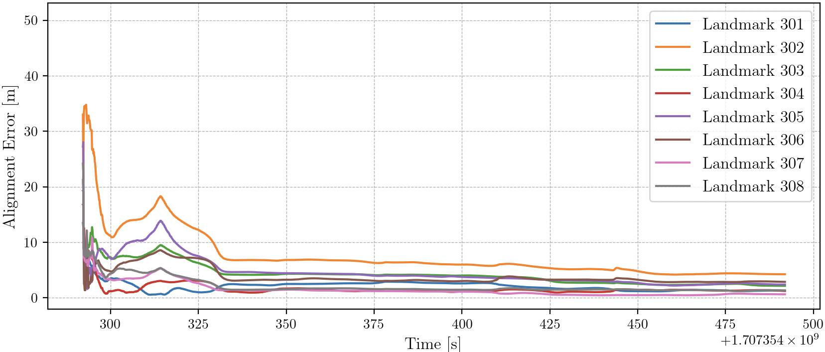
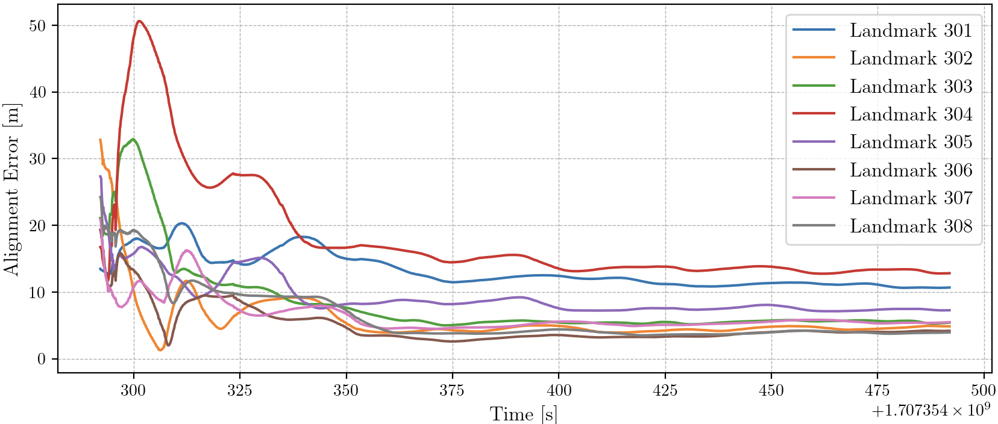
Cooperative Distributed Agent Testbed Dataset
System Theory and Robotics Group
School of Engineering
Australian National University
Ground Systems Autonomy – Perception Vehicle Autonomy and Dynamics | Platforms Division Defense Science and Technology Group
Research Question
Most successful demonstrations of multi-robot autonomy rely on accurate positioning information. While GPS remains the dominant localisation sensor, its performance is unreliable or unavailable in indoor, remote, and contested environments.
As a result, cooperative localisation and SLAM approaches have gained increasing attention for enabling robust multi-robot navigation in GPS-denied areas.
However, progress in this area is limited by the lack of high-quality real-world multi-robot collaborative localisation datasets.
Such a dataset would allow for the testing of collaborative localisation algorithms under real-world circumstances and enable meaningful evaluation of the performance of different algorithms using a common benchmark dataset.
Hardware Platform Design
Cooperative Distributed Agent (CoDA) Dataset
CoDA dataset is a comprehensive multi-vehicle collaborative localisation dataset collected using a fleet of three UAVs, three UGVs, and eight static landmarks.
Processed dataset HDF5 filesystem structure
10 different mission profiles
Equivariant Filter (EqF) using SOT(3) Symmetry
Define the Range-SLAM Group:
The Scaled orthogonal transformations are scaled rotations:
where is a rotation and is a scaling factor.
Coordinate chart on SOT(3)
Visual bearing measurement: low uncertainty in directional information, high uncertainty in depth information;
UWB range measurement: high uncertainty in directional information, low uncertainty in depth information;
The SOT(3) formulation decouples the bearing information and depth information, so the filter can better handle the uncertainties in those directions, leading to higher accuracy and consistency.
EqF
Collaboration with DSTG
This work is part of the DSTG funded grant “Variable topology distributed collaborative localisation and control” UA216424-S08, with CIs Prof. Robert Mahony and Prof. Jochen Trumpf, in collaboration with Ground Systems Autonomy, Platforms Division, DSTG.
EKF
Notes:
Ground Systems Autonomy – Perception Vehicle Autonomy and Dynamics | Platforms Division Defence Science and Technology Group
Background of Research Project: Most successful demonstrations of multi robot autonomy rely heavily on availability of good positioning data for the robots. While GPS is the most commonly used sensor for achieving good positioning it is often times intermittent and unreliable in indoor, remote or contested environments. DST is about to conclude a current research agreement with ANU in which both teams innovated a collaborative positioning system consisting of robotic vehicles, sensors and algorithms that result in good positioning without relying heavily on GPS. This current project is the continuation of that project based on lessons learnt and the opportunities identified for improving this collaborative positioning system. The project will involve exploring new camera technologies, integration/improvements with the robot fleet and research and algorithm design work for positioning and control.

