Slide 1
Computer-Use Benchmark Landscape
FINAL REPORT · Benchmark planning
Domains, software and shared-canvas suitability · October 2026

Slide 2
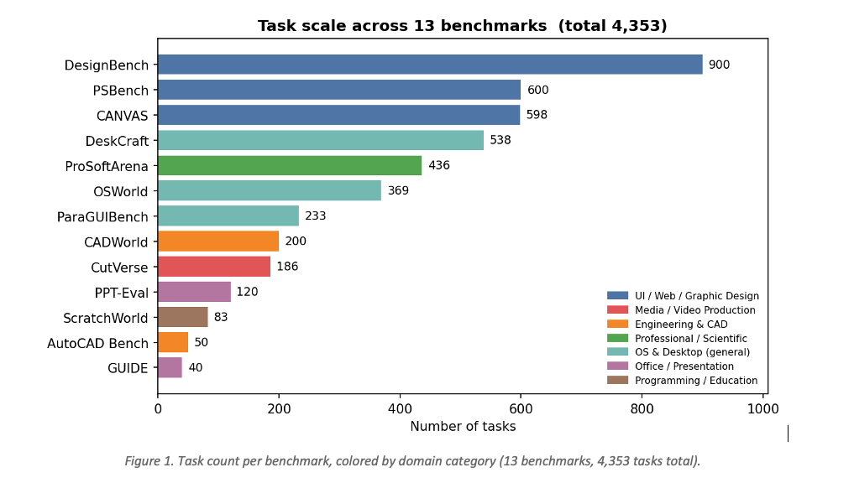
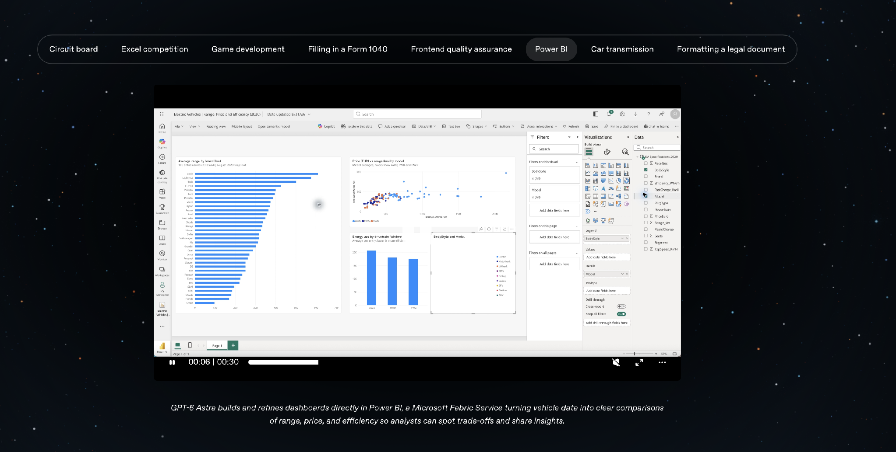
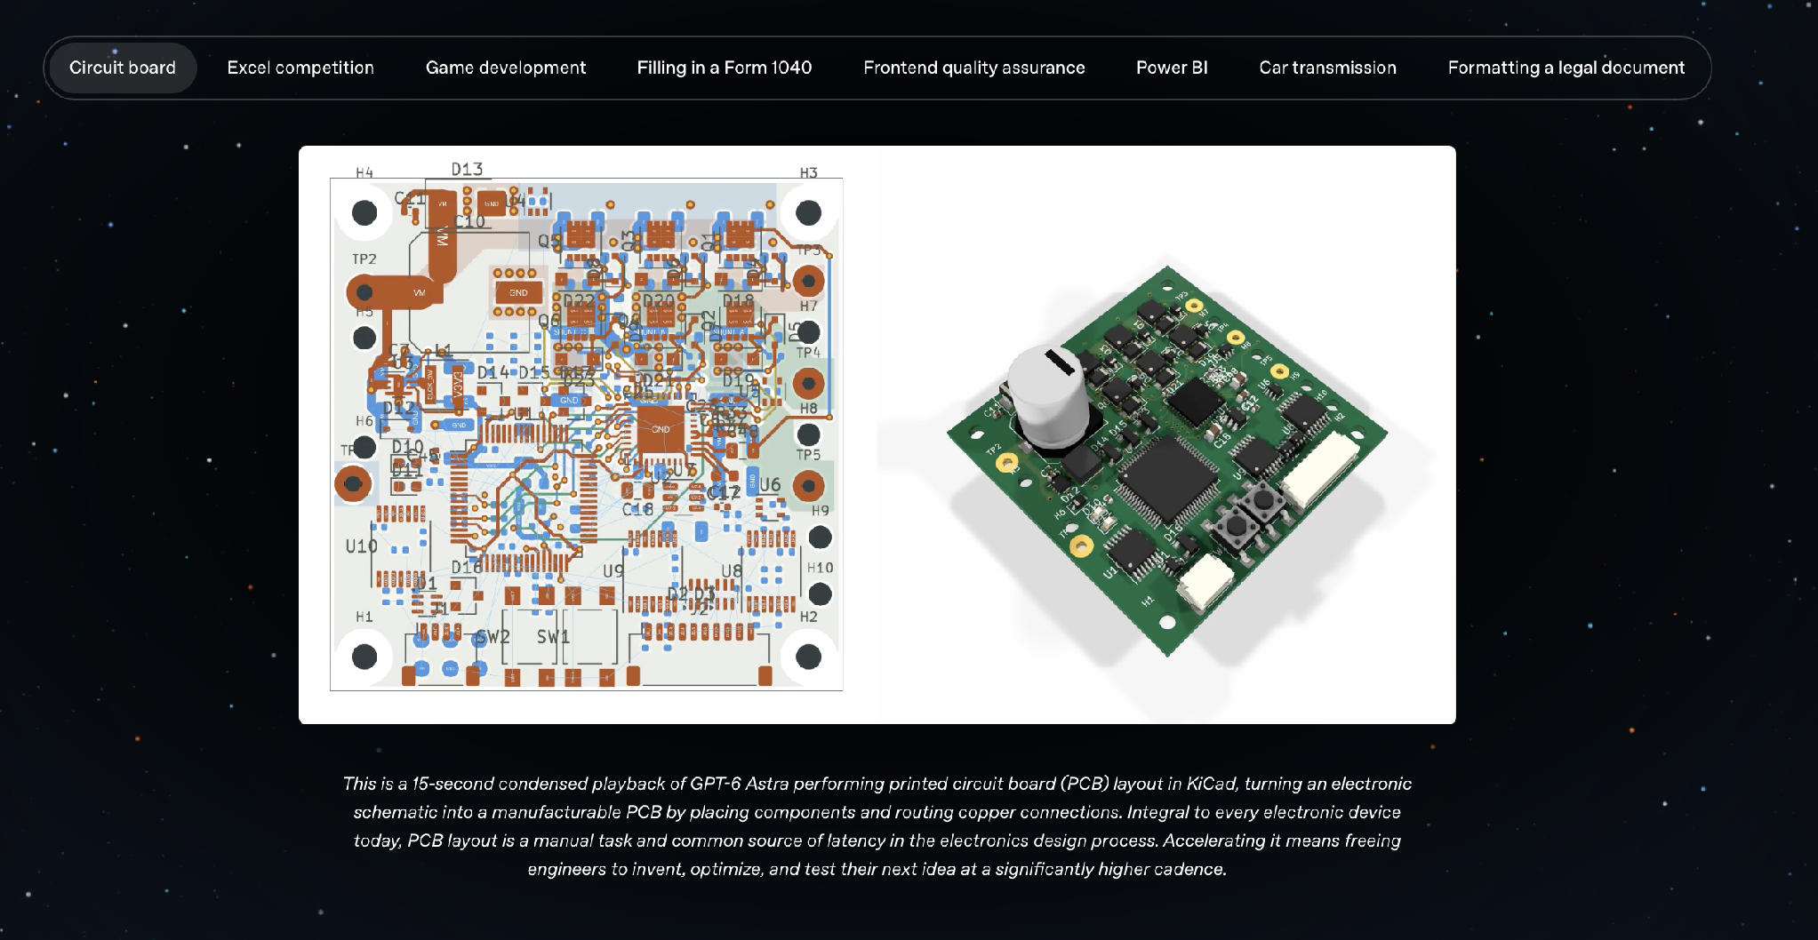
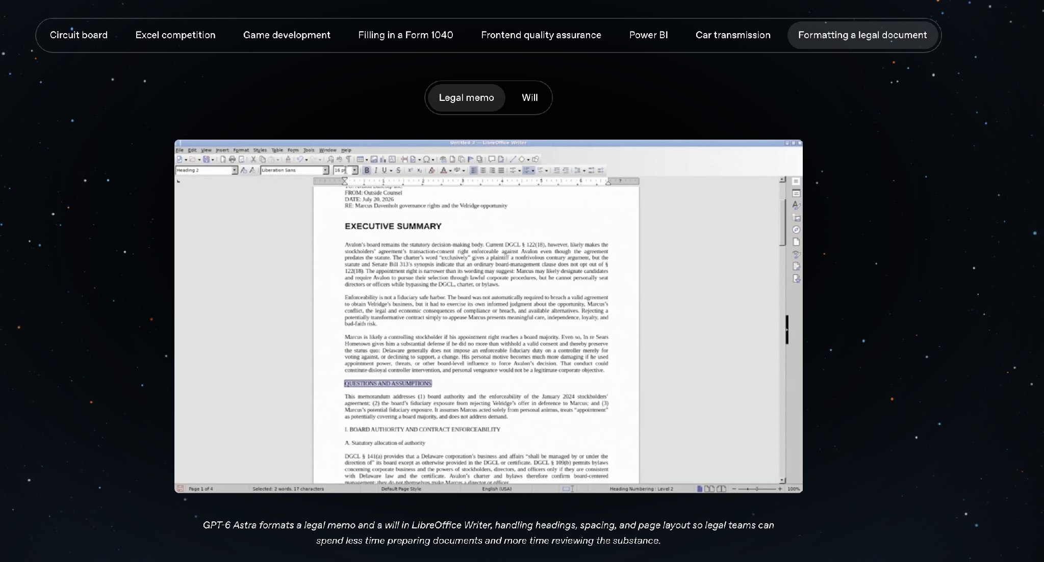
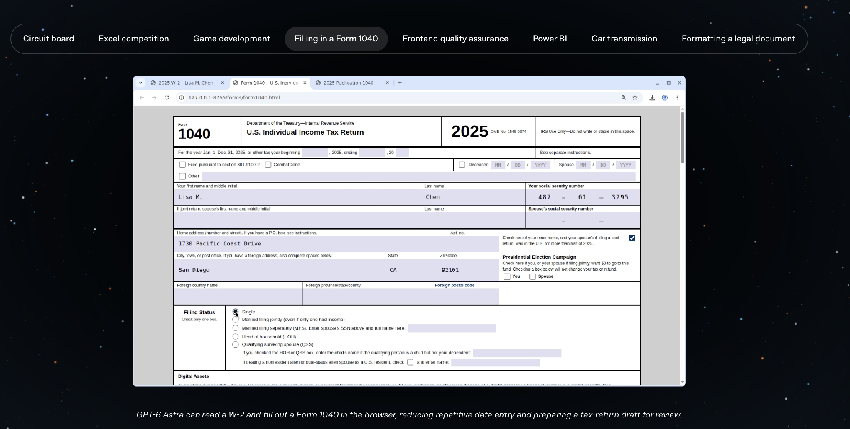
The landscape spans 13 benchmarks and 4,353 tasks
13
4,353
benchmarks
tasks
WHY THIS REVIEW
Map domains and operation types
Identify tasks that fit concurrent work on one shared artifact
Design a benchmark spanning professional, creative, office, engineering and OS software
Source: updated Domains & Tasks report, October 2026.

Slide 3
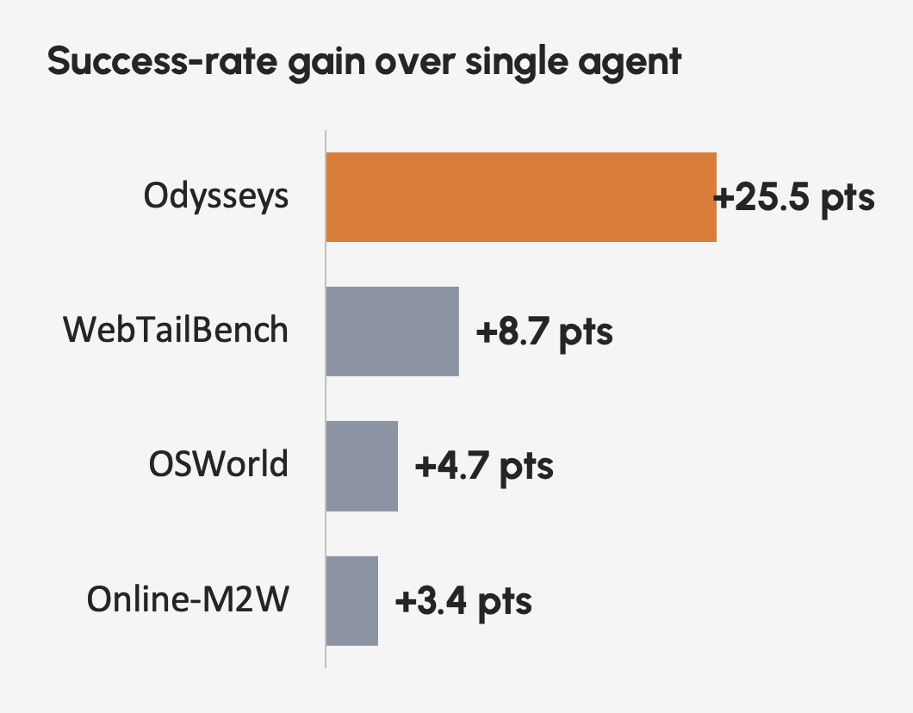
The catalog covers creative, office, engineering and desktop work
PSBench
600 · Photoshop
24 High
DeskCraft
538 · Linux creative tools
59 High
CANVAS
598 · Figma
23 High
DesignBench
900 · Web frameworks
529 High
ProSoftArena
436 · 13 professional apps
78 High
ParaGUIBench
233 · Ubuntu / LibreOffice
Not flagged
GUIDE
40 · 10 creative/office apps
32 High
CADWorld
200 · FreeCAD
12 High
PPT-Eval
120 · PowerPoint Online
Reviewed
CutVerse
186 · Media production
6 High
OSWorld
369 · Ubuntu / LibreOffice
14 High
AutoCAD Bench
50 · AutoCAD
1 Medium
ScratchWorld
83 · MIT Scratch
6 High
Shared-canvas column reports the source document’s classified fit.

Slide 4
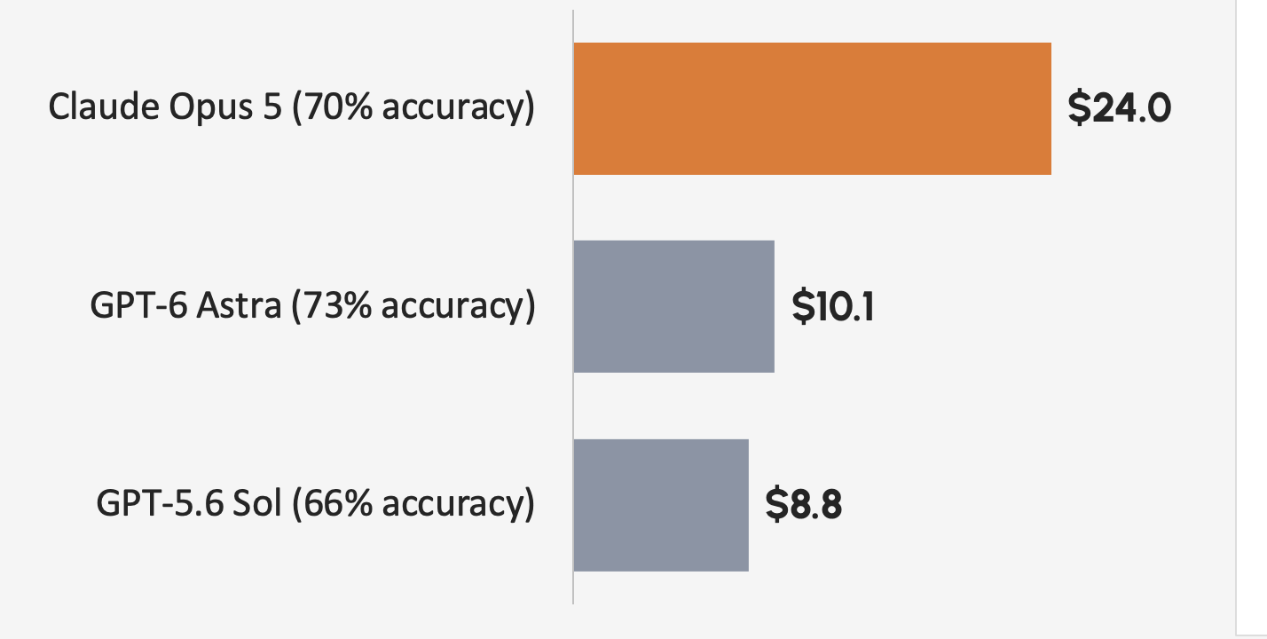
Shared-canvas work splits cleanly but still produces one artifact
WORKING DEFINITION
Different agents own clean regions of the same canvas and work concurrently.
The result remains one coherent slide, design, image, document, project or timeline.
Best-fit software
PPT-Eval
PowerPoint Online
CANVAS
Figma
PSBench
Photoshop
GUIDE
Canva, Slides, Office, media
ProSoftArena
Photoshop, Illustrator, CAD
CutVerse
Premiere, AE, Resolve
DeskCraft
GIMP, Inkscape, Kdenlive
DesignBench
React, Vue, Angular, HTML/CSS

Slide 5
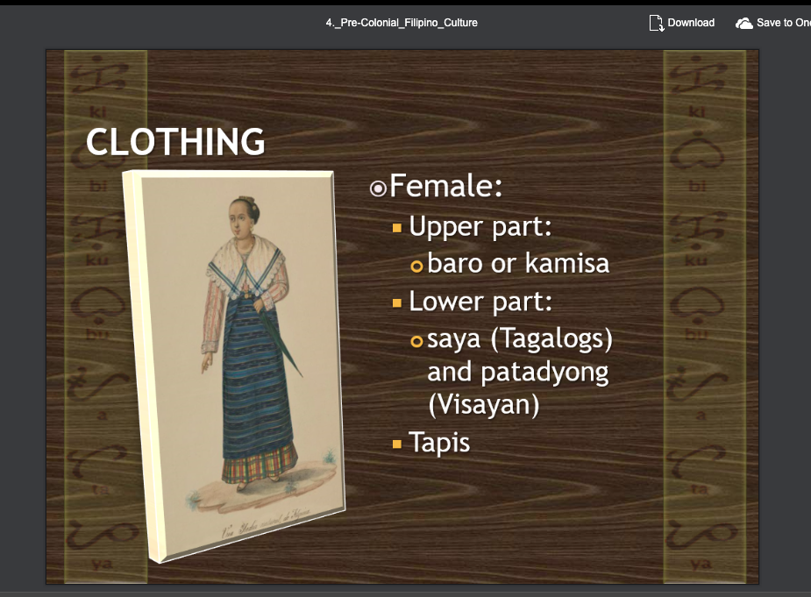
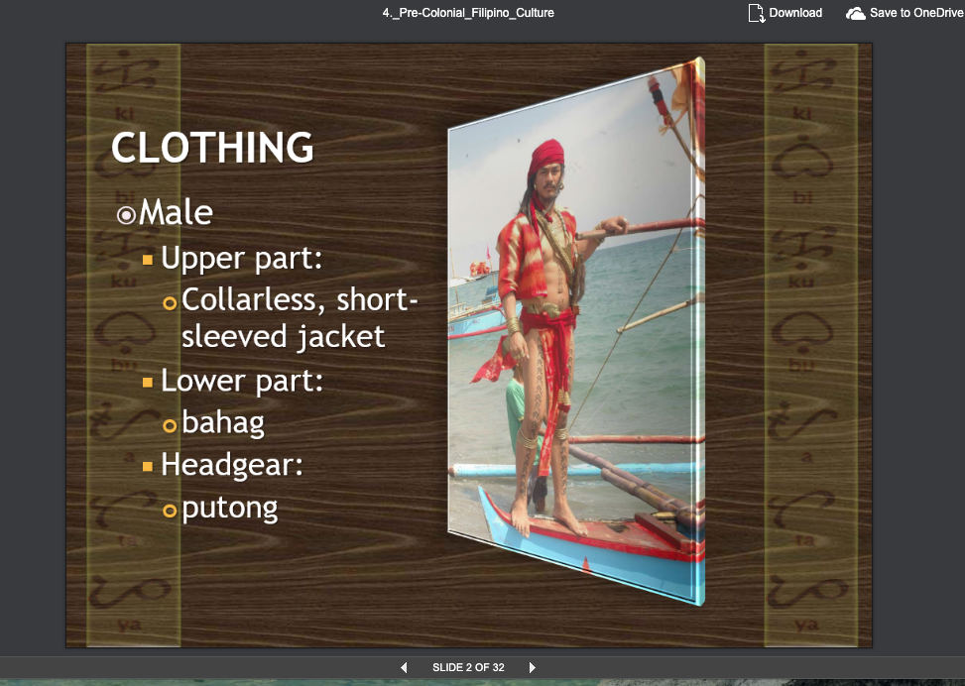
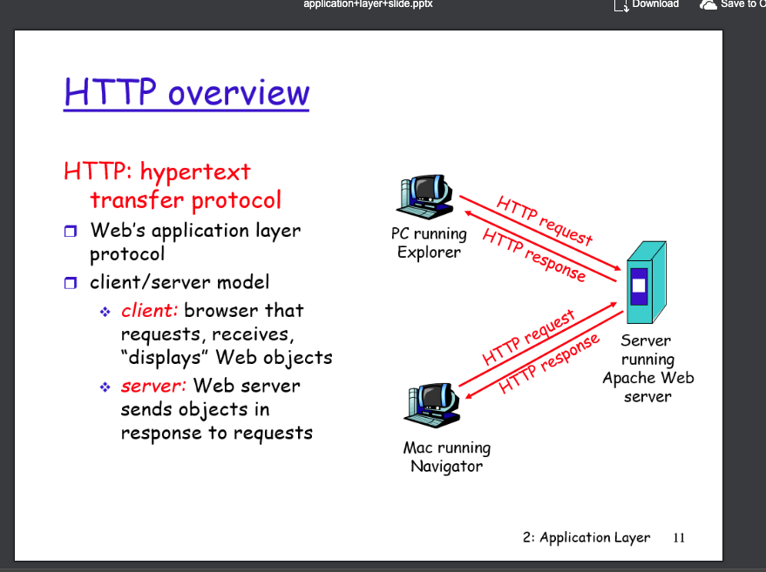
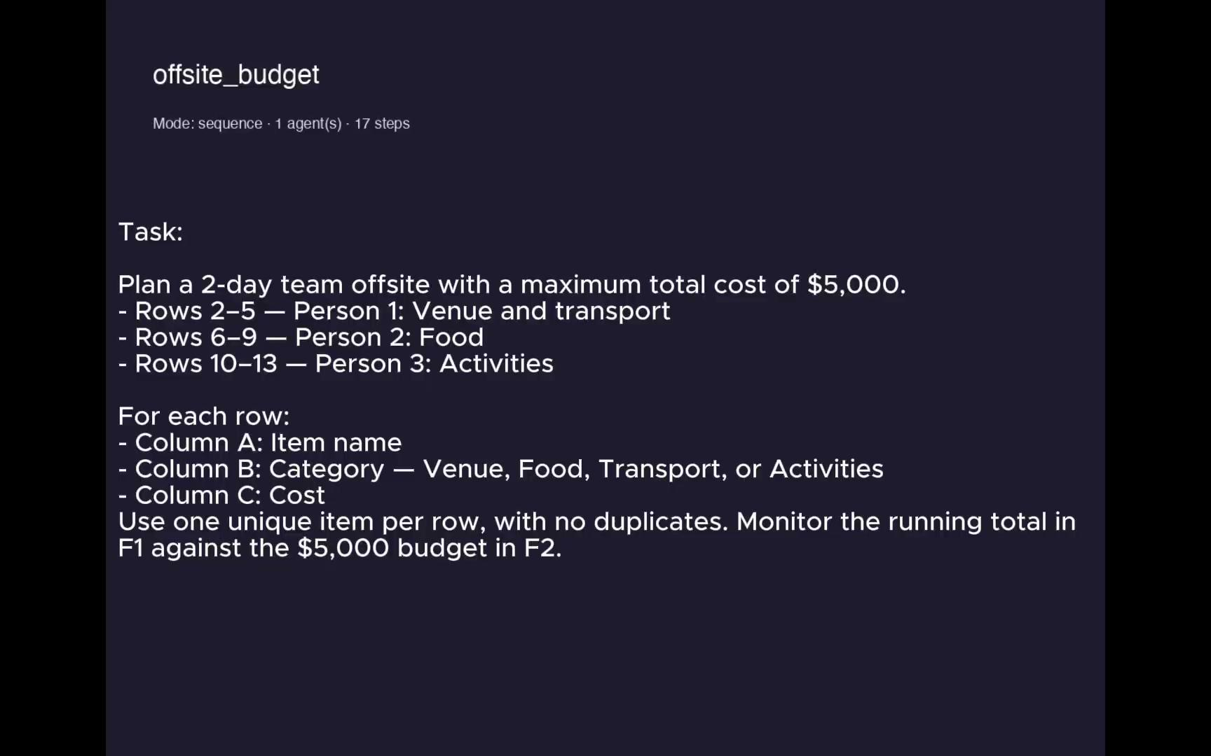
PPT-Eval divides naturally by slide region and diagram component
TASK 1 · COMBINE SLIDES
TASK 2 · REBUILD A FLOWCHART
Combine slides 2 and 3 into one new slide with male and female clothing tables and both images.
Replace the slide 11 diagram with: Browser → HTTP Request → Web Server → HTTP Response → Browser.
Agent A
Male clothing table
Agent B
Female clothing table
Five components can be built concurrently, then aligned as one flow.

Slide 6
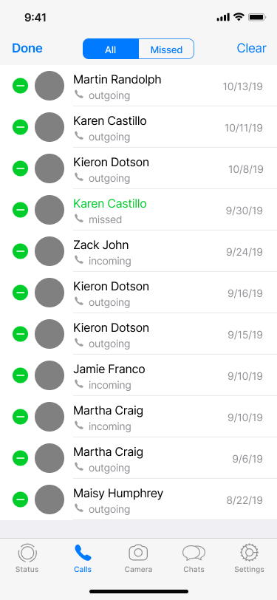
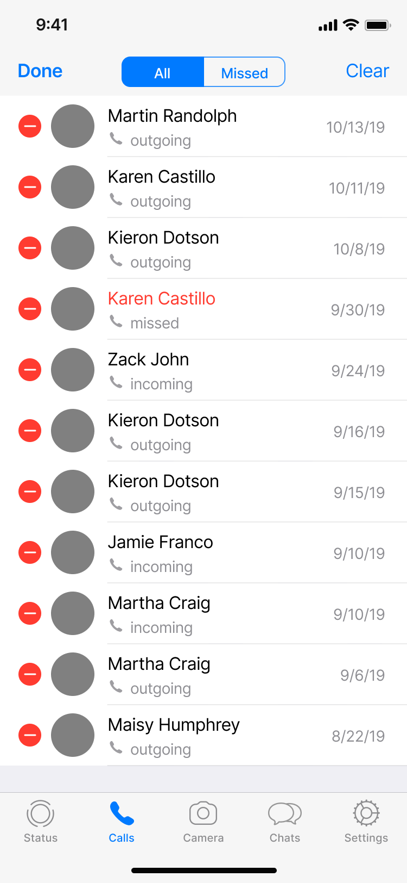


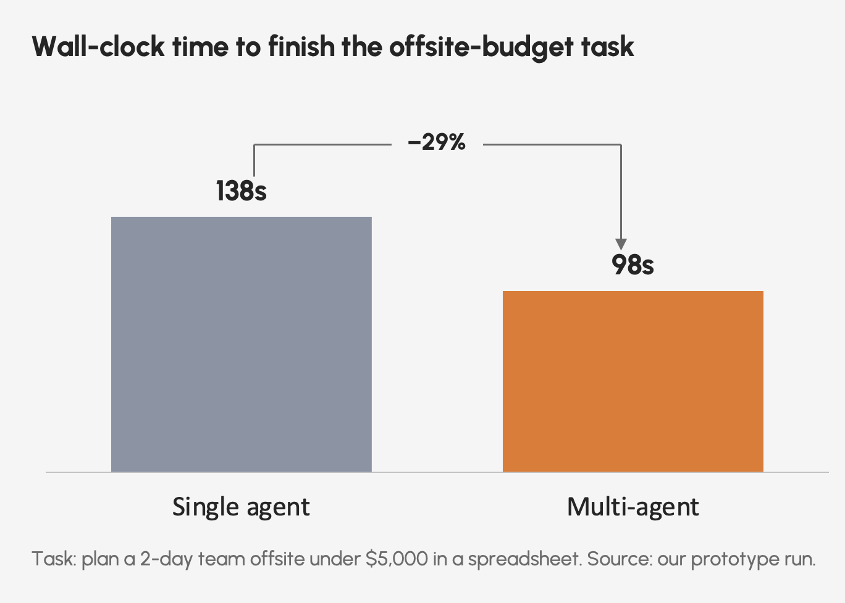
CANVAS exposes independent UI components on one Figma screen
01
Contact list recolor
Shared artifact
One Figma screen
Change minus buttons and missed-call names from green to red.
Buttons and contact names can be owned separately.
STARTING
TARGET
02
Commerce UI recolor
Shared artifact
One Figma screen
Change Shop, forward arrows and bottom navigation from pink to blue.
Button, arrows and navigation icons can change in parallel.
STARTING
TARGET

Slide 7




PSBench separates subject treatment from background treatment
01 Luminous flowers
02 Sharp tree, blurred background
Keep flowers vivid and glowing while converting the surrounding scene to black and white.
Keep the tree sharp and dark blue-black; make the background grayscale with strong Gaussian blur.
STARTING
TARGET
STARTING
TARGET
A Flowers and glow
B Monochrome scene
A Foreground tree
B Background treatment

Slide 8
ScratchWorld and ProSoftArena split work by module or document region
SCRATCHWORLD
PROSOFTARENA
Maze timer and scoring
Add timeLeft and score; enforce countdown, wall penalties and a +50 goal bonus.
A Stage — initialize and enforce timeout
B Ball — wall-contact penalties
C Goal — award bonus and stop timer
Microsoft Excel
Build a PivotTable summarizing revenue by quarter and product, then add a slicer.
A Quarter summary
B Product dimension
C Slicer
Voltage-aware circuit
Cycle a Battery between 3V and 6V and map voltage to Lightbulb brightness when the circuit is complete and ON.
A Battery
B Lightbulb
C Circuit integration
Adobe Illustrator
Design a three-icon brand pictogram set for a sustainable coffee shop.

Slide 9
OSWorld assigns independent worksheet or slide regions
LIBREOFFICE CALC
Create separate monthly-cost column charts for 2019 and 2020.
Agent A
2019 table and chart
Agent B
2020 table and chart
LIBREOFFICE IMPRESS
Set the three slide-1 textboxes to yellow, red and green from top to bottom.
Agent A Top textbox — yellow
Agent B Middle textbox — red
Agent C Bottom textbox — green
One file, multiple clean regions, one integrated deliverable.

Slide 10
Four constraints shape the rollout—and three actions come next
MAIN CONCERNS
NEXT STEPS
01
Licensing
Commercial apps make execution and verification hard to scale.
1
Finalize the task list
Export the approved set as the benchmark seed.
02
Taxonomy
Benchmarks use incompatible labels for task and operation types.
2
Prefer open software
Use Figma, GIMP, FreeCAD, LibreOffice, Inkscape, Scratch and web frameworks where possible.
03
Environments
Windows, Ubuntu, web apps and code/render harnesses need different runners.
3
Build one harness
04
Evaluation
One harness must compare all tasks, benchmarks and final artifacts.
Run the shared-canvas agent across every selected task and benchmark.

Slide 11
Thank you. Questions?

