Slide 1
数据库技术
Database Techniques

Slide 2
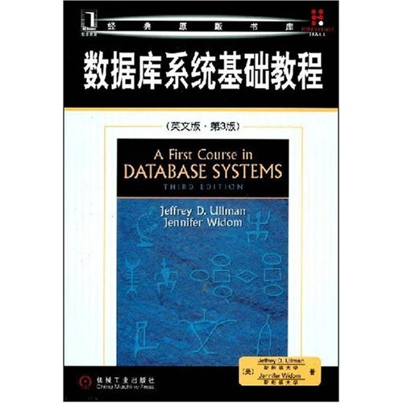
Textbook
A First Course in Database Systems
(Third Edition)
J. D. Ullman, J. Widom
机械工业出版社, 2008.8
Note: A Chinese translation version has been published, but the original version is recommended.
Lu Chaojun, SJTU

Slide 3
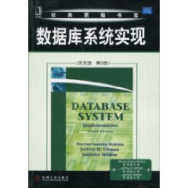
Reference
Database System Implementation
(Second Edition)
H. Garcia-Molina
J. D. Ullman
J. Widom
机械工业出版社, 2010.1
Lu Chaojun, SJTU

Slide 4
Course Material
Canvas
http://oc.sjtu.edu.cn
ftp://public.sjtu.edu.cn lucj/public
Homepage of the Textbook
www-db.stanford.edu/~ullman/fcdb.html
infolab.stanford.edu/~ullman/dscb.html
Lu Chaojun, SJTU

Slide 5
Grading
Homework and Attendance: 20%
Final Exam: 80%
Lu Chaojun, SJTU

Slide 6
End

