Slide 1
Basic Concepts

Slide 2
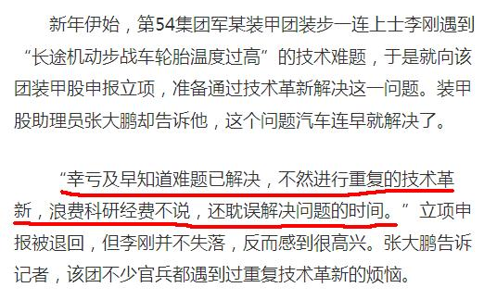
Lu Chaojun, SJTU

Slide 3
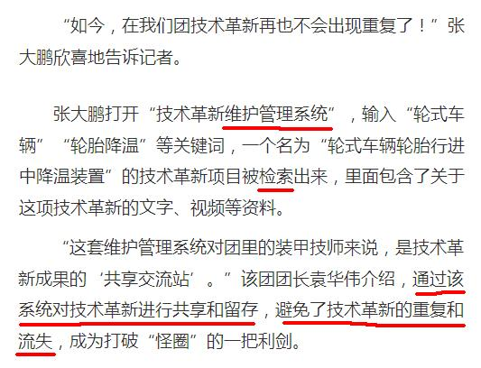
Lu Chaojun, SJTU

Slide 4
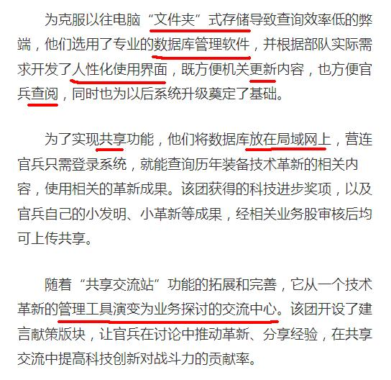
Lu Chaojun, SJTU

Slide 5
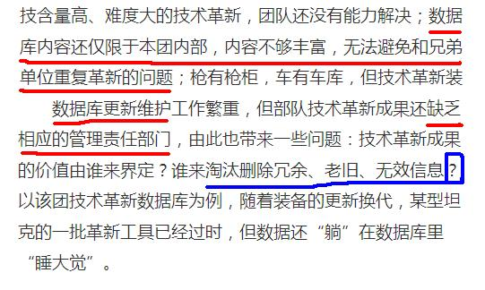
Lu Chaojun, SJTU

Slide 6
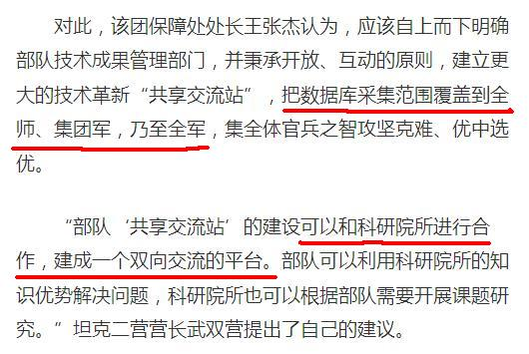
Lu Chaojun, SJTU

Slide 7
What’s a Database? （数据库的定义）
A collection of data.
  Very large amounts of data
  Structured and interrelated data
  Operational data
  Persistent data
Managed by a DBMS（DataBase Management System）（可以认为和OS平级的，也是一种系统）
Used by applications
Lu Chaojun, SJTU

Slide 8
What’s a DBMS?(什么是数据库管理系统)
Supports storage of v.l.a.d.(very large amout of data) over a long period of time
Supports efficient access to DB
Supports a query language: DDL and DML(从这可以看出DBMS有编译器的功能，编译DDL and DML语言)
Supports durability of DB
Supports concurrent access to DB
Supports atomic access to DB
……
Lu Chaojun, SJTU

Slide 9
DBMS Architecture
User/Application
Query processor Transaction manager
Execution engine Logging/Recovery/CC
Index/file/record manager
Buffer manager
Storage manager
data, metadata, index, log records, statistics
Lu Chaojun, SJTU

Slide 10
What’s a DBS?（其中一种定义）
Hardware
DB
DBMS
People
  DBA（DataBase Administrator）
  Applications programmer
  End user (基层员工)
Lu Chaojun, SJTU

Slide 11
Why DB?
Information sharing
Data independence
  Program + Data
    Dependent: P1+D1, P2+D2, …（如P1是以数组存储数据D1，则P1的代码是以索引处理数据。 P2以链表储存数据D2，P2的代码是以链表处理数据。因此数据和程序是相互依赖的，有什么样的数据有什么样的程序）
    Independent: (P1, P2, … ) + D （建立数据库时候没有考虑以后程序要怎么使用，而是仅考虑数据怎么存储）
Lu Chaojun, SJTU

Slide 12
History of Data Management
Manual
File system
DB
  Late 1960s: hierarchical, network
  1970s: relational model (原始关系模型)
  Present: OR（ Object-relational database）, XML（ data persistence software system that allows data to be specified ）
Lu Chaojun, SJTU

Slide 13
DBS Studies（本课程可以学会什么）
DB modeling and design
  E/R, （UML）, ODL
  Relational implementation
  Semistructured data modeling（大数据并不强制要求数据具有很强的structure） and programming
DB programming
  Algebra- and logic-based
  SQL
  Embedded SQL, PSM, CLI, JDBC, PHP
DBMS implementation（相当于微型操作系统的实现）
Lu Chaojun, SJTU

Slide 14
End

