Slide 1
Relational Data Model
Lu Chaojun, SJTU

Slide 2
What’s a Data Model?
A notation (collection of conceptual tools) for describing data as seen by the user.
  Structure of data (math representation)
    Examples: relational model = relations(tables); semistructured model = trees/graphs.
  Operations on data.
  Constraints on data.
Lu Chaojun, SJTU

Slide 3
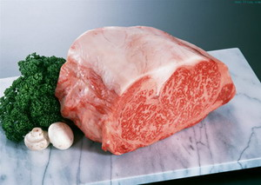


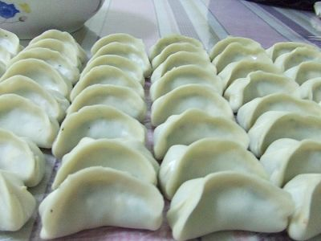
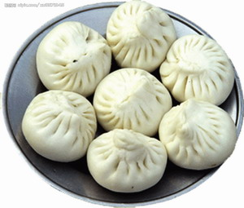

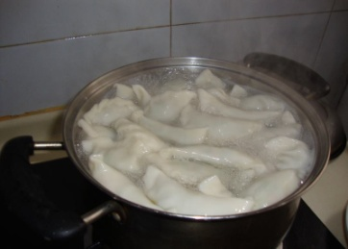
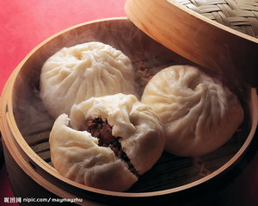

Data Model: An Analogy
Data
Structure
Operation
Constraint
站得住
不能煮破
18个褶
毛细,大宽
Lu Chaojun, SJTU

Slide 4
Some Data Models
Widely used today:
  Relational（关系型）, OR（对象关系型）
  Semistructured （半结构型）
Others
  OO（Oriented Object,面向对象，将海量的对象存储起来成为一个数据库）
History:
  Hierarchical(层级)
  Network（网络型）
Lu Chaojun, SJTU

Slide 5
Comparison
Relational model is preferred, because of its
  1. simple and 2. limited, yet 3. versatile（能应用于各种情景）, approach to structuring data
  limited, yet useful, collection of operations (少数的操作，但是能满足所有请求操作)
  allow implementation of VHL（Very High Level） language: SQL(Tell the computer WHAT(想要什么), not HOW(如何实现我们想要的) like C/C++/JAVA)
    ease of use: just state what to do
    efficiency: optimization possible
Semistructured models have more flexibility, but less preferred in DBMS(不是主流)
Lu Chaojun, SJTU

Slide 6
Relational Model: Basics
A single way to represent data:
Relation = 2-D table
  Attribute = column (header)
  tuple = row
A Reminder:
In math, a relation R is a subset of
S₁× S₂ ×… × S_{n}
i.e.
R = {(a₁, a₂,…, a_{n}) | a_{i} ∈ S_{i} }
Lu Chaojun, SJTU

Slide 7
Relation: An Example
Attributes
(column
headers)
codename name
007 James Bond
008 Steven Chow
Spy
Tuples
(rows)
Relation
name
Lu Chaojun, SJTU

Slide 8
Relational Model: Basics(cont.)
Relation schema（关系架构，定义Relation schema 相当于定义了一个类，这个schema的Relations/Tables相当于类的实例）: relation name and set of attributes.
  written as: relation_name(attribute_list)
  SET of attributes, not a LIST.（SET：无序， LIST：有序）
    But take the “list” as standard order.（但是实际使用中，我们通常将它看为有序， 顺序即我们写下属性的顺序。E.g Spy(codename,name), 顺序为 1.codename 2.name
    ）
  Optionally: specify types and other structure info
  Usually not change over time
  Example: Spy(codename,name)
Relational DB schema = set of relation schemas
Lu Chaojun, SJTU

Slide 9
Relational Model: Basics(cont.)
Relation instance = a set of tuples (set: 表示其独一无二， tuples: 表示其无序)
  change over time
  Not a list （tuples）
  DB maintains only the current instance.
RDB instance = set of relation instances
Lu Chaojun, SJTU

Slide 10
Relational Model: Basics(cont.)
Domain
  atomic values for each attributes
  a domain (type) is associated with each attribute
  include domain in a relation schema: R(A1:D1(A1属性的值来自于Domian1),A2:D2)
Lu Chaojun, SJTU

Slide 11
Relational Model: Basics(cont.)
Key(数据必须满足的 规定->区分两个tuples)
  A set of attribute(s) to distinguish tuples in a relation, i.e. no two tuples have the same values in the key.
  notation: R(A1, A2, A3)
  Semantic constraint for schema (not instance)
  Create artificial keys
  There can be several choices of key for a relation schema.
Lu Chaojun, SJTU

Slide 12
Why Relational Model?
Very simple model
  single data-modeling concept: relation
Very High-level prog. language: SQL
  simple yet powerful
Design theory
  mathematically strict
Lu Chaojun, SJTU

Slide 13
SQL（Sequel, 源于IBM）
Standard DB language
  Latest version: SQL:2016
SQL(由两个子语言组成): DDL (Data Definition Language，数据定义语言)+ DML(Data Manipulate Language，数据操纵语言)
Relations in SQL
  Stored relation(确确实实被存储了的关系): table
  View: not stored, constructed when needed(每当要查询临时算出来的)
  Temporary table: constructed by SQL processor（可以使得整个查询加快，是SQL处理器内部构造的表，最后将被删除回收）
SJTU Lu Chaojun
Lu Chaojun, SJTU

Slide 14
SQL Data Types
Data Types
  CHAR(n), VARCHAR(n), clob
  BIT(n), BIT VARYING(n), blob (少用，已被淘汰)
  BOOLEAN (少用)
  SMALLINT, INT/INTEGER, BIGINT
  DECIMAL(n,d)/NUMERIC(n,d), FLOAT/REAL, DOUBLE PRECISION
  TIME WITH/WITHOUT TIME ZONE, TIMESTAMP WITH/WITHOUT TIME ZONE, DATE, INTERVAL
  NULL (空值)
Implicit type coercions（隐式强迫）
Lu Chaojun, SJTU

Slide 15
SQL Values
Integers and reals: as expected
Strings: single quotes!
  Two single quotes = real quote（表示’的方法）
    e.g., ’I’’m Back.’
Any value can be NULL.
Date: DATE ’yyyy-mm-dd’
  Example: DATE ’2011-01-11’
Time: TIME ’hh:mm:ss’, with optional fractions of a second
  Example: TIME ’15:30:02.5’
SJTU Lu Chaojun
Lu Chaojun, SJTU

Slide 16
SQL:2016 Data Types
A data type is a set of representable values. Every representable value belongs to at least one data type.
Three sorts of Data types
  Predefined: built-in.
  Constructed: specified using one of ARRAY, MULTISET, REF, and ROW.
  User-defined(结构体类型数据)
Lu Chaojun, SJTU

Slide 17
Defining Relation Schema（即一种类）
CREATE TABLE name (
column_1 type_1,
... ,
column_n type_n
);
  Most simple table declaration.
Lu Chaojun, SJTU

Slide 18
Example
CREATE TABLE Student (
sno CHAR(10),
name VARCHAR(20),
age INTEGER,
dept VARCHAR(30)
);
Lu Chaojun, SJTU

Slide 19
Drop Table
DROP TABLE relation;
  No longer part of DB schema
  Tuples also removed
Lu Chaojun, SJTU

Slide 20
Modifying Relation Schema（一般不用，改变关系模式会带来很多麻烦，关系型数据库本身在构建后默认不改变）
ALTER TABLE relation
ADD column type
| DROP column;
  ADD: use NULL values as default.
Lu Chaojun, SJTU

Slide 21
Default Values
CREATE TABLE Student (
sno CHAR(10),
name VARCHAR(20),
age INT DEFAULT 18,
dept VARCHAR(30) DEFAULT ‘CS’
);
  Default to NULL, if not designated.
Lu Chaojun, SJTU

Slide 22
Declaring Keys
An attribute or list of attributes may be declared PRIMARY KEY or UNIQUE.
Either says that no two tuples of the relation may agree in all the attribute(s) on the list. (没有两个tuple能在Key column相同，保证了唯一性)
There are a few distinctions to be mentioned later.
Lu Chaojun, SJTU

Slide 23
Declaring Single-Attribute Keys
Place PRIMARY KEY or UNIQUE after the type in the declaration of the attribute.
Example:
  CREATE TABLE Student (
  sno CHAR(10) PRIMARY KEY,
  name VARCHAR(20),
  age INTEGER,
  dept VARCHAR(30)
  );
Lu Chaojun, SJTU

Slide 24
Declaring Multiattribute Keys
A key declaration can also be another element in the list of elements of a CREATE TABLE statement.
This form is essential if the key consists of more than one attribute.
  May be used even for one-attribute keys.
Lu Chaojun, SJTU

Slide 25
Example: Multiattribute Key
The student number and course number together are the key for SC:
  CREATE TABLE SC (
  sno CHAR(10),
  cno CHAR(5),
  grade INTEGER,
  PRIMARY KEY (sno, cno)
  );
Lu Chaojun, SJTU

Slide 26
PRIMARY KEY vs. UNIQUE
There can be only one PRIMARY KEY for a relation, but several UNIQUE attributes.
No attribute of a PRIMARY KEY can ever be NULL in any tuple. But attributes declared UNIQUE may have NULL’s.
Lu Chaojun, SJTU

Slide 27
End
Lu Chaojun, SJTU

