Slide 1
Semistructured-Data Model

Slide 2
Semistructured Data
Structured data has a separate schema to describe its structure.
  Advantage: efficient implementation of storage organization and query processing.
Semi-structured data is self-describing, i.e., the data itself carries information about what its schema is.
  Advantage: flexibility in adding new attributes and relationships. That is, schema can vary arbitrarily, both over time and within a single database.
Lu Chaojun, SJTU

Slide 3
Semistructured-Data Model
Provides flexible conceptual tools to describe the real world.
It is a kind of data model that
  is suitable for integration of heterogeneous databases, and
  serves as the underlying model for XML that are being used to share of information on the Web.
Lu Chaojun, SJTU

Slide 4
Graph Representation
A database of semi-structured data is a collection of nodes.
Nodes = objects.
  Leaf nodes have associated data of atomic types.
  Interior nodes have arcs out.
Root node has no arcs entering and represents the entire database.
Label on arc: indicates how the target node relates to the source node.
  No restriction on labels: representing attributes or relationships.
Lu Chaojun, SJTU

Slide 5
The Graph
Nodes are connected in a rooted graph structure.
takes
sno
name
cno
007
j.bond
CS123
Lu Chaojun, SJTU

Slide 6
Example
Root
bar
beer
beer
name
manf
manf
prize
Bud
A.B.
name
year
award
M’lob
servedAt
1995
Gold
name
addr
Joe’s
Maple
Lu Chaojun, SJTU

Slide 7
Application: Info. Integration
Problem: related data exists in many places, and needs be accessible as if they were one DB. (A is B’s parent, B is C’s parent, and have A is C’s parent stored(redundancy))
  Integration of heterogeneous DB’s.
    e.g., company merge
  The DB’s differ in data models and schemas, even if they talk about the same thing.
Create a new DB to solve the problem?
  Cost
Lu Chaojun, SJTU

Slide 8
Legacy Databases
Legacy-database problem: once a DB has been in existence for a while, it becomes impossible to disentangle it from the applications that grow up around it, so the DB can never be decommissioned.
  Even if we could efficiently transform the data from one schema to another, we shouldn’t do so.
Lu Chaojun, SJTU

Slide 9
A Possible Solution
User
Query
Interface
Other Applications
Other Applications
Legacy DB
Legacy DB
Integrating two legacy databases through an interface that supports semistructured data.
Lu Chaojun, SJTU

Slide 10
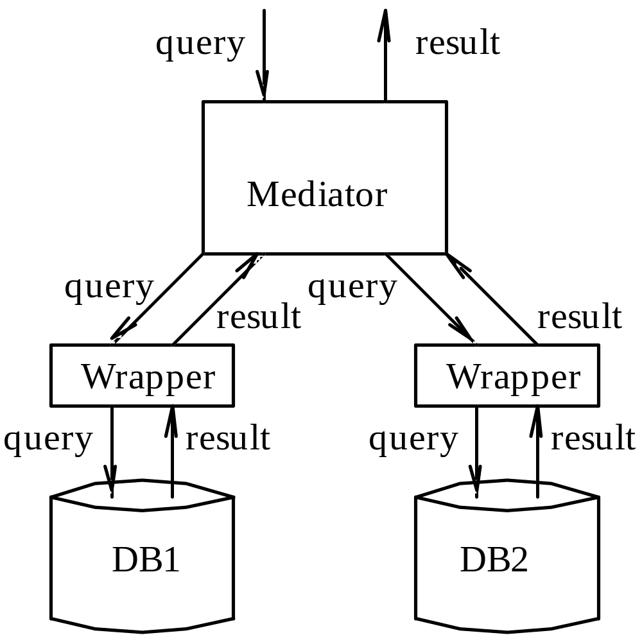
Mediation(调解)
Lu Chaojun, SJTU

Slide 11
XML
Extensible Markup Language
  Designed originally for marking documents.
  But here treated as a data model.
HTML vs. XML
  HTML uses tags for presentation (formatting) (e.g., “italic”).
  XML uses tags for semantics (e.g., “this is an address”).
XML captures, in a linear form, the same structure as do the graphs of semi-structured data.
  Tags play the same role as do the labels on the arcs of a semi-structured-data graph.
Lu Chaojun, SJTU

Slide 12
Semantic Tags
Tags: <tagname>
  In pairs: <FOO> is balanced by </FOO>,
    There can be text between them:
    <FOO>Any tex here.</FOO>
    Abbreviation <tFOO/> means no text in between.
    Element: a pair of matching tags and everything that comes between them.
  Tags may be nested, as in
    <FOO> … <BAR> … </BAR> … </FOO>
  XML is case-sensitive
Lu Chaojun, SJTU

Slide 13
XML vs Semistructured Data
<T>
<S>
......
</S>
</T>
T-node
S
S-node
Only allows tree structure?
Lu Chaojun, SJTU

Slide 14
XML Used in Two Modes
Well-formed XML
  No predefined schema
    Documents are free to use whatever tags you wish.
  Corresponds closely to semistructured data.
Valid XML
  Conforms to a DTD (Document Type Definition) that specifies the allowable tags and gives a grammar for how they may be nested.
  This form is intermediate between the strict-schema models and the completely schemaless model of semistructured data.
Lu Chaojun, SJTU

Slide 15
Well-Formed XML
Minimal requirements:
  The document begins with a declaration that it is XML:
  It has a root element that is the entire body of the document.
Outer structure looks like:
  <?xml version = “1.0” encoding = “utf-8” standalone = “yes” ?>
  <roottag> ...
  </roottag>
    standalone=“yes” means that there is no DTD.
Lu Chaojun, SJTU

Slide 16
Example
<?xml version = "1.0" standalone = "yes"?>
<Students>
<Student><SNO>007</SNO>
<NAME>James Bond</NAME>
<CNO>CS123</CNO>
<CNO>CS456</CNO>
</Student> <Student><SNO>008</SNO>
<NAME>Stephen Chow</NAME>
<CNO>CS123</CNO>
</Student>
</Students>
Lu Chaojun, SJTU

Slide 17
Attributes
Attributes are intended for extra information associated with an element used only by programs that read and write the file, and not for the content of the element that’s read and written by humans.
Attributes (name-value pairs) appear within the opening tag.
  Alternative way to represent leaf nodes or labelled arcs of semistructured data.
Lu Chaojun, SJTU

Slide 18
Example
<Student SNO = “007”>
<NAME>James Bond</NAME>
<CNO>CS123</CNO>
<CNO>CS456</CNO>
</Student>
  Note: SNO here is no longer part of the content of the document, but part of the markup.
Lu Chaojun, SJTU

Slide 19
Attributes that Connect Elements
Represent connections in a semistructured data graph that do not form a tree.
  Element ID’s vs. references
Example
<Student SNO=“007” taking=“CS123 CS456”>
<NAME>James Bond</NAME>
</Student>
<Course CNO=“CS123” taken=“007”>
<TITLE>Database Systems</TITLE>
</Course>
Attribute of type ID
Attribute of type IDREF
Lu Chaojun, SJTU

Slide 20
Namespaces
To associate a URI with a tag set, and attach a prefix to element/attribute, in order to:
  Disambiguate mixed use of multiple markup vocabulary.
  Avoiding name conflicts.
Definition of a namespace:
  <myns:myTag xmlns:myns=“URI”>
  myns is meaningful only in this element.
Lu Chaojun, SJTU

Slide 21
Example: Namespace
In general:
  <?xml standalone = “yes”?>
  <sjtu:Students xmlns:sjtu=
  “http://www.sjtu.edu.cn/jwc/” sjtu:SNO=“007”>
  …
  </sjtu:Students>
Default namespace:
  <Students xmlns=
  “http://www.sjtu.edu.cn/jwc/” SNO=“007”>
  …
  </Students>
Lu Chaojun, SJTU

Slide 22
XML and DB
XML is originally for document processing, not data processing.
XML is often used for exchange/sharing of information over the Internet.
  Publishing and shredding: DB1➔XML➔DB2
XML can also be used to store large amount of data with strict schema.
  Stored in specialized XML DBMS?
  Stored in RDB?
Lu Chaojun, SJTU

Slide 23
Storing XML in RDB
Method I:
  Documents(docID, strXML)
Method II:
  DocRoot(docID, rootElementID)
  SubElement(parentID, childID, position)
  ElementAttribute(elementID, name, value)
  ElementValue(elementID, value)
Method III:
  SQL:2003 provides XML type.
Lu Chaojun, SJTU

Slide 24
Document Type Definitions
Grammar-like set of rules describing
  what tags can appear in documents
  how tags can be nested
Intention is that DTD’s will be standards for a domain, used by everyone preparing or using data in that domain.
  Establishing a shared view of the semantics of their elements.
  Example: a DTD for describing protein structure, etc.
Lu Chaojun, SJTU

Slide 25
Gross Structure of a DTD
  <!DOCTYPE root-tag [
  <!ELEMENT name (components)>
  more elements
  ]>
root-tag is used (with its matching ender) to surround a document that conforms to the rules of this DTD.
Lu Chaojun, SJTU

Slide 26
DTD Elements
An element is described by its name (tag) and a parenthesized list of components (nested elements) within it.
  Including order of subelements and their multiplicity.
  Leaves (text elements) have (#PCDATA) as components.
  Special case: EMPTY indicate that the element has no subelements.
Lu Chaojun, SJTU

Slide 27
Example
  <!DOCTYPE STUDENTS [
  <!ELEMENT STUDENTS (STUDENT+)>
  <!ELEMENT STUDENT (SNO,NAME,CNO*)>
  <!ELEMENT SNO (#PCDATA)>
  <!ELEMENT NAME (#PCDATA)>
  <!ELEMENT CNO (#PCDATA)>
  ]>
Lu Chaojun, SJTU

Slide 28
Components
The components of an element are the subelements that appear nested within, in the order specified.
Multiplicity of a subelement:
  a) * = zero or more.
  b) + = one or more.
  c) ? = zero or one.
In addition, | = “or”.
  e.g. (#PCDATA | (STREET CITY))
Lu Chaojun, SJTU

Slide 29
Example: Element Description
A name is an optional title (e.g., “Prof.”), a first name, and a last name, in that order, or it is an IP address:
  <!ELEMENT NAME (
  (TITLE?, FIRST, LAST) | IPADDR
  )>

Slide 30
Using a DTD
1. Set standalone = "no".
2. Either
  a) Include the DTD as a preamble to the document, or
  b) Follow the xml tag by a DOCTYPE declaration with the root tag, the keyword SYSTEM, and a file where the DTD can be found.
Lu Chaojun, SJTU

Slide 31
Example of (a)
<?xml version = "1.0" standalone = "no"?>
<!DOCTYPE STUDENTS [
  <!ELEMENT STUDENTS (STUDENT+)>
  <!ELEMENT STUDENT (SNO,NAME,CNO*)>
  <!ELEMENT SNO (#PCDATA)>
  <!ELEMENT NAME (#PCDATA)>
  <!ELEMENT CNO (#PCDATA)>
]>
<STUDENTS>
<STUDENT><SNO>007</SNO>
<NAME>James Bond</NAME>
<CNO>CS123</CNO>
<CNO>CS456</CNO></STUDENT>
<STUDENT><SNO>008</SNO>
<NAME>Stephen Chow</NAME></STUDENT>
</STUDENTS>
Lu Chaojun, SJTU

Slide 32
Example of (b)
Suppose the DTD is in file stud.dtd:
  <?xml version = "1.0" standalone = "no"?>
  <!DOCTYPE STUDENTS SYSTEM “stud.dtd">
  <STUDENTS>
  <STUDENT><SNO>007</SNO>
  <NAME>James Bond</NAME>
  <CNO>CS123</CNO>
  <CNO>CS456</CNO></STUDENT>
  <STUDENT><SNO>008</SNO>
  <NAME>Stephen Chow</NAME>
  </STUDENT>
  </STUDENTS>
<!ELEMENT STUDENTS (STUDENT+)>
<!ELEMENT STUDENT (SNO,NAME, CNO*)>
<!ELEMENT SNO (#PCDATA)>
<!ELEMENT NAME (#PCDATA)>
<!ELEMENT CNO (#PCDATA)>
Lu Chaojun, SJTU

Slide 33
Attributes Declaration in DTD
In a DTD,
  <!ATTLIST E A T V >
declares attribute A for element E, along with its datatype T and default value V.
  Common types: CDATA, enumerations, ID, IDREF, IDREFS, …
  Default value may be “def_value”, #REQUIRED, #IMPLIED, or #FIXED “fixed_value”.
  Several attributes can be declared in one ATTLIST statement, but this may not be a good style.
Lu Chaojun, SJTU

Slide 34
Example
  <!ELEMENT STUDENT EMPTY>
  <!ATTLIST STUDENT SNO CDATA #REQUIRED>
  <!ATTLIST STUDENT NAME CDATA #REQUIRED>
  <!ATTLIST STUDENT AGE CDATA #IMPLIED>
  <!ATTLIST STUDENT DEPT (CS | AUTO | EE) “CS”>
Example of use:
  <STUDENT SNO = “007”
  NAME = “James Bond”
  DEPT = “CS” />
  <STUDENT SNO = “008”
  NAME = “Stephen Chow”
  AGE = “47”
  DEPT = “EE” />
Lu Chaojun, SJTU

Slide 35
ID and IDREF
These support pointers from one object to another
  Allows the structure of an XML document to be a general graph, rather than just a tree.
An attribute of type ID can be used to give the element a unique identifier.
An attribute of type IDREF refers to some element by its ID.
  Type IDREFS allow an attribute to contain multiple references.
Lu Chaojun, SJTU

Slide 36
Example: DTD
  <!DOCTYPE UNIVERSITY [
  <!ELEMENT UNIVERSITY (STUDENT*,COURSE*)>
  <!ELEMENT STUDENT (NAME)>
  <!ATTLIST STUDENT SNO ID #REQUIRED>
  <!ATTLIST STUDENT TAKES IDREFS IMPLIED>
  <!ELEMENT NAME (#PCDATA)>
  <!ELEMENT COURSE (TITLE)>
  <!ATTLIST COURSE CNO ID #REQUIRED)>
  <!ELEMENT TITLE (#PCDATA)>
  ]>
Lu Chaojun, SJTU

Slide 37
Example: A Document
  <?xml version = "1.0" standalone = "no"?>
  <!DOCTYPE UNIVERSITY SYSTEM “univ.dtd">
  <UNIVERSITY>
  <STUDENT SNO = “007”
  TAKES = “CS123 CS456”>
  <NAME>James Bond</NAME></STUDENT>
  <STUDENT SNO = “008”>
  <NAME>Stephen Chow</NAME></STUDENT>
  <COURSE CNO = “CS123”>
  <TITLE>DB</TITLE></COURSE>
  <COURSE CNO = “CS456”>
  <TITLE>OS</TITLE></COURSE>
  </UNIVERSTIY>
Lu Chaojun, SJTU

Slide 38
XML Schema
A more powerful way to describe the schema of XML documents.
XML Schema declarations are themselves XML documents.
  They describe “elements” and the things doing the describing are also “elements.”

Slide 39
Form of an XML Schema
<?xml version = “1.0”?>
<xs:schema xmlns:xs =
”http://www.w3.org/2001/XMLSchema”>
. . .
</xs:schema>
Defines ”xs” to be the
namespace described in
the URL shown.
So uses of ”xs” within the
schema element refer to
tags from this namespace.

Slide 40
Element Definition
Use xs:element element.
Has attributes:
  name = the tag-name of the element being defined.
  type = the type of the element being defined.
    Could be an XML-Schema type, e.g., xs:string.
    Or the name of a type defined in the document itself.

Slide 41
Example
<xs:element name = ”NAME”
type = ”xs:string” />
Describes elements such as
<NAME>James Bond</NAME>

Slide 42
Complex Types
To describe elements that consist of subelements, we use xs:complexType.
  Attribute name gives a name to the type.
Typical subelement of a complex type is xs:sequence, which itself has a sequence of xs:element subelements.
  Use minOccurs and maxOccurs attributes to control the number of occurrences of an xs:element.

Slide 43
Example: Element Type Def
<xs:complexType name = ”studentType”>
<xs:sequence>
<xs:element name = ”SNO”
type = ”xs:string”
minOccurs = ”1” maxOccurs = ”1” />
<xs:element name = ”NAME”
type = ”xs:string”
minOccurs = ”1” maxOccurs = "unbounded”/>
<xs:element name = ”AGE”
type = ”xs:integer”
minOccurs = ”0” maxOccurs = ”1” />
</xs:sequence>
</xs:complexType>

Slide 44
Example: Elements of the Type
<xxx>
<SNO>007</SNO>
<NAME>James Bond</NAME>
</xxx>
<xxx>
<SNO>008</SNO>
<NAME>Stephen Chow</NAME>
<NAME>Zhou Xingxing</NAME>
<AGE>47</AGE>
</xxx>
Unknown from previous slide

Slide 45
Attribute Definition
xs:attribute elements can be used within a complex type to indicate attributes of elements of that type.
Attributes of xs:attribute:
  name and type as for xs:element.
  default = default value.
  use = ”required” or ”optional”.

Slide 46
Example
<xs:complexType name = ”studentType”>
<xs:attribute name = ”SNO”
type = ”xs:string”
use = ”required” />
<xs:attribute name = ”NAME”
type = ”xs:string”
use = ”optional” />
<xs:attribute name = ”AGE”
type = ”xs:integer”
default = “18” />
</xs:complexType>

Slide 47
An Element of studentType
<xxx SNO = ”007”
NAME = ”James Bond” />
The element is
empty, since there
are no declared
subelements.
We still don’t know the
element name.

Slide 48
Restricted Simple Types
xs:simpleType can describe enumerations and range-restricted base types.
  name is an attribute indicating type name.
xs:restriction is a subelement.
  Attribute base gives the simple type to be restricted, e.g., xs:integer.

Slide 49
Restrictions
xs:{min|max}{Inclusive|Exclusive} are four elements that, with attribute value, can give lower or upper bounds on a numerical range.
xs:enumeration is a subelement with attribute value that allows enumerated types.

Slide 50
Example
<xs:simpleType name = ”degree”>
<xs:restriction base = ”xs:string”>
<xs:enumeration value = ”bachelor”/>
<xs:enumeration value = ”master”/>
<xs:enumeration value = ”doctorate”/>
</xs:restriction>
</xs:simpleType>

Slide 51
Example: Age Range [1,180)
<xs:simpleType name = ”ageType”>
<xs:restriction base = ”xs:integer” />
<xs:minInclusive value = ”1”/>
<xs:maxExclusive value = ”180”/>
</xs:restriction>
</xs:simpleType>

Slide 52
Keys in XML Schema
An xs:element can have an xs:key subelement.
Meaning: within this element, all subelements reached by a certain selector path will have unique values for a certain combination of fields.
Example: within one BAR element, the name attribute of a BEER element is unique.

Slide 53
Example: Key
<xs:element name = ”STUDENTS” … >
. . .
<xs:key name = ”studKey”>
<xs:selector xpath = ”STUDENT” />
<xs:field xpath = ”SNO” />
</xs:key>
. . .
</xs:element>
XPath is a query language
for XML. A path is a sequence
of tags separated by /.

Slide 54
Foreign Keys
An xs:keyref subelement within an xs:element says that within this element, certain values (defined by selector and field(s), as for keys) must appear as values of a certain key.

Slide 55
Example
Suppose that we have declared that subelement CNO of COURSE is a key.
  The name of the key is cKey.
We wish to declare STUDENT elements that have TAKES subelements. An attribute cno of TAKES is a foreign key, referring to the CNO of a COURSE.

Slide 56
Example (cont.)
<xs:element name = ”UNIVERSITY” … >
. . .
<xs:keyref name = ”cRef” refers = ”cKey”
<xs:selector xpath = ”STUDENT/TAKES” />
<xs:field xpath = ”@cno” />
</xs:keyref>
. . .
</xs:element>

Slide 57
End

