Slide 1

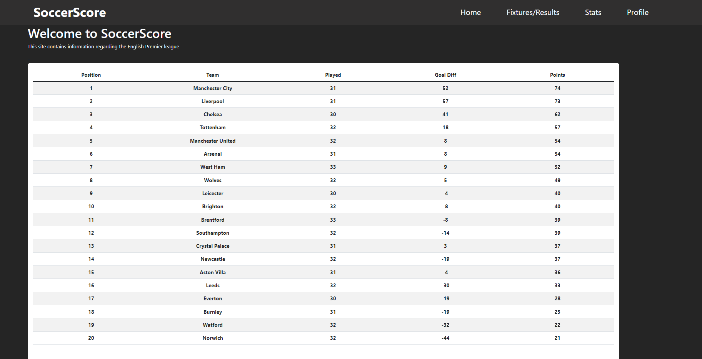
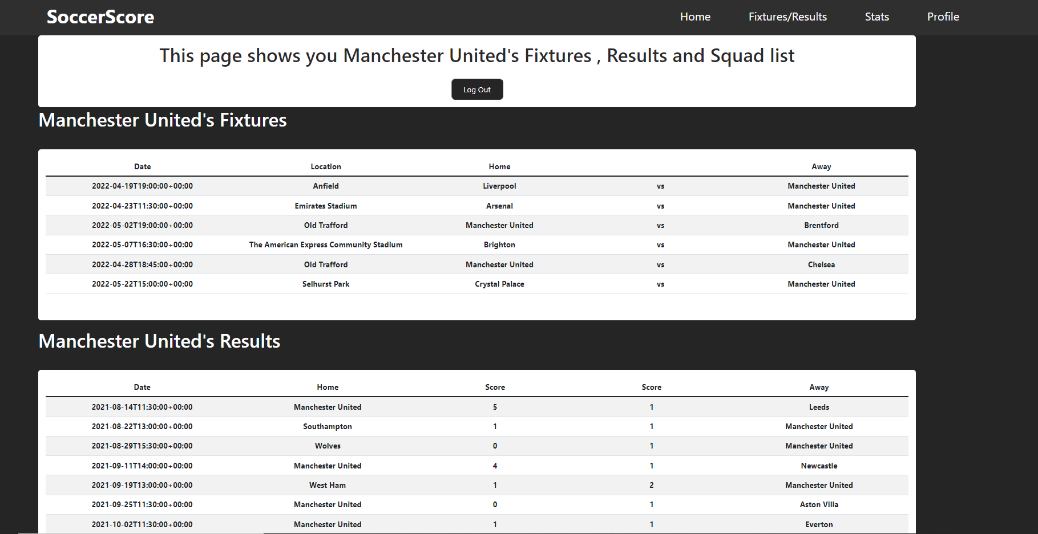
SoccerScore
Brian Williams, G00368681
Software and Electronic Engineering GMIT
Mentors: Niall O’Keeffe
SoccerScore is a football website that contains all useful information regarding the English premier league and is easy to use and follow.
The motivation for this project was to create a website that was not full of unwanted and unnecessary information that the user might not want or need.
Introduction
Conclusion
The Home page of SoccerScore displays a welcome message and a live table of the current English premier league standings.
The Fixtures and Results page displays the fixtures and results for the English premier league for the 2021/22 season.
The stats page displays the leagues top 10 scorers and the leagues top 10 assists. It also displays the top 10 players with the most yellow and red card for this season.
The profile page has a login feature to allow the user to login into their account and display fixtures and results for their favorite team. It also shows them a squad list for that team. If the user does not already have an account, there is a signup feature that allows them to create their login and choose a favorite team.
The frontend of the website was designed and created by using React, JavaScript and CSS. Using API’s, I pulled data required for the league table, fixture, results and stats.
The backend of the website works with mongo DB atlas to store and fetch the account information for the users to login and sign-up. The backend also fetches the user's favorite team to display information on the favorites page.
Software Used

