Slide 1
EECE 5698: Homework 3 Write-up
By Brian Wilcox

Slide 2
Objectives
Develop portable Python code for data collection of GPGGA data using a GPS and LCM for communication purposes
Steps:
Write a struct for the GPGGA data we are interested in (timestamp, latitude, longitude, altitude, utm_x, utm_y)
Implement a driver that parses this data from the GPS and performs a conversion of latitude and longitude to UTM values
GPGGA Gives DDMMMM.MM for Latitude and Longitude
Proper magnitude conversion goes by:
utm_lat/long = msg.lat/long / 100 + (msg.lat/long % 100)/60
If Latitude is South -> Make Latitude negative. If Longitude is West -> Make Longitude negative.
3. Collect data of staying in one place outside for 10 minutes
4. Collect data of moving in a straight line for 1 minute
5. Plot Data in Matlab from LCM logfile

Slide 3
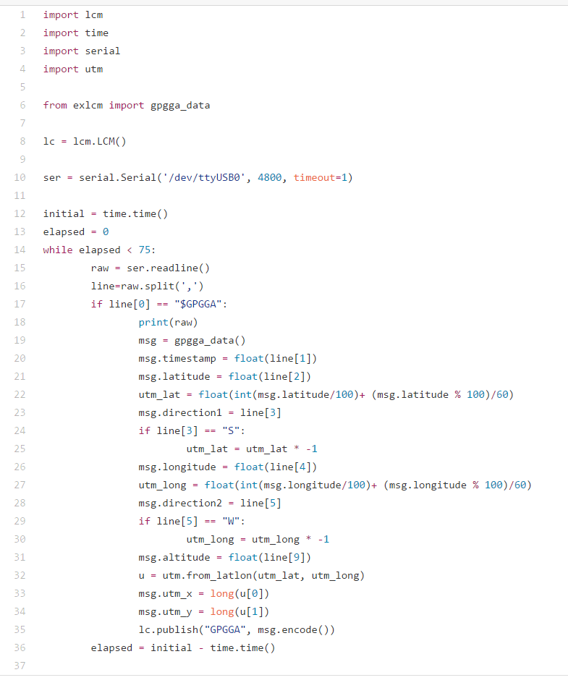
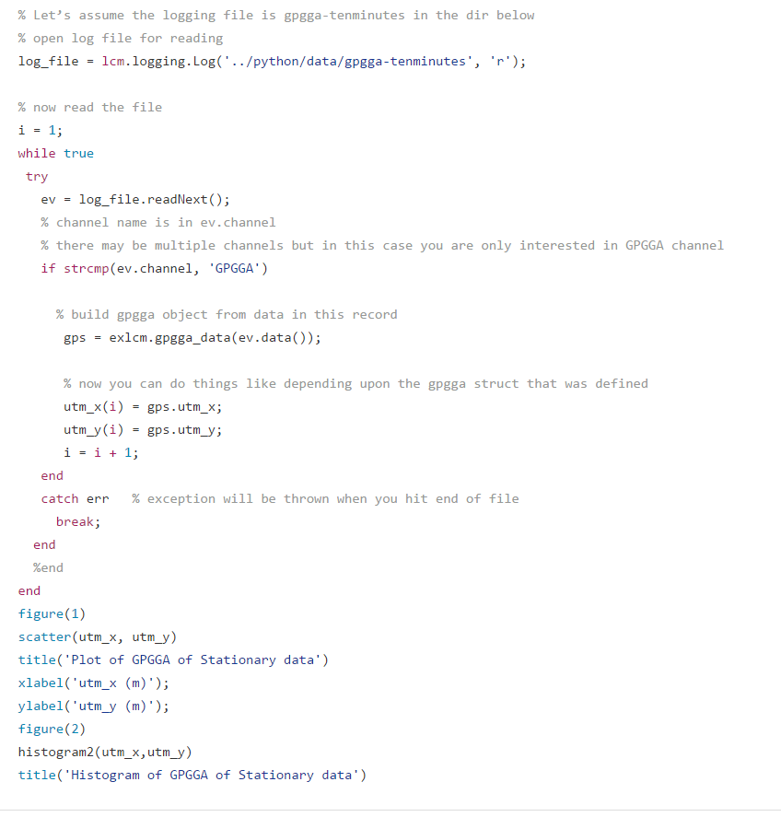
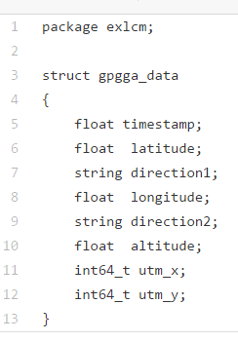
Software
gpgga-driver.py
lcm_read.m
gpgga_data.lcm

Slide 4
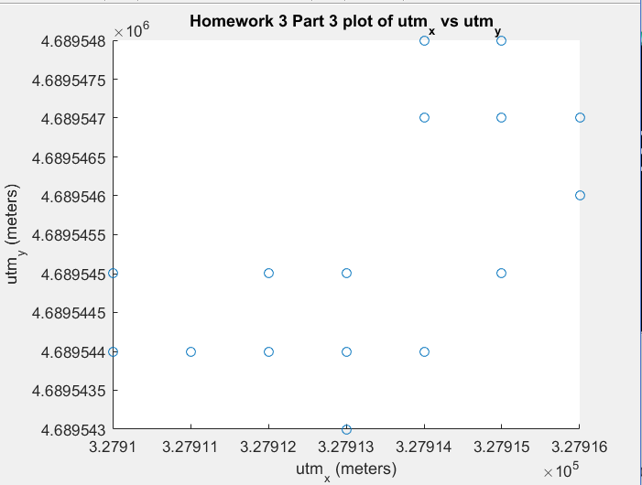
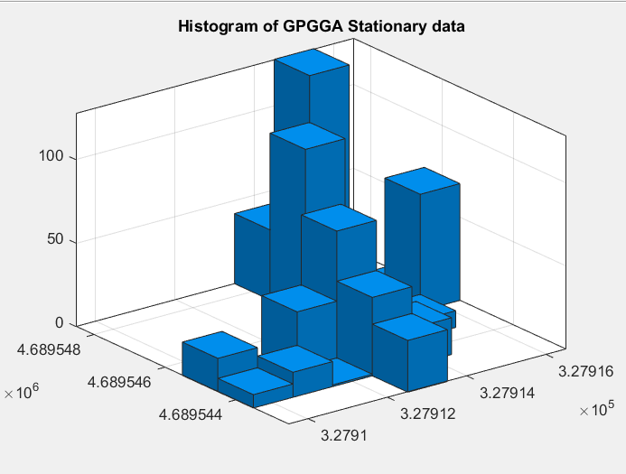
Results of Ten Minutes Stationary
From the stationary data, one can conclude that there is Circular Gaussian Noise in GPS readings

Slide 5
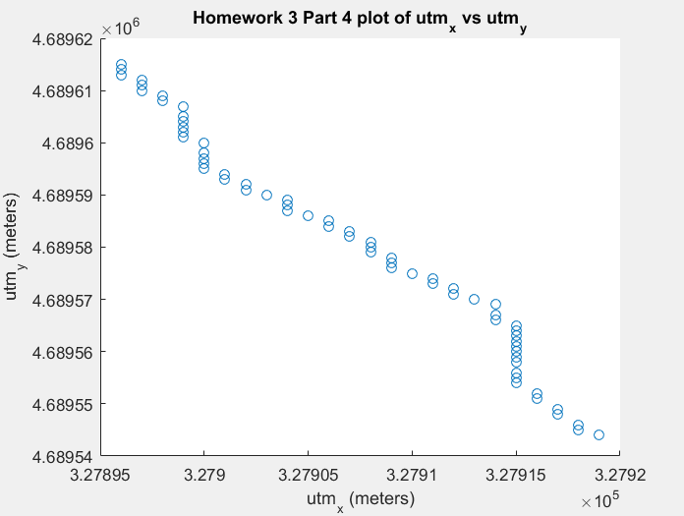
Trajectory of Moving in a straight LINE for a minute

Slide 6
Analysis/Conclusions
GPS data produces a Circular Gaussian Noise Distribution (really an Elliptical one that can be modeled well by a Circular Distribution. Source: http://gpsworld.com/gpsgnss-accuracy-lies-damn-lies-and-statistics-1134/)
GPS Navigation can provide noisy data which would require proper filtering to handle deviations from actual positions. This would be an interesting research topic to explore in greater depth.
LCM can be used to provide GPS data to pinpoint locations at high accuracy.
UTM data is useful for plotting relative position given your zone.
It was windy outside and that may have caused the GPS to change position while data was being collected.
Apparently, I cannot stay in one place for ten minutes.
I also apparently struggle to walk in a straight line.
What exactly are ideal conditions for this device? The middle of Centennial?
When Installing Matlab on Ubuntu, try not to install all the toolboxes. Also, try not to enter the wrong username for who will be accessing your Matlab license. Both will set you back a few hours

