Slide 1
HTML & CSS
Crash course

Slide 2
???
What’s your name?
What reason brought you here tonight?
Ex. Curiosity, Career change, Boredom
How much experience with code do you have?

Slide 3
Go Download
http://bit.ly/BCgithub
Hit the download button
Find it in downloads and unzip
Drag folder to the desktop

Slide 4
HTML
HyperText Markup Language
Defines the content of a webpage
Using already defined tags to structure the content
Ex: <body></body>

Slide 5
Important Starting Tags
<!DOCTYPE html>
<head>
<title></title>
</head>
<body>
</body>
</html>
Notes:
*It is necessary to declare a doctype
Can anyone take a guess as to why? It helps older browsers interpret it better.
Most tags need to be closed!
Okay go ahead and open atom. Start typing in these tags as the best way to learn and remember code is by doing.
Head is not going to be visible to the viewer
Title tag~ text will appear in tab of browser best to keep it short. Ideally under 64 characters!

Slide 6
Content Tags
<h1></h1> ~ header tag range 1 – 6
<p></p> ~ paragraph tag
Let’s give it a shot!
Type out one h1 tag, and a p tag then one h3 tag and one p tag
Notes:
*With 6 being the smallest

Slide 7
Link and Image Tags
<a href=“ ”></a> ~anchor tag creates links
<img src=“”/> ~ image tag
Notes:
Lets add some links:

Slide 8
List types
<ul></ul> ~unordered list
<li></li> ~list item tag
<ol></ol> ~ ordered list
<li></li> ~list item tag

Slide 9
Grouping & Commenting
<div></div> ~ Helps group tags together
<!--- Hello there -->
Notes:
Use the div tag to group multiple tags together symbolically
Commenting your code is helpful for someone who is taking a look at it whether they are a teammate or even yourself

Slide 10
CSS
Cascading Style Sheet
It defines the look of a webpage/website
There are different ways to implement it
Inline-style
Internal
External - <link rel="stylesheet" href="css/style.css">
Notes:
External is the most used and industry standard way of doing things

Slide 11
CSS example
Selector { property: ;}
body{
background-color: limegreen;
}

Slide 12
Text properties
color
font-style
Italic
font-weight
Bold
font-size
Notes:
There are many properties

Slide 13
Getting specific
Ids ~ Can Only be used once
id=“container”
Classes ~ used as many times as you want
class=“intro”

Slide 14
Other
width
Display
Inline-block
block

Slide 15
Box model
Margin
Border
Padding
Content
Notes:
Margin, border, padding are all properties that can be used in css

Slide 16
Pseudo classes
a:hover{}
a:visited{}

Slide 17
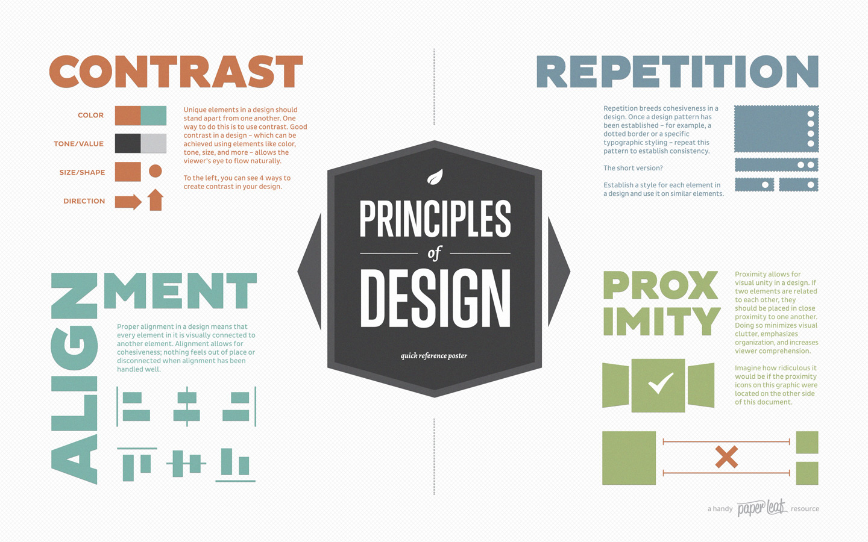
Design

