Slide 1

104KM Presentation Report
Ho Sze Long 56235256
Leong Ho Yin 56235350
Fung Tsz Hin 56235000

Slide 2
Technology and system used
Web system development: Django, Python, HTML
Website: JavaScript, CSS
PyCharm, Dreamweaver, Visual studio, Brackets

Slide 3
How does the Website resolves and improves the business
Take less resource to manage(Less personnel, Shop equipment)
Spreads and gain publicity much quicker than traditional shops
Easier access/more convenient for the customer
Reduction in operational costs.

Slide 4
Design of the online shop
The online shop features different functions, but keeps the webpage straight forward.
Login/Registration system
Purchase system-Purchase page and shopping cart.
Catalogue search-bar
Online query-instant chat room

Slide 5
Usage flow of the webpage
1.Registration/login
2.View products
3.Adding items into shopping cart
4. Detail confirmation and payment

Slide 6
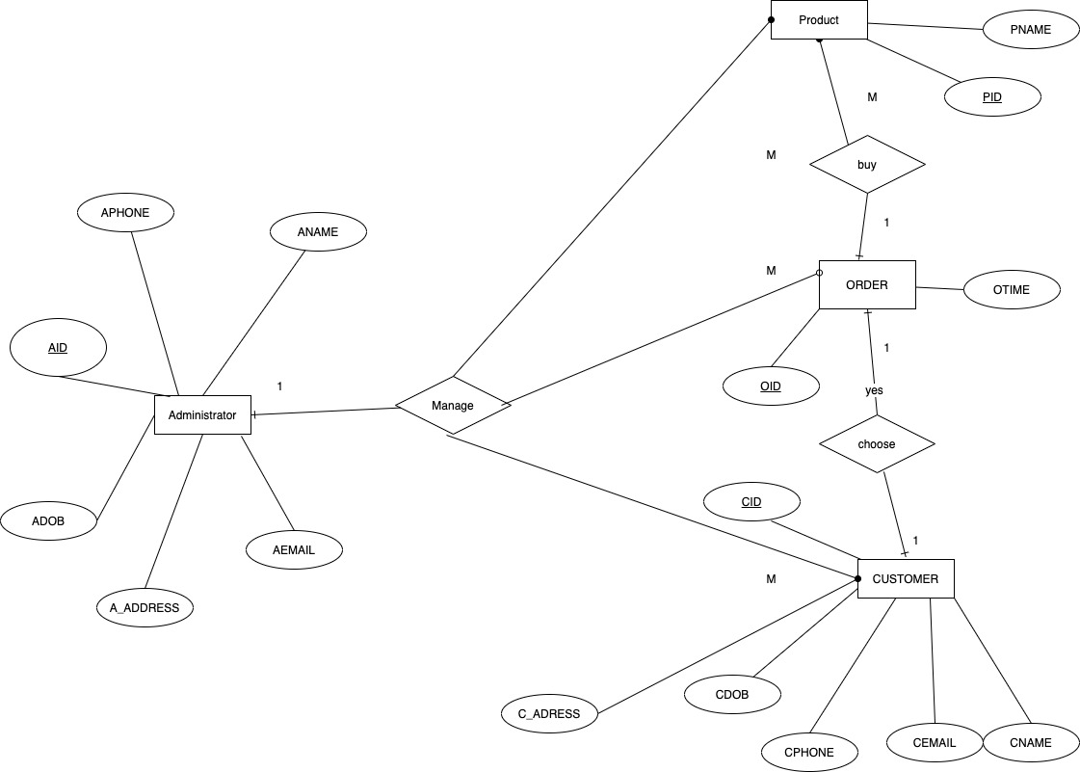
ER diagram
Introduces the relationship between different entities
System layout

Slide 7
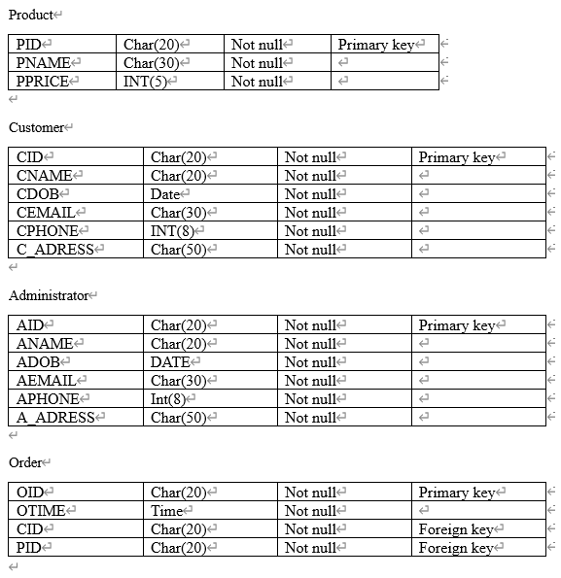
Database design
Different attributes in a table
Primary key and Foreign key

Slide 8
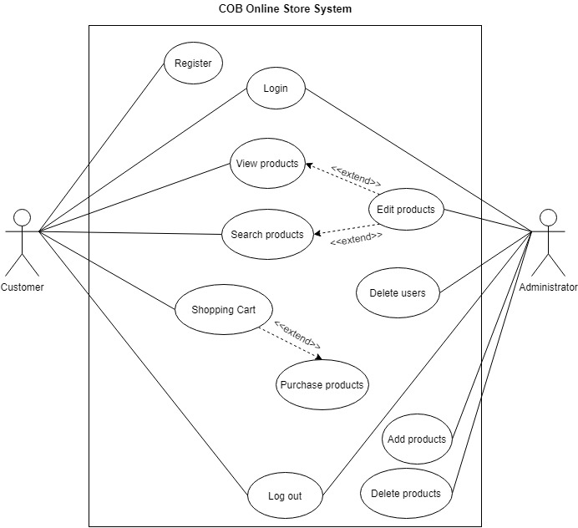
Use case diagram
The interaction between the actor and the system

Slide 9
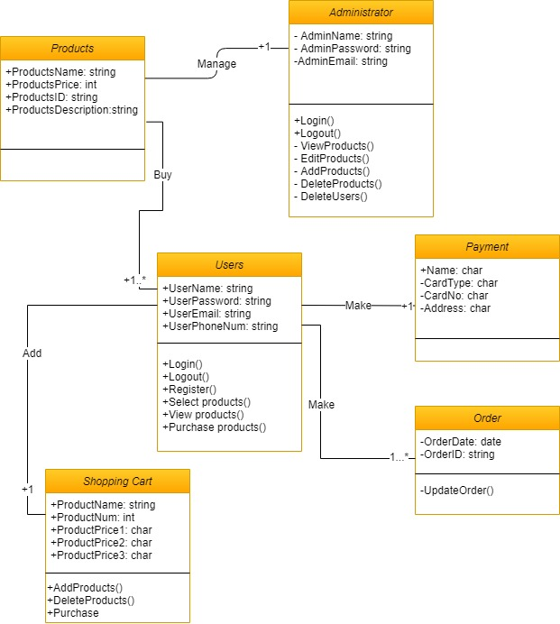
Class diagram
UML
Describes the system with the use of system class
Relation and attributes

Slide 10
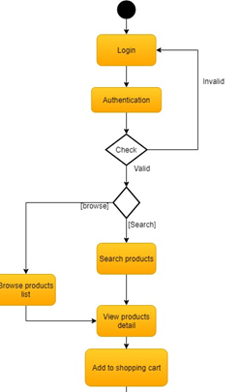
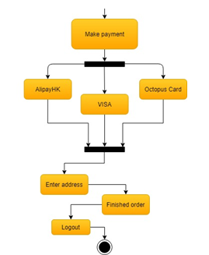
Activity diagram (Customers)
Usage flow from the customer side
Payment system

Slide 11
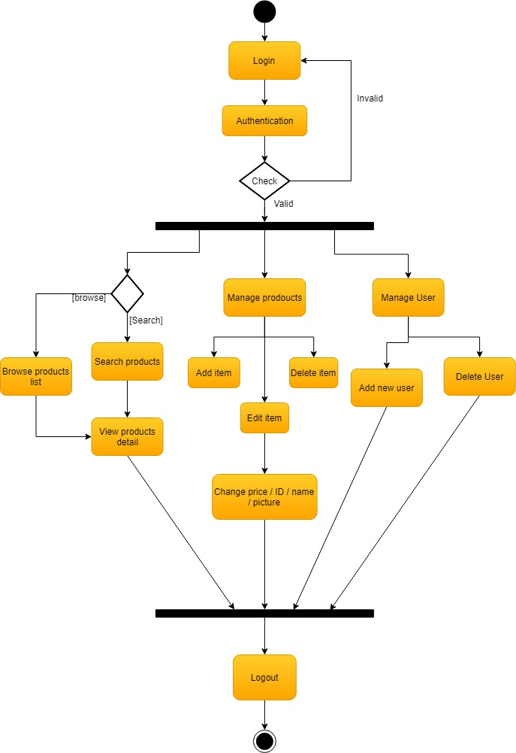
Activity diagram (Administrator)
Administrator’s side of interaction with the system

Slide 12
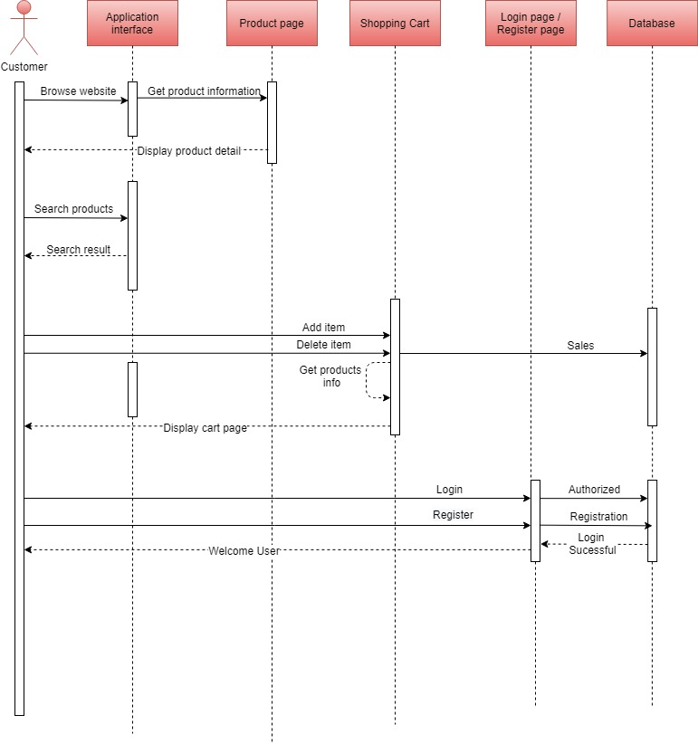
Sequence Diagram
The use sequence of the online shop system

Slide 13
Thank you!

