Slide 1
EDES 301 Dog Treat Dispenser Proposal
09/30/2024
Aden Briano

Slide 2
Background Information
Inspiration: Dog Treat Dispenser W/Arduino
Packages to use: Adafruit,
Is your dog tired of having to sit or lie down to receive a treat? Do they want something more stimulating? Well I’ve got them covered! I’m going to make a treat dispenser box with a flywheel launcher and treat feeder mechanism lying on top. In front of the box there will be a large blue button and a large yellow button with a same colored LED above, embedded into the wall of the box. When the test subject barks at the box, a random LED will light up, and the test subject is required to press the corresponding button in 15 seconds to launch a treat (which they can then chase after). The box will need to be barked at again to restart the process. The Dispenser will use an IR sensor to detect if the feeding tube is out of treats, and then send you an email requesting to be refilled!

Slide 3
System Block Diagram
DC Motor
Motor Shield
GPIO x2
PocketBeagle
CRM
PWM
Mic
USB
IR Sensor
GPIO
Buzzer
PWM
LEDS x2
GPIO
Buttons x2
GPIO

Slide 4
Power Block Diagram
DC Motor
Motor Shield
PWR
SYS
SYS
5V
IO
PWR
PocketBeagle
CRM
SYS
IO
Mic
USB/SYS
Buttons/LEDS/Buzzer/IR Sensor
3.3V

Slide 5
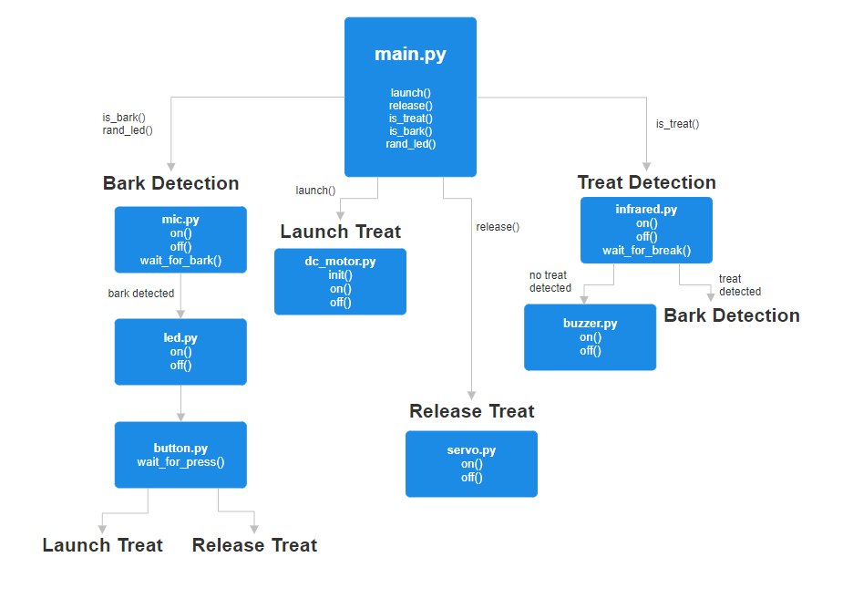
Software Framework Diagram

Slide 6
Components / Budget
Component | EDES301 to Buy? | Cost
Continuous Rotation Motors | Yes | $26.99
L298N Motor Driver | Yes | $6.99
Blue and Yellow Button | No | $20
USB Microphone | No | $7.96
Buzzer | No | N/A
DC Motors | No | $11.99
Rigid Clear Acrylic Pipe | No | $14.14
IR Sensor | No | $9.99
Yellow and Blue LEDS | No | N/A
Notes:
Need DC motors for flywheel mechanism. Continuous rotation servo for feeding mechanism.
How do I know when the treats are empty? How will I alert the user?
When do I stop dispensing treats?
Finalize BOM

