Slide 1
EDES 301 Dog Treat Dispenser
12/05/2024
Aden Briano

Slide 2
Background Information
Inspiration: Dog Treat Dispenser W/Arduino
Packages to use: Adafruit_BBIO, SpeechRecognition, PyAudio
Is your dog tired of having to sit or lie down to receive a treat? Do they want something more stimulating? Well I’ve got them covered! I’m going to make a treat dispenser box with a flywheel launcher and treat feeder mechanism lying on top. In front of the box there will be a large blue button and a large yellow button with a same colored LED above, embedded into the wall of the box. When the human gives the “Start the game” command, a random LED will light up, and the dog is required to press the corresponding button in 10 seconds to launch a treat (which they can then chase after). The box will need to receive the command again to restart the process. The Dispenser will use an IR sensor to detect if the feeding tube is out of treats, and buzz loudly when it needs to be refilled.

Slide 3
Github Repository and Hackster.io Post
Dog Treat Launcher
EDES301 Github

Slide 4
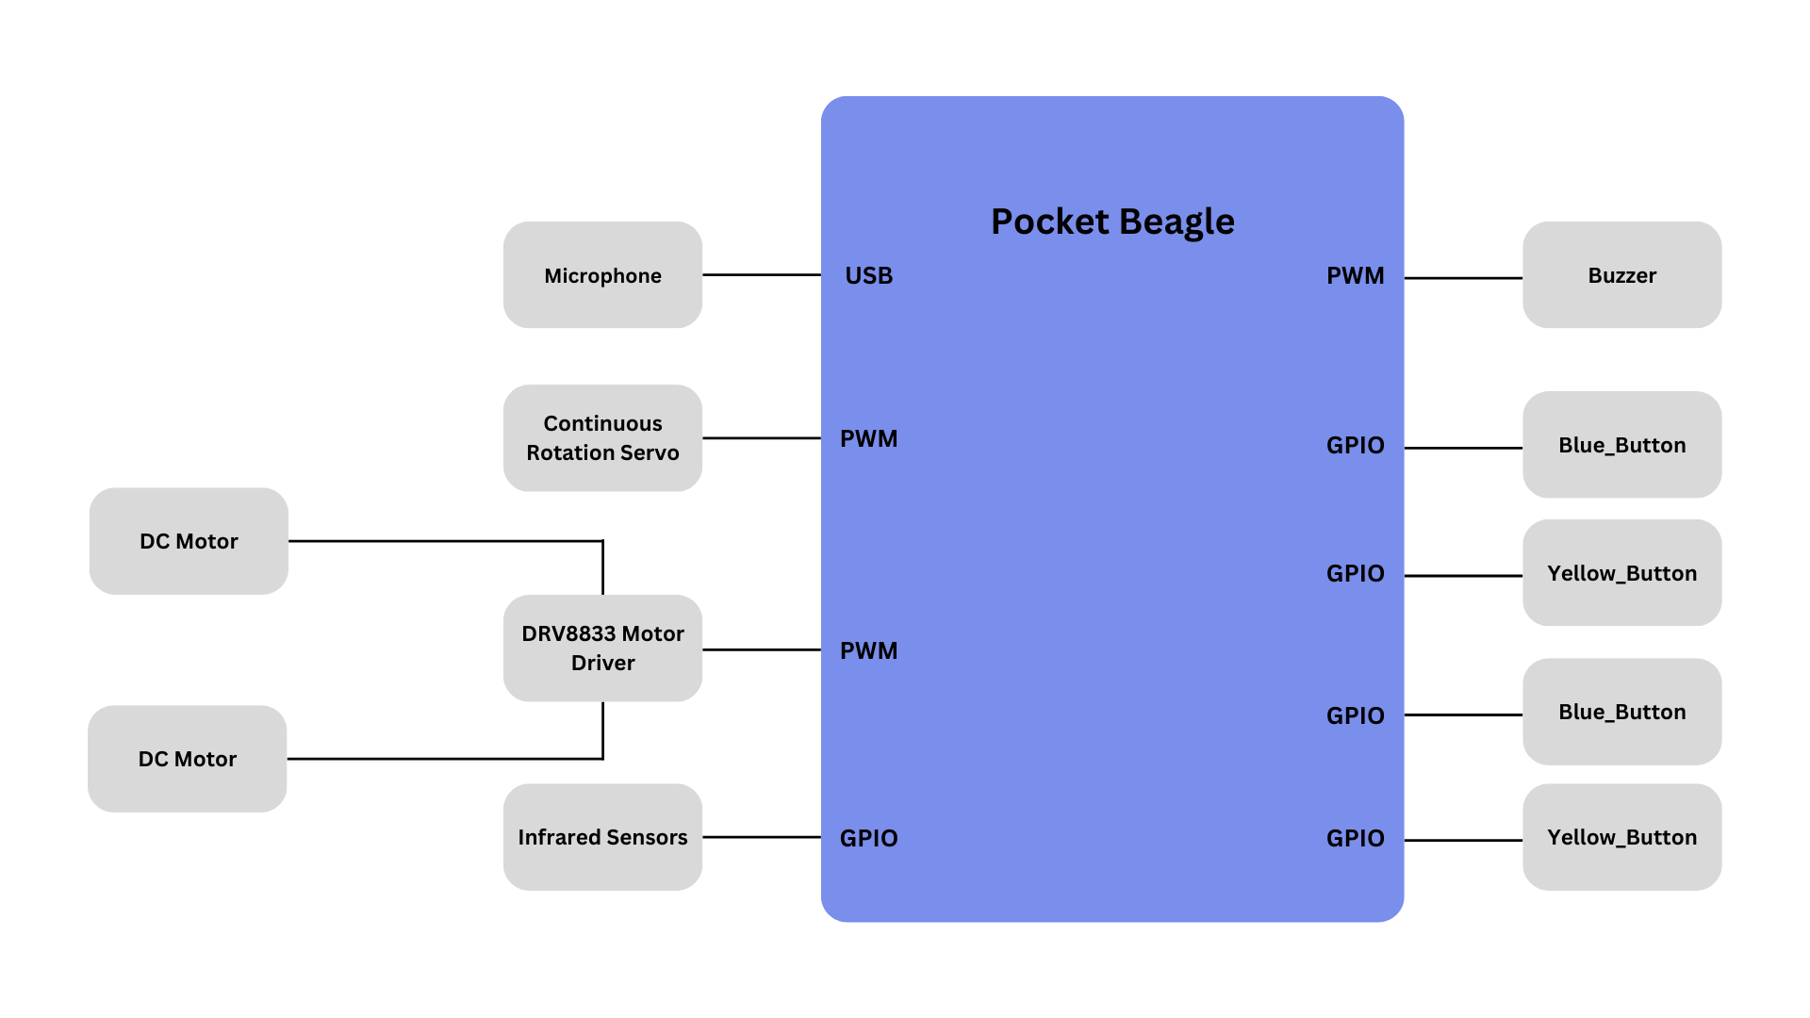
System Block Diagram

Slide 5
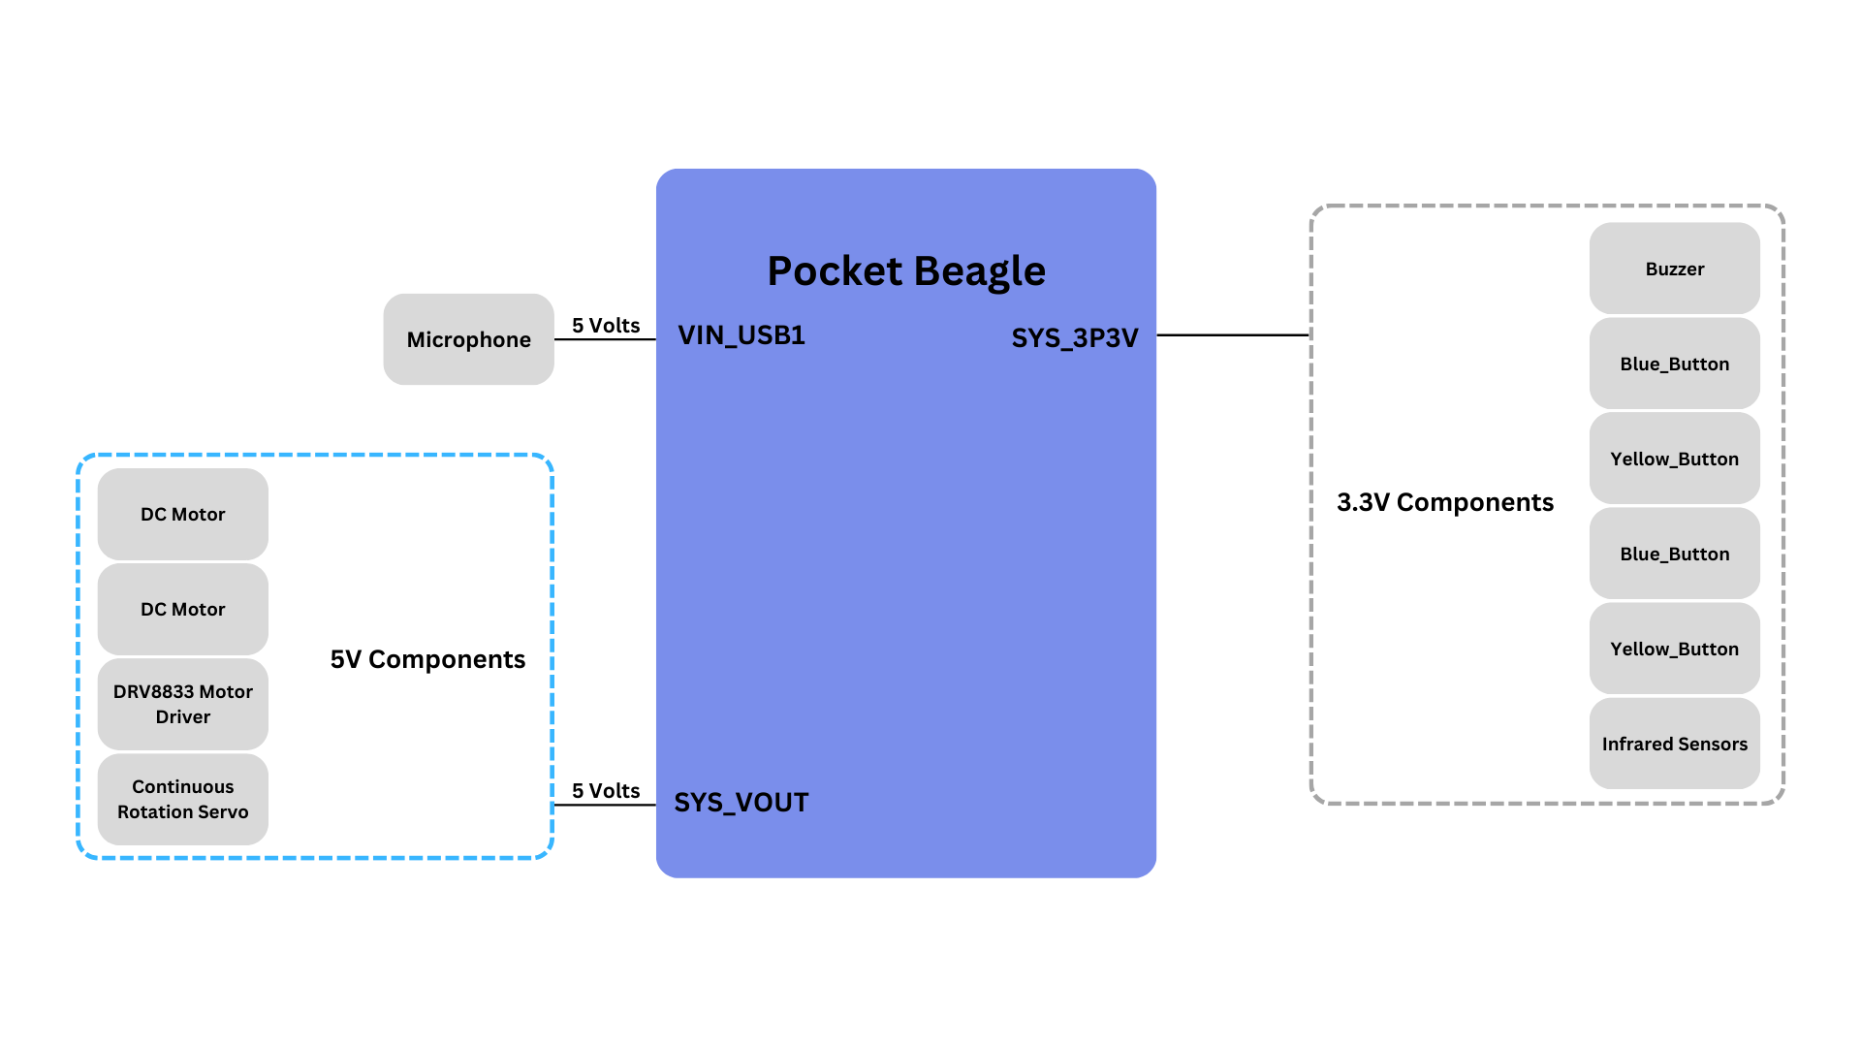
Power Block Diagram

Slide 6
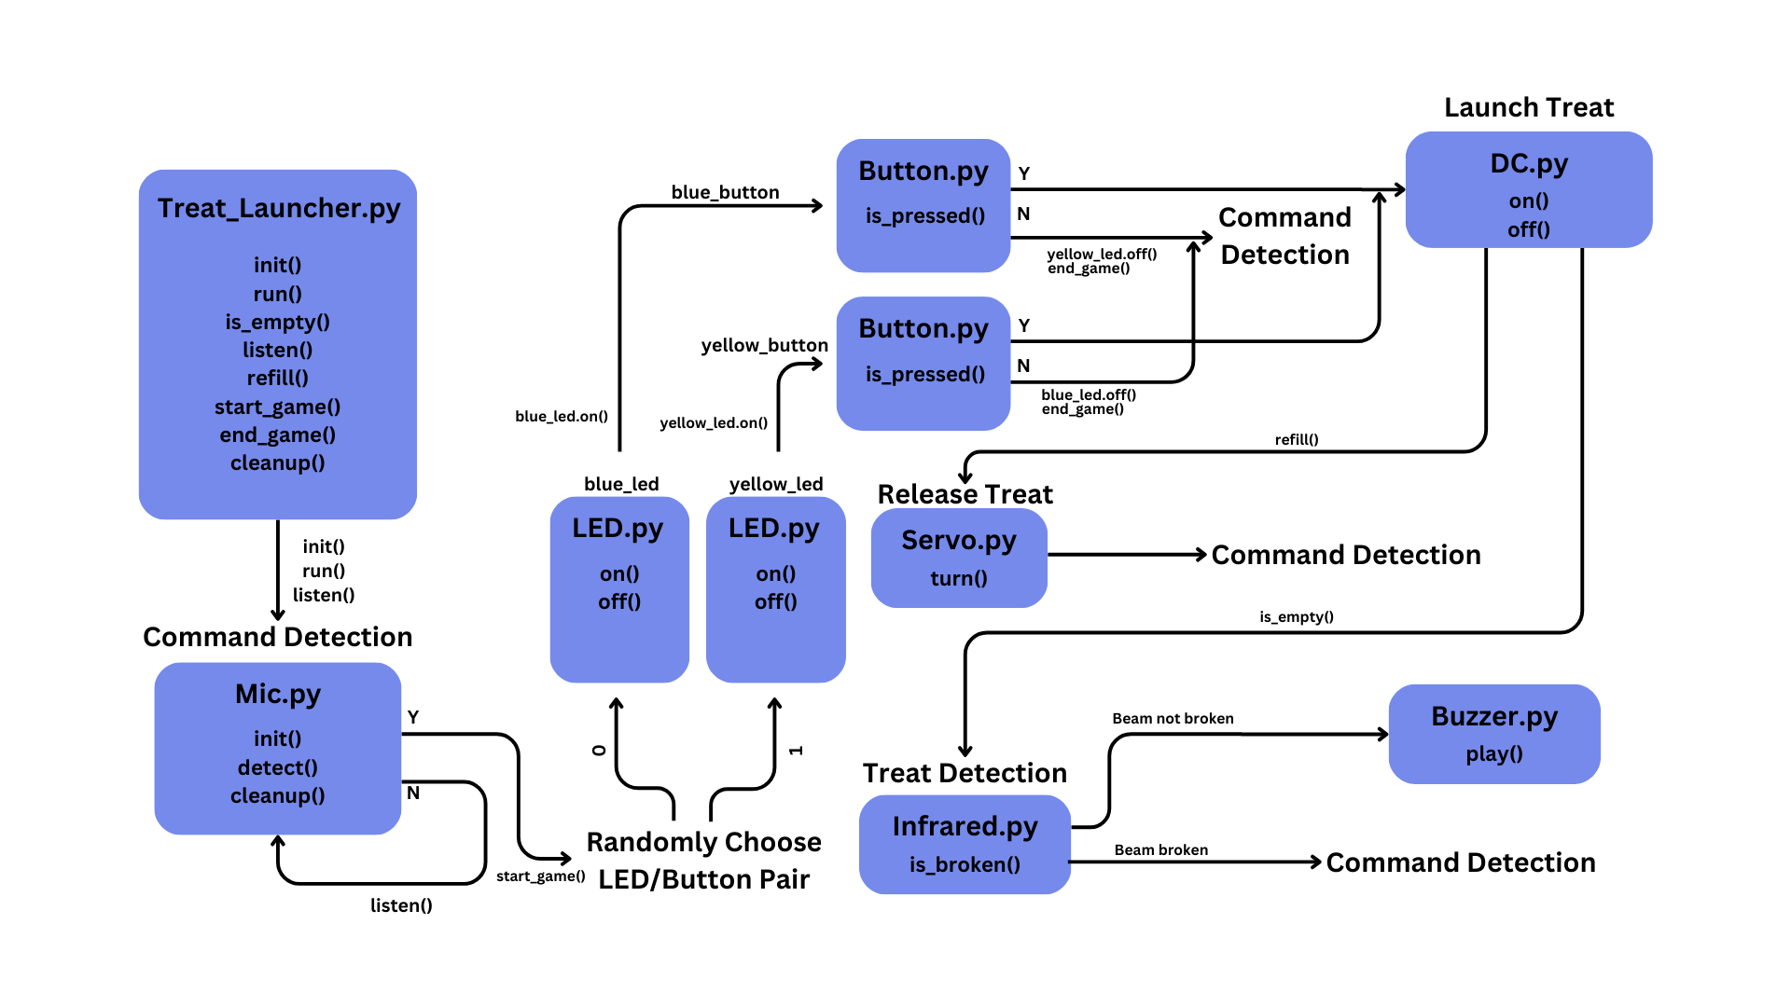
Software Framework Diagram

Slide 7
Components / Budget
Component | EDES301 to Buy? | Cost
Continuous Rotation Motors | Yes | $26.99
L298N Motor Driver | Yes | $6.99
Blue and Yellow Button | No | $20
USB Microphone | No | $7.96
Buzzer | No | N/A
DC Motors | No | $11.99
Rigid Clear Acrylic Pipe | No | $14.14
IR Sensor | No | $9.99
Yellow and Blue LEDS | No | N/A
Notes:
Need DC motors for flywheel mechanism. Continuous rotation servo for feeding mechanism.
How do I know when the treats are empty? How will I alert the user?
When do I stop dispensing treats?
Finalize BOM

