Slide 1
EDES 301 PCB Project
Aden Briano
Due 12/17/2024 @ 11:59pm

Slide 2
Project Options
Can choose one of two options:
Create a PCB based on your Project #1
Create a PCB based on an example project
See Project #2 assignment for specific details
If choosing Option 1
Replace Background Information and System Block Diagram slides with your slides from the Project #1 proposal
Create a Mechanical Drawing
If choosing Option 2
Used provided Background Information and System Block Diagram slides
Create a Mechanical Drawing
Remove this slide in your submission

Slide 3
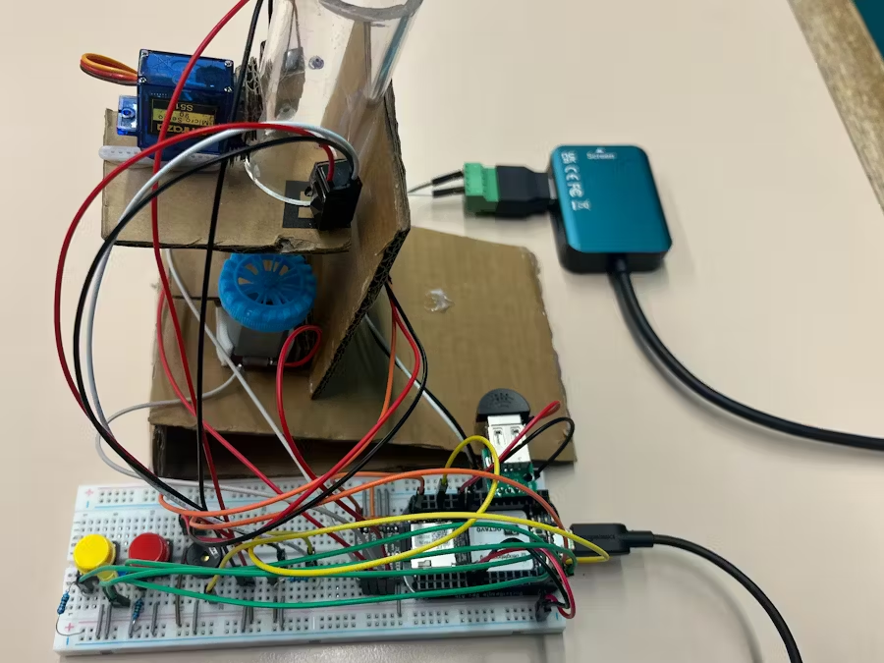
Background Information
Hardware:
Two DC Motors
SG90 Servo
IR Break Beam Sensor
Two Buttons and Two LEDS (Blue, Yellow)
USB Microphone
Buzzer
Software:
Adafruit_BBIO
SpeechRecognition
PyAudio

Slide 4
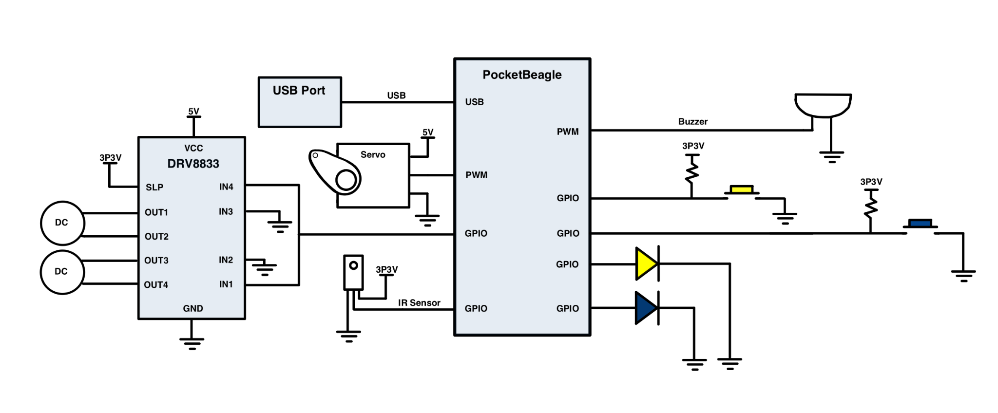
System Block Diagram – Dog Treat Launcher

Slide 5
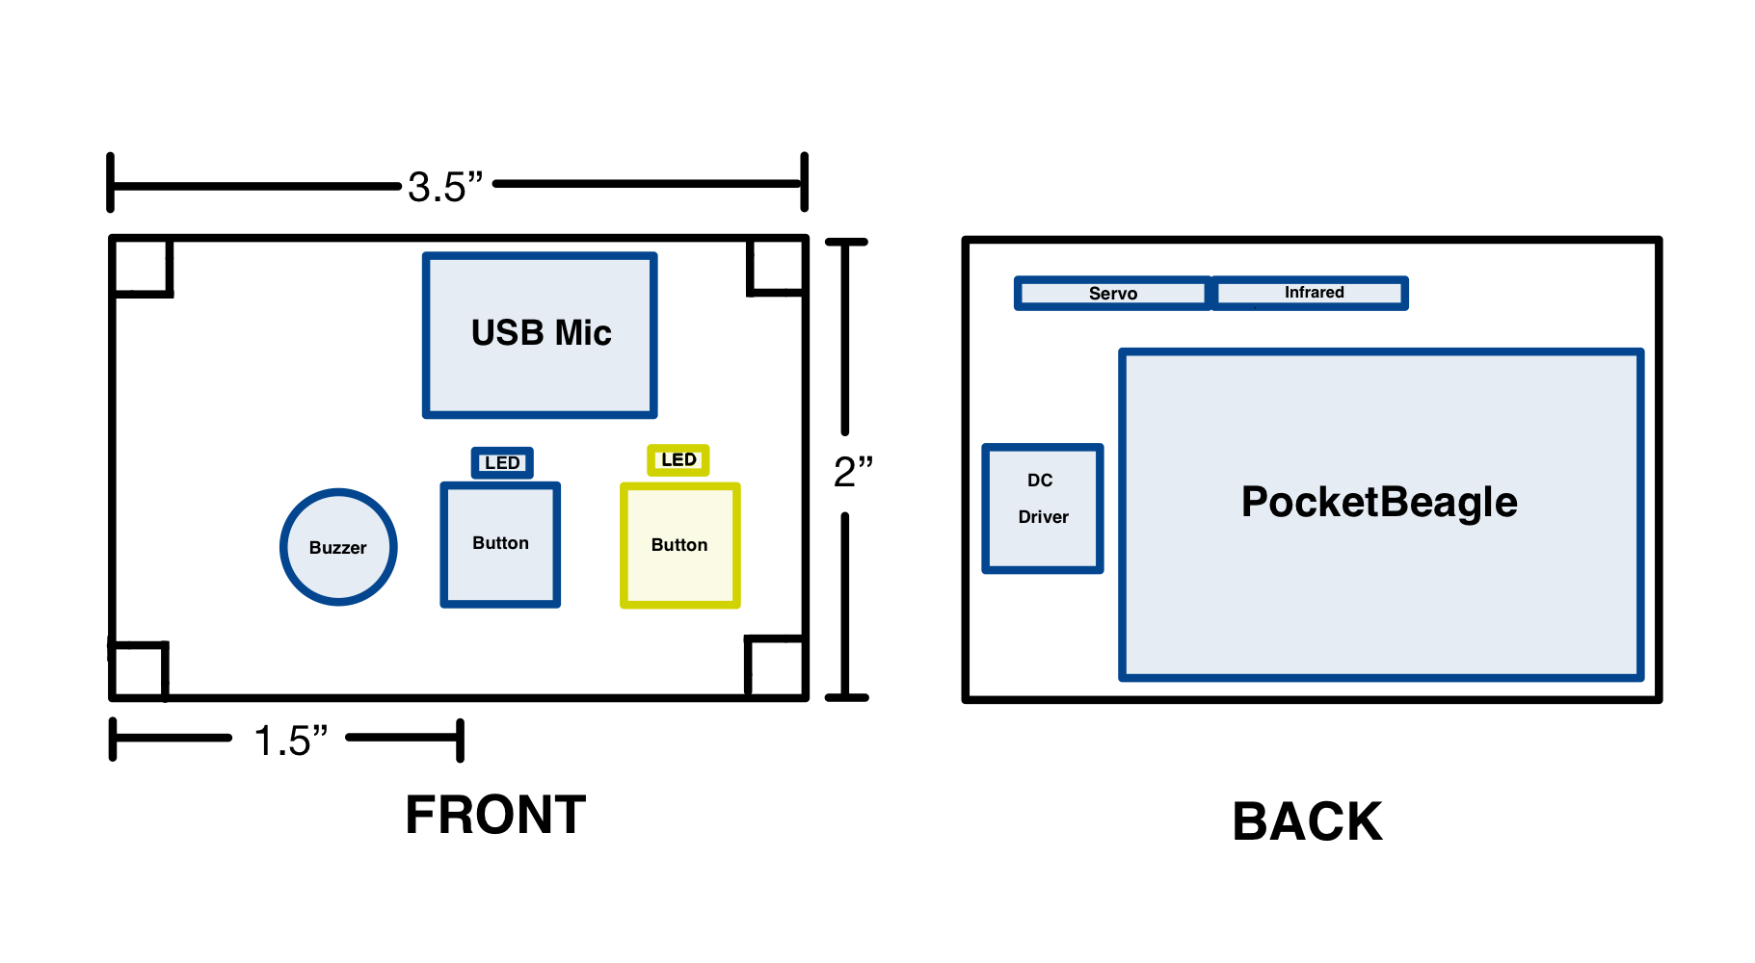
Mechanical Drawing

