Slide 1
A Content Delivery Network for Music
Integrate Rights and Media with Administration
Cut costs by Automation and Pay stakeholders in real-time
Promote Artists and Content directly to consumers
Build an audience with social features

Slide 2
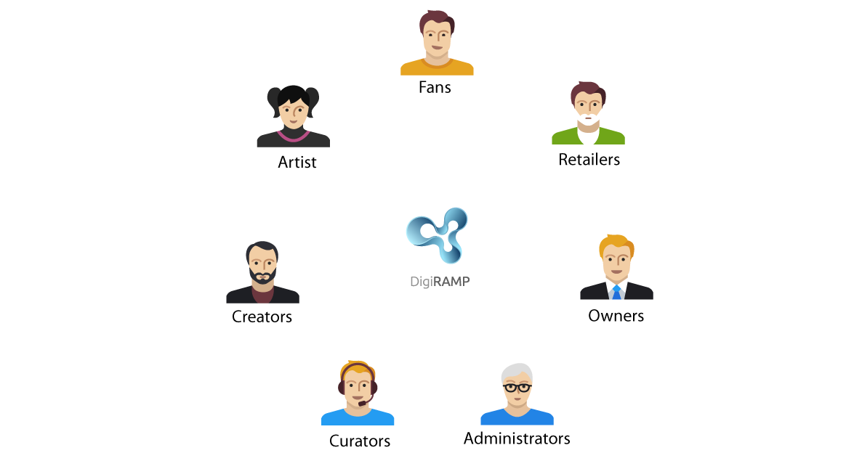
Ecosystem for music
Many kind of users supported
Users manage their own interest

Slide 3
User segments
Listeners and fans
Influencers
Aspirational artists / Amateurs
Professionals
Brands and advertisers
Notes:
Listeners and fans
This group is the largest. It’s also the bottom of the food chain and everyone wants access to this group.
They join DigiRAMP because they get.
Easy access to free music.
Great content curated in playlists.
Stories behind the music.
Cool graphics and videos
Tools to share what they like and do
Access to engage with peers artists
Influencers
DJ’s. Pretty girls. Artists. YouTubers. Comedians. Explainers. They are today’s online trendsetters.
They join DigiRAMP because they get
A media to communicate true
Ways to monetize on their followers
Metrics and data on their followers
Aspirational artists / Amateurs
Individual. Bands. DJ’s, Songwriters. Composers. Producers. Artists.
This group represents many of the different kind of parties in the music universe.
This group is the second largest group of users.
They join DigiRAMP because they get.
Opportunities
A way to find people to collaborate with
A merchant system
Legal documentation and protection
Exposure
Recognition
Promotional tools
They can participate in contests
Professionals
Individual. Bands. DJ’s, Songwriters. Composers. Producers. Artists. Indie Labels. Curators. Music Supervisors. This group represents most of the different kind of users
They join DigiRAMP because they get
An easy. Efficient and cost effective way to conduct business
A way to own their customers and clients and monetize directly on them
Promotional tools
Metrics
Brands and Advertisers
Many artists and bands build relations
Artists promote instruments
Artists promote closing
Brands sponsor events
Brands sponsor competitions

Slide 4
Content providers
Aggregators
Indie labels
Professionals
Aspirational artists and amateurs
Bands
Majors

Slide 5
Buyers
Consumers
Shops, Cafe’s. Restaurant’s, Clubs, Radio’s
Supervisors
Resellers / Representatives
Curators

Slide 6
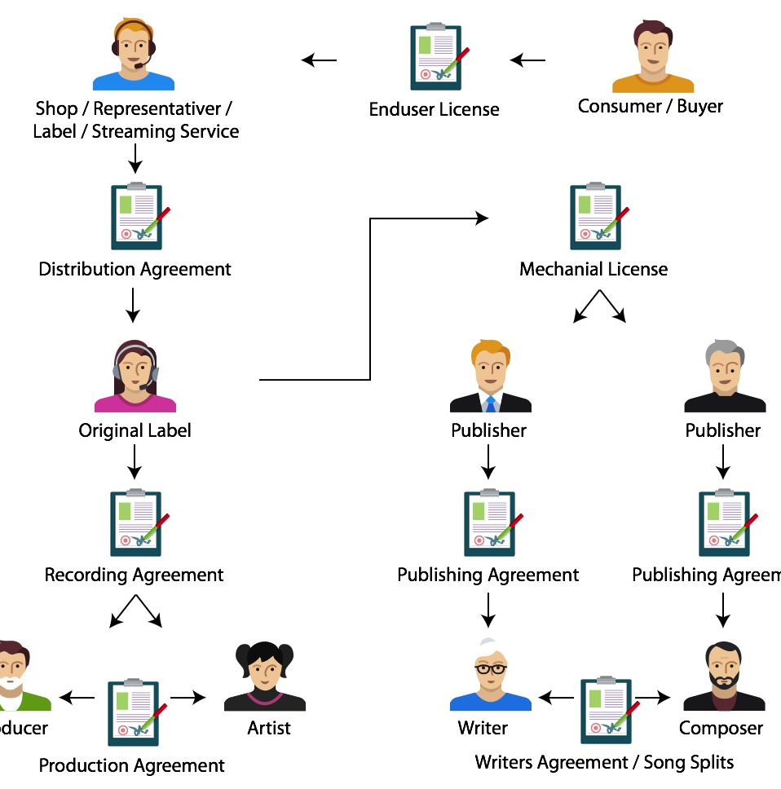
Legal framework

Slide 7
A segmented industry
Sales to end consumers
Management of rights
Collection of royalties
Distribution
Licensing
Production
…

Slide 8
Potential revenue streams
Shop / Curated products
Streaming
Licensing / Opportunities
Metrics / Analytics
Subscriptions
Advertising
Storage
Email campaigns
Publishing / Label / Administrating
PRO / Collections
Content delivery API / SDK / production library
Bundling
Plugins for DAW
Services / Legal / Help to import / Special features / Education
Books / Video
DigiRAMP become an Aggregator
Mobile apps
Campaign tool
Mastering
Music Hardware
Provide cleared music to hardware vendors’ game developers and third party streaming app true an API

Slide 9
Business model
All users conduct their own business
DigiRAMP take a rake on transactions
4% credit card fee

