Slide 1
UiPath
Sentinel Agentic AML
Investigation Case Manager
UiPath AgentHack Track 1: Maestro Case. Build the AI agents of tomorrow.

Slide 2
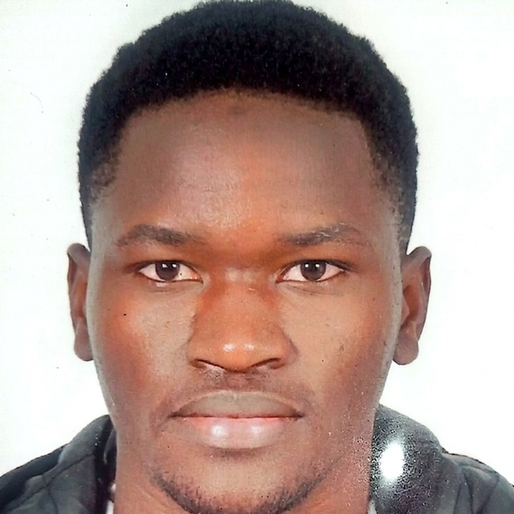
Team: TheSecond
Project Title: Sentinel
UiPath
ZEMBA Wendemi Brice Roméo
Assistant Researcher @ University Mohamed VI Polytechnic
Wendemi.ZEMBA-EXT@um6p.ma
2

Slide 3
Problem statement and proposed solution
UiPath
Problem
Solution
~95% of AML transaction-monitoring alerts are false positives.
Each one is still investigated by hand, pull data, screen sanctions, write the SAR.
A compliance officer must sign off every filing it's legally mandated.
Result: slow, inconsistent, costly, and the risk of late or defective filings.
Sentinel makes every alert a governed case in UiPath Maestro.
Agents investigate, robots act on systems of record, an MLRO signs off.
The path is dynamic: duplicates auto-close, sanctions fast-track, weak cases loop back.
Every decision is auditable end to end the differentiator for regulators.
3

Slide 4
How it works: one case, five stages
UiPath
1
2
3
4
5
Triage
Investigation
Narrative
Quality Review
Disposition
Low-code agent
Coded agent + robot
Coded agent
Low-code agent
Human MLRO
Dedup, classify, prioritize, route
Resolve, analyze, screen, score
Draft the FinCEN 5-Ws SAR
Verify evidence; loop back if thin
Approve → file · reject → dismiss
Dynamic by design: duplicates auto-close · sanctions fast-track to a senior MLRO · Quality Review loops back to Investigation · SLA breaches escalate.
4

Slide 5
Solution architecture
UiPath
UiPath Maestro Case orchestration · SLAs · escalation · full audit trail
AGENTS
ROBOTS
PEOPLE
Triage (low-code, Agent Builder)
Investigator (coded · LangGraph)
Narrator (coded · LangGraph)
Quality Review (low-code)
DataFetcher (API Workflow)
Filer (RPA files the SAR)
Notifier (escalations)
DocIntake (Document Understanding)
MLRO / Compliance Officer
Reviews in Action Center
Owns the filing decision
Accountable · audited · in control
Agents never touch source systems robots do, behind the UiPath credential vault. A CrewAI build of the Investigator drops in behind the same Maestro stage.
5

Slide 6
Benefits and technologies used
UiPath
Details
Benefits, impact and outcomes
End-user | AML analysts and the MLRO / compliance officer
User department | Financial Crime / BSA-AML Compliance
Industries | Banking, fintech, payments, crypto, gaming
UiPath products used | Maestro Case, Agent Builder, Coded Agents (Python SDK), Action Center, API Workflows + RPA, Document Understanding, Orchestrator
Other APIs / tech | LangGraph, CrewAI, Claude (Anthropic); built via Claude Code + uip CLI
Multi-hour manual investigations → minutes of agent work + one human decision.
Consistent rigor on every alert no analyst-to-analyst drift.
Reconstructable risk score + complete audit trail → fewer late / defective filings.
A human is accountable for every SAR filing and dismissal.
Production path: swap mocks for core-banking, sanctions, and FinCEN E-Filing.
6

Slide 7
Platform depth and coding-agent bonus
UiPath
Hybrid agents, one control plane
External frameworks, governed
Low-code Agent Builder (Triage, QA) + coded LangGraph agents (Investigator, Narrator) + RPA robots + Document Understanding all governed by Maestro Case.
The Investigator ships in two builds LangGraph and CrewAI behind the same UiPath contract, swappable at the Maestro stage. UiPath stays the orchestration layer.
Built with coding agents (+bonus)
Engineered to run, not just demo
The coded agents, risk logic, tests, and deploy scripts were built with Claude Code via the UiPath uip CLI. Documented and verifiable in CODING_AGENTS.md.
Both coded agents pass automated tests (8 total) and run offline with a deterministic fallback a case is never left without a result.
7

Slide 8
UiPath
THANK
YOU.
Sentinel agents investigate, robots act, a compliance officer signs off.
GitHub: https://github.com/BriceZemba/sentinel-aml · Demo video & deck in the submission.

