Slide 1
Advanced LDCC Topics
BrickFest 2003
DCC Track
Presented by:
  Tom Cook
Presentation:
  Mark Riley

Slide 2
Tethered Throttles I
Permits more than one person to control trains on the layout…

Slide 3
Tethered Throttles II
Two types:
  Rotation sensor
  Potentiometer
Up to three throttles supported
  One on each of the RCX’s sensor ports
One or more function buttons per throttle:
  Headlight
  Motorized points
  Additional decoder functions such as:
    Sound
    Ditch lights
    Reverse Light

Slide 4
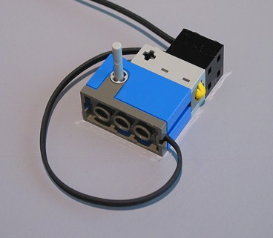
Rotation Sensor Throttle
100% Lego
Single button (optional)
  Press briefly to toggle headlight
  Hold down to stop
Can configure rotation angle representing full throttle

Slide 5
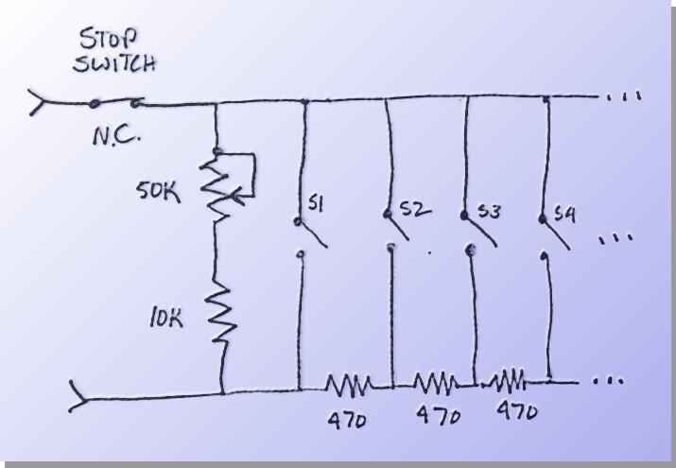
Potentiometer Throttle I
Simple circuit
50K potentiometer
Optional:
  One or more function buttons
  Stop button

Slide 6
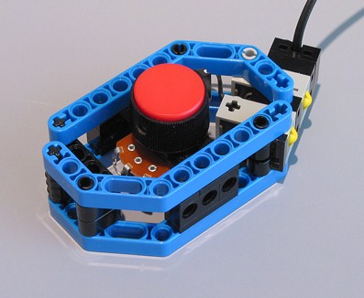
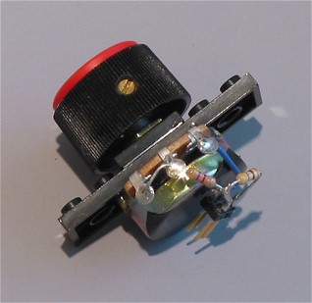
Potentiometer Throttle II
Example using mostly Lego parts
  50K linear potentiometer
  2 function buttons
Potentiometer “element”

Slide 7
Track Work
Techniques for DCC track work…

Slide 8
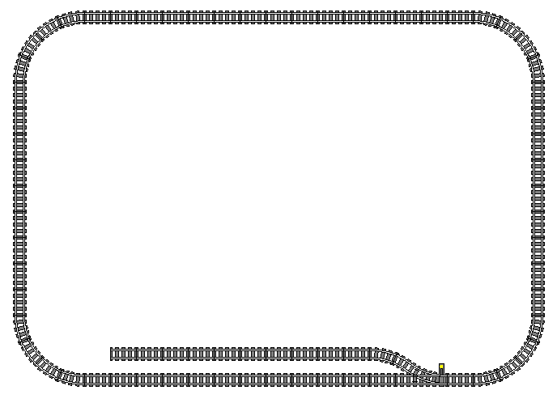
Voltage Droop
Trains may slow when far from power source
More noticeable when running LDCC
9V
8V
Lower voltage because of track resistance
LDCC
Command
Station

Slide 9
Track Wiring I
Supply power to distant track using additional track connectors
Maintain correct polarity
9V
9V
LDCC
Command
Station

Slide 10
Track Wiring II
All track can be live with DCC
Switches can cause dead track
9V
9V
LDCC
Command
Station
Keep yard live by adding extra track connectors
9V

Slide 11
Power & Switches
Power routing by switch not required for DCC operation
Switching yards can be “live” since each locomotive is independently controlled
Switches can be modified to always supply power to both routes (straight & divergent)

Slide 12
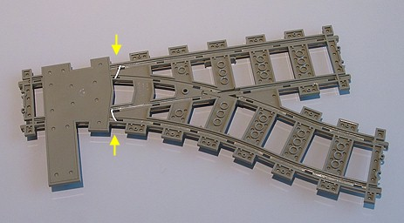
Always Powered Switch
Solder wires as indicated to provide power to both routes
Moderate difficulty

Slide 13
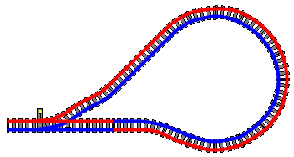
Reversing Loops
Reversing loops cause short
Use insulated track section to fix
Fix short by adding insulated track section here

Slide 14
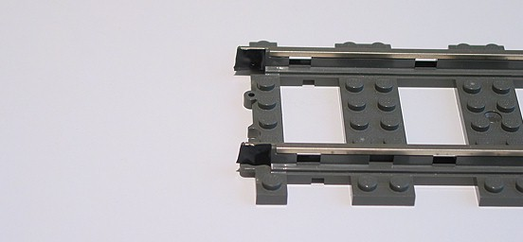
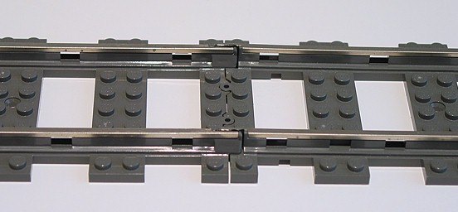
Insulated Track Section I
Add 2 small pieces of tape (or paper) to track ends
Join with second track piece

Slide 15
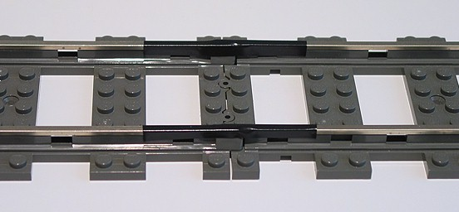
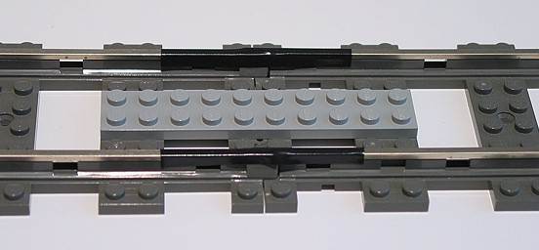
Insulated Track Section II
Apply two 5cm strips of tape
Use track ties as visual alignment aid
Add plate(s) for strength
Credit: Jeff Elliott

Slide 16
Introducing LACC
New firmware allows RCX to become DCC Booster or Stationary Decoder…

Slide 17
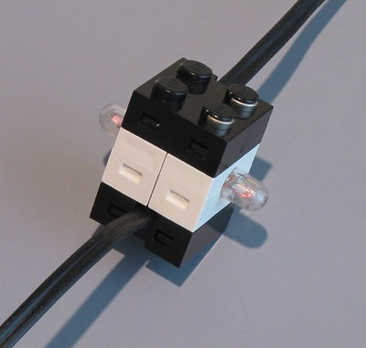
Track “Sensor”
Connects track to RCX sensor port #1
Requires
  (2x) Lamp bricks
  (1x) Track connector
  (1x) Electrical wire
Important
  Connect as shown to protect RCX sensor port
  Lamp bricks face perpendicular to direction of wires

Slide 18
LACC Booster
Large layouts divided into “Power Districts”
Districts separated by insulated track sections
Boosters copies master DCC signal onto slave district
Enables more trains to run concurrently

Slide 19
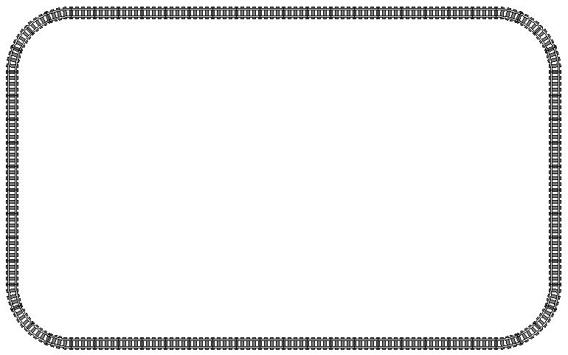
Power Districts Layout
Main District
Slave District
Insulating Track
Booster replicates signal from main district on slave district
LDCC
Command
Station
Input 1
LACC
Booster
Track
Sensor
Insulating Track

Slide 20
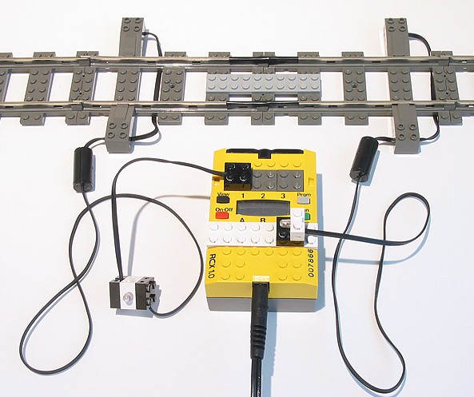
Booster Hookup
Main District
Slave District
Insulating Track
RCX running LACC firmware
Track Sensor

Slide 21
LACC Stationary Decoder
Control up to 3 motorized switches per RCX
Switches operated by RCX remote control
Configurable
  Base address (default is switches 1 though 3)
  Stroke duration (default is 0.8 second)
RCX can be battery powered
  Permits use of RCX 2.0 (or 1.0 w/o power jack)
AKA “Accessory Decoder”

Slide 22
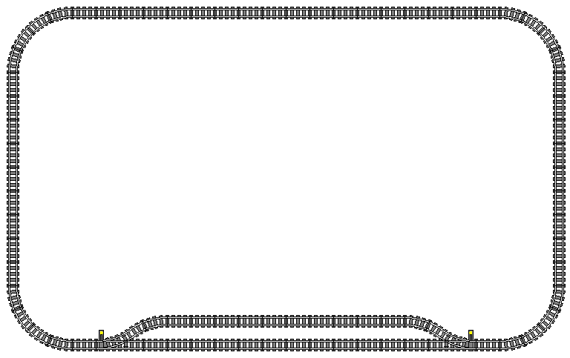
Stationary Decoder Layout
Stationary decoder reads switch commands from track
LDCC
Command
Station
LACC
Stationary
Decoder
Track
Sensor
Input 1
Output A
Output C
Switch
Machine
Switch
Machine

Slide 23
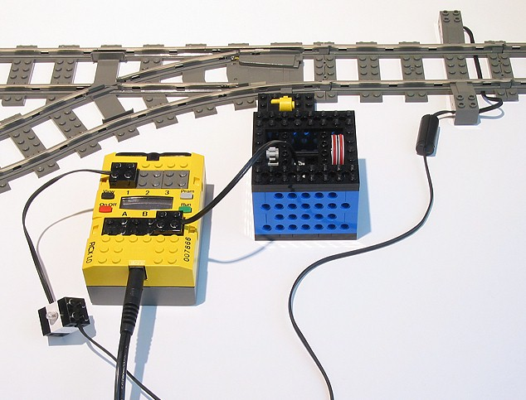
Stationary Decoder Hookup
RCX running LACC firmware
Motorized Switch Machine
Track Sensor

Slide 24
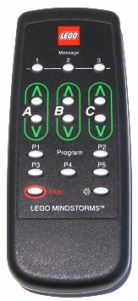
Operating Switches
P1 to P5 on remote operate switches 1 to 5
Hold down sound key to operate switches 6 to 10
Switches 1 to 255 can also be controlled by LDCC IR Protocol

Slide 25
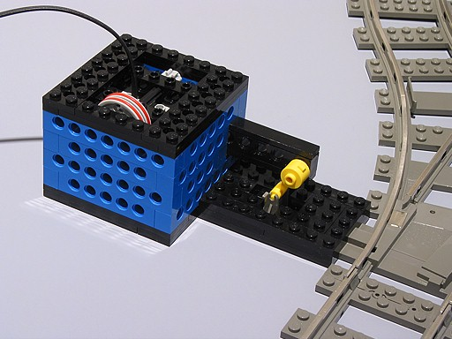
Motorized Switch Machine
Example design

Slide 26
Acknowledgements
Tom Cook
  Idea to use RCX as booster
Jeff Elliott
  Insulated track section using 5cm tape
Matthew Bates
  Track Designer imagery

Slide 27
Online Resources
Mark Riley’s LDCC Page
http://home.surewest.net/markril/lego/dcc/index.html
Motorized Switch Plans
http://home.surewest.net/markril/lego/mswitch/index.html

