Slide 1


Slide 2

Why Lego MindStorms?

Slide 3
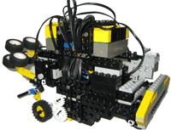
Why Lego MindStorms?
>> Rapid prototyping of mechanical solutions
>> Tool for learning JAVA programming
>> Getting used to embedded systems

Slide 4
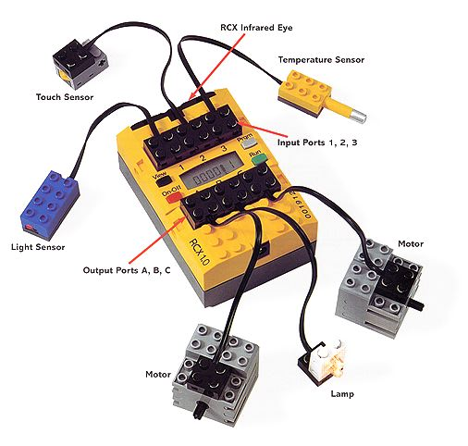
Mindstorms H/W functionalities
>> Sensor input
>> Button input
>> Actuator output
>> LCD output
>> IR communication
>> Computation

Slide 5
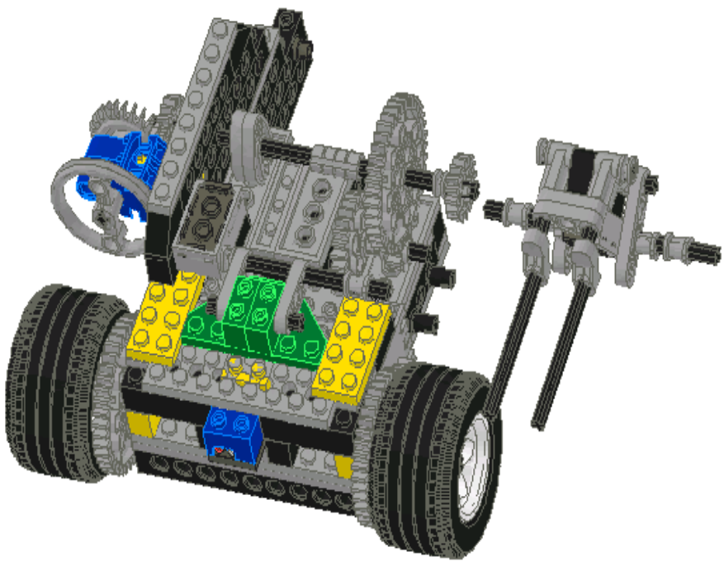
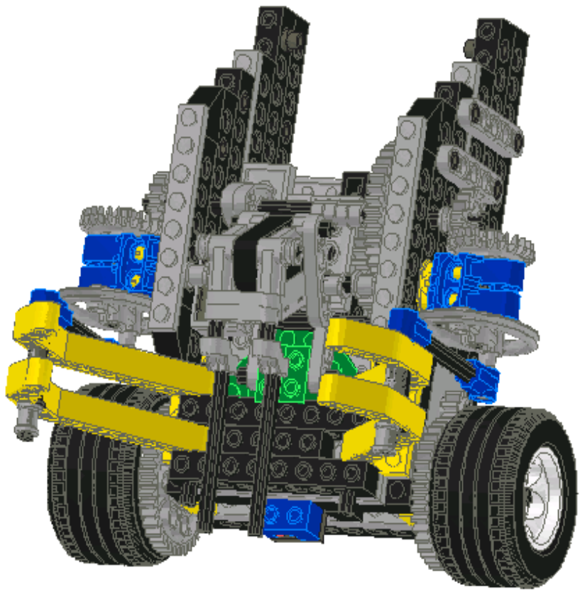
Basic MindStorms procedure
>> Build Lego

Slide 6
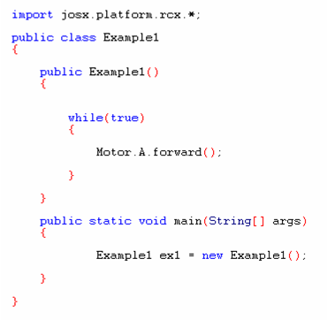
Basic MindStorms procedure
>> Build Lego
>> Write software code

Slide 7
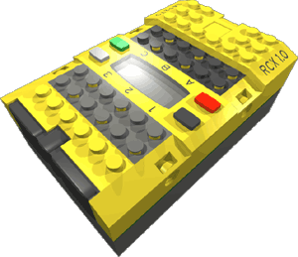
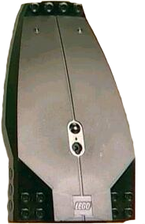
Basic MindStorms procedure
>> Build Lego
>> Write software code
>> Upload software

Slide 8
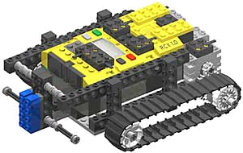
Basic MindStorms procedure
>> Build Lego
>> Write software code
>> Upload software
>> Run robot

Slide 9
Basic: Motor control
Rotate motor forward
Rotate motor backward
Change direction
Set motor power
Stop motor
Float motor

Slide 10
Basic: Sensor reading
Set sensor type (light, touch, rotation, raw)
Set sensor mode (boolean, percent, raw)
Activate / passivate
Read sensor value
Registering sensor listeners

Slide 11

Basic: Timing
Start timer
Stop timer
Set delay
Define timer action

Slide 12
Advanced: Robotic navigation
Where am I?
Timing navigation use of internal timer to determain position (calibration required) | Rotation navigation use rotation sensors to track movement and determain position | Sensory navigation sense environment to determain position

Slide 13

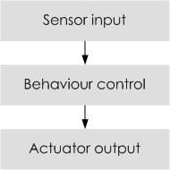
Advanced: Behavior Control
A very popular design pattern for small, limited memory, “insect”-level programming.
Defined by Rodney Brooks
(MIT Artificial Intelligence Lab)
To react fast to changes in the environment.
Inspired by insects
“Hard-wired” thinking

Slide 14

Advanced: Multithreading
To run multiple processes simultaneously:
very important in robotics!
Maximum 255 threads on RCX
Execution of threads

Slide 15
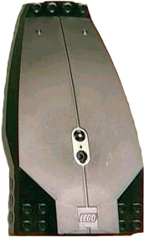
Advanced: Communication
Use of RCXPort
Sending + receiving data
Advantage: enables to run complex computations on PC
Disadvantage: disables autonomity

Slide 16
Introduction to workshop
>> What is special about this project?
>> Why this workshop?

Slide 17

Program for workshops
Wednesday:
>> Introduction to Lego Mindstorms and LeJos
>> Installing Intellejos
Thursday:
>> Basic LeJos concepts
>> Intellejos assignment 1
Friday:
>> Advances LeJos concepts
>> Intellejos assignment 2

Slide 18
Assignment
>> Install Java: http://java.sun.com
>> Install Lejos: http://lejos.sourceforge.net
>> Install Intellejos: http://kooijmans.nu/intellejos
>> Understand how to make a robot for Intellejos

