Slide 1


Slide 2
Introduction
Solving problems within the restrictions of Lego Mindstorms requires a sophisticated strategy, a lot of creativity and even more energy!
Some restrictions…
>> Limited toolbox
>> 16 Kb memory for software
>> Battery power
>> Low processing speed
>> Restricted JAVA API
… lead to opportunities!

Slide 3
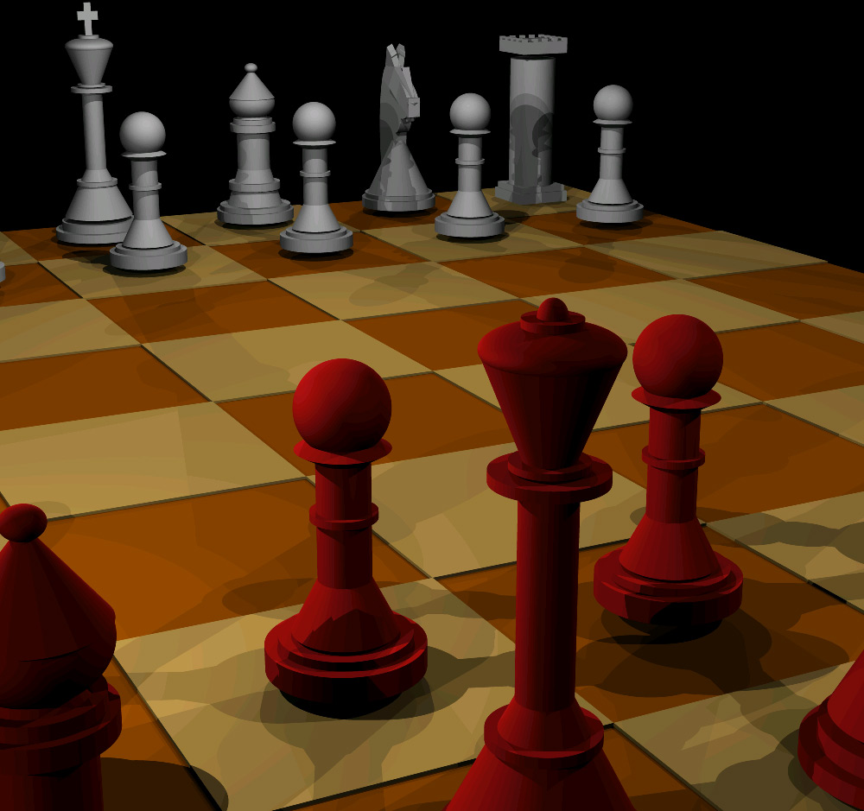
Problem strategy
Here you have most of your freedom. Be sure to use this!
Hardware strategy
Software strategy

Slide 4
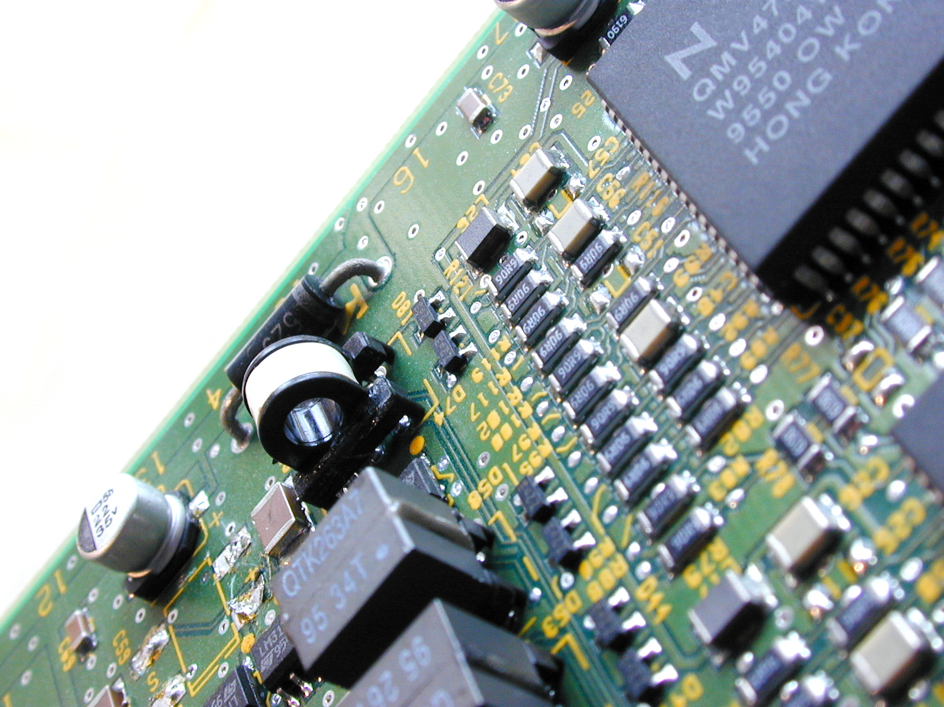
Problem strategy
Here you have most of your freedom. Be sure to use this!
Hardware strategy
Translate your game strategy into a hardware plan.
Software strategy

Slide 5
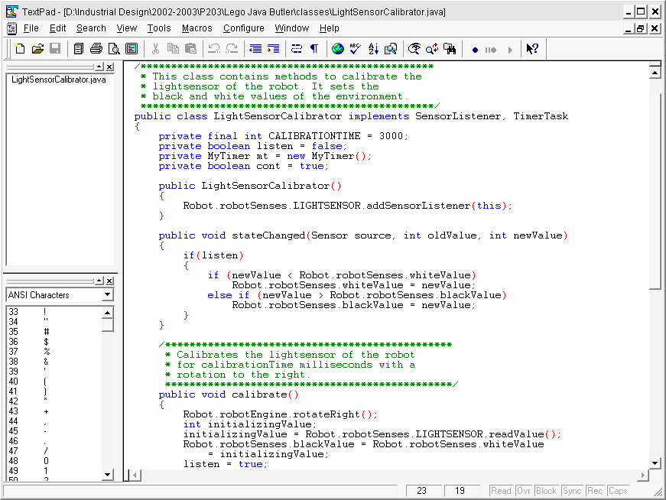
Problem strategy
Here you have most of your freedom. Be sure to use this!
Hardware strategy
Translate your game strategy into a hardware plan.
Software strategy
Model your classes to finish robot architecture (e.g. UML)

Slide 6
Programming strategies
Start with a plan!
Make a class-model to define the interconnections and relationships of different robot parts. Essential for both planning and task division!
UML specification language
(Unified Modeling Language)
Specific tool for OOP
UML example >>

Slide 7
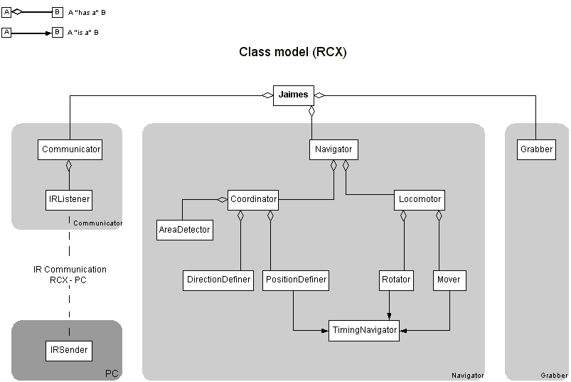

Slide 8
Programming strategies
Example of algorithmic strategy:
How to sort this list of numbers from small to big as fast as possible?
<89, 12, 45, 113, 4, 56, 32, 876, 16, 255>
Design patterns in Java
e.g. Event-driven programming
The use of design patterns in Java can increase the efficiency of your software significantly!
Design patterns example >>

Slide 9
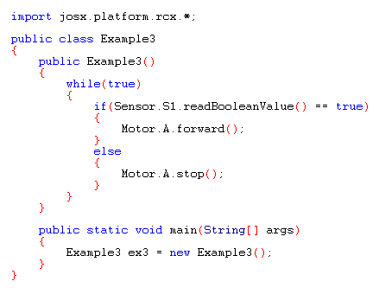
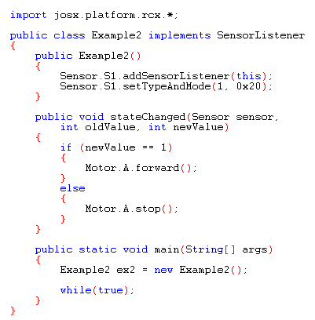
Sensor reading example

Slide 10
Sensor reading example
WARNING:
no perceptable difference
in small programs

Slide 11
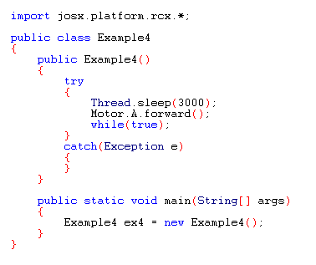
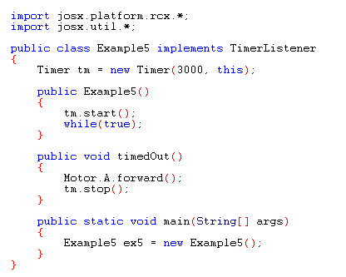
Timing example

Slide 12
Timing example
WARNING:
no perceptable difference
in small programs

Slide 13
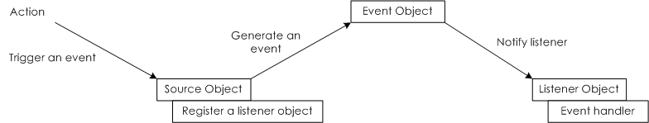

Programming strategy tips
>> Occupy the micro controller as little as possible! This delays timing and processing speed
>> Use the event-driven design pattern:
>> Go for multithreading by using the “Thread”-class or “Runnable”-interface

