Slide 1
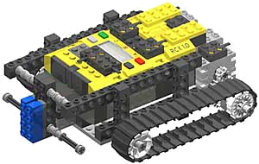
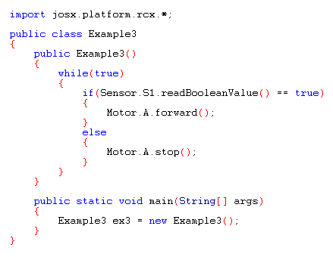

Slide 2
What is LeJos?
Lego Java Operating System
Enables to program RCX with Java
Recommended tools:
- Java editor: TextPad (www.textpad.com)
- Integrated Development Environment: Eclipse
(www.kooijmans.nu/mindstorms/getstarted.htm)

Slide 3
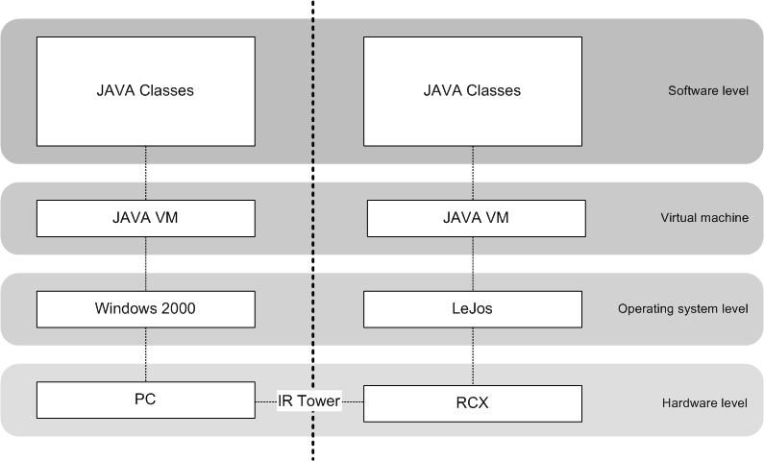
System architecture

Slide 4
The LeJOS API
Application Programming Interface
Collection of packages with classes and interfaces that can be used within your classes by using the “import”-statement.
e.g.: import josx.platform.rcx.*;
import josx.util.*;
API documentation
This is your programming guide and library. Learn to work with this documentation as soon as possible and use it during your software development.
Refer to Java book chapter 6.13 for Java API
View documentation >>

Slide 5
Inheritance
Reusing and extending a certain class in an adjusted form without rewriting it completely.
Superclass
Subclass
class Dier
{
int poten = 0;
void eten()
{
<<method body>>
}
}
class Mens extends Dier
{
int poten = 4; //overridden
int hersens = 3; //added
void lopen() //added
{
<<method body>>
}
}
New methods or instance variables can be added. Existing ones can be used or overrided.

Slide 6
Classes vs. Interfaces
Ways to model data
Class
Definition of properties and methods that are specific for a certain object.
(object = instance of Class)
Interface
An interface says: “This is how all classes that implement this interface look like”.
Provide a “protocol” between classes.
class Dier
{
int poten;
void eten()
{
<<method body>>
}
}
interface Dier
{
void eten(); // no body!
void slapen();
void bewegen();
}

Slide 7
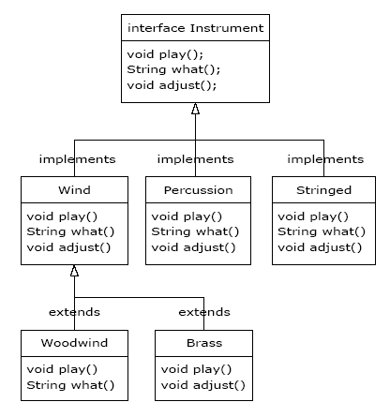
Interfaces examples

Slide 8
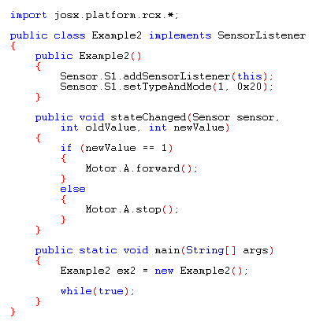
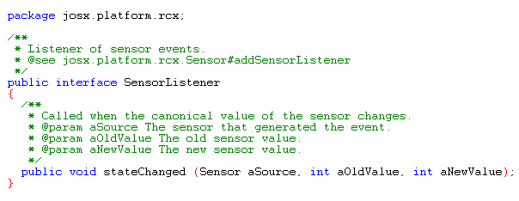
Interfaces examples

Slide 9
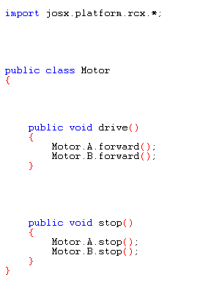
Encapsulation
Very useful to do efficient software development in a team.
How to encapsulate?

Slide 10
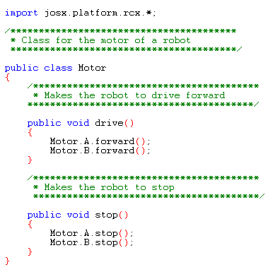
Encapsulation
Very useful to do efficient software development in a team.
How to encapsulate?
>> Document your code!

Slide 11
Encapsulation
Very useful to do efficient software development in a team.
How to encapsulate?
>> Document your code!
>> Use the javadoc program:
javadoc Motor.java
Now use the documentation instead of (sometimes hard to read) Java code to understand and use the class.

Slide 12
Practical Tips & Tricks
Sensors:
>> You can read different types of data from a sensor (boolean, raw, percentage).
>> You can use combinations of standard sensors to make new, powerful sensors.
e.g. a proximity sensor
Programming:
>> Work structured and prevent spaghetti code.
>> Divide programming tasks using class models (UML).
>> Good stealing is better then bad programming.
>> Learn the design patterns. (events, timers, threads, behavior,…)
>> Make plenty use of the API documentation.
>> Document your code thoroughly.

Slide 13
Practical Tips & Tricks
Debugging:
>> Use LCD and sound output for debugging.
>> Learn to check your code thoroughly before downloading it to the RCX to save a lot of time.
Some bottlenecks:
>> Experimenting is fun and very useful, but try not to waste too much time.
>> Assembling the different parts of robot software can take a lot of time.

