Slide 1
import josx.platform.rcx.*;
public class Example
{
public Example()
{
Motor.A.forward();
}
public static void main(String[] args)
{
Example e = new Example();
while(true);
}
}

Slide 2
LeJOS advantages and limitations
Advantages >> support for floating points >> trigonometry and advanced math | Limitations >> 255 threads >> 10 recursive iterations >> double numbers don’t work >> 12 kB memory for user programs >> no garbage collection

Slide 3
The LeJOS API
Application Programming Interface
Collection of packages with classes and interfaces that can be used within your classes by using the “import”-statement.
e.g.: import josx.platform.rcx.*;
import josx.util.*;
API documentation
This is your programming guide and library. Learn to work with this documentation as soon as possible and use it during your software development.
Refer to Java book chapter 6.13 for Java API
View documentation >>

Slide 4
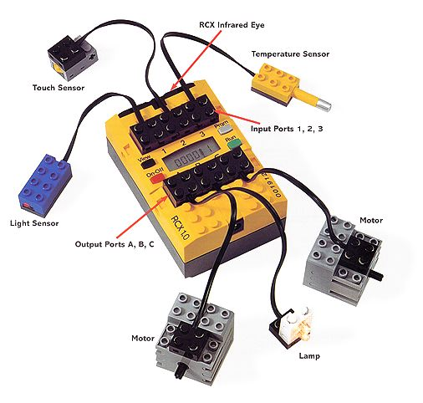
Basic: Motor control
Rotate motor forward
Rotate motor backward
Change direction
Set motor power*
Stop motor
Float motor*
* Not supported with Intellejos

Slide 5
import josx.platform.rcx.*;
public class Example
{
public Example()
{
Motor.C.setPower(7);
Motor.C.forward();
try
{
Thread.sleep(3000);
}
catch(Exception e) {}
Motor.C.stop();
}
public static void main(String[] args)
{
Example e = new Example();
try
{
Button.RUN.waitForPressAndRelease();
}
catch(Exception e) {}
System.exit(0);
}
}

Slide 6
Basic: Sensor reading
Set sensor type (light, touch, rotation, raw)
Set sensor mode (boolean, percent, raw)
Activate / passivate
Read sensor value
Registering sensor listeners

Slide 7
import josx.platform.rcx.*;
public class Example implements SensorConstants
{
public Example()
{
Sensor.S1.setTypeAndMode(SENSOR_TYPE_LIGHT, SENSOR_MODE_RAW)
Sensor.S1.activate();
while(true)
{
LCD.showNumber(Sensor.S1.readValue());
}
}
public static void main(String[] args)
{
Example e = new Example();
try
{
Button.RUN.waitForPressAndRelease();
}
catch(Exception e) {}
System.exit(0);
}
}

Slide 8
Sensor Listening
Action
Notify Listener Thread
Listener Thread
Register Listener
Call Listener
(user-defined) Sensor Object
(user-defined) Listener Object
(Implements SensorListener interface)

Slide 9
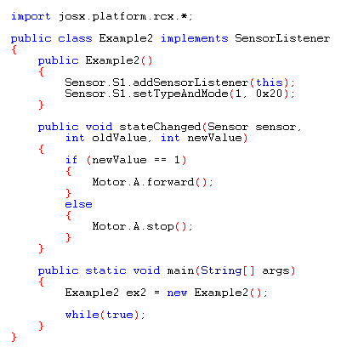
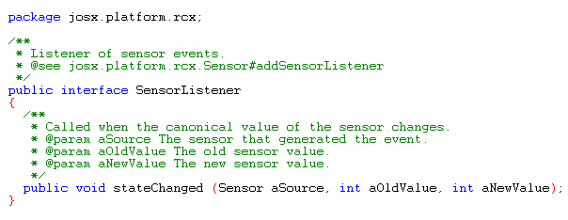
SensorListener interface

Slide 10

Basic: Timing
Start timer
Stop timer
Set delay
Define timer action

Slide 11
Timer Listening
Action
Notify Listener Thread
Listener Thread
Register Listener
Call Listener
(user-defined) Timer Object
(user-defined) Listener Object
(Implements TimerListener interface)

Slide 12
import lejos.platform.rcx.*;
import lejos.util.*;
public class Jojo implements TimerListener
{
public Jojo()
{
Motor.A.forward();
Motor.B.forward();
Timer t = new Timer(2000, this);
t.start();
}
public void timedOut()
{
Motor.A.reverseDirection();
Motor.B.reverseDirection();
}
public static void main(String[] args)
{
Jojo jj = new Jojo();
try
{
Button.RUN.waitForPressAndRelease();
}
catch(Exception e) {}
System.exit(0);
}
}

Slide 13
Errata online manuals
Compatibility issues:
>> Use Java2 SDK 1.4.* only
>> Use Eclipse 2.*.* only
Intellejos issues:
>> Add bin-directory of Java to path system-variable

Slide 14
Assignment
1. Use time to let an Intellejos robot drive a square in the Room world
2. Make an Intellejos robot that drives forward and changes direction when it hits the wall in the Room world.

