Slide 1
import josx.platform.rcx.*;
public class LineFollower extends Thread implements SensorConstants, SensorListener
{
private Sensor lineSensor;
private Motor leftMotor;
private Motor rightMotor;
private boolean active;
public LineFollower(Sensor aSensor, Motor aRightMotor, Motor aLeftMotor)
{
lineSensor = aSensor;
lineSensor.setTypeAndMode(SENSOR_TYPE_LIGHT, SENSOR_MODE_RAW);
lineSensor.activate();
lineSensor.addSensorListener(this);
rightMotor = aRightMotor;
leftMotor = aLeftMotor;
active = false;
}
public void stateChanged(Sensor aSensor, int oldValue, int newValue)
{
if (active)
{
if (newValue > 735) //dark
public void run()
{
lf = new LineFollower(LIGHTSENSOR1, Motor.C, Motor.A);
lf.start();
LIGHTSENSOR2.setTypeAndMode(SENSOR_TYPE_LIGHT, SENSOR_MODE_RAW);
LIGHTSENSOR2.activate();
LIGHTSENSOR2.addSensorListener(this);
LIGHTSENSOR1.addSensorListener(this);
Motor.A.setPower(7);
Motor.B.setPower(7);
Motor.C.setPower(7);
}
public void stateChanged(Sensor aSensor, int oldValue, int newValue)
{
if (read)
{
//detection of crossing
if (aSensor == LIGHTSENSOR2)
{
LCD.showNumber(newValue);
if (lf.isActive())
{
if (newValue > 735)
{
// crossing detected
lf.passivate();
Sound.beep();

Slide 2
Question
How would you make a robot follow a black line?

Slide 3
Robotic navigation
Where am I?
Timing navigation use of internal timer to determain position (calibration required) | Rotation navigation use rotation sensors to track movement and determain position | Sensory navigation sense environment to determain position

Slide 4

Timing navigation
A TimingNavigator object is included in the LeJos API
Constructor:
TimingNavigator (Motor right, Motor left,
float timeOneMeter, float timeRotate)
Methods:
backward()
forward()
stop()
rotate(float angle)
travel(int distance)
gotoAngle(float angle)
gotoPoint(float x, float y)
getAngle()
getX()
getY()

Slide 5
Timing navigation example
Problem:
TimingNavigator uses Thread.sleep() to time the robot movement. This will block all other processes in this thread.
import lejos.platform.rcx.*;
import lejos.robotics.*;
public class TimeNavi
{
public TimeNavi()
{
TimingNavigator tn = new
TimingNavigator(Motor.A, Motor.B, 4, 4);
tn.gotoAngle(180);
}
public static void main(String[] args)
{
TimeNavi jj = new TimeNavi();
}
}

Slide 6
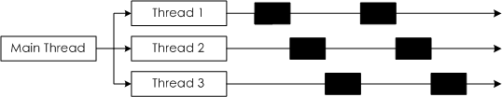
Advanced: Multithreading
To run multiple processes concurrently:
very important in robotics!
Maximum 255 threads on RCX
Execution of threads

Slide 7
Timing navigation with multithreating
public class Loader
{
public Loader()
{
TimeNavi t = new TimeNave();
t.start();
}
public static void main(String[] args)
{
Loader ld = new Loader();
}
}
import lejos.platform.rcx.*;
import lejos.robotics.*;
public class TimeNavi extends Thread
{
public void run()
{
TimingNavigator tn = new
TimingNavigator(Motor.A, Motor.B, 4, 4);
tn.gotoAngle(180);
}
}

Slide 8
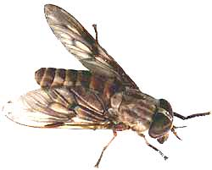
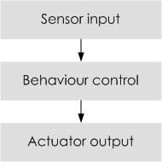
Behavior Control
A very popular design pattern for small, limited memory, “insect”-level programming.
Defined by Rodney Brooks
(MIT Artificial Intelligence Lab)
To react fast to changes in the environment.
Inspired by insects
“Hard-wired” thinking

Slide 9
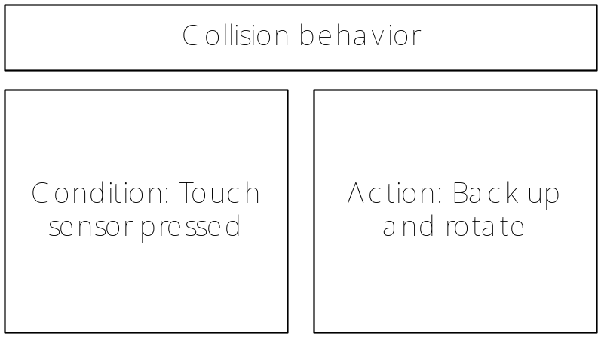
Behavior Theory
A behavior is a program the robot (or organism) follows for a period of time, caused by a certain observation.
Example:

Slide 10
Behavior Theory
Conditions, internal or external to the robot, can activate a behavior.
Behavior control concept = changing modes.
Building up several simple behaviors can theoretically form a complex logical model.
Example: Fire-Fighting Behavior Control
Condition | Behavior | Action | Priority
Temperature hotter in another area | Seak heat | Move toward heat | Low
Ultraviolet light sensor detects flame | Extinguish flames | Spay CO₂ | Medium
Temperature > 160° | Avoid flames | Move away from heat | Highest

Slide 11
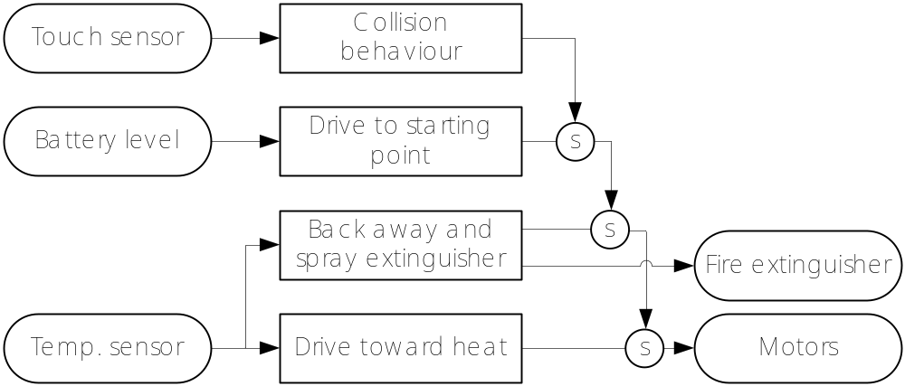
Behavior Theory
Sensors can be shared for determining conditions.
By setting priorities, the robot can determine which mode to break into, when more than one behavior will seek to be activated.
S = suppressed

Slide 12
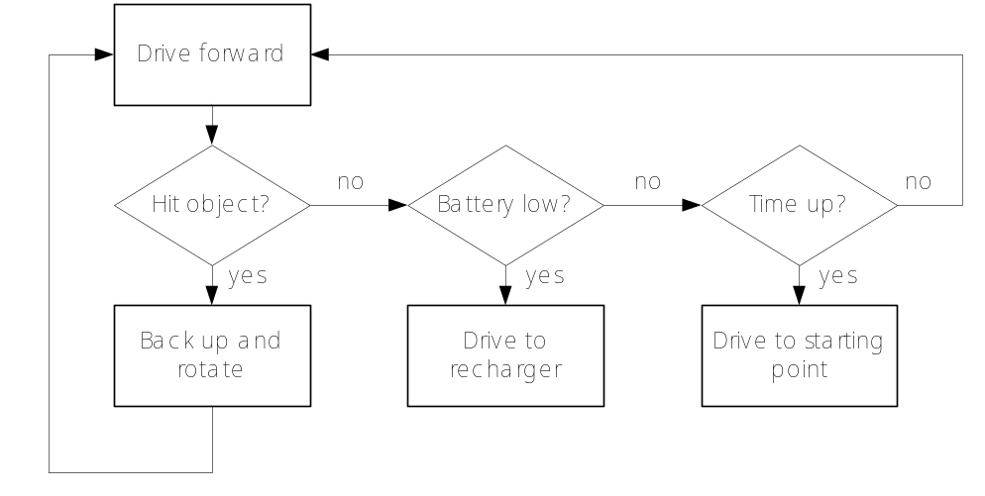
Programming Behavior with leJOS
Use diagrams to visualize behavior control model. This is required for structured programming.
Possible tools: State-transition diagrams and Petri-nets (assignment Interaction Design I)

Slide 13
Programming Behavior with leJOS
Documentation of the Behavior API can be found in the leJOS API documentation
The Behavior API
Behavior interface: implemented by a class that specifies a certain behavior
Arbitrator class: Arbitrator object regulates when each of the behaviors will become active
View documentation >>

Slide 14
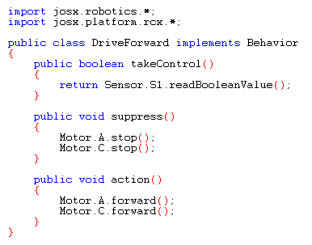
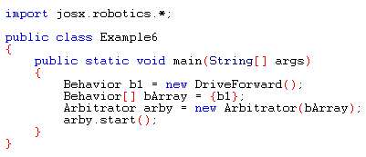
Behavior with leJOS design pattern

Slide 15
Assignment review
1. Let the robot drive a square
import lejos.platform.rcx.*;
import lejos.util.*;
public class Square implements TimerListener
{
public Square()
{
Motor.A.forward();
Motor.B.forward();
Timer t = new Timer(2700, this);
t.start();
}
public void timedOut()
{
Motor.B.reverseDirection();
}
public static void main(String[] args)
{
Square jj = new Square();
}
}

Slide 16
Assignment review
1. Let the robot drive a square
Problems with timing:
>> Need for calibration
>> Not very accurate after a while
import lejos.platform.rcx.*;
import lejos.util.*;
public class Square implements TimerListener
{
public Square()
{
Motor.A.forward();
Motor.B.forward();
Timer t = new Timer(2700, this);
t.start();
}
public void timedOut()
{
Motor.B.reverseDirection();
}
public static void main(String[] args)
{
Square jj = new Square();
}
}

Slide 17
Assignment review
2. Let the robot detect a wall
import lejos.platform.rcx.*;
import lejos.util.*;
public class Wallfinder implements SensorListener, SensorConstants
{
public Wallfinder ()
{
Sensor.S2.setTypeAndMode(SENSOR_TYPE_TOUCH, SENSOR_MODE_BOOL);
Sensor.S2.addSensorListener(this);
Motor.A.forward();
Motor.B.forward();
}
public void stateChanged(Sensor aSensor, int newValue, int oldValue)
{
if (newValue == 1)
{
Motor.A.backward();
Motor.B.backward();
}
}
public static void main(String[] args)
{
Wallfinder jj = new Wallfinder ();
}
}

Slide 18
Assignment review
2. Let the robot detect a wall
Advantage of sensing:
>> Robot is triggered at the exact moment
import lejos.platform.rcx.*;
import lejos.util.*;
public class Wallfinder implements SensorListener, SensorConstants
{
public Wallfinder ()
{
Sensor.S2.setTypeAndMode(SENSOR_TYPE_TOUCH, SENSOR_MODE_BOOL);
Sensor.S2.addSensorListener(this);
Motor.A.forward();
Motor.B.forward();
}
public void stateChanged(Sensor aSensor, int newValue, int oldValue)
{
if (newValue == 1)
{
Motor.A.backward();
Motor.B.backward();
}
}
public static void main(String[] args)
{
Wallfinder jj = new Wallfinder ();
}
}

Slide 19
Intellejos assignment
1. Use the TimingNavigator to follow the two crossings left-right in the Grid world
2. Use sensor reading to follow the line in the Grid world with an initial robot bearing of 10

Slide 20
Presentations
are available at www.kooijmans.nu/mindstorms

