Slide 1

Apache Calcite Overview
Julian Hyde
Julian Hyde
Kylin Meetup (eBay, San Jose)
December 4th, 2014

Slide 2
Apache Calcite
Apache incubator project since May, 2014
Originally named Optiq
Query planning framework
Relational algebra, rewrite rules, cost model
Extensible
Packaging
Library (JDBC server optional)
Community-authored rules, adapters
Adoption
Embedded: Lingual (SQL interface to Cascading), Apache Drill, Apache Hive, Apache Kylin
Adapters: Splunk, Spark, MongoDB, JDBC, CSV, JSON, Web tables, In-memory, Phoenix

Slide 3
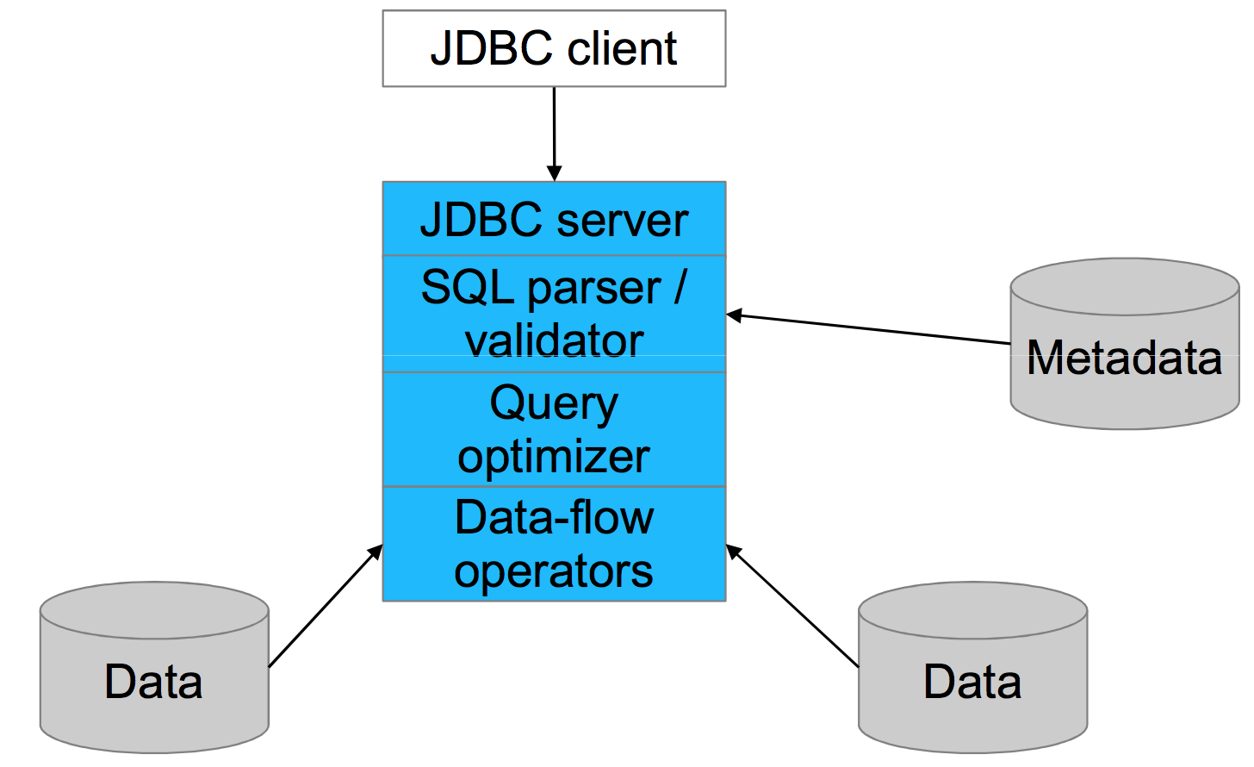
Conventional DB architecture

Slide 4
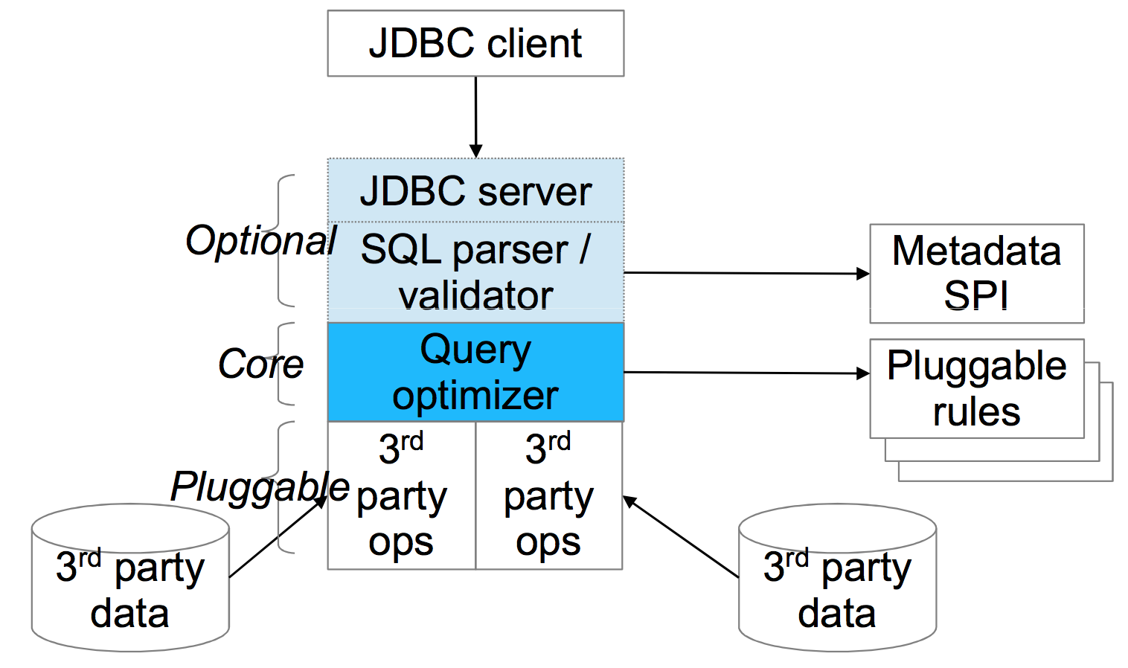
Calcite architecture

Slide 5
Expression tree
SELECT p.“product_name”, COUNT(*) AS c FROM “splunk”.”splunk” AS s JOIN “mysql”.”products” AS p ON s.”product_id” = p.”product_id” WHERE s.“action” = 'purchase' GROUP BY p.”product_name” ORDER BY c DESC
Splunk
Table: splunk
Key: product_name Agg: count
Key: product_id
Condition: action = 'purchase'
Key: c DESC
scan
join
MySQL
filter
group
sort
scan
Table: products
Notes:
It's much more efficient if we psuh filters and aggregations to Splunk. But the user writing SQL shouldn't have to worry about that.
This is not about processing data. This is about processing expressions. Reformulating the question.
The question is the parse tree of a query. The parse tree is a data flow. In Splunk, a data flow looks like a pipeline of Linux commands. SQL systems have pipelines too (sometimes they are dataflow trees) built up of the basic relational operators. Think of the SQL SELECT, WHERE, JOIN, GROUP BY, ORDER BY clauses.

Slide 6
Expression tree (optimized)
SELECT p.“product_name”, COUNT(*) AS c FROM “splunk”.”splunk” AS s JOIN “mysql”.”products” AS p ON s.”product_id” = p.”product_id” WHERE s.“action” = 'purchase' GROUP BY p.”product_name” ORDER BY c DESC
Splunk
Table: splunk
Condition: action = 'purchase'
Key: product_name Agg: count
Key: c DESC
scan
filter
Key: product_id
MySQL
join
group
sort
scan
Table: products
Notes:
It's much more efficient if we psuh filters and aggregations to Splunk. But the user writing SQL shouldn't have to worry about that.
This is not about processing data. This is about processing expressions. Reformulating the question.
The question is the parse tree of a query. The parse tree is a data flow. In Splunk, a data flow looks like a pipeline of Linux commands. SQL systems have pipelines too (sometimes they are dataflow trees) built up of the basic relational operators. Think of the SQL SELECT, WHERE, JOIN, GROUP BY, ORDER BY clauses.

Slide 7
Defining a rule
class FilterIntoJoinRule extends RelOptRule { public FilterIntoJoinRule() { super( operand(Filter.class, operand(Join.class, any()))); } public void onMatch(RelOptRuleCall call) { Filter filter = call.rel(0); Join join = call.rel(1);
Filter newFilter = ...; Join newJoin = ...; call.transformTo(newJoin); } }
Filter
Join’
Join
Filter’
R1
R2
R1
R2

Slide 8
Calcite – APIs and SPIs
Relational algebra
RelNode (operator) Scan Filter Project Union Aggregate … RelDataType (type) RexNode (expression) RelTrait (physical property) RelConvention (calling-convention) RelCollation (sortedness) TBD (bucketedness/distribution)
Transformation rules
RelOptRule MergeFilterRule PushAggregateThroughUnionRule RemoveCorrelationForScalarProjectRule 100+ more Unification (materialized view) Column trimming
SQL parser
SqlNode SqlParser SqlValidator
Metadata
Schema Table Function TableFunction TableMacro
Cost, statistics
RelOptCost RelOptCostFactory RelMetadataProvider RelMdColumnUniquensss RelMdDistinctRowCount RelMdSelectivity
JDBC driver

Slide 9

Thank you!
@julianhyde
http://calcite.incubator.apache.org/

