Slide 1

Cost-based query optimization in Apache Hive 0.14
Julian Hyde
Julian Hyde
Seattle
September 24th, 2014

Slide 2
About me
Julian Hyde
Architect at Hortonworks
Open source:
Founder & lead, Apache Optiq (query optimization framework)
Founder & lead, Pentaho Mondrian (analysis engine)
Committer, Apache Drill
Contributor, Apache Hive
Contributor, Cascading Lingual (SQL interface to Cascading)
Past:
SQLstream (streaming SQL)
Broadbase (data warehouse)
Oracle (SQL kernel development)

Slide 3








Hadoop - A New Data Architecture for New Data
Traditional Data Architecture
OLTP, ERP, CRM Systems
New Data Requirements:
Scale
Economics
Flexibility
APPLICATIONS
Business Analytics
Unstructured documents, emails
Custom Applications
Packaged Applications
Server logs
DATA SYSTEM
Sentiment, Web Data
REPOSITORIES
RDBMS
EDW
MPP
Sensor. Machine Data
Geolocation
SOURCES
Existing Sources (CRM, ERP, Clickstream, Logs)
Clickstream
Notes:
On the left is the old data architecture
On the right are new sources that produce high volume and variety of data
Storing this data requires a new architecture that can
1. scale to petabytes
2. where it is economic to put this volume of data, the $/TB < value generated
3a. provides flexibility in types of data
3b. and flexibility in having new tools for new data problems in the same ecosystem

Slide 4


Interactive SQL-IN-Hadoop Delivered
HDP 2.1
Data Access
Governance & Integration
Security
Operations
Data Management
Stinger Initiative – DELIVERED Next generation SQL based interactive query in Hadoop
Business Analytics
Custom
Apps
Window
Functions
Stinger Project
SQL
Apache Hive
Stinger Phase 1:
Base Optimizations
SQL Types
SQL Analytic Functions
ORCFile Modern File Format
Apache MapReduce
Apache Tez
Speed Improve Hive query performance has increased by 100X to allow for interactive query times (seconds)
Apache YARN
Stinger Phase 2:
SQL Types
SQL Analytic Functions
Advanced Optimizations
Performance Boosts via YARN
Delivered
Scale
The only SQL interface to Hadoop designed for queries that scale from TB to PB
ORC File
HDFS (Hadoop Distributed File System)
1
°
°
°
°
SQL
Support broadest range of SQL semantics for analytic applications running against Hadoop
°
°
°
°
°
Stinger Phase 3
Hive on Apache Tez
Query Service (always on)
Buffer Cache
Cost Based Optimizer (Optiq)
°
°
°
°
N
Apache Hive Contribution… an Open Community at its finest
1,672
145
44
~390,000
13
Jira Tickets Closed
Developers
Companies
Lines Of Code Added… (2x)
Months

Slide 5


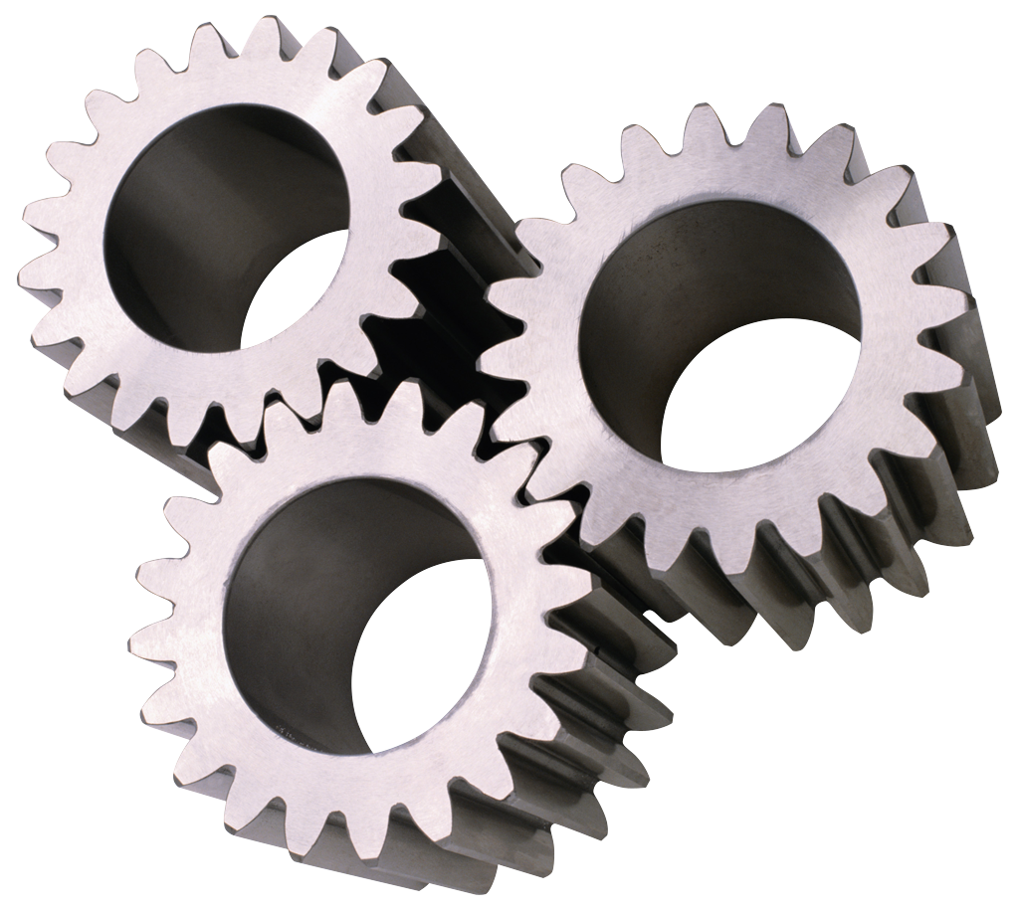


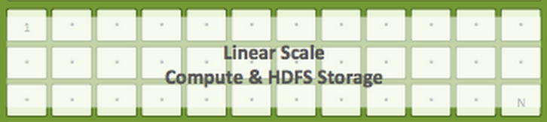
Hive – Single tool for all SQL use cases
Interactive
Analytics
Batch Reports /
Deep Analytics
ETL / ELT
OLTP, ERP, CRM Systems
Unstructured documents, emails
Server logs
Sentiment, Web Data
Hive - SQL
Sensor. Machine Data
Geolocation
Clickstream

Slide 6
Incremental cutover to cost-based optimization
Release | Date | Remarks
Apache Hive 0.12 | October 2013 | Rule-based Optimizations No join reordering Main optimizations: predicate push-down & partition pruning Semantic info and operator tree tightly coupled
Apache Hive 0.13 | April 2014 | “Old-style” JOIN & push-down conditions: … FROM t1, t2 WHERE …
HDP 2.1 | April 2014 | Cost-based ordering of joins
Apache Hive 0.14 | soon | Bushy joins, large joins, better operator coverage, better statistics, …

Slide 7

Apache Optiq (incubating)

Slide 8
Apache Optiq
Apache incubator project since May, 2014
Query planning framework
Relational algebra, rewrite rules, cost model
Extensible
Usable standalone (JDBC) or embedded
Adoption
Lingual – SQL interface to Cascading
Apache Drill
Apache Hive
Adapters: Splunk, Spark, MongoDB, JDBC, CSV, JSON, Web tables, In-memory data

Slide 9
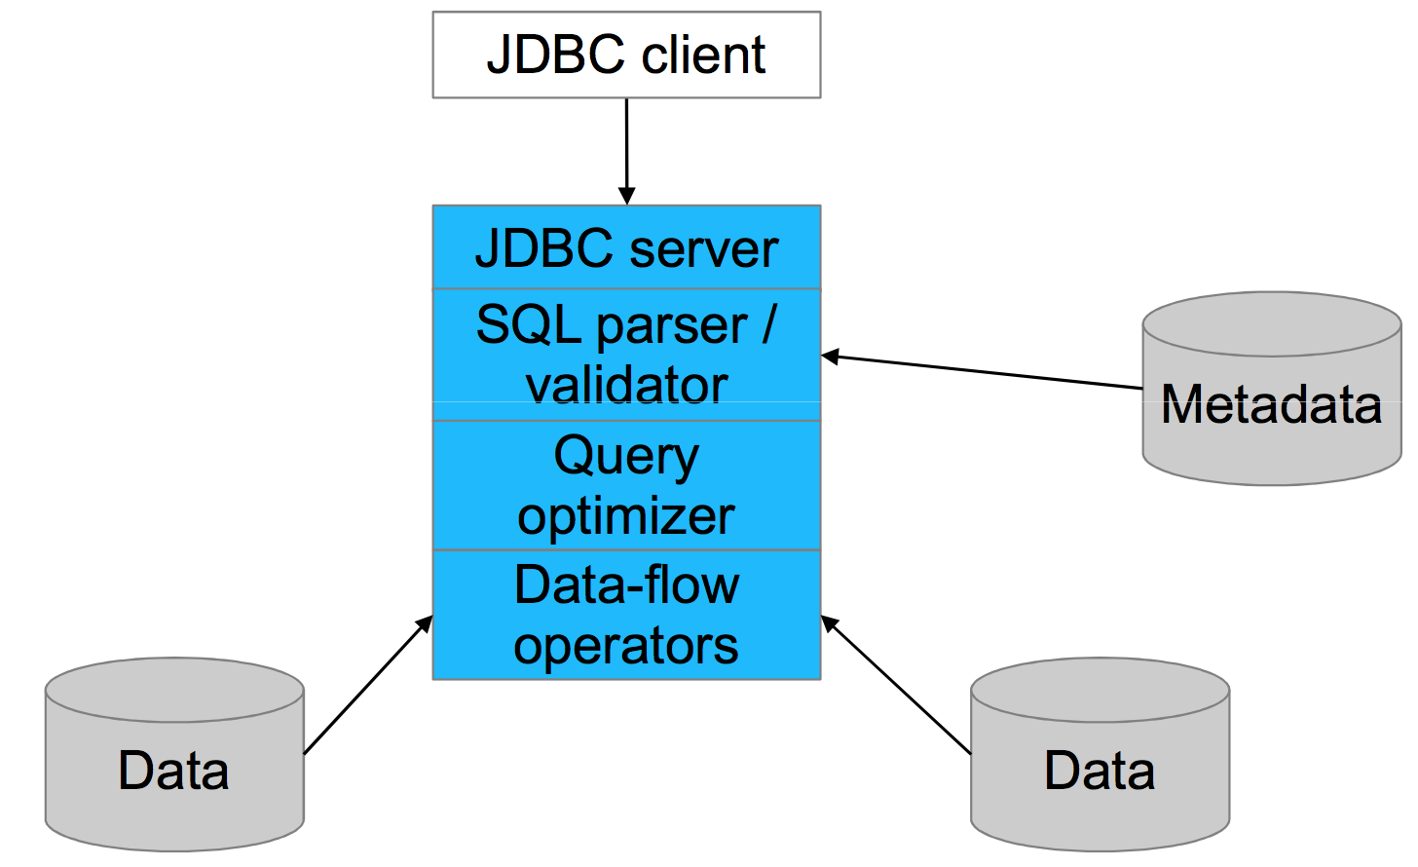
Conventional DB architecture

Slide 10
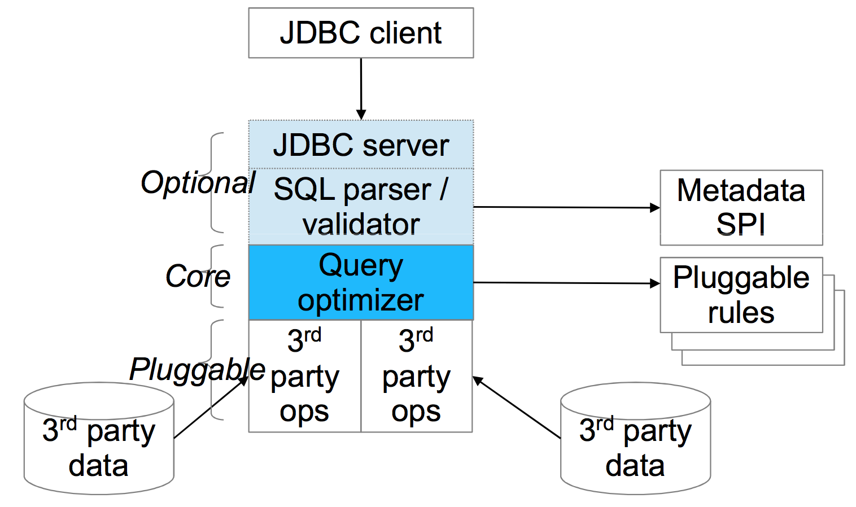
Optiq architecture

Slide 11
Expression tree
SELECT p.“product_name”, COUNT(*) AS c FROM “splunk”.”splunk” AS s JOIN “mysql”.”products” AS p ON s.”product_id” = p.”product_id” WHERE s.“action” = 'purchase' GROUP BY p.”product_name” ORDER BY c DESC
Splunk
Table: splunk
Key: product_name Agg: count
Key: product_id
Condition: action = 'purchase'
Key: c DESC
scan
join
MySQL
filter
group
sort
scan
Table: products
Notes:
It's much more efficient if we psuh filters and aggregations to Splunk. But the user writing SQL shouldn't have to worry about that.
This is not about processing data. This is about processing expressions. Reformulating the question.
The question is the parse tree of a query. The parse tree is a data flow. In Splunk, a data flow looks like a pipeline of Linux commands. SQL systems have pipelines too (sometimes they are dataflow trees) built up of the basic relational operators. Think of the SQL SELECT, WHERE, JOIN, GROUP BY, ORDER BY clauses.

Slide 12
Expression tree (optimized)
SELECT p.“product_name”, COUNT(*) AS c FROM “splunk”.”splunk” AS s JOIN “mysql”.”products” AS p ON s.”product_id” = p.”product_id” WHERE s.“action” = 'purchase' GROUP BY p.”product_name” ORDER BY c DESC
Splunk
Table: splunk
Condition: action = 'purchase'
Key: product_name Agg: count
Key: c DESC
scan
filter
Key: product_id
MySQL
join
group
sort
scan
Table: products
Notes:
It's much more efficient if we psuh filters and aggregations to Splunk. But the user writing SQL shouldn't have to worry about that.
This is not about processing data. This is about processing expressions. Reformulating the question.
The question is the parse tree of a query. The parse tree is a data flow. In Splunk, a data flow looks like a pipeline of Linux commands. SQL systems have pipelines too (sometimes they are dataflow trees) built up of the basic relational operators. Think of the SQL SELECT, WHERE, JOIN, GROUP BY, ORDER BY clauses.

Slide 13
Optiq – APIs and SPIs
Relational algebra
RelNode (operator) TableScan Filter Project Union Aggregate … RelDataType (type) RexNode (expression) RelTrait (physical property) RelConvention (calling-convention) RelCollation (sortedness) TBD (bucketedness/distribution)
Transformation rules
RelOptRule MergeFilterRule PushAggregateThroughUnionRule RemoveCorrelationForScalarProjectRule 100+ more Unification (materialized view) Column trimming
SQL parser
SqlNode SqlParser SqlValidator
Metadata
Schema Table Function TableFunction TableMacro
Cost, statistics
RelOptCost RelOptCostFactory RelMetadataProvider RelMdColumnUniquensss RelMdDistinctRowCount RelMdSelectivity
JDBC driver

Slide 14
Under development in Optiq - materialized views
Query: SELECT x, SUM(y) FROM t GROUP BY x
In-memory materialized
queries
Tables on disk
http://hortonworks.com/blog/dmmq/

Slide 15

Now… back to Hive

Slide 16
CBO in Hive
Why cost-based optimization?
Ease of Use – Join Reordering
View Chaining
Ad hoc queries involving multiple views
Enables BI Tools as front ends to Hive
More efficient & maintainable query preparation process
Laying the groundwork for deeper optimizations, e.g. materialized views

Slide 17
Query preparation – Hive 0.13
Annotated
AST
SQL parser
Semantic analyzer
Logical Optimizer
Physical Optimizer
Tez
Hive SQL
Abstract Syntax Tree (AST)
Plan
Tuned Plan

Slide 18
Query preparation – full CBO
Annotated
AST
SQL parser
Semantic analyzer
Translate to algebra
Physical Optimizer
Tez
Hive SQL
Abstract Syntax Tree (AST)
Optiq optimizer
Tuned Plan
RelNode

Slide 19
Query preparation – Hive 0.14
SQL parser
Semantic analyzer
Logical Optimizer
Physical Optimizer
Tez
Translate to algebra
Hive SQL
Tuned Plan
Optiq optimizer
AST with optimized join-ordering

Slide 20
Query Execution – The basics
π
SELECT R1.x
FROM R1
JOIN R2 ON R1.x = R2.x
JOIN R3 on R1.x = R3.x AND R2.x = R3.x WHERE R1.z > 10;
σ
⋈
R3
⋈
R1
R2
TS [R1]
RS
Shuffle Join
Map Join
Filter
FS
TS [R2]
RS
TS [R3]

Slide 21
Optiq Planner Process
Hive Op → RelNode
Hive Expr → RexNode
Add Rule matches to Queue
Apply Rule match transformations to Plan Graph
Iterate for fixed iterations or until Cost doesn’t change.
Match importance based on Cost of RelNode and height.
Planner
Hive Plan
RelNode Graph
RelNode Converter
RexNode Converter
Rule Match Queue
2. Rules
1. Plan Graph
4. Metadata Providers
Logical Plan
Physical traits: Table Part./Buckets; RedSink Ops removed
Rule: specifies a Operator sub-graph to match and logic to generate equivalent ‘better’ sub-graph.
We only have Join Reordering Rules.
Node for each node in Input Plan
Each node is a Set of alternate Sub Plans
Set further divided into Subsets: based on traits like sortedness
Used to Plugin Schema, Cost Formulas: Selectivity, NDV calculations etc.
We only added Selectivity and NDV formulas; Schema is only available at the Node level
Best
RelNode Graph
3. Cost Model
Revised AST
RelNodes have Cost (& Cumulative Cost)
We only use Cardinality for Cost.
AST Converter
Notes:
0. Converters convert a Hive Op. Graph to an Optiq representation. In Optiq we have RelNodes and RexNodes in place of Operators and ExprNodes.
The conversion creates a ‘Logical’ plan. RedSinks are dropped; Physical traits like Partitioning/Bucketness is lost.
The Plan Graph is the central data structure of the Planner. There is a Node for each Node in the input Plan. A Node represents a Set of equivalent Sub Graphs(Plans). Each Set is further divided into Subsets based on traits: traits capture physical attributes like sortedness/bucketness
Rules comprise of a Match Graph Template and an onMatch action. Action generates a ‘better’ equivalent Plan. So Rule match actions populates Plan Graph Sets.
Metadata Providers provide all Metadata information to the Planner: Schema, but also Cost Formulas like Selectivity and NDV calculations.
RelNodes have Cost. The Cost model encapsulates Cost calculations.
Rule Match Queue is a Queue of Rule Matches. Planner runs until the Queue is empty for a fixed number of iterations. The application of a RuleMatch adds to the Plan Graph and also adds new Rule Matches to the Queue. RuleMatches are ordered based on importance: which is based on RelNode cost and distance of Node in Plan from Root.

Slide 22
Star schema
Sales
Inventory
Time
Customer
Warehouse
Product
Key
Fact table Dimension table
Many-to-one relationship

Slide 23
Query combining two stars
SELECT product.id, sum(sales.units), sum(inventory.on_hand) FROM sales ON … JOIN customer ON … JOIN time ON … JOIN product ON … JOIN inventory ON … JOIN warehouse ON … WHERE time.year = 2014 AND time.quarter = ‘Q1’ AND product.color = ‘Red’ AND warehouse.state = ‘WA’ GROUP BY …
_{Customer}
_{Sales}
_{Time}
_{Inventory}
_{Warehouse}
_{Product}

Slide 24
Left-deep tree
Initial tree is “left-deep”
No join node is the right child of its parent
Join-ordering algorithm chooses what order to join tables – does not re-shape the tree
Typical plan:
Start with largest table at bottom left
Join tables with more selective conditions first
Warehouse
Inventory
Product
Time
Sales
Customer

Slide 25
Bushy tree
No restrictions on where join nodes can occur
“Bushes” consist of fact tables (Sales and Inventory) surrounded by many-to-one related dimension tables
Dimension tables have a filtering effect
This tree produces the same result as previous plan but is more efficient
Product
Inventory
Warehouse
Time
Sales
Customer

Slide 26
Two approaches to join optimization
Algorithm #1 “exhaustive search”
Apply 3 transformation rules exhaustively:
SwapJoinRule: A join B → B join A
PushJoinThroughJoinRule: (A join B) join C → (A join C) join B
CommutativeJoinRule: (A join B) join C → A join (B join C)
Finds every possible plan, but not practical for more than ~8 joins
Algorithm #2 “greedy”
Build a graph iteratively
Use heuristics to choose the “best” node to add next
Applying them to Hive
We can use both algorithms – and we do!
Both are sensitive to bad statistics – e.g. poor estimation of intermediate result set sizes

Slide 27
Statistics
Feeding the beast
CBO disabled if your tables don’t have statistics
No longer require statistics on all columns, just join columns
Better optimizations need ever-better statistics… so, statistics are getting better
Kinds of statistics
Raw statistics on stored data: row counts, number-of-distinct-values (NDV)
Statistics on intermediate operators, computed using selectivity estimates
Much improved selectivity estimates this release, based on NDVs
Planned improvements to raw statistics (e.g. histograms, unique keys, sort order) will help
Materialized views
Run-time statistics
Example 1: 90% of the rows in this join have the same key → use skew join
Example 2: Only 10 distinct values of GROUP BY key → auto-reduce parallelism

Slide 28
Stored statistics – recent improvements
ANALYZE
Clean up command syntax
Faster computation
Table vs partition statistics
All statistics now stored per partition
Statistics retrieval
Faster retrieval
Merge partition statistics
Extrapolate for missing statistics
Extrapolation
SQL:
SELECT productId, COUNT(*)
FROM Sales
WHERE year = 2014
GROUP BY productId
Required statistic: NDV(productId)
Extrapolate
{Q1, Q2, Q3}
stats for Q4
Used in query
2013 Q1
2013 Q2
2013 Q3
2013 Q4
2014 Q1
2014 Q2
2014 Q3
2014 Q4
Statistics available

Slide 29
Dynamic partition pruning
Consider a query with a partitioned fact table, filters on the dimension table:
SELECT … FROM Sales JOIN Time ON Sales.time_id = Time.time_id WHERE time.year = 2014 AND time.quarter IN (‘Q1’, ‘Q2’)
At execute time, DAG figures out which partitions could possibly match, and cancels scans of the others
Time
2013 Q1
2013 Q2
2013 Q3
2013 Q4
2014 Q1
2014 Q2
2014 Q3
2014 Q4

Slide 30
Summary
Join-ordering: (exhaustive & heuristic), scalability, bushy joins
Statistics – faster, better, extrapolate if stats missing
Very few operators that CBO can’t handle – TABLESAMPLE, SCRIPT, multi-INSERT
Dynamic partition pruning
Auto-reduce parallelism

Slide 31
Show me the numbers…

Slide 32
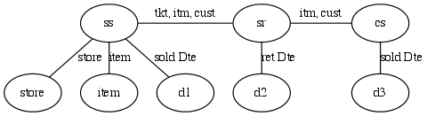
TPC-DS (30TB) Q17
SELECT i_item_id
,i_item_desc
,s_state
,count(ss_quantity) as store_sales_quantitycount
,….
FROM store_sales ss ,store_returns sr, catalog_sales cs, date_dim d1, date_dim d2, date_dim d3, store s, item I
WHERE d1.d_quarter_name = '2000Q1’ AND d1.d_date_sk = ss.ss_sold_date_sk AND i.i_item_sk = ss.ss_item_sk AND … GROUP BY i_item_id ,i_item_desc, ,s_state
ORDER BY i_item_id ,i_item_desc, s_state
LIMIT 100;
Joins Store Sales, Store Returns and Catalog Sales fact tables.
Each of the fact tables are independently restricted by time.
Analysis at Item and Store grain, so these dimensions are also joined in.
As specified Query starts by joining the 3 Fact tables.
CBO | Elapsed (s) | Intemediate data (GB)
Off | 10,683 | 5,017
On | 1,284 | 275

Slide 33
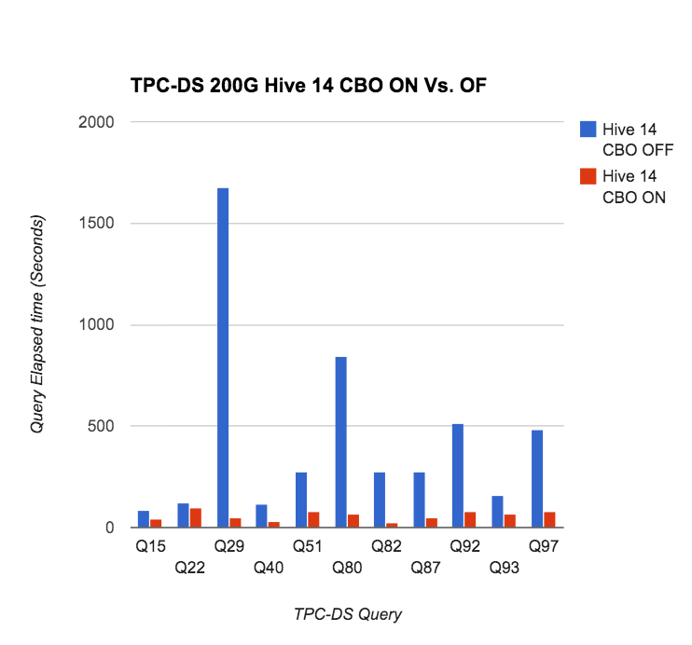
TPC-DS (200G) queries
Query | Hive 14 CBO off | Hive 14 CBO on | Gain
Q15 | 84 | 44 | 91%
Q22 | 123 | 99 | 24%
Q29 | 1677 | 48 | 3,394%
Q40 | 118 | 29 | 307%
Q51 | 276 | 80 | 245%
Q80 | 842 | 70 | 1,103%
Q82 | 278 | 23 | 1,109%
Q87 | 275 | 51 | 439%
Q92 | 511 | 80 | 539%
Q93 | 160 | 69 | 132%
Q97 | 483 | 79 | 511%

Slide 34
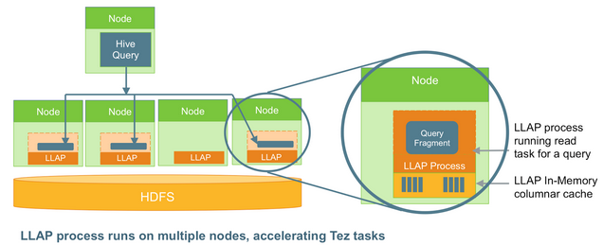
Stinger.next
SQL compliance: interval data type, non-equi joins, set operators, more sub-queries
Transactions: COMMIT, savepoint, rollback)
LLAP
Materialized views
In-memory
Automatic or manual
http://hortonworks.com/blog/stinger-next-enterprise-sql-hadoop-scale-apache-hive/

Slide 35

Thank you!
@julianhyde
http://hive.apache.org/
http://optiq.incubator.apache.org/

