Slide 1

Cost-based query optimization in Apache Hive
Julian Hyde
Julian Hyde
June 4th, 2014

Slide 2
About me
Julian Hyde
Architect at Hortonworks
Open source:
Founder & lead, Apache Optiq (query optimization framework)
Founder & lead, Pentaho Mondrian (analysis engine)
Committer, Apache Drill
Contributor, Apache Hive
Contributor, Cascading Lingual (SQL interface to Cascading)
Past:
SQLstream (streaming SQL)
Broadbase (data warehouse)
Oracle (SQL kernel development)

Slide 3
(Thanks to John Pullokkaran, Harish Butani for presentation content and actually doing the work.)

Slide 4

Apache Hive
The original “SQL on Hadoop”
Undergoing extensive renovation
Tez execution engine
YARN execution environment
Vectorized data representation
Column-oriented data storage (ORC)
ACID transactions
SQL standards compliance
SQL authorization model
Cost-based query optimization (CBO)
“Stinger
Initiative”
What? Why? How? When?
Notes:
Hive CBO didn’t quite make it into Apache Hive 0.13.
This talk: What is CBO? Why are we putting it in Hive? How did we do it? When is it released? And what next?

Slide 5
Incremental cutover to cost-based optimization
Release | Date | Remarks
Apache Hive 0.12 | October 2013 | Rule-based Optimizations No join reordering Main optimizations: predicate push-down & partition pruning Semantic info and operator tree tightly coupled
Apache Hive 0.13 | April 2014 | “Old-style” JOIN & push-down conditions: … FROM t1, t2 WHERE … CBO just missed the deadline ☹
HDP 2.1 | April 2014 | Cost-based ordering of joins HIVE-6439 “Introduce CBO step in Semantic Analyzer” HIVE-5775 “Introduce Cost Based Optimizer in Hive”
Apache Hive 0.14 | ? | CBO patches More rework of internals More cost-based features…

Slide 6

Apache Optiq (incubating)

Slide 7
Apache Optiq
Apache incubator project since May, 2014
Query planning framework
Extensible
Usable standalone (JDBC) or embedded
Adoption
Lingual – SQL interface to Cascading
Apache Drill
Apache Hive
Adapters: Splunk, Spark, MongoDB, JDBC, CSV, Web tables, In-memory data

Slide 8
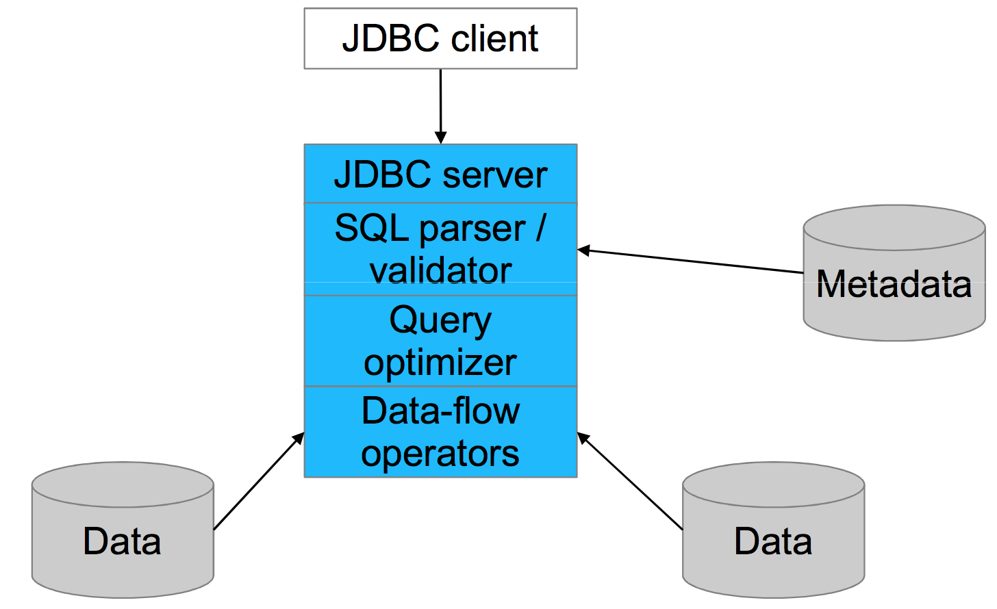
Conventional DB architecture

Slide 9
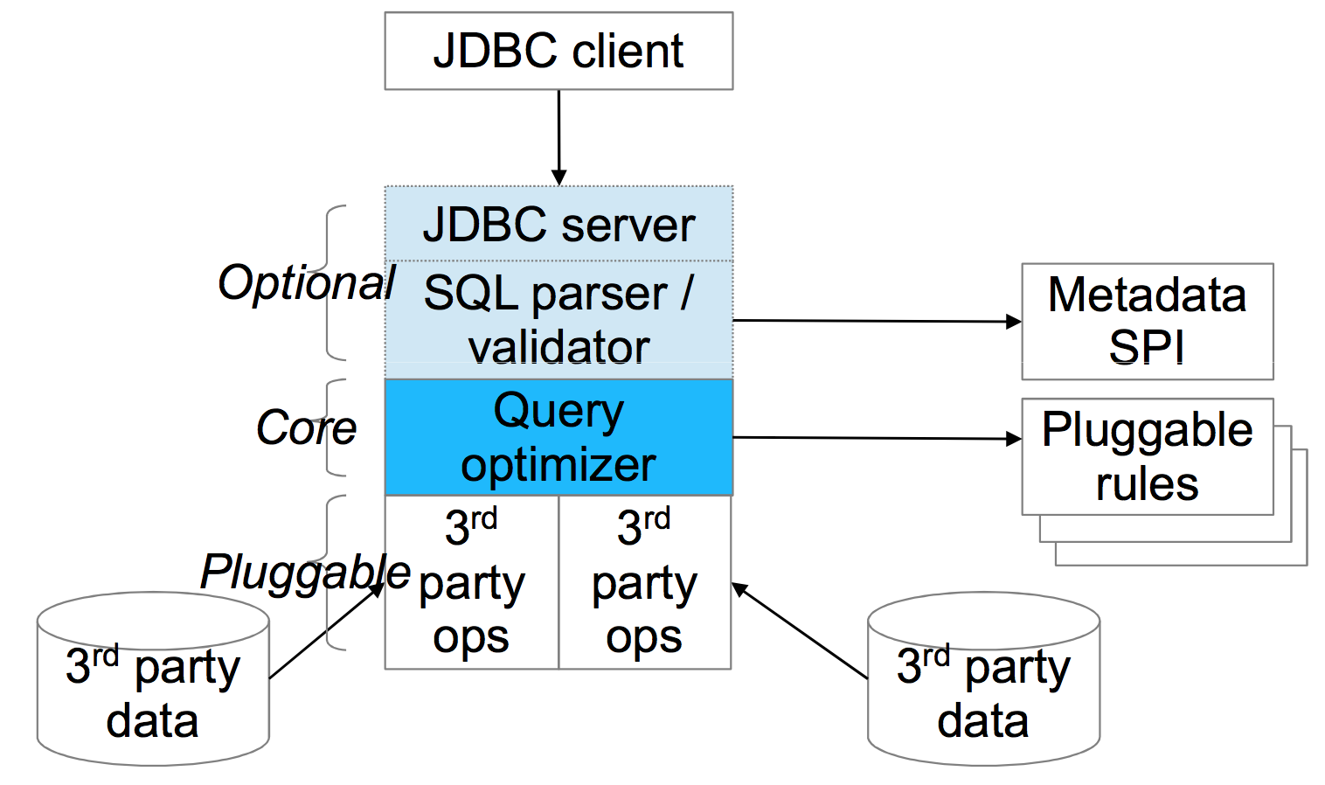
Optiq architecture

Slide 10
Optiq – APIs and SPIs
Relational algebra
RelNode (operator) TableScan Filter Project Union Aggregate … RelDataType (type) RexNode (expression) RelTrait (physical property) RelConvention (calling-convention) RelCollation (sortedness) TBD (bucketedness/distribution)
Transformation rules
RelOptRule MergeFilterRule PushAggregateThroughUnionRule RemoveCorrelationForScalarProjectRule 100+ more Unification (materialized view) Column trimming
SQL parser
SqlNode SqlParser SqlValidator
Metadata
Schema Table Function TableFunction TableMacro
Cost, statistics
RelOptCost RelOptCostFactory RelMetadataProvider RelMdColumnUniquensss RelMdDistinctRowCount RelMdSelectivity
JDBC driver

Slide 11

Now… back to Hive

Slide 12
CBO in Hive
Why cost-based optimization?
Ease of Use – Join Reordering
View Chaining
Ad hoc queries involving multiple views
Enables BI Tools as front ends to Hive
First version
Modest goal
Concrete results
Join re-ordering

Slide 13
Query preparation – Hive 0.13
Annotated
AST
SQL parser
Semantic analyzer
Logical Optimizer
Physical Optimizer
Tez
Hive SQL
Abstract Syntax Tree (AST)
Plan
Tuned Plan

Slide 14
Query preparation – full CBO
Annotated
AST
SQL parser
Semantic analyzer
Translate to algebra
Physical Optimizer
Tez
Hive SQL
Abstract Syntax Tree (AST)
Optiq optimizer
Tuned Plan
RelNode

Slide 15
Query preparation – initial CBO
SQL parser
Semantic analyzer
Logical Optimizer
Physical Optimizer
Tez
Translate to algebra
Hive SQL
Tuned Plan
Optiq optimizer
AST with optimized join-ordering

Slide 16
Query Execution – The basics
π
SELECT R1.x
FROM R1
JOIN R2 ON R1.x = R2.x
JOIN R3 on R1.x = R3.x AND R2.x = R3.x WHERE R1.z > 10;
σ
⋈
R3
⋈
R1
R2
TS [R1]
RS
Shuffle Join
Map Join
Filter
FS
TS [R2]
RS
TS [R3]

Slide 17
Query Optimization – Rule Based vs. Cost Based
π
π
π
π
σ
⋈
⋈
⋈
R3
R2
R1
⋈
⋈
⋈
⋈
R3
⋈
σ
R2
σ
R3
σ
R3
R1
R2
R1
R1
R2

Slide 18
Introduction of CBO into Hive Planning
cbo
enabled?
No
Series of gating factors to get a CBO Plan.
Generate Plan w/o multi-way joins
Fallback to Regular planning: as though cbo is disabled.
< 10 total Join Ops
No Outer Joins
No Windowing, Lateral Views, Script Op.
Can cbo handle
plan?
No
Pre CBO Optimizer
Predicate Pushdown
Part. Pruning
Column Pruning
Stats Annotation
No
Col stats available?
Hive Plan
Regular Planning route on new AST with CBO turned off.
Optiq-based Planner
Revised AST

Slide 19
Optiq Planner Process
Hive Op → RelNode
Hive Expr → RexNode
Add Rule matches to Queue
Apply Rule match transformations to Plan Graph
Iterate for fixed iterations or until Cost doesn’t change.
Match importance based on Cost of RelNode and height.
Planner
Hive Plan
RelNode Graph
RelNode Converter
RexNode Converter
Rule Match Queue
2. Rules
1. Plan Graph
4. Metadata Providers
Logical Plan
Physical traits: Table Part./Buckets; RedSink Ops removed
Rule: specifies a Operator sub-graph to match and logic to generate equivalent ‘better’ sub-graph.
We only have Join Reordering Rules.
Node for each node in Input Plan
Each node is a Set of alternate Sub Plans
Set further divided into Subsets: based on traits like sortedness
Used to Plugin Schema, Cost Formulas: Selectivity, NDV calculations etc.
We only added Selectivity and NDV formulas; Schema is only available at the Node level
Best
RelNode Graph
3. Cost Model
Revised AST
RelNodes have Cost (& Cumulative Cost)
We only use Cardinality for Cost.
AST Converter
Notes:
0. Converters convert a Hive Op. Graph to an Optiq representation. In Optiq we have RelNodes and RexNodes in place of Operators and ExprNodes.
The conversion creates a ‘Logical’ plan. RedSinks are dropped; Physical traits like Partitioning/Bucketness is lost.
The Plan Graph is the central data structure of the Planner. There is a Node for each Node in the input Plan. A Node represents a Set of equivalent Sub Graphs(Plans). Each Set is further divided into Subsets based on traits: traits capture physical attributes like sortedness/bucketness
Rules comprise of a Match Graph Template and an onMatch action. Action generates a ‘better’ equivalent Plan. So Rule match actions populates Plan Graph Sets.
Metadata Providers provide all Metadata information to the Planner: Schema, but also Cost Formulas like Selectivity and NDV calculations.
RelNodes have Cost. The Cost model encapsulates Cost calculations.
Rule Match Queue is a Queue of Rule Matches. Planner runs until the Queue is empty for a fixed number of iterations. The application of a RuleMatch adds to the Plan Graph and also adds new Rule Matches to the Queue. RuleMatches are ordered based on importance: which is based on RelNode cost and distance of Node in Plan from Root.

Slide 20


Join Reordering Rules
1. Swap Join Rule
3. So
=
≠
a
b
b
a
d
b
c
d
a
b
a
c
2. Push Join Through Join Rule
4. Pull Up Project above Join
c
=
b
Added bonus
Join permutations across sub-query blocks
d
=
a
b
a
c
d
b
b
=
a
a
c
but is really:
Optiq schema is position based
a
c
c
b
5. Merge Projects
b
a
c

Slide 21
Summary
Join re-ordering
Join cardinality is used for cost
All other operators are assumed to have tiny cost
Cardinality of filter, join, group-by is based on selectivity
Selectivity is computed based on number-of-distinct-values (NDV)
Table Stats and Column stats are required
Current limitations
Only supports: filter, inner join, group-by, project, order-by, limit
Not all UDFs
Does not attempt all join permutations (e.g. bushy trees; 10-way joins or more)
May not work well for Bucket, SMB & Skew Joins

Slide 22
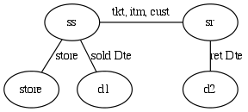
TPC-DS Query 50
Join Graph
Joins Store Sales, and Store Returns fact tables.
Each of the fact tables are independently restricted by date.
Analysis at Store grain, so this dimension also joined in.
As specified Query starts by joining the 2 Fact tables.
select
s_store_name , .. other store details
,sum(case when (sr_returned_date_sk - ss_sold_date_sk <= 30 ) then 1 else 0 end) as `30 days`, …
from
store_sales ss,store_returns sr,store s ,date_dim d1 ,date_dim d2
where
d2.d_year = 2000 and d2.d_moy = 9
and ss.ss_ticket_number = sr.sr_ticket_number and ss.ss_item_sk = sr.sr_item_sk
and ss.ss_sold_date_sk = d1.d_date_sk and sr.sr_returned_date_sk = d2.d_date_sk
and ss.ss_customer_sk = sr.sr_customer_sk and ss.ss_store_sk = s.s_store_sk
group by store details
order by store details limit 100;

Slide 23
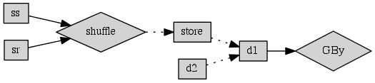
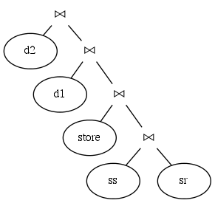
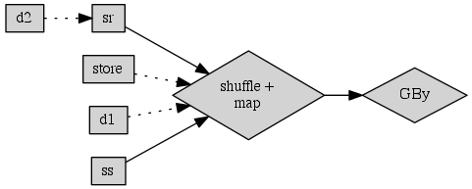
TPC-DS Query 50
Non CBO Plan
Specified
Join Tree
CBO Plan

Slide 24
TPC-DS Query 50
1 year test
> 10 mins for Non CBO
CBO time was about the same
Fact tables
partitioned by Day,
bucketed by Item
Bucketing off
Bucketing should help CBO plan.
SR table much smaller. Better chance of Bucket Join in place of Shuffle Join.
Facts restricted to 3 months
 | Run 1 | Run 2
Non CBO | 53.1 | 53.4
CBO | 22.5 | 21.9
Orderings considered by Planner
Join Ordering | Cost Estimate
['d2', [[['store_sales', 'd1'], 'store_returns'], 'store']] | 515074768.659
['d1', [[['store_sales', 'store'], 'store_returns'], 'd2']] | 448155.355
…
['store_returns', 'd2'] | 9938.93
['store_sales', 'store_returns'] | 156727295.634
['d1', 'store_sales'] | 123675664.449

Slide 25
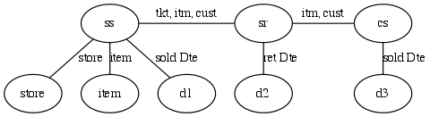
TPC-DS Query 17
select i_item_id
,i_item_desc
,s_state
,count(ss_quantity) as store_sales_quantitycount
,….
from store_sales ss ,store_returns sr, catalog_sales cs, date_dim d1, date_dim d2, date_dim d3, store s, item I
where d1.d_quarter_name = '2000Q1’ and d1.d_date_sk = ss.ss_sold_date_sk and i.i_item_sk = ss.ss_item_sk and … group by i_item_id ,i_item_desc, ,s_state
order by i_item_id ,i_item_desc, s_state
limit 100;
Joins Store Sales, Store Returns and Catalog Sales fact tables.
Each of the fact tables are independently restricted by time.
Analysis at Item and Store grain, so these dimensions are also joined in.
As specified Query starts by joining the 3 Fact tables.

Slide 26
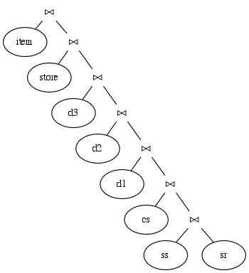
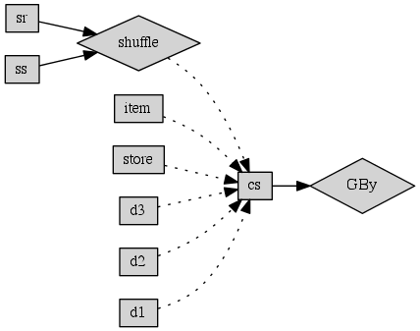
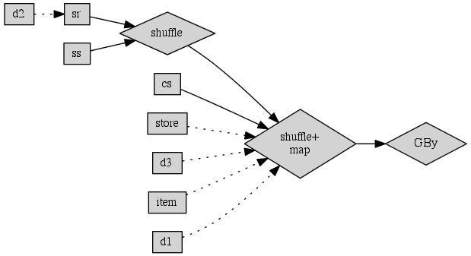
TPC-DS Query 17
Specified
Join Tree
Non CBO Plan
CBO Plan

Slide 27
TPC-DS Query 17
1 year test
> 10 mins for Non CBO
CBO time was about the same
Fact tables
partitioned by Day,
bucketed by Item
Bucketing off
Bucketing should help CBO plan.
SR table much smaller. Better chance of Bucket Join in place of Shuffle Join.
Facts restricted to 3 months
 | Run 1 | Run 2
Non CBO | 100.71 | 127.53
CBO | 50.9 | 44.52
Orderings considered by Planner
Join Ordering | Cost Estimate
['item', [[[[[['d2', 'store_returns'], 'store_sales'], 'catalog_sales'], 'd1'], 'd3'], 'store']] | 3547898.061
…
['store_returns', 'd2’] | 19224.71
['store_sales', 'store_returns’] | 23057497.991
['d1', 'store_sales'] | 26142.943

Slide 28
Next?
Outer joins
Scale to larger numbers of joins
Support all expressions (UDFs)
Join algorithm selection
Sortedness & distribution as a trait
Trait propagation
Better cost model
More statistics
Move all pre-planning and logical planning to Optiq
Use Optiq costs/statistics to help physical planning
Constant reduction & tree pruning
Rewrite query to use materialized view

Slide 29

Thank you!
@julianhyde
http://hive.apache.org/
http://incubator.apache.org/projects/optiq.html

