Slide 1
Discardable, In-Memory Materialized Queries
Julian Hyde
2014-05-23

Slide 2
Hadoop today
Brute force
Hadoop brings a lot of CPU, disk, IO
Yarn, Tez, Vectorization are making Hadoop faster
How to use that brute force is left to the application
Business Intelligence
Best practice is to pull data out of Hadoop
Populate EDW e.g. Teradata
In-memory analytics, e.g. Platfora
Custom analytics, e.g. Lambda architecture
Ineffective use of memory
Opportunity to make Hadoop smarter

Slide 3
Materialized views - Classic
CREATE MATERIALIZED VIEW SalesMonthZip AS
SELECT t.year, t.month,
c.state, c.zipcode,
COUNT(*), SUM(s.units), SUM(s.price)
FROM SalesFact AS s
JOIN TimeDim AS t USING (timeId)
JOIN CustomerDim AS c USING (customerId)
GROUP BY t.year, t.month,
c.state, c.zipcode;
Classic materialized view (Oracle, DB2, Teradata, MSSql)
A table defined using a SQL query
Designed by DBA
Storage same as a regular table
On disk
Can define indexes
DB populates the table
Queries are rewritten to use the table**
DB updates the table to reflect changes to source data (usually deferred)*
*Magic required
SELECT t.year, AVG(s.units) FROM SalesFact AS s
JOIN TimeDim AS t USING (timeId)
GROUP BY t.year;

Slide 4
Tables and in-memory materialized queries
Query: SELECT x, SUM(y) FROM t GROUP BY x
In-memory materialized
queries
Tables on disk

Slide 5
Materialized views - DIMMQ
DIMMQs - Discardable, In-memory Materialized Queries
Differences with classic materialized views
May be in-memory
HDFS may discard – based on DDM (Distributed Discardable Memory)
Lifecycle support:
Assume table is populated
Don’t populate & maintain
User can flag as valid, invalid, or change definition (e.g. date range)
HDFS may discard
More design options:
DBA specifies
Retain query results (or partial results)
An agent builds MVs based on query traffic

Slide 6
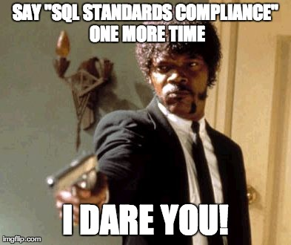

Slide 7
Data independence
This is not just about SQL standards compliance!
Materialized views are supposed to be transparent in creation, maintenance and use.
If not one DBA ever types “CREATE MATERIALIZED VIEW”, we have succeeded
Data independence
Ability to move data around and not tell your application
Replicas
Redundant copies
Moving between disk and memory
Sort order, projections (à la Vertica), aggregates (à la Microstrategy)
Indexes, and other weird data structures

Slide 8
Dynamic equilibrium
Ongoing activities:
Agent suggests new MVs
MVs are built in background
Ongoing query activity uses MVs
User marks MVs as invalid due to source data changes
HDFS throws out MVs that are not pulling their weight
(Rinse and repeat)
System moves data around to adapt to changing usage patterns.

Slide 9
Lattice
Space of possible materialized views
A star schema, with mandatory many-to-one relationships
Each view is a projected, filtered aggregation
Sales by zipcode and quarter in 2013
Sales by state in Q1, 2012
Lattice gathers stats
“I used MV m to answer query q and avoided fetching r rows”
Cost of MV = construction effort + memory * time
Utility of MV = query processing effort saved
Recommends & builds optimal MVs
CREATE LATTICE SalesStar AS
SELECT * FROM SalesFact AS s JOIN TimeDim AS t USING (timeId)
JOIN CustomerDim AS c USING (customerId);

