Slide 1
FireWall

Slide 2
Who are we?
Victor, Ivan, Nikolay

Slide 3

IDEA

Slide 4





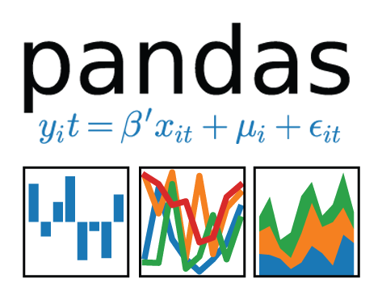

Technologies

Slide 5
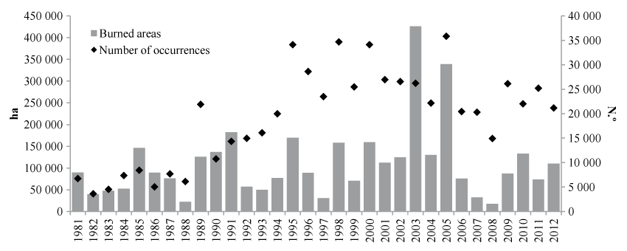

Slide 6
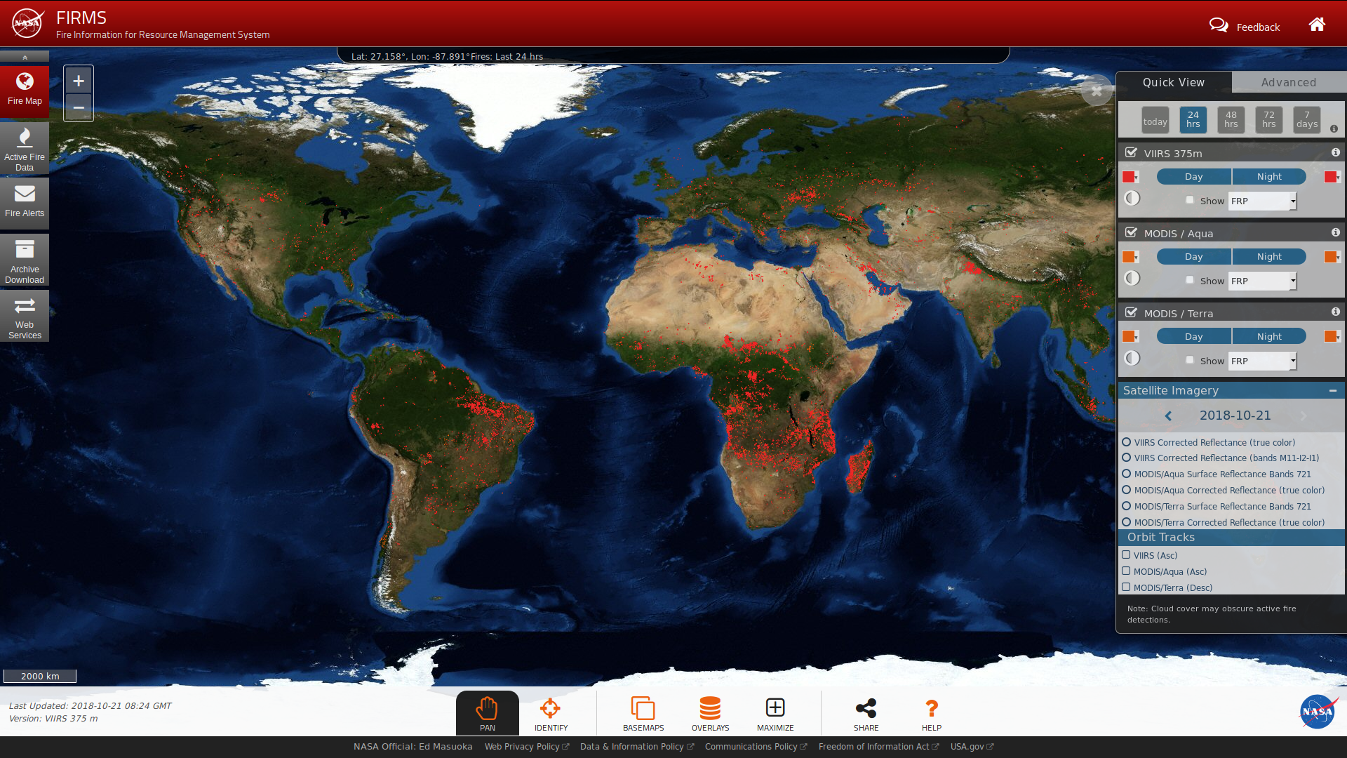
Monitoring wildfires
Detection is a key element for a successful firefighting:
Three major categories
satellite-based
infrared/smoke scanners
local sensors (e.g. meteorological)

Slide 7
How we use the data in our solution
Fire clustering - where to start to look from
Fire probability prediction - how likely a fire is to occur (96% accuracy)
Fire area prediction - we estimate the size of the possible burned area
Notify the endangered communities and their firefighters
Our features:
Current temperature in Celsius.
Humidity
Wind speed
Rain- mm/sq meter

Slide 8
Our model is not perfect
People can report and confirm fires on interactive satellite map.

Slide 9
Future development
Add more features
Explore more data
Tune our models better

Slide 10
DEMO

