Slide 1
Sampling Data for Machine Learning
Nik Bear Brown
nik@ccs.neu.edu
Chernoff bounds
Sampling Theorem
Linearity of Expectation
Union bound

Slide 2
Topics
Chernoff bounds
Sampling Theorem
Linearity of Expectation
Union bound

Slide 3
Basic Probability: Large Deviations
Chebyshev inequality: For any random variable X with mean μ and standard deviation σ
Applies to any random variable
Can be used to effectively bound large deviation for sum of pairwise independent random variables

Slide 4
Basic Probability
Linearity of expectation: For any random variables X₁, X₂, …, X_{n}, we have
E[Σ_{i} X_{i}] = Σ_{i} E[X_{i]}
Markov’s inequality: For any random variable X
Pr[X ≥ c] ≤ E[X]/c
Union bound: For any sequence of events E₁, E₂, …, E_{n}, we have
Pr[U_{i} E_{i}] ≤ Σ_{i} Pr[E_{i}]

Slide 5
Chernoff Bounds (above mean)
Theorem. Suppose X₁, …, X_{n} are independent 0-1 random variables. Let X = X₁ + … + X_{n}. Then for any μ ≥ E[X] and for any δ > 0, we have
or
sum of independent 0-1 random variables is tightly centered on the mean

Slide 6
Chernoff Bounds (above mean)
Pf. (cont)
Let p_{i} = Pr[X_{i} = 1]. Then,
Combining everything:
Finally, choose t = ln(1 + δ). ▪
for any α ≥ 0, 1+α ≤ e ^{α}
previous slide
inequality above
∑_{i} p_{i} = E[X] ≤ μ

Slide 7
Chernoff Bounds (below mean)
Theorem. Suppose X₁, …, X_{n} are independent 0-1 random variables. Let X = X₁ + … + X_{n}. Then for any μ ≤ E[X] and for any 0 < δ < 1, we have
or
or

Slide 8
Chernoff Bound
Let X₁, X₂, ..., X_{n} be n independent random variables in {0,1}
For any nonnegative δ
For any δ in [0,1]

Slide 9
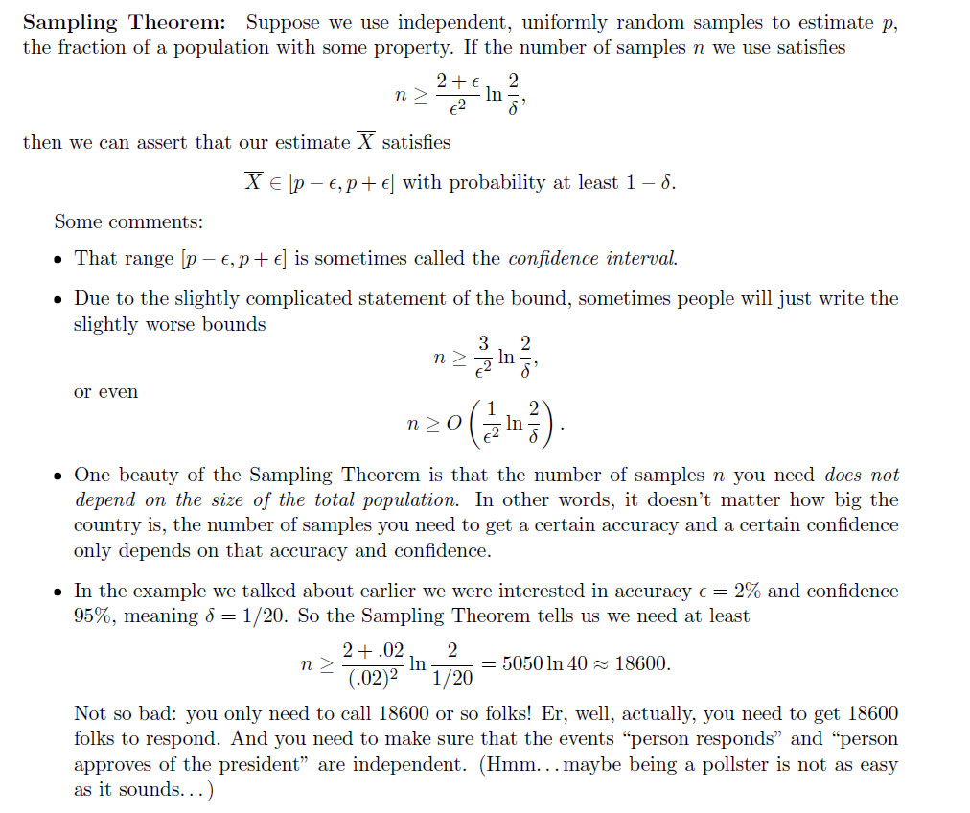
Sampling Theorem

Slide 10

Coin Flips

Slide 11
Linearity of Expectation
Expectation. Given a discrete random variables X, its expectation E[X] is defined by:
Waiting for a first success. Coin is heads with probability p and tails with probability 1-p. How many independent flips X until first heads?
j-1 tails
1 head

Slide 12
Expectation: Two Properties
not necessarily independent
Linearity of expectation. Given two random variables X and Y defined over the same probability space, E[X + Y] = E[X] + E[Y].
Decouples a complex calculation into simpler pieces.

Slide 13
Union bound
Union bound
The probability of a finite union of events is upper bounded
by the sum of the probabilities of the individual events.
Let denote that the observation vector is closer to the symbol vector than , when is transmitted.
depends only on and .
Applying Union bounds yields

