Slide 1
Lab 5
User account & Organizations

Slide 2
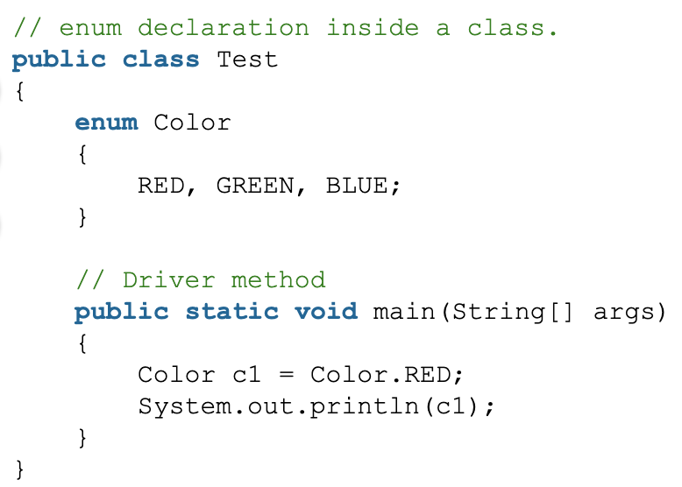

Enum
Enumerations serve the purpose of representing a group of named constants in a programming language.
Output:

Slide 3
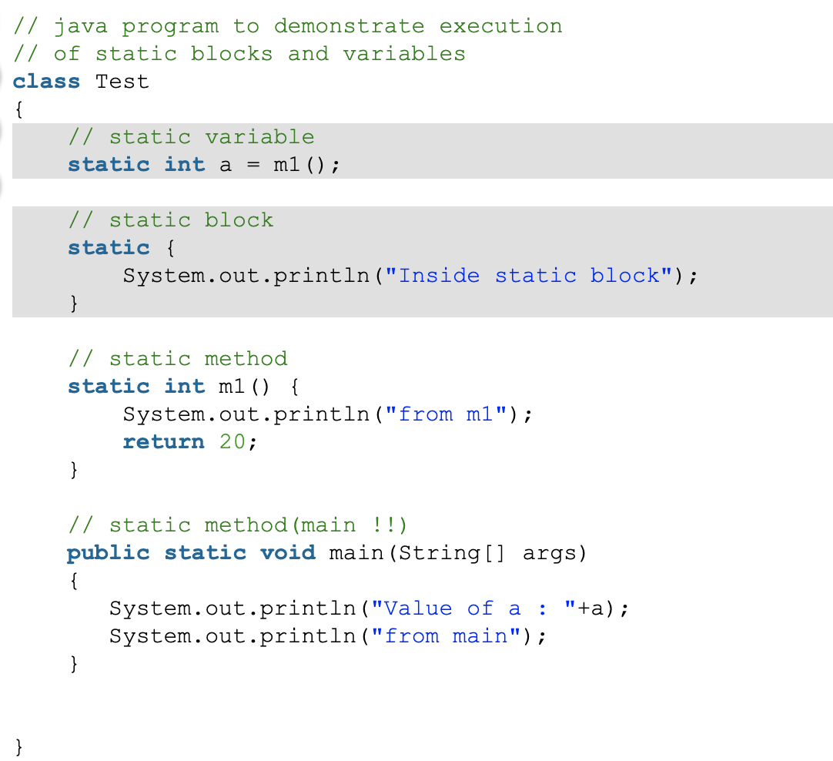
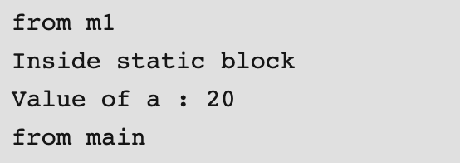
Static
When a member is declared static, it can be accessed before any objects of its class are created, and without reference to any object.
Output:

Slide 4
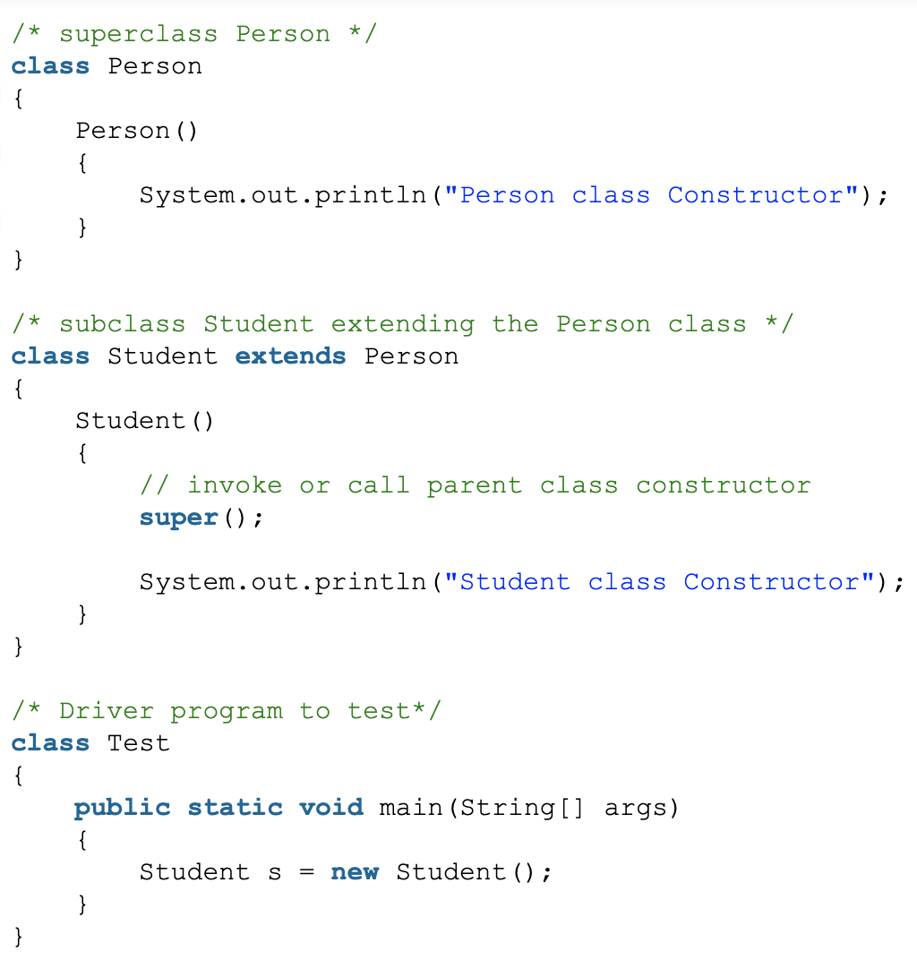
Super
super keyword can be used to access the parent class constructor. One more important thing is that, ‘’super’ can call both parametric as well as non parametric constructors depending upon the situation.

Slide 5
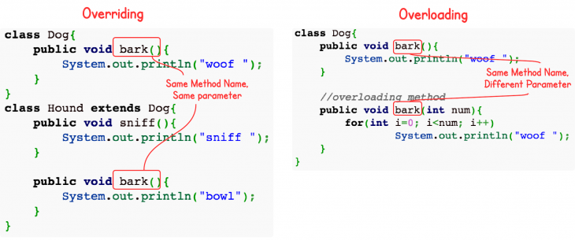
Overriding & Overloading
Overloading : Overloading occurs when two or more methods in one class have the same method name but different parameters.
Overriding means having two methods with the same method name and parameters (i.e., method signature). One of the methods is in the parent class and the other is in the child class. Overriding allows a child class to provide a specific implementation of a method that is already provided its parent class.

Slide 6
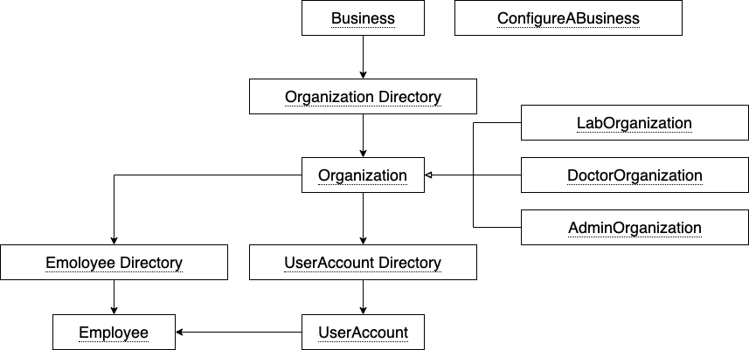
Architecture

Slide 7
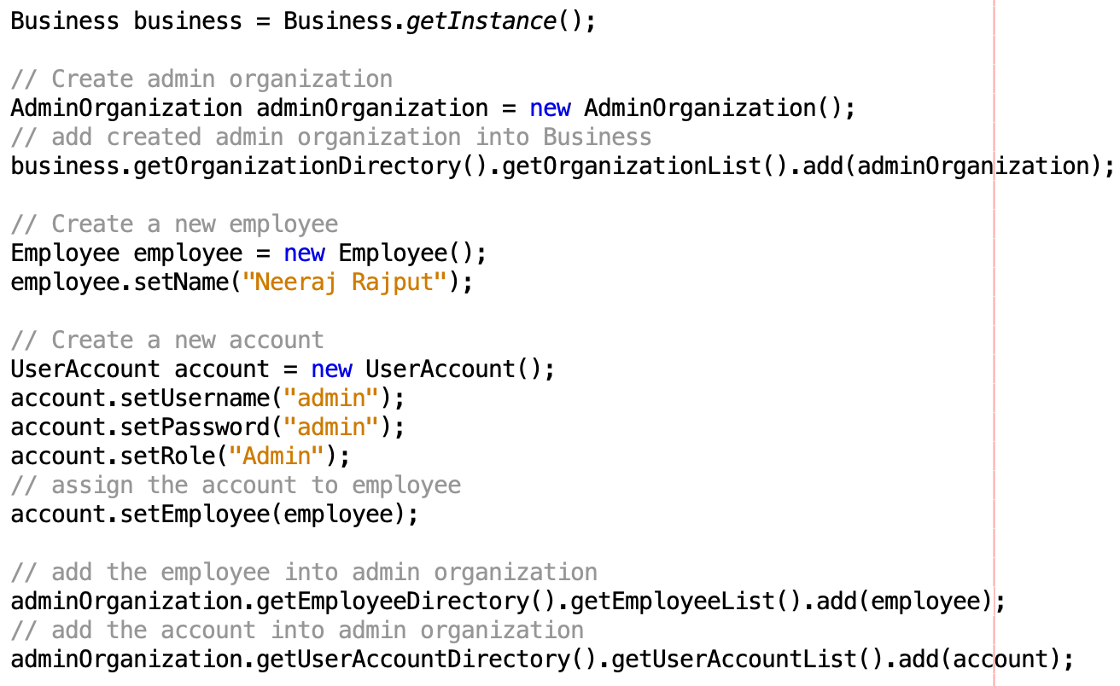
Create Admin

Slide 8
Homework (continue)
This is an individual assignment
Create two employees with their accounts in corresponding organization (ConfigureABusiness.java):
Lab Assitant -- Name: Ben, Username: lab, password: lab
Doctor – Name: Jackie, Username: doctor, password: doctor
Implement login functionality in MainJFrame.
Complete “SuccessScreen” so that a success screen with the user’s role and name will be shown after a successful login. For the failed login, there should be a pop-up message box to remind users.

Slide 9
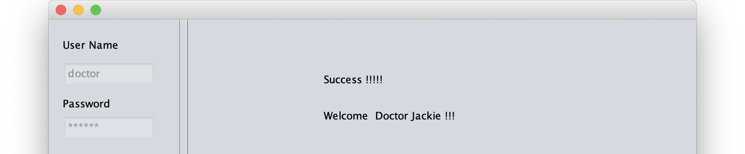
Homework
Git requirements:
No direct commits on master branch.
Commit on a new branch
Create pull request and merge into master branch.
Multiple small commits.
Due Date: Sat, Oct 19th, 11:59pm on BitBucket

