Slide 1
Lab 7
Reading csv files

Slide 2
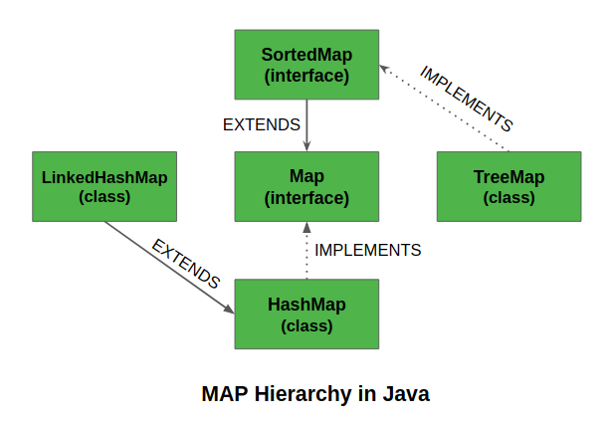
Map
java.util.Map is an interface
Eg. Map<String, String> map = new HashMap<>();
A Map cannot contain duplicate keys and each key can map to at most one value.
Some implementations allow null key and null value like the HashMap and LinkedHashMap, but some do not like the TreeMap.

Slide 3
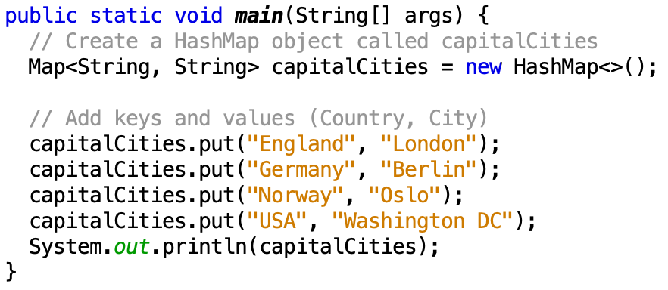
HashMap
A HashMap stores items in "key/value" pairs.
https://docs.oracle.com/javase/8/docs/api/java/util/HashMap.html

Slide 4
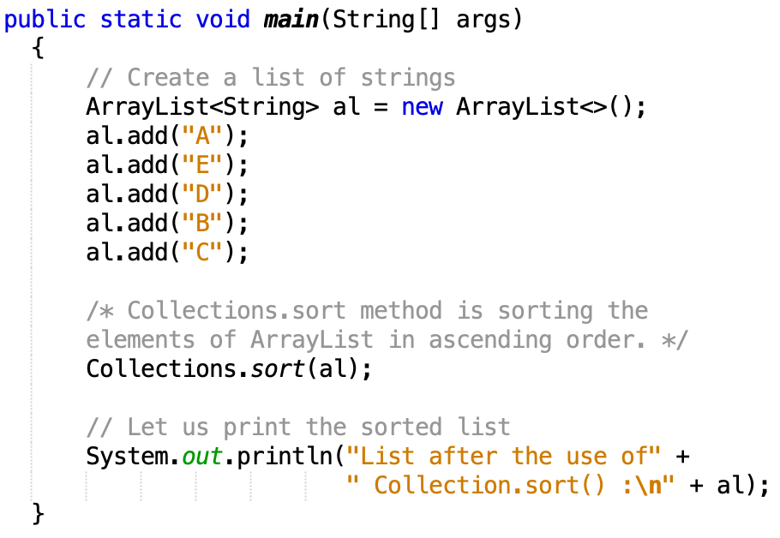
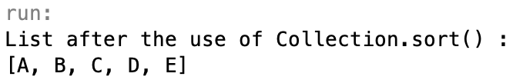
Collections.sort()
Collections. sort(List<T> list)

Slide 5
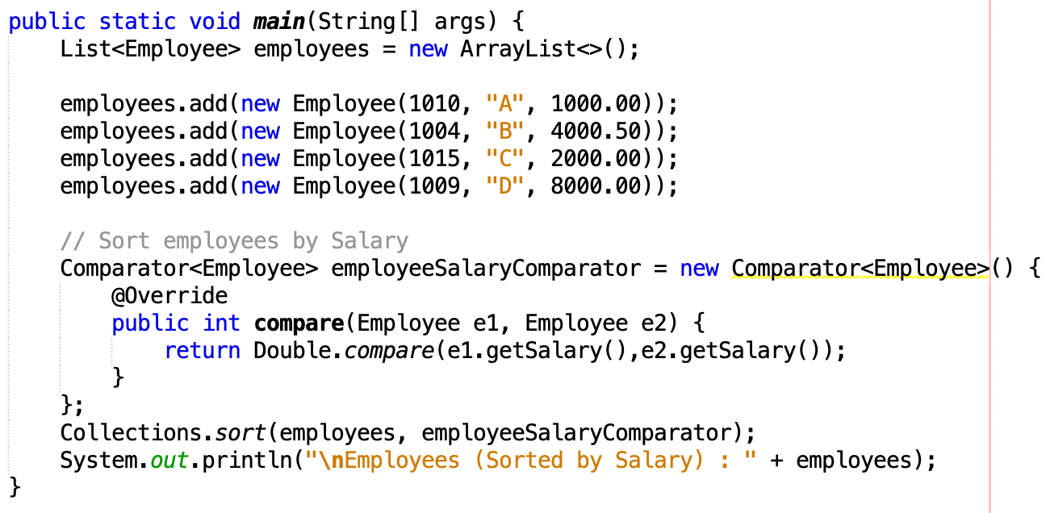
Collections.sort()
Collections. sort(List<T> list, Comparator<? super T> c)

Slide 6
Homework
This is a team assignment.
Multiple git commits is required (at least 3 per person)
No direct commit on master branch
1). Find Average number of likes per comment.
2). Find the post with most liked comments.
3). Find the post with most comments.
4). Top 5 inactive users based on total posts number.
5). Top 5 inactive users based on total comments they created.
6). Top 5 inactive users overall (sum of comments, posts and likes)
7). Top 5 proactive users overall (sum of comments, posts and likes)
Due Date: Sat, Nov 2nd, at 11:59 pm., on Bitbucket

