Slide 1

ISYG100 : Application Engineering and Development
Our Engineering Method

Slide 2
The definition of system : An organized set of parts and interacting elements that perform a function that is more than the sum of its parts. A system may consist of things, people, and organizations. An important theoretical underpinning of the research presented in this thesis is that humans and social constructs are analyzed as part of the system. Humans and organizations must be analyzed beyond the ―man–machine‖ interface. Humans must be treated as part of the system because their role (job) is designed, their interactions with the system and each other are designed, and their interactions with each other create the most powerful drivers of system safety (and system risk).

Slide 3
How work happens?
The main event is a request to
do something
From someone
To someone
At some time
According to specs
Etc

Slide 4
Push Work Model
Lab Processing
Donor Services
Intelligent Work Router:
E.g. Give high priority items to Jessica since she is always prompt with her response...
Client Operations
Client Data Feed
A team member will log into her/his work area and find a To-Do List of Work Requests
This can be best described as a MyWorkArea type interaction
Responsibility for doing the work is specific to the individual

Slide 5
Pull Work Model
Client Operations
Client Operations
Get Work Request
Client Operations
The Staff will log into a shared work area in order to retrieve a task from a list of available tasks
The list is visible to other staff members
The requested Employee updates are a shared responsibility by a team

Slide 6
Work moves from one group to another

Slide 7
Impact of Work Model
Shared List Of Work Requests
My To-Do for the day
Team Work Area
Work Space
Pull Model Interface
Push Model Interface (MyWorkArea)

Slide 8
Our Engineering Method

Slide 9
Traditional Application Thinking
Data
Users
Data
Roles
Data
User Processes
(Activities)
Data

Slide 10
Application Structure
(User, Password)
User Screen
User Directory
User account +
role
User Interface
Role
Role 1
Role 2
Role n
…..
Person Directory
Person
Work Area
Work Responsibility 1
Activity 1, Activity 2, …
Work Responsibility 2
Activity 1, Activity 2, …

Slide 11
Application Structure (Contd.)
Role 1
Work Area
Data as input
Work Responsibility 1
Data as output
Activity 1, Activity 2, …
Work Responsibility 2
Activity 1, Activity 2, …

Slide 12

Communication

Slide 13
Work Area
Work Area

Slide 14
Communication
Outbox
Inbox
….
queue
queue
Work Area
Work Area

Slide 15
Organization C
Reporting
Work Area
Work Area
Work Area
Communication

Slide 16
Organization A
Organization B
Organization C
Work Area
Work Area
Work Area

Slide 17
Management Goes to Work As Well
Customer Services
Call Center Team A
Work Area
Work Area

Slide 18
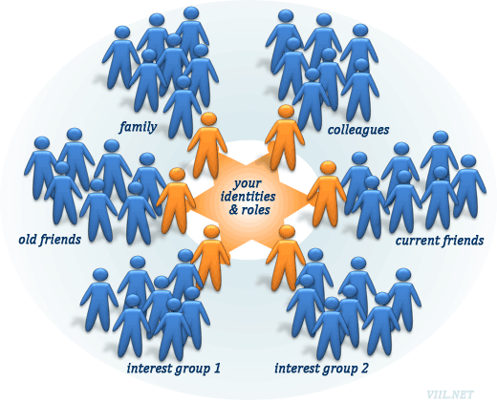
Management Goes to Work As Well
Customer Services
Work Area

Slide 19
Management Goes to Work As Well
Customer Services
Call Center Team A
Work Area
Work Area

Slide 20
Linking it together
User Account Directory
Organization
Staff Directory
Work Area
User Account
Person
out-Queue
originator
performer
in-Queue
Work Responsibility
Work Queue
Work Request

Slide 21
Linking it together
User Account Directory
Organization
Staff Directory
Work Area
User Account
Person
out-Queue
originator
performer
in-Queue
Work Responsibility
Work Queue
Work Request

Slide 22
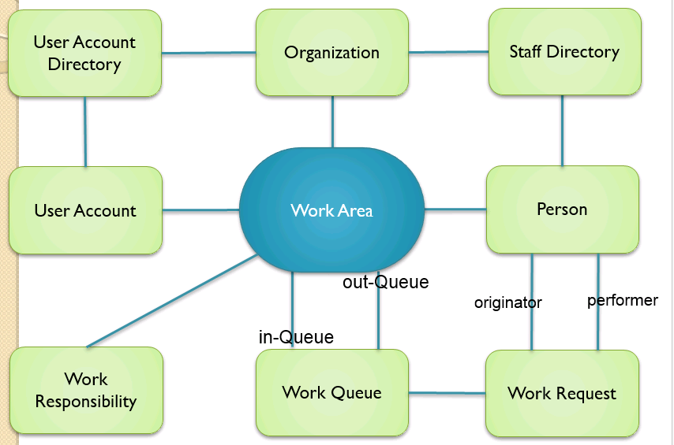

Slide 24
Network
Enterprise
Enterprise
Enterprise

Slide 26
Vaccine
System
Disease
Network
Enterprise
Industry
Organization
Jobs
Location
Work Area
Processes
People
Activity

Slide 27
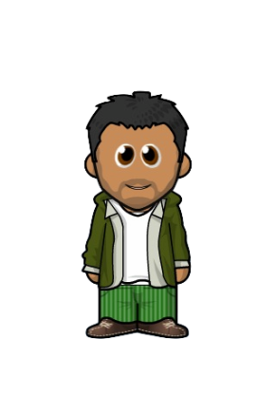
Vaccine
System
Disease
Vaccine Network
Department of Public Health
Northeastern University
Mass General
CVS
Immunizat-ion Depart
Clinic
Clinic
Clinic
Event 1
Contracts/funding flow
Event 1
Event 1
Event 1
Patient

Slide 28
Possible Structure of the Vaccine System
System
Vaccine
Disease
Network
Enterprise
…
NY State PHD
CDC
Mass PHD
Distributor
Mass General
Distribution Warehouse 1
Distribution Warehouse 2
Provider
Distribution Center 2

Slide 29
3
2
Enterprise
4
…
Mass State PHD
CDC
Mass PHD
Distributor
Mass General
Distribution Warehouse 1
Distribution Warehouse 2
Distribution Center 2
1
Provider
Provider
5
Provider
Provider

Slide 30
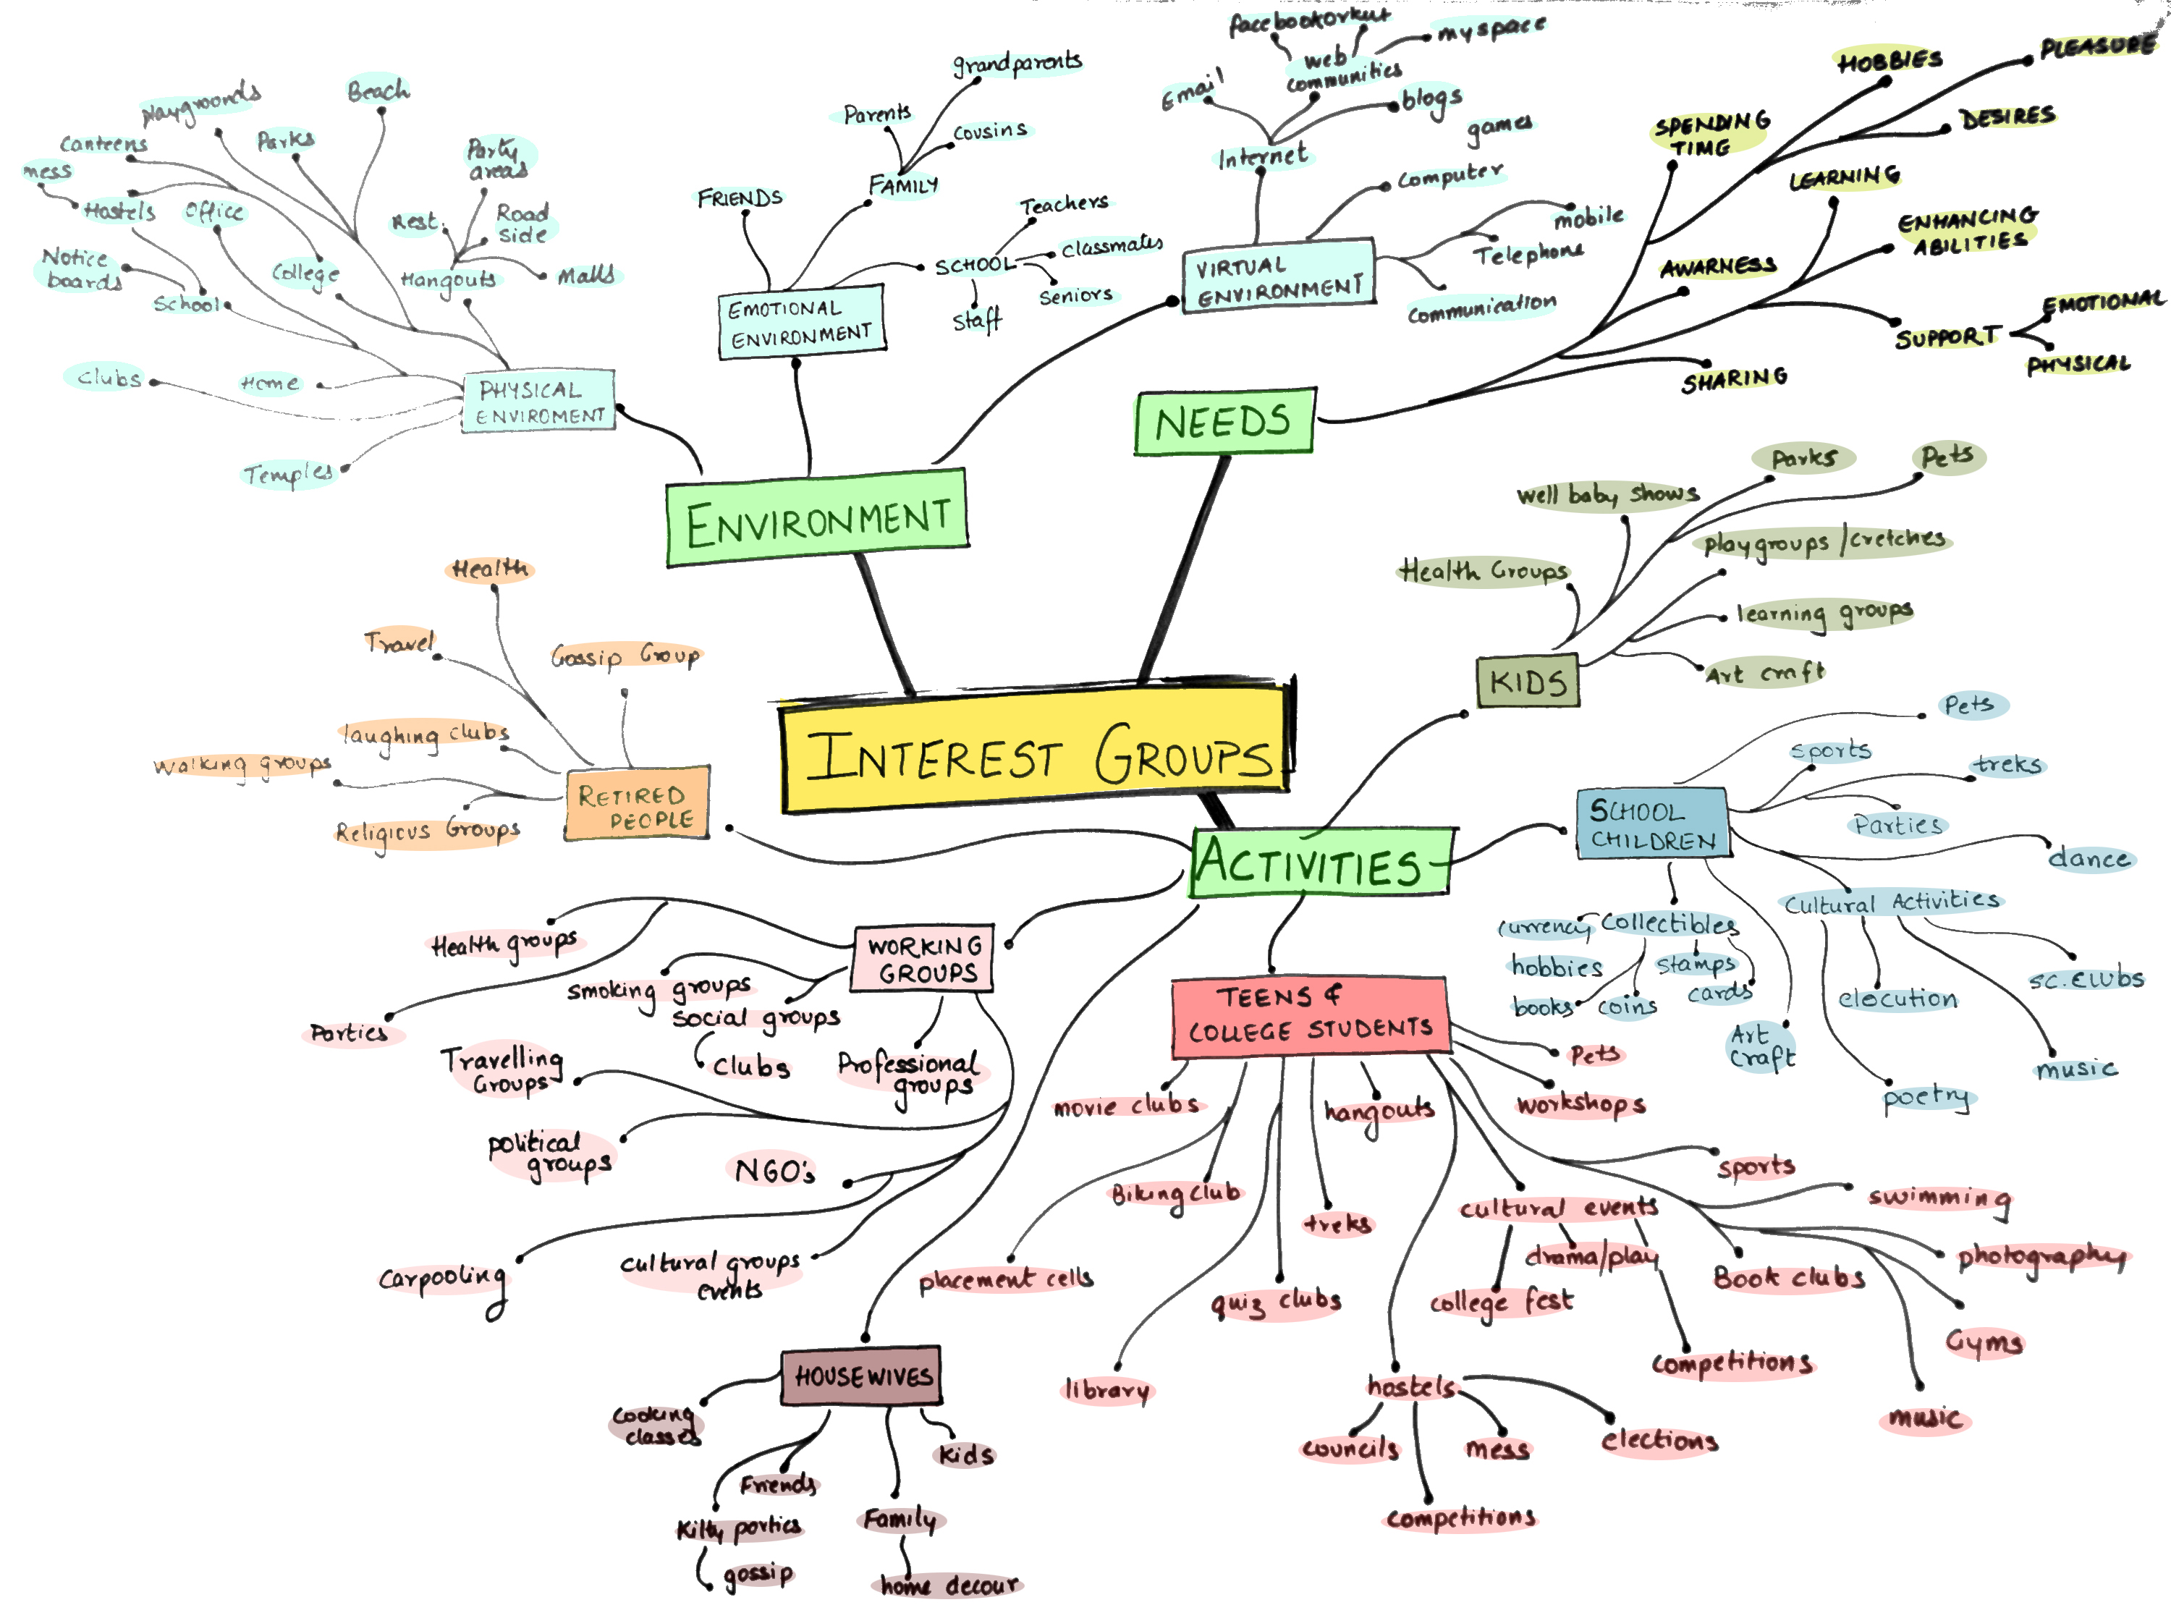
Org 2
Org 1
Enterprise 1
Enterprise 2
Network
Enterprise 5
Enterprise 4
Enterprise 6
Enterprise 3

Slide 31
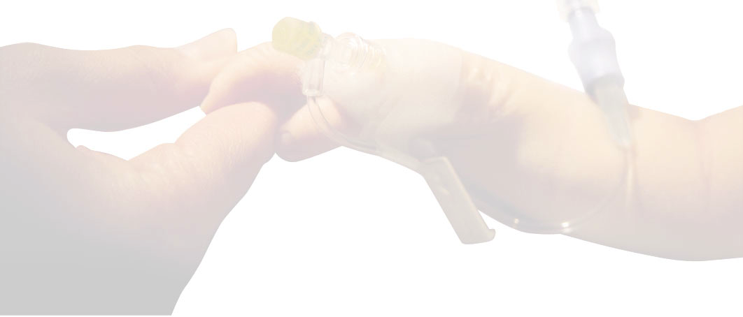
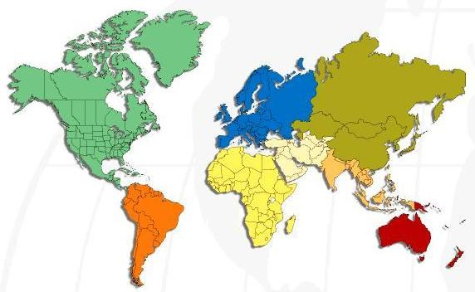





Vision: Make the system available world-wide
China
India
S.T.A.B.L.E Team
South
Africa
10/16/2015
Dr. Kal Bugrara
31

