Slide 1

Factor Modeling

Slide 2

Brief Introduction

Slide 3
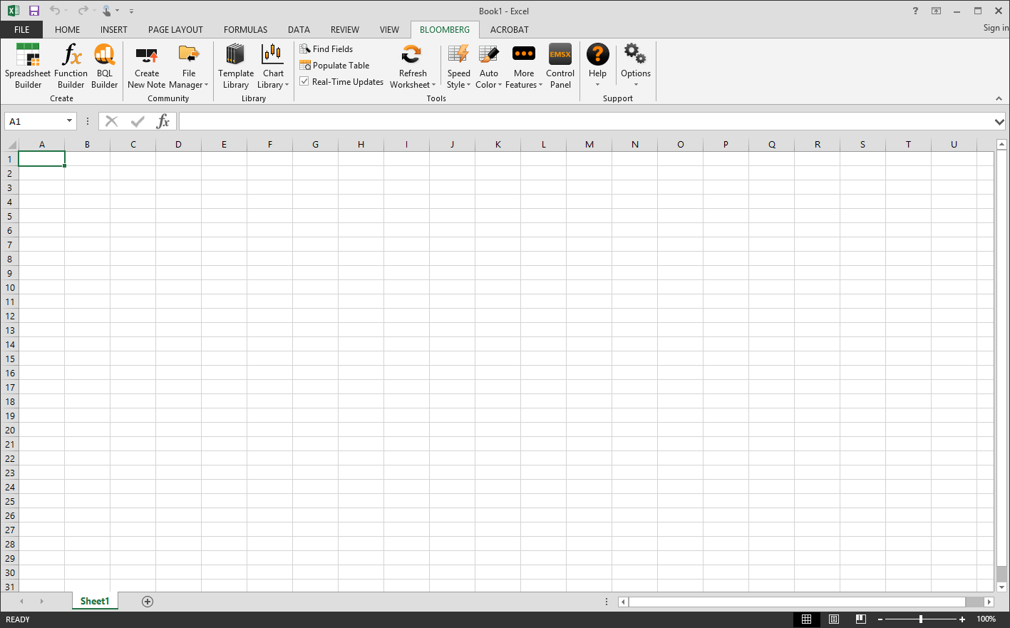
Data

Slide 4

Data Cleaning
Transforming data:
Fill blank data columns
Processing data:
Reciprocal for factor exposures
Make all dates the same(Year-Month)
Use good data to forward fill missing data
Depolarization
Standardization
Fill missing data

Slide 5
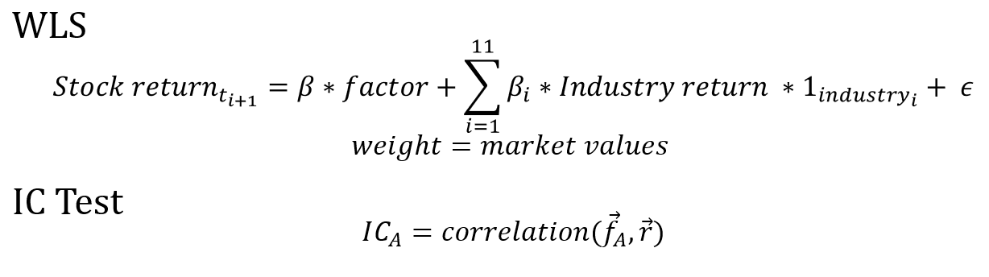
Significance Test

Slide 6
Factor | Percentage of positive IC | Sd IC | Mean IC | Sd P_value | mean P_value
EP | 0.507462687 | 0.050893554 | 0.039748423 | 0.285873435 | 0.471102614
BP | 0.402985075 | 0.055346813 | 0.039661963 | 0.319394692 | 0.501342493
ROA | 0.552238806 | 0.051505557 | 0.03757162 | 0.298860435 | 0.498179006
ROE | 0.582089552 | 0.043503106 | 0.034388987 | 0.281022954 | 0.517710279
CFP | 0.462686567 | 0.053580995 | 0.037409262 | 0.296857883 | 0.511173945
asset_to_liability | 0.507462687 | 0.053132214 | 0.040963682 | 0.292090944 | 0.456532927
CF_to_Liability | 0.507462687 | 0.048560207 | 0.036823058 | 0.274868312 | 0.50223869
debt_to_asset | 0.462686567 | 0.0589736 | 0.043106926 | 0.299146183 | 0.460100479
RSI_30 | 0.52238806 | 0.058877747 | 0.042838278 | 0.296779133 | 0.458065005
Turnover | 0.507462686 | 0.049879687 | 0.040291019 | 0.299217722 | 0.454313488
cash_ratio | 0.402985075 | 0.056292151 | 0.038788066 | 0.285515845 | 0.487508859
Div_yeild | 0.582089552 | 0.049647197 | 0.037099445 | 0.308901713 | 0.504830874
EBITDA_EV | 0.462686567 | 0.041546931 | 0.031547654 | 0.285342296 | 0.552781456
volatility | 0.582089552 | 0.049647197 | 0.037099445 | 0.308901713 | 0.504830874

Slide 7
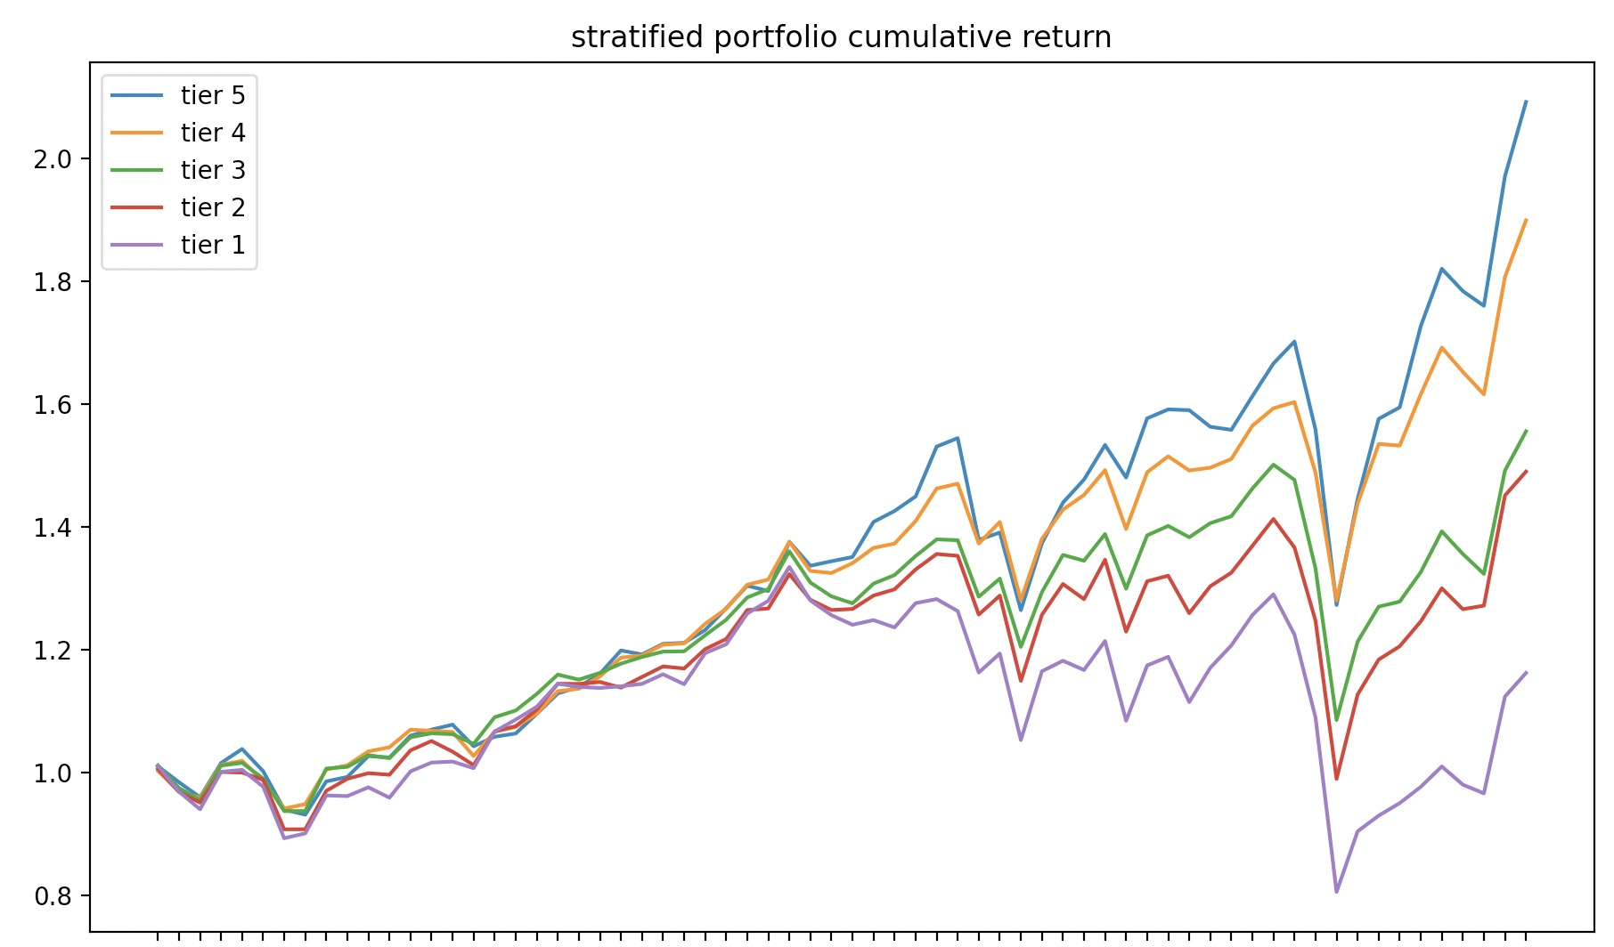

Monotonicity
Tier 5
$↓$
Tier 4
$↓$
Tier 3
$↓$
Tier 2
$↓$
Tier 1

Slide 8
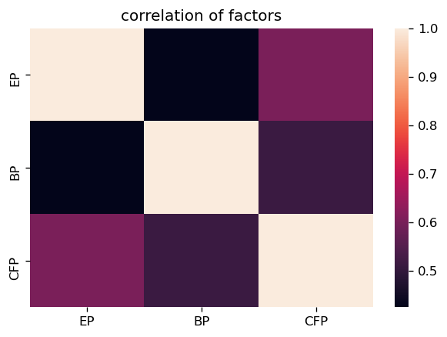
Multicollinearity

Slide 9
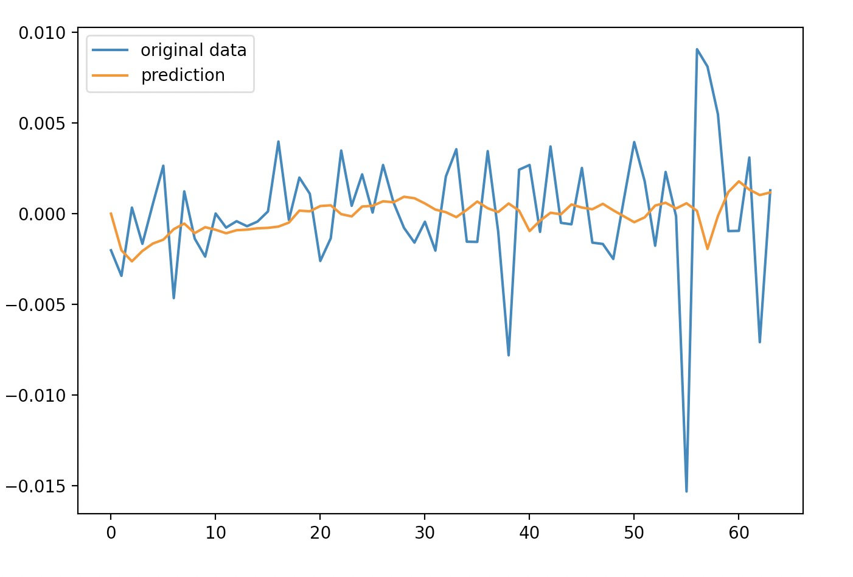


Prediction
OLS
$$Y_{t+1}=β∗S\&P return+\sum_{i=1}^{n}{β_{i}∗factor+ε }$$
Where:
$Y_{t+1}=$ $Stock Return in certain period$
$β_{i}=$ How much of return can factor return explain
$$Arima$$
$${ β}_{t}=c+∅_{1}β_{i}+…+∅_{p}β_{t−p}+θ_{1}e_{t−1}+…+θ_{p}e_{t−p}+e_{t}$$
Where:
$β_{t}=$ the beta we want at time t
$c=$ intercept
$∅=$ coefficient of each parameter q
$θ=$ coefficient of each parameter q
$e=$ residuals or errors in time t

Slide 10


Lagrange Multipliers
$$\left\{\begin{aligned}f\left(w\right)=−w∗R \\ w∗Σ∗w^{T}=a \\ w∗I=1\end{aligned}\right.$$
Where:
$f\left(w\right)=$ function that we want to minimize
$w=$ weights of stocks, shape=(1,500)
$R=$ stock returns, shape=(500,1)
$I$ = identity matrix
$a$ = S&P variance
$Σ$ = covariance matrix of S&P 500 returns

Slide 11
Thanks!

Slide 12
Reference
https://blog.optimalworkshop.com/wp-content/uploads/2020/03/A-beginners-guide-to-qualitative-and-quantitative-research.png
https://www.vectorstock.com/royalty-free-vector/investment-model-vector-3632837
https://www.vectorstock.com/royalty-free-vector/costs-optimization-icon-flat-design-vector-13784262

