Slide 1
Named Entity Recognition using Positive-Unlabeled Learning
Minlong Peng, Xiaoyu Xing, Qi Zhang, Jinlan Fu, Xuanjing Huang
Fudan University
{Mlpeng16, xyxing18, qz, fujl16, xjhuang}@fudan.edu.cn

Slide 2
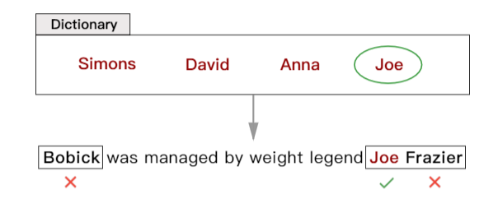
NER Using Only Dictionary
“Bobick” and “Joe Frazier” are two person names.
Only “Joe Frazier” is partially labeled by the dictionary

Slide 3
NER Using Only Dictionary
We know “Joe” is of entity words, but we do not know its
position (BMES) in the entity.
Formulate the task as a binary-class classification problem.

Slide 4
NER Using Only Dictionary
Ordinary supervised models require labeled data
of both positive and negative classes.
We only know “Joe” is of entity words (positive class),
while labels of the rest words are unknown.
V.S.

Slide 5

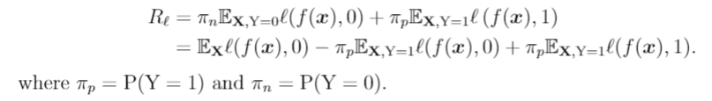
PU-Learning for Dictionary-based NER
Expected task loss
Premise
The expected task loss can be unbiasedly estimated
using only positive and unlabeled data.

Slide 6

PU-Learning for Dictionary-based NER
can be optimized to make
! The loss function should be upper bounded.

Slide 7


PU-Learning for Dictionary-based NER
! The loss function should be upper bounded.
MAE:
MSE:
Truncated CE:

Slide 8
PU-Learning for Dictionary-based NER
! Should be non-negative

Slide 9
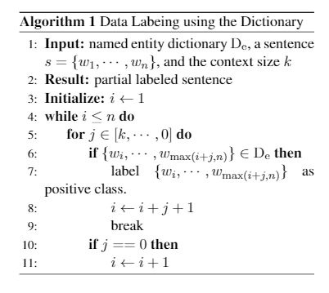
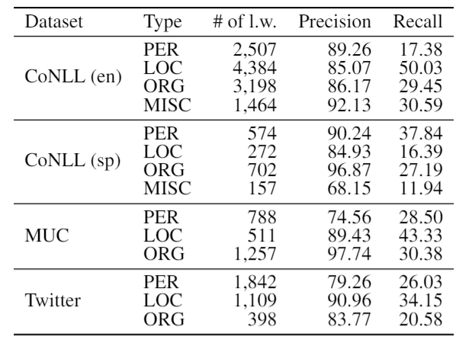
Implementation Detail
Dictionary and Data Labeling:
1. Dictionaries were crawled from Wikipedia (refer to the paper).
2. Data labeling using maximum matching algorithm.

Slide 10
Implementation Detail
Classifier f:
1. Character-level CNN + word embedding + binary features for word representation.
2. BiLSTM for sequence modeling.

Slide 11
Implementation Detail
Inference:
Build a distinct classifier for every entity type.
Input: {w1, w2, w3, w4, w5}; Label: {1, 1, 0, 0, 1} {w1, w2} and {w5} are predicted as two entities of the type.
Type conflict is resolved by choosing the type with the highest prediction probability.

Slide 12
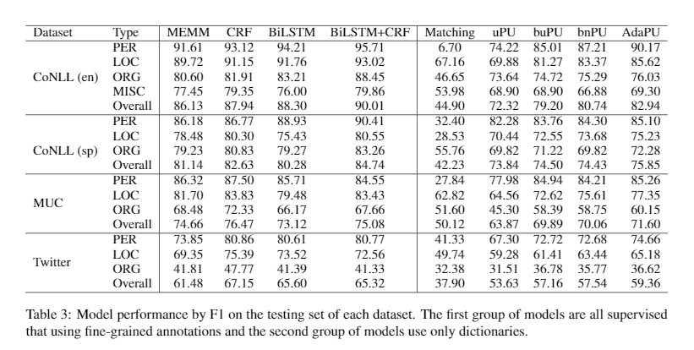
Results
Notes:
uPU: cross entropy loss function
buPU: uPU with unbiased loss function
bnPU: buPU + non-negative constrain
AdaPU: bnPU + adaptative learning

Slide 13
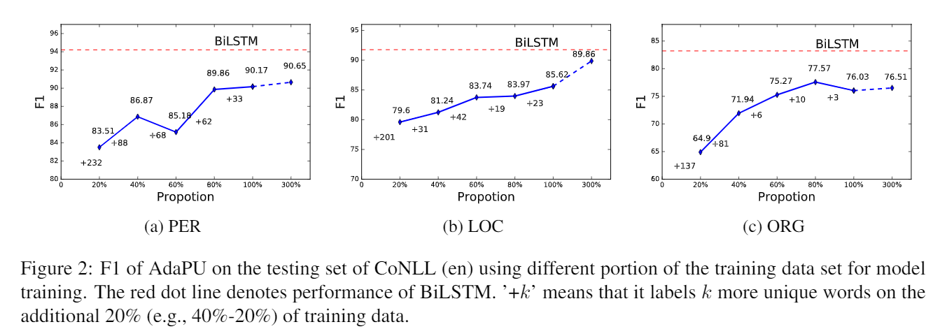
Results
Notes:
uPU: cross entropy loss function
buPU: uPU with unbiased loss function
bnPU: buPU + non-negative constrain
AdaPU: bnPU + adaptative learning

Slide 14
Paper & Source Code & Slides
https://github.com/v-mipeng/LexiconNER

Slide 15
Thanks!

