Slide 1
CLASS WEB SITE: http://upmcsms.weebly.com/
Updated with Lecture Notes

Slide 2
Named Data Networking (NDN)
Introduction to NDN

Slide 3












Named Data Networking (NDN)
http://named-data.net • http://github.com/named-data

Slide 4

IP
NDN
Host-centric
addressing
Data-centric
addressing

Slide 5
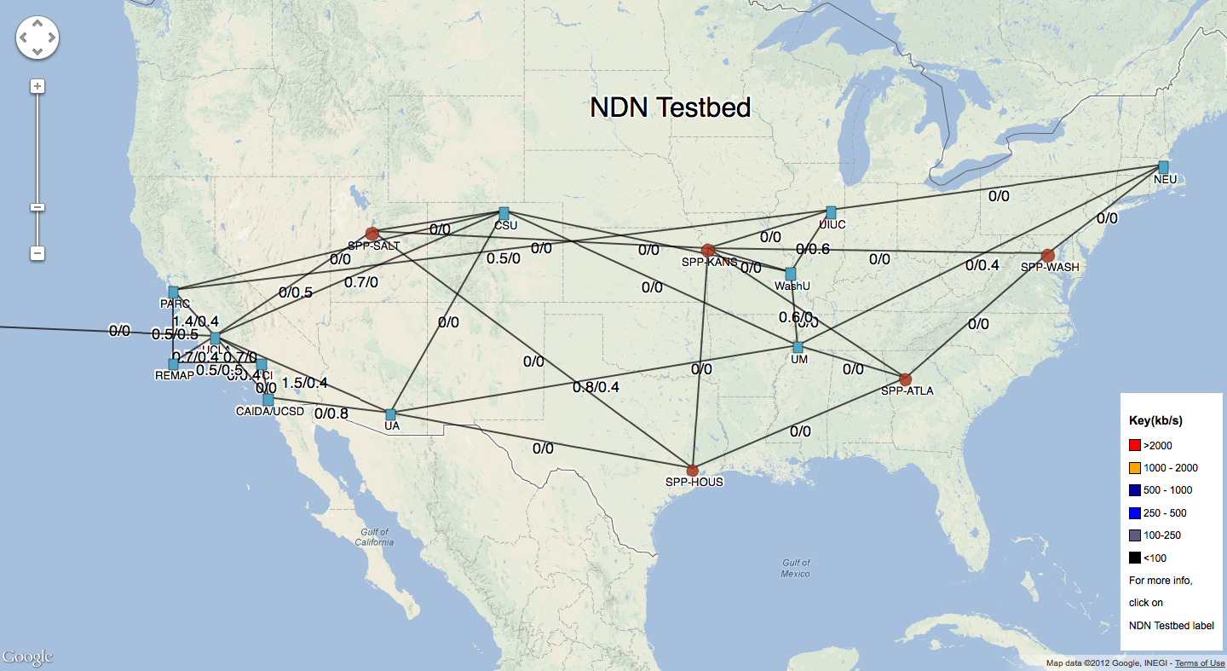
Is It Deployed?
Deployable now as an overlay (TCP, UDP) or on Layer 2 transport
C, Java, Python, Javascript libraries
http://github.com/named-data
Testbed of 15 routers, including 5 on Internet2 / GENI
http://ndnmap.arl.wustl.edu/

Slide 6
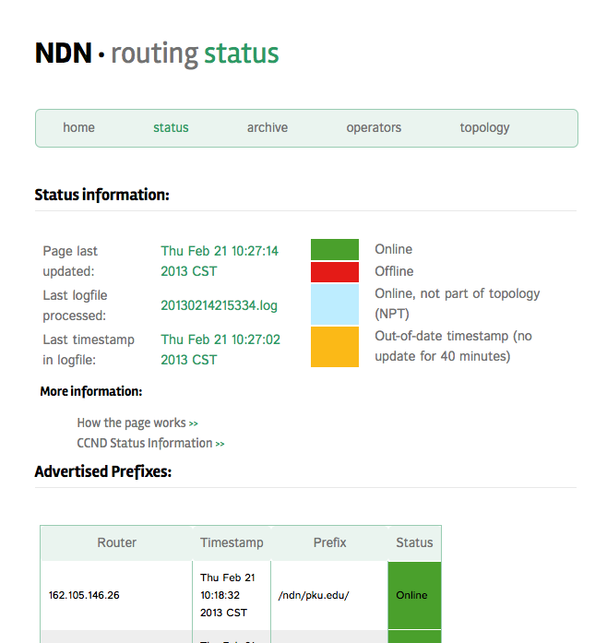
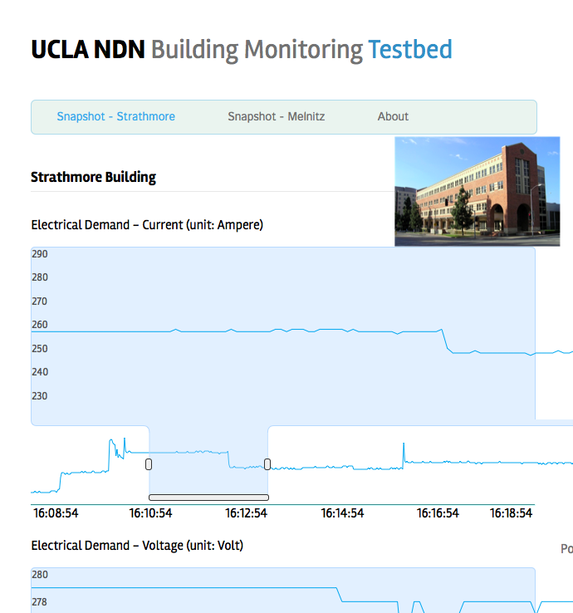
Run a Bit of NDN in your Browser Now
tinyurl.com/ndnrouting
tinyurl.com/ndnsensor
* - Requires working connection to current Internet.

Slide 7


Telephone Network was the 1st Communication System
Focus on building and connecting the wires

Slide 8
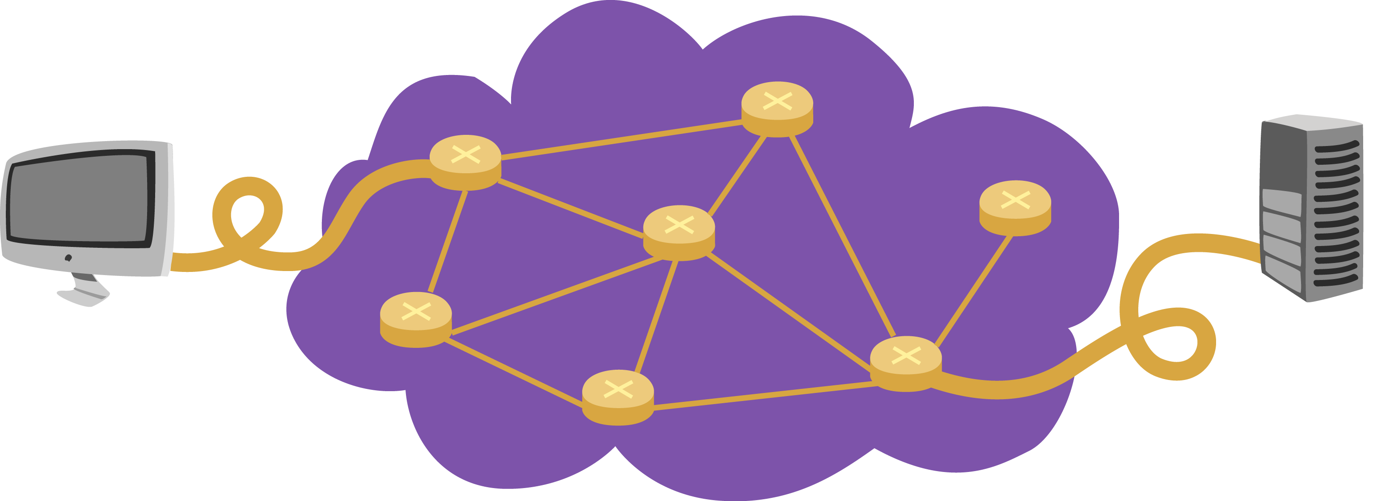
IP Revolutionized the Communication System
Internet Protocol (RFC791): Focused on delivering packets to destination host

Slide 9

NDN: Focus on Data
Abstracting away the notion of “host”
Superset of host-to-host communication model

Slide 10
Two Problems with Current Internet
Focus is on end-point communication
Artifact of original thinking: share resources, not content
Login to fast machine, access to the tape drive, the printer, etc.
Security
To get data, you build a secure path
Once you authenticated with the server, you trust the content

Slide 11
New Communication Paradigm
Users today care about content, not the servers
Accessing the server is a by-product of the need to retrieve the desired content
If the server is down, no access to the content
But what if the content was available from other places (e.g., my neighbor)?
We do a lot of this already with HTTP
URLs, CDNs, caches, etc.

Slide 12
Two Focal Points in NDN
Focus on the what not the where
Secure the data not the container

Slide 13
NDN Operation
Interest packets
Data packets
Enhanced Forwarding
Pending Interest Table (PIT)- new!
Content Store (CS) – new!
Forwarding Information Base (FIB) – similar to IP

Slide 14
The IPv4 Datagram Format
IP protocol version
number
32 bits
total datagram
length (bytes)
header length
(bytes)
head.
len
type of
service
ver
length
fragment
offset
for
fragmentation/
reassembly
“type” of data
16-bit identifier
flgs
max number
remaining hops
(decremented at
each router)
time to
live
upper
layer
Internet
checksum
32 bit source IP address
upper layer protocol
to deliver payload to
32 bit destination IP address
Options (if any)
E.g. timestamp,
record route
taken, specify
list of routers
to visit.
data
(variable length,
typically a TCP
or UDP segment)

Slide 15
Two Simple Changes
32 bits
ver
head.
len
type of
service
length
flgs
fragment
offset
16-bit identifier
time to
live
upper
layer
Internet
checksum
IPv6 killed these already
Delete the Source. Named Data Networking does not have sources
32 bit source IP address
32 bit destination IP address
Options (if any)
Delete the Destination. Named Data Networking does not have destinations
data
(variable length)

Slide 16
NDN Packets
Interest Packet
Data Packet
Content Name: Identifies the data I want to receive
Content Name: Identifies the data in this packet
Selector: identifier publisher, etc
Signature: Required for all packets
Nonce
Nonce
Data

Slide 17


NDN Forwarding: Interests
Interest
Publisher
For X
Interest: Content Name (CN) = X
Forward interest towards Publisher (X)
Mark incoming faces as wanting X (lay down breadcrumbs)
Merge same interests for X

Slide 18
NDN Forwarding: Data
Data
Publisher
For X
Data: Content Name (CN) = X Forward Data back to where interests came from
Follow the breadcrumbs back to requestors
Delete breadcrumbs
Duplicate at appropriate routers
Cache data at each router

Slide 19
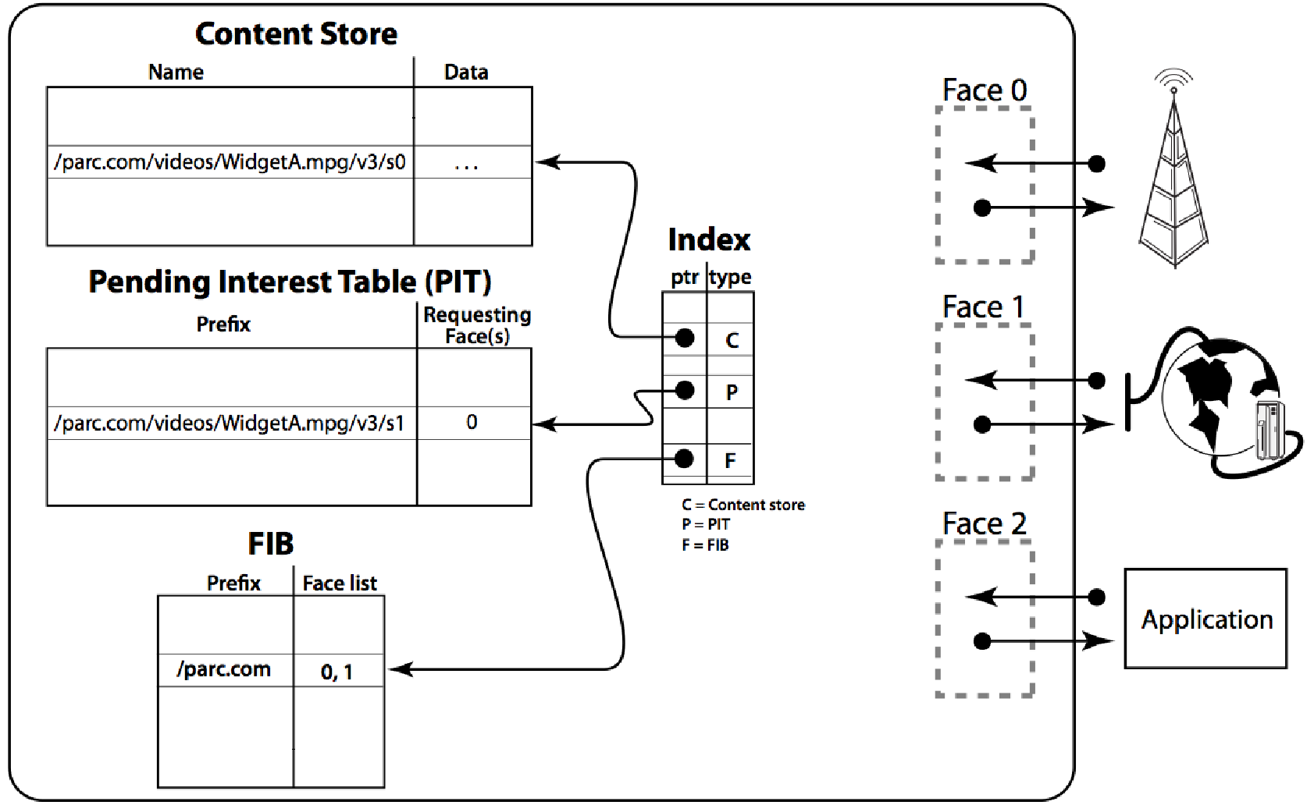
Forwarding Process

Slide 20
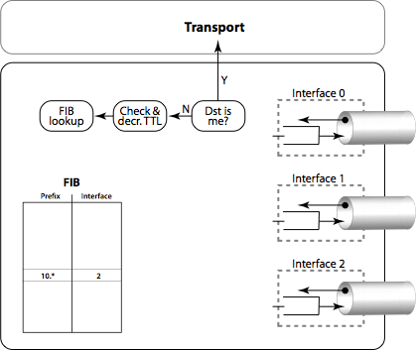
Comparison with IP Packet Forwarding

Slide 21
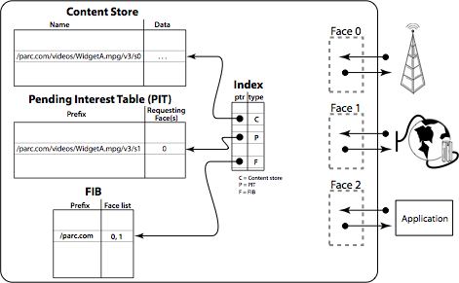
NDN Interest Forwarding
get /parc.com/videos/WidgetA.mpg/v3/s2
P
/parc.com/videos/…../mpg/v3/s2 0
2
get /parc.com/videos/WidgetA.mpg/v3/s2

Slide 22
NDN Data Forwarding
/parc.com/videos/…../mpg/v3/s2 0 2

Slide 23


Summary
? /nytimes.com/today
Route on content names
Content from anywhere: not just the producer
“Breadcrumbs” & de-duplication of requests
Cache retrieved data in Content Store (CS)

Slide 24
Hitting Cached Data
X was cached here
Publisher
For X
Interests only go so far until they find the data
Cached data can satisfy requests efficiently

Slide 25
Multipath Interest Forwarding
Interest
Publisher
For X
Repository
That may have X
Interests may be forwarded opportunistically to many destinations
Strategy Layer
Data may be concurrently retrieved from multiple places

Slide 26
Example: Delivering Mail
Mail client
Mail server
Interest: I have mail for you
Interest: Give me your mail
Data: here’s my mail

Slide 27
The Power of Naming
Naming can fetch the data transparently regardless of location
Requests can go to appropriate place
Naming can result in generation of new data
Can ask for data that does not yet exist!

Slide 28
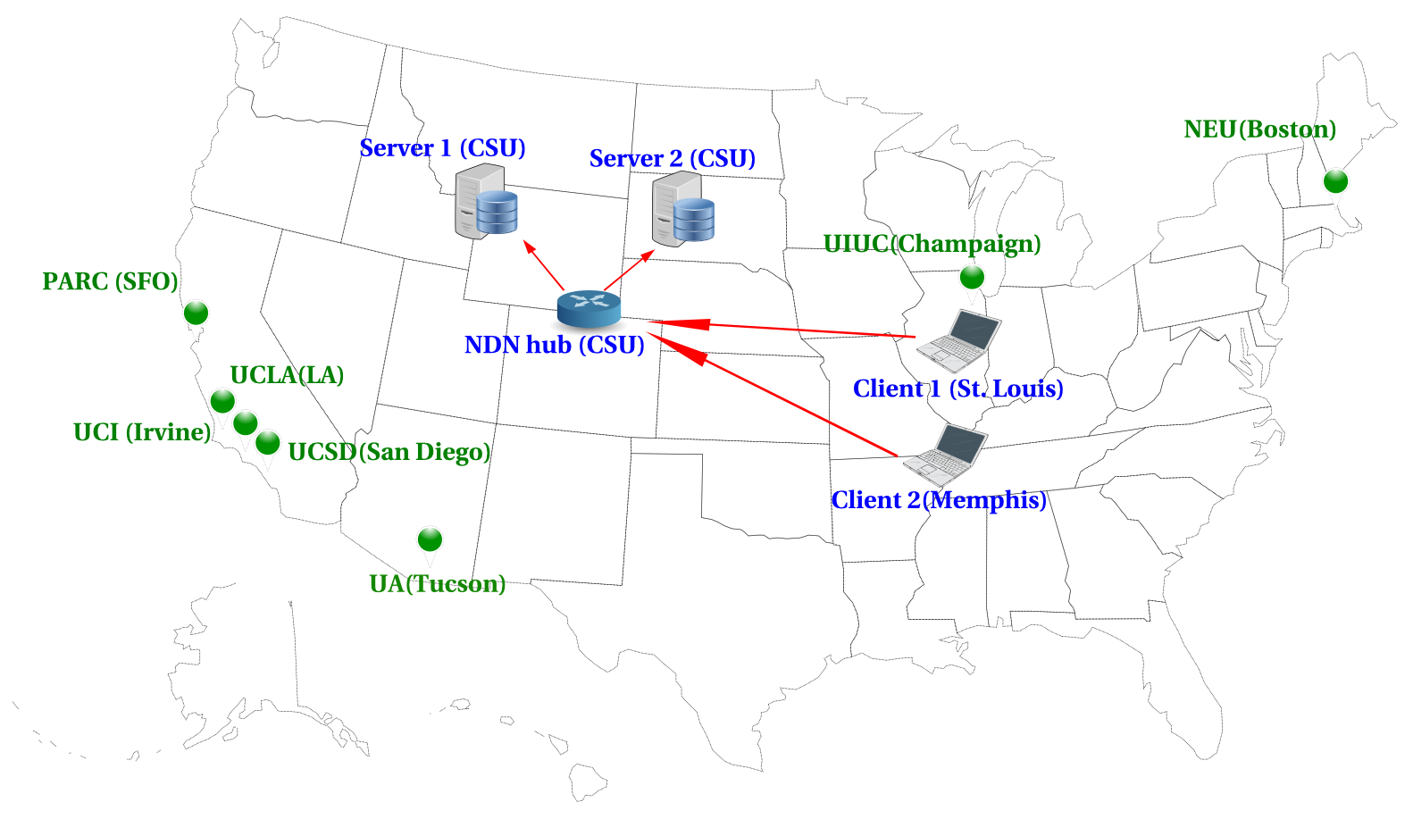
Experiment Topology

Slide 29
NDN and Anonymity
NDN has no endpoint addresses – names in interests and data packets are ephemerally associated with incoming/outgoing faces
Info retrievable at a router:
PIT – interest/data names and associated face information; in-memory, ephemeral (~RTT)
Content Store – data names, no face information; in-memory, ephemeral (~nRTT)
Attached storage (repo) – data names, no face information; on non-volatile memory, long-lived
Individual endpoints, however, engaged in a private conversation can still be identified by their names

Slide 30


In NDN Vantage Point Matters
Vantage
Point C
Vantage
Point D
? /nytimes.com/today
AT&T
Vantage
Point E
Regional ISP A
Vantage
Point B
Regional ISP B
Vantage
Point A
Information aggregation increases
and user targeting decreases going
from vantage points A – E
In IP it’s the opposite
Notes:
Consumer modems/routers may connect to neighborhood aggregator
Wiretap at ISP level has no info about where request came from
Problem made worse intermediate ISPs
Must drill down closer, into neighborhood and even home level to get info

Slide 31
Recap
In NDN routers hold ephemeral name-to-interface associations – no e2e associations
Vantage point matters
Caching may satisfy interests before they reach your vantage point
Multipath may divert interests away from your vantage point
But private parties still visible on the wire

Slide 32
DDoS Attacks
Classic DDoS is not possible
Cannot send packets without interests
However, can still do Interest packet flooding
Standard push-back defenses still possible
Smart decisions based on parsing names
In general, NDN raises the bar

Slide 33
Congestion Control
Use lessons learned from TCP – mechanisms carry over
Define congestion window just like TCP
Send interests that fall within the congestion window
Use similar AIMD behavior
Note that receiver window is not needed – receiver pulls what it wants

Slide 34
Key Distribution
No single way to distribute keys
Key distribution outside the architecture
Certificates, consensus, out-of-band, applications are free to implement anything that works
Packets tell you how to get the key (or may even carry the key with them)
Key delegation
Example: www.nytimes.com can delegate keys to editors for www.nytimes.com/sports, www.nytimes/com/business, etc.

Slide 35
Conclusions
NDN preserves the hourglass shape of IP but with names at the narrow waist
Architecture focused on the what, not the where
New forwarding mechanisms enable multipath, multicast and other group operations
All content is signed
More at http://www.named-data.net/

Slide 36


Slide 37
Backup slides

Slide 38
Naming the Content
Client requests www.nytimes.com/today
Interests go out for each packet:
www.nytimes.com/today/packet1
www.nytimes.com/today/packet2
…
Routers forward based on www.nytimes.com prefix (longest prefix match, just like IP)
Data is pulled and cached one packet at a time
Each packet contains information on how to retrieve the signing key

Slide 39
Communication by Names
Applications using names
Applications using names
Translation
Delivering packet by IP addresses
Delivering packets by names
Producer announces data prefix
e.g., www.nytimes.com/
Consumer sends interest
Producer replies with data
Notes:
At 3000 feet view:

Slide 40
Hitting Cached Data
X was cached here
Publisher
For X
Interests only go so far until they find the data
Cached data can satisfy requests efficiently

Slide 41
Multipath Interest Forwarding
Interest
Publisher
For X
Repository
That may have X
Interests may be forwarded opportunistically to many destinations
Strategy Layer
Data may be concurrently retrieved from multiple places

Slide 42
Transparency in NDN
With a search warrant for a router, what can you discover about an ISP's users?
Assumption: warrant covers volatile and non-volatile memory

Slide 43

Network Security in IP: why so Hard?
IP identifies interfaces/hosts
Current attempts aim at:
Securing the box
Securing the channel
Securing an IP network by firewall
Securing the perimeter is hard
Global Internet
My net
Notes:
How many papers published?
Are we better off today?

Slide 44











30 Years Down the Road
IP changed the world
Interconnections of computers
A new world of applications & computing devices
Moore’s Law & silicon revolution
Notes:
All these were developed on top of point-to-point communication model
Twitter outages

Slide 45
So Why a New Architecture?
What are the problems with the current Internet?
Are they worth re-designing the network?
With the current architecture being so entrenched, can we even deploy a new one?

Slide 46
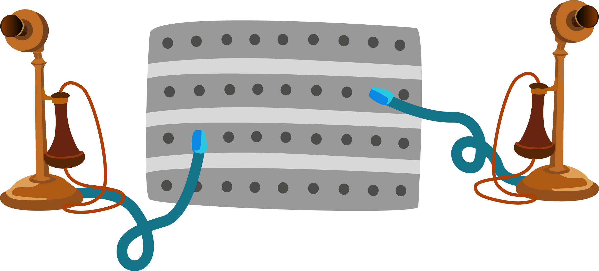
Evolution of Communication Abstraction
Internet Protocol (RFC791): Focused on delivering packets to destination node
Telephone Network:
Focused on building the wires
NDN: Focusing on retrieving data
Abstracting away the notion of “node”
Superset of node-to-node communication model
Notes:
Evolution of the Web, REST on Internet

Slide 47
A New Way to Think About Security
Secure the Content, Not the Channel!
SSL, VPN, ssh tunnel, ToR, etc all focus on providing a secure channel
Users don’t really care if the channel is secure, focus on the content
Require Authentication on All Content
Security is not an option, its part of architecture
Encrypt the content if you don’t trust the channel
Encryption is optional and applied where needed
Notes:
How many papers published?
Are we better off today?

