Slide 1
MultiPackComboDrug Regression Test

Slide 2
Scenario
Drug Parameters
"PKPD_Model": "CONCENTRATION_VERSUS_TIME",
"Malaria_Drug_Params": {
"TestDrugA": {
"Bodyweight_Exponent": 0,
"Drug_Cmax": 100,
"Drug_Decay_T1": 1,
"Drug_Decay_T2": 4,
"Drug_Dose_Interval": 2,
"Drug_Fulltreatment_Doses": 4,
"Drug_Gametocyte02_Killrate": 0,
"Drug_Gametocyte34_Killrate": 0,
"Drug_GametocyteM_Killrate": 0,
"Drug_Hepatocyte_Killrate": 0,
"Drug_PKPD_C50": 500,
"Drug_Vd": 3,
"Max_Drug_IRBC_Kill": 3.45
},
"TestDrugB": {
"Bodyweight_Exponent": 0,
"Drug_Cmax": 500,
"Drug_Decay_T1": 1,
"Drug_Decay_T2": 5,
"Drug_Dose_Interval": 4,
"Drug_Fulltreatment_Doses": 4,
"Drug_Gametocyte02_Killrate": 10.6,
"Drug_Gametocyte34_Killrate": 10.7,
"Drug_GametocyteM_Killrate": 10.8,
"Drug_Hepatocyte_Killrate": 10.9,
"Drug_PKPD_C50": 600,
"Drug_Vd": 2,
"Max_Drug_IRBC_Kill": 1.45
}
}
7 Nodes
1000 people per node
No Migration
Zero Vectors
TestDrugB has interval twice that of TestDrugA
TestDrugB is better than TestDrugA
Same # of Doses

Slide 3
Campaign
All nodes, Day 10, Outbreak
Node 1, No drugs
Node 2, Day 30, AntimalarialDrug – TestDrug A
Node 3, Day 30, MultiPackComboDrug - TestDrugA
Node 4, Day 30, AntimalarialDrug - TestDrugB
Node 5, Day 30, MultiPackComboDrug - TestDrugB
Node 6, Day 30, MulitInterventionDistributor
AntimalarialDrug – TestDrugA
AntimalarialDrug – TestDrugB
Node 7, Day 30, MultiPackComboDrug – TestDrugA & TestDrugB
To keep TestDrugB on same interval there is even an interval with no doses

Slide 4
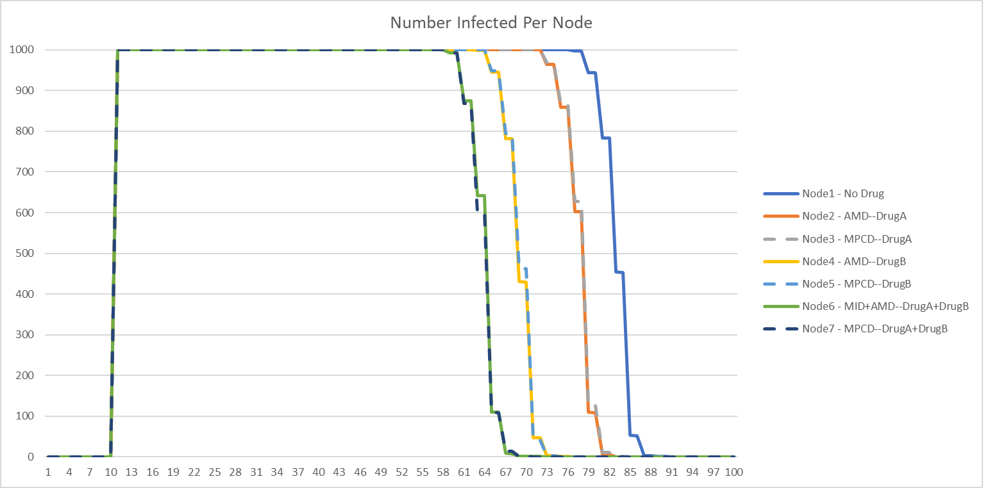
Number Infected Per Node

