Slide 1



Understanding Decision-focused Learning
Financial Engineering Lab
Department of Industrial Engineering

Slide 2
Introduction
Motivating Example
1. Must choose one box
2. Predict the value of each box
3. Decide the box with a higher value
?
?

Slide 3
Introduction
Motivating Example
Choose Blue Box
Value of
Blue Box
?
Choose Red Box
1. Must choose one box
2. Predict the value of each box
3. Decide the box with a higher value
3
True Value
4
Value of
Red Box
?

Slide 4
Introduction
Motivating Example
Choose Blue Box
Value of
Blue Box
?
Choose Red Box
1. Must choose one box
2. Predict the value of each box
3. Decide the box with a higher value
True Value
2
1
Good
Decision
4
Value of
Red Box
?

Slide 5
Introduction
Motivating Example
Choose Blue Box
Value of
Blue Box
?
Choose Red Box
Bad
Decision
1. Must choose one box
2. Predict the value of each box
3. Decide the box with a higher value
3
True Value
2
2
Value of
Red Box
?

Slide 6
Introduction
Motivating Example
Choose Blue Box
Value of
Blue Box
?
Bad
Decision
Choose Red Box
1. Must choose one box
2. Predict the value of each box
3. Decide the box with a higher value
Good
Decision
Same MSE
Value of
Red Box
?

Slide 7
Prediction & Optimization Framework
Overview
Features
Predictive Model
Prediction
Optimizer
Decision
Prediction Stage
Optimization Stage

Slide 8
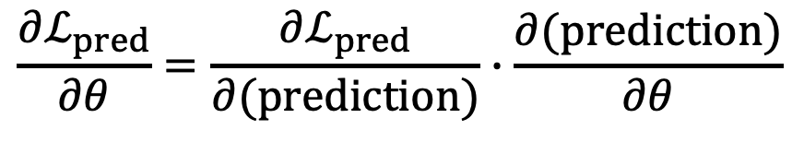
Prediction & Optimization Framework
Prediction-focused Learning (PFL)
Features
Predictive Model
Prediction
Prediction Loss
Differentiate
$$\frac{∂ℒ_{pred}}{∂θ}=\frac{∂ℒ_{pred}}{∂(prediction)}∙\frac{∂(prediction)}{∂θ}$$
Prediction Loss

Slide 9
Prediction & Optimization Framework
Prediction-focused Learning (PFL)
Features
Predictive Model
Prediction
Features
TRAINED
Predictive Model
Prediction
Optimizer
Decision

Slide 10
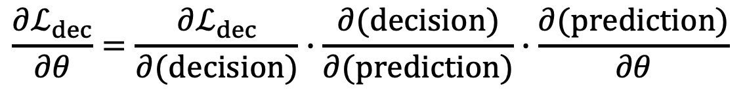
Prediction & Optimization Framework
Decision-focused Learning (DFL)
Features
Predictive Model
Prediction
Optimizer
Decision
Decision Loss
Differentiate
Decision Loss > o
$$\frac{∂ℒ_{dec}}{∂θ}=\frac{∂ℒ_{dec}}{∂(decision)}∙\frac{∂(decision)}{∂(prediction)}∙\frac{∂(prediction)}{∂θ}$$
Decision Loss = 0
How?

Slide 11
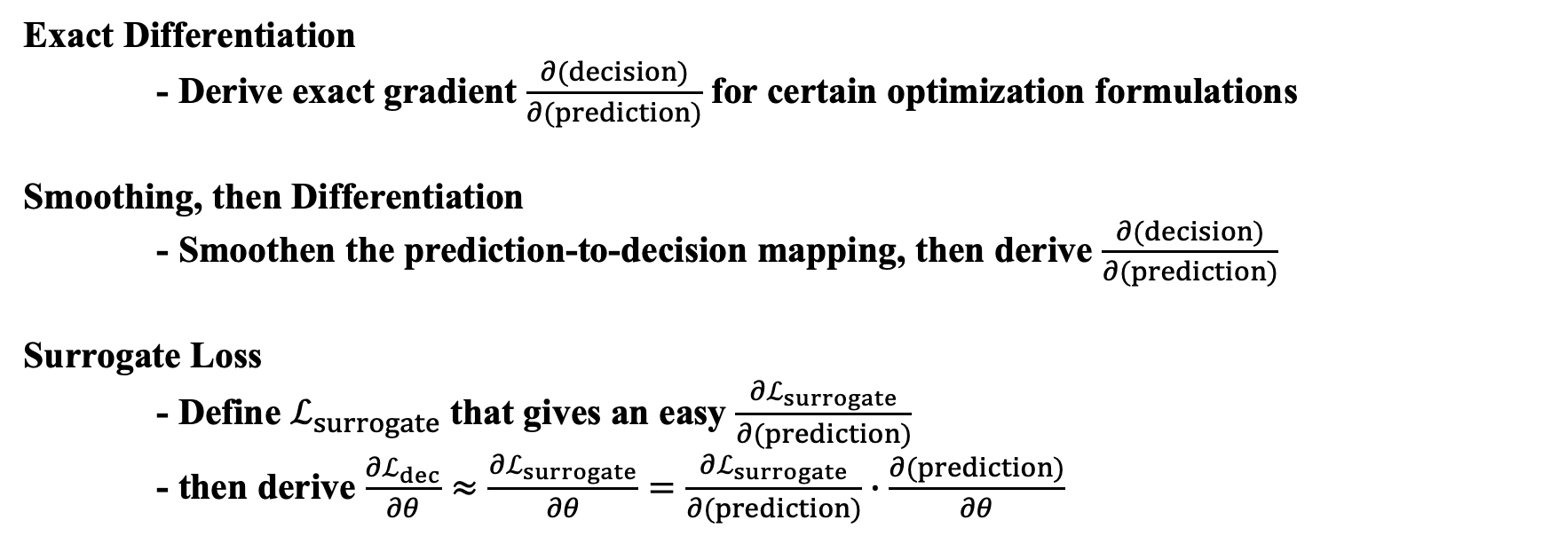
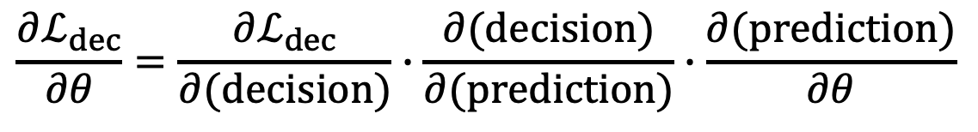
Prediction & Optimization Framework
Decision-focused Learning (DFL)
$$\frac{∂ℒ_{dec}}{∂θ}=\frac{∂ℒ_{dec}}{∂(decision)}∙\frac{∂(decision)}{∂(prediction)}∙\frac{∂(prediction)}{∂θ}$$
Exact Differentiation
- Derive exact gradient $\frac{∂(decision)}{∂(prediction)}$ for certain optimization formulations
Smoothing, then Differentiation
- Smoothen the prediction-to-decision mapping, then derive $\frac{∂(decision)}{∂(prediction)}$
Surrogate Loss
- Define $ℒ_{surrogate}$ that gives an easy $\frac{∂ℒ_{surrogate}}{∂(prediction)}$
- then derive $\frac{∂ℒ_{dec}}{∂θ}≈\frac{∂ℒ_{surrogate}}{∂θ}=\frac{∂ℒ_{surrogate}}{∂(prediction)}∙\frac{∂(prediction)}{∂θ}$

Slide 12
Hands-on Exercise
Recall: Motivating Example
1. Must choose one box
2. Predict the value of each box
3. Decide the box with a higher value
?
?

Slide 13


Hands-on Exercise
True underlying reward of each box
?
$$(x_{1},x_{2})$$
$$red=(x_{1}^{2}−x_{2}^{2})+100(x_{1}+x_{2})$$
?
$$(x_{1},x_{2})$$
$$blue=−(x_{1}^{2}−x_{2}^{2})+100(x_{1}+x_{2})$$

Slide 14




Hands-on Exercise
True optimal decision
?
$$(x_{1},x_{2})$$
$$red=(x_{1}^{2}−x_{2}^{2})+100(x_{1}+x_{2})$$
$$x_{1}^{2}≥x_{2}^{2}$$
?
$$(x_{1},x_{2})$$
$$blue=−(x_{1}^{2}−x_{2}^{2})+100(x_{1}+x_{2})$$
$$x_{1}^{2}<x_{2}^{2}$$

Slide 15

Hands-on Exercise
Overview of Problem Framework
Features
Prediction
Decision
Predictive Model
$$(x_{1},x_{2})$$
Max

Slide 16

Hands-on Exercise
Step 1: Data Generation
Features
Predictive Model
$$(x_{1},x_{2})$$
$$x_{i} \sim U(−1,1)$$

Slide 17
Hands-on Exercise
Step 2: Building Predictive Model
Features
Prediction
Predictive Model
$$(x_{1},x_{2})$$
MLP with 1 hidden layer

Slide 18
Hands-on Exercise
Step 3A: Train with Prediction-focused Learning (PFL)
Features
Prediction
Predictive Model
$$(x_{1},x_{2})$$
Differentiate
Prediction Loss

Slide 19
Hands-on Exercise
Step 3B: Train with Decision-focused Learning (DFL)
Features
Prediction
Decision
Predictive Model
$$(x_{1},x_{2})$$
Max
Differentiate
Decision Regret

Slide 20
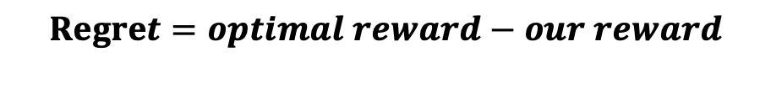

Hands-on Exercise
Step 3B: Train with Decision-focused Learning (DFL)
Features
Prediction
Decision
Predictive Model
$$(x_{1},x_{2})$$
$$softmax$$
Differentiate
Decision Regret
$$Regret=optimal reward−our reward$$

Slide 21
Hands-on Exercise
Step 4: Test and Plot Results
Features
Prediction
Decision
TRAINED
Predictive Model
$$(x_{1},x_{2})$$
Max

Slide 22

Hands-on Exercise
Github Link

