Slide 1
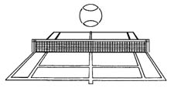
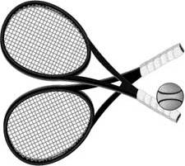
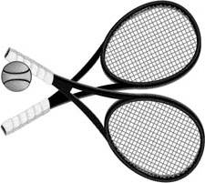
2009 Tarnowski Cup
Men’s Doubles Tournament
Saturday & Sunday Aug 15th & 16st
Please Sign up at the Tennis House or Call 589-9838
Award Presentation and Refreshments on Sunday After the Finals
Everyone Welcome !

