Slide 1
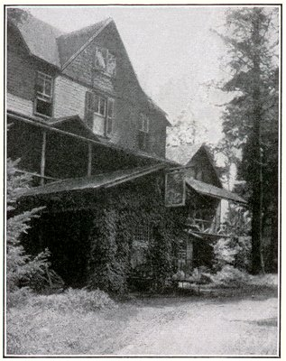
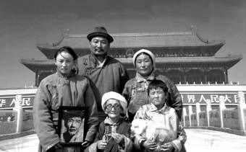
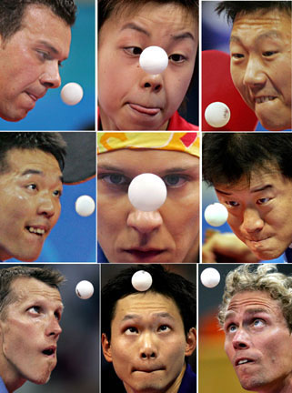
Ping Pong Competition
In Pursuit of the Twelka Cup
Hi Ping Pong Enthusiasts,
The ultimate ping pong competition of the season is rapidly approaching: Twilight Park versus Elka Park on Sunday, July 26, 2009 at 2:15 pm in the Elka Park clubhouse, in pursuit of the vaunted TWELKA CUP! Now is the time for Twilight Cottagers and renters to sign up to play in the preliminary matches which will determine who will represent Twilight Park in the finals.
Please call or email one of Twilight Park’s Twelka Cup Co-Captains to register, providing your name, phone number, email address, and tournament category (men (age 17 to whatever); women (age 17 to whatever); kids (age 12 through 16); and kids (age 11 and under).
John Gordon 518 589-6540 or jrg07@aol.com
Ellen Lasch 212 579-6483 or elasch@nyc.rr.com
Twelka Cup participants should register with John or Ellen as soon as possible, but no later than Sunday, July 5, 2009. Those registering must be available for the finals on July 26th, and should also be (somewhat) available for practice and play during late June and most of July.
Thanks in advance for your support of returning the Twelka Cup to Twilight Park in 2009!

