Slide 1

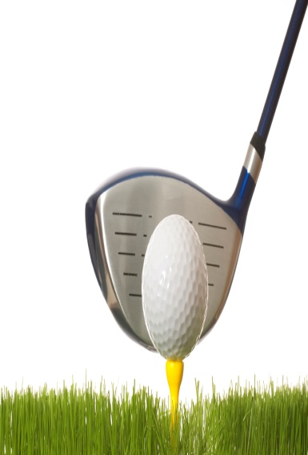
Twilight Golf Scramble
Saturday August 21st at Lazy Swan Golf Club, Saugerties, NY
Rain Date Sunday
2:00 PM Tee Time
$28.00 Per Person Includes 9 Holes and Cart
$5 Per Person Contribution for Prizes
4 Persons Per Team
1st and 2nd Place Team Prizes
Longest Drive Prize (Ladies/Gentlemen)
Closest to the Pin Prize (Ladies/Gentlemen)
All are Welcome for Cocktails and Prize Presentations
5 O’ Clock @ 35 Ledge End Rd (Galatti Cottage)
Please RSVP to John Galatti x6543 jgalatti@twilightparkrock.com by 8/14/10
Golf Fees Payable to Lazy Swan Golf Club

