Slide 1
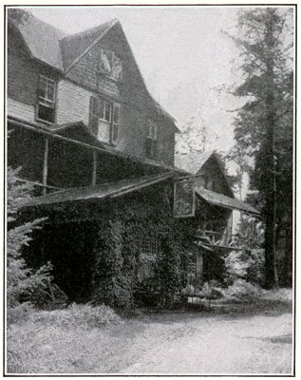
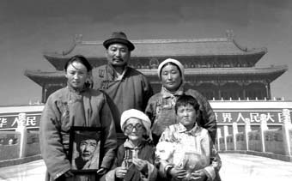
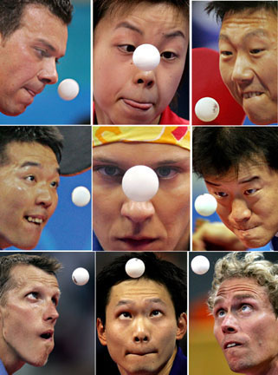
Ping Pong Competition
In Pursuit of the Twelka Cup
Hi Ping Pong Enthusiasts,
The ultimate ping pong competition of the season is rapidly approaching: Twilight Park versus Elka Park on Sunday, July 31st, 2016 at 2:00 pm in the Elka Park clubhouse, in pursuit of the vaunted TWELKA CUP! Now is the time for Twilight Cottagers and renters to sign up to play in the preliminary matches which will determine who will represent Twilight Park in the finals.
Please call or email one of Twilight Park’s Twelka Cup Co-Captains to register, providing your name, phone number, email address, and (newly categorized) tournament category (men (age 17 to whatever); women (age 17 to whatever); girls (age 16 and under); boys (age 16 and under); kids (age 12 and under); and masters-senior (age 65 and over).
John Gordon 518 589-6540 or jrg07@aol.com
Ellen Lasch 518 589-5270 or ellen.lasch@gmail.com
Twelka Cup participants should register with John or Ellen as soon as possible, but no later than Monday, July 4th, 2016. Those registering must be available for the finals on July 31st, and should also be (somewhat) available for practice and play during most of July.
Thanks in advance for your support in once again returning the Twelka Cup to Twilight Park in 2016!

