Slide 1
Fellowship Workshop
Materials at https://bridgeslab.github.io/FellowshipWorkshopDocuments/

Slide 2
Goals and Expectations
Help organize/support writing of competitive F31 applications
Next deadline is August 15 (to NIH)
Peer review each other’s documents, learn from each other’s writing
Do homework, contribute to discussions, be honest with and receptive to feedback

Slide 3
Fellowships and Training Programs (NIH)

Slide 4
Other NIH Fellowship Programs

Slide 5
Award Eligibility
Fellowship | Citizenship | Stage
F31 | US Citizen or Permanent Resident | PhD Program, Candidate when awarded
F32 | US Citizen or Permanent Resident | Postdoc (PhD when awarded)
K01 | US Citizen or Permanent Resident | Postdoc (2-6 years)
K08 | US Citizen or Permanent Resident | Clinical Postdoc (2-6 years)
K23 | US Citizen or Permanent Resident | Clinical Postdoc (2-6 years)
K99 | Any | Postdoc (1-4 years)

Slide 6
Some terms
Principal Investigator (PI) – You
Sponsor – Your mentor
Co-Sponsor – Your co-mentor (if you have one)
Collaborators/Co-Investigators – Support team

Slide 7
What are we working on
Section | Length | Notes
Project Summary/Abstract | 30 lines of text
Project Narrative | Three sentences
Introduction to Resubmission or Revision Application (when applicable) | 1 page | Only if revising
Applicant’s Background and Goals for Fellowship Training | 6 pages | Includes Research Experience, Goals, and Activities
Specific Aims | 1 page
Research Strategy | 6 pages
Respective Contributions | 1 page
Selection of Sponsor and Institution | 1 page
Training in the Responsible Conduct of Research
Sponsor and Co-Sponsor Statements | 6 pages
Letters of Support from Collaborators, Contributors, and Consultants
Description of Institutional Environment and Commitment to Training | 2 pages
Biographical Sketches | 5 pages | Candidate and all key personnel

Slide 8
Timeline for Writing and Revising

Slide 9
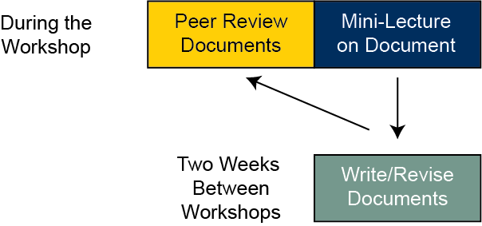
How this workshop series will work

Slide 10
The NIH Review Process
Criteria
Investigator
Mentors
Career Development Plan
Research Plan
Environment
Also give overall score (10-90)
Specific NRSA Review Criteria here
Three reviewers assigned
Each will score your application
Discussion
Primary will introduce application (~15 minutes_
Secondary, tertiary will add details
Panel (~20-30 people) ask clarifying questions
Restate scores, panel votes

Slide 11
This Week
Budget
Candidate Information
Biosketch

Slide 12
Budget
Fill out this worksheet
Allowable items include
Stipend (see https://grants.nih.gov/grants/guide/notice-files/NOT-OD-24-104.html)
Tuition and Fees (F31 capped, F32 only if courses are in training plan)
Institutional Allowance
Childcare Allowance

Slide 13
Candidate Information
Key points in this worksheet

Slide 14
Biosketch

Slide 15
Homework for next meeting (in two weeks)
Fill out planning worksheet here
Review candidate worksheet with your sponsor
Write candidate introduction and upload to dropbox
Write biosketch and upload to dropbox
Write budget justification and upload to dropbox
Review each other’s documents before next meeting

