Slide 1
Fellowship Workshop
Materials at https://bridgeslab.github.io/FellowshipWorkshopDocuments/

Slide 2
Goals and Expectations
Help organize/support writing of competitive F31 applications
Next deadline is August 15 (to NIH)
Peer review each other’s documents, learn from each other’s writing
Do homework, contribute to discussions, be honest with and receptive to feedback

Slide 3
Fellowships and Training Programs (NIH)

Slide 4
Other NIH Fellowship Programs

Slide 5
Award Eligibility
Fellowship | Citizenship | Stage
F31 | US Citizen or Permanent Resident | PhD Program, Candidate when awarded
F32 | US Citizen or Permanent Resident | Postdoc (PhD when awarded)
K01 | US Citizen or Permanent Resident | Postdoc (2-6 years)
K08 | US Citizen or Permanent Resident | Clinical Postdoc (2-6 years)
K23 | US Citizen or Permanent Resident | Clinical Postdoc (2-6 years)
K99 | Any | Postdoc (1-4 years)

Slide 6
Some terms
Principal Investigator (PI) – You
Sponsor – Your mentor
Co-Sponsor – Your co-mentor (if you have one)
Collaborators/Co-Investigators – Support team

Slide 7
What are we working on
Section | Length | Notes
Project Summary/Abstract | 30 lines of text
Project Narrative | Three sentences
Introduction to Resubmission or Revision Application (when applicable) | 1 page | Only if revising
Candidate’s Goals, Preparedness, and Potential | 3 pages
Training Activities and Timeline | 3 pages
Research Training Project Specific Aims | 1 page
Research Training Project Strategy | 6 pages
Budget and Justification | no explicit limit, should be ~ 1 page
Training in the Responsible Conduct of Research | 1 page
Sponsor(s) Commitment | 6 pages
Letters of Support from Collaborators, Contributors, and Consultants | 6 pages
Institutional Environment Description | 2 pages
Biographical Sketches | 5 pages each | Candidate and all key personnel; prepared via SciENcv

Slide 8
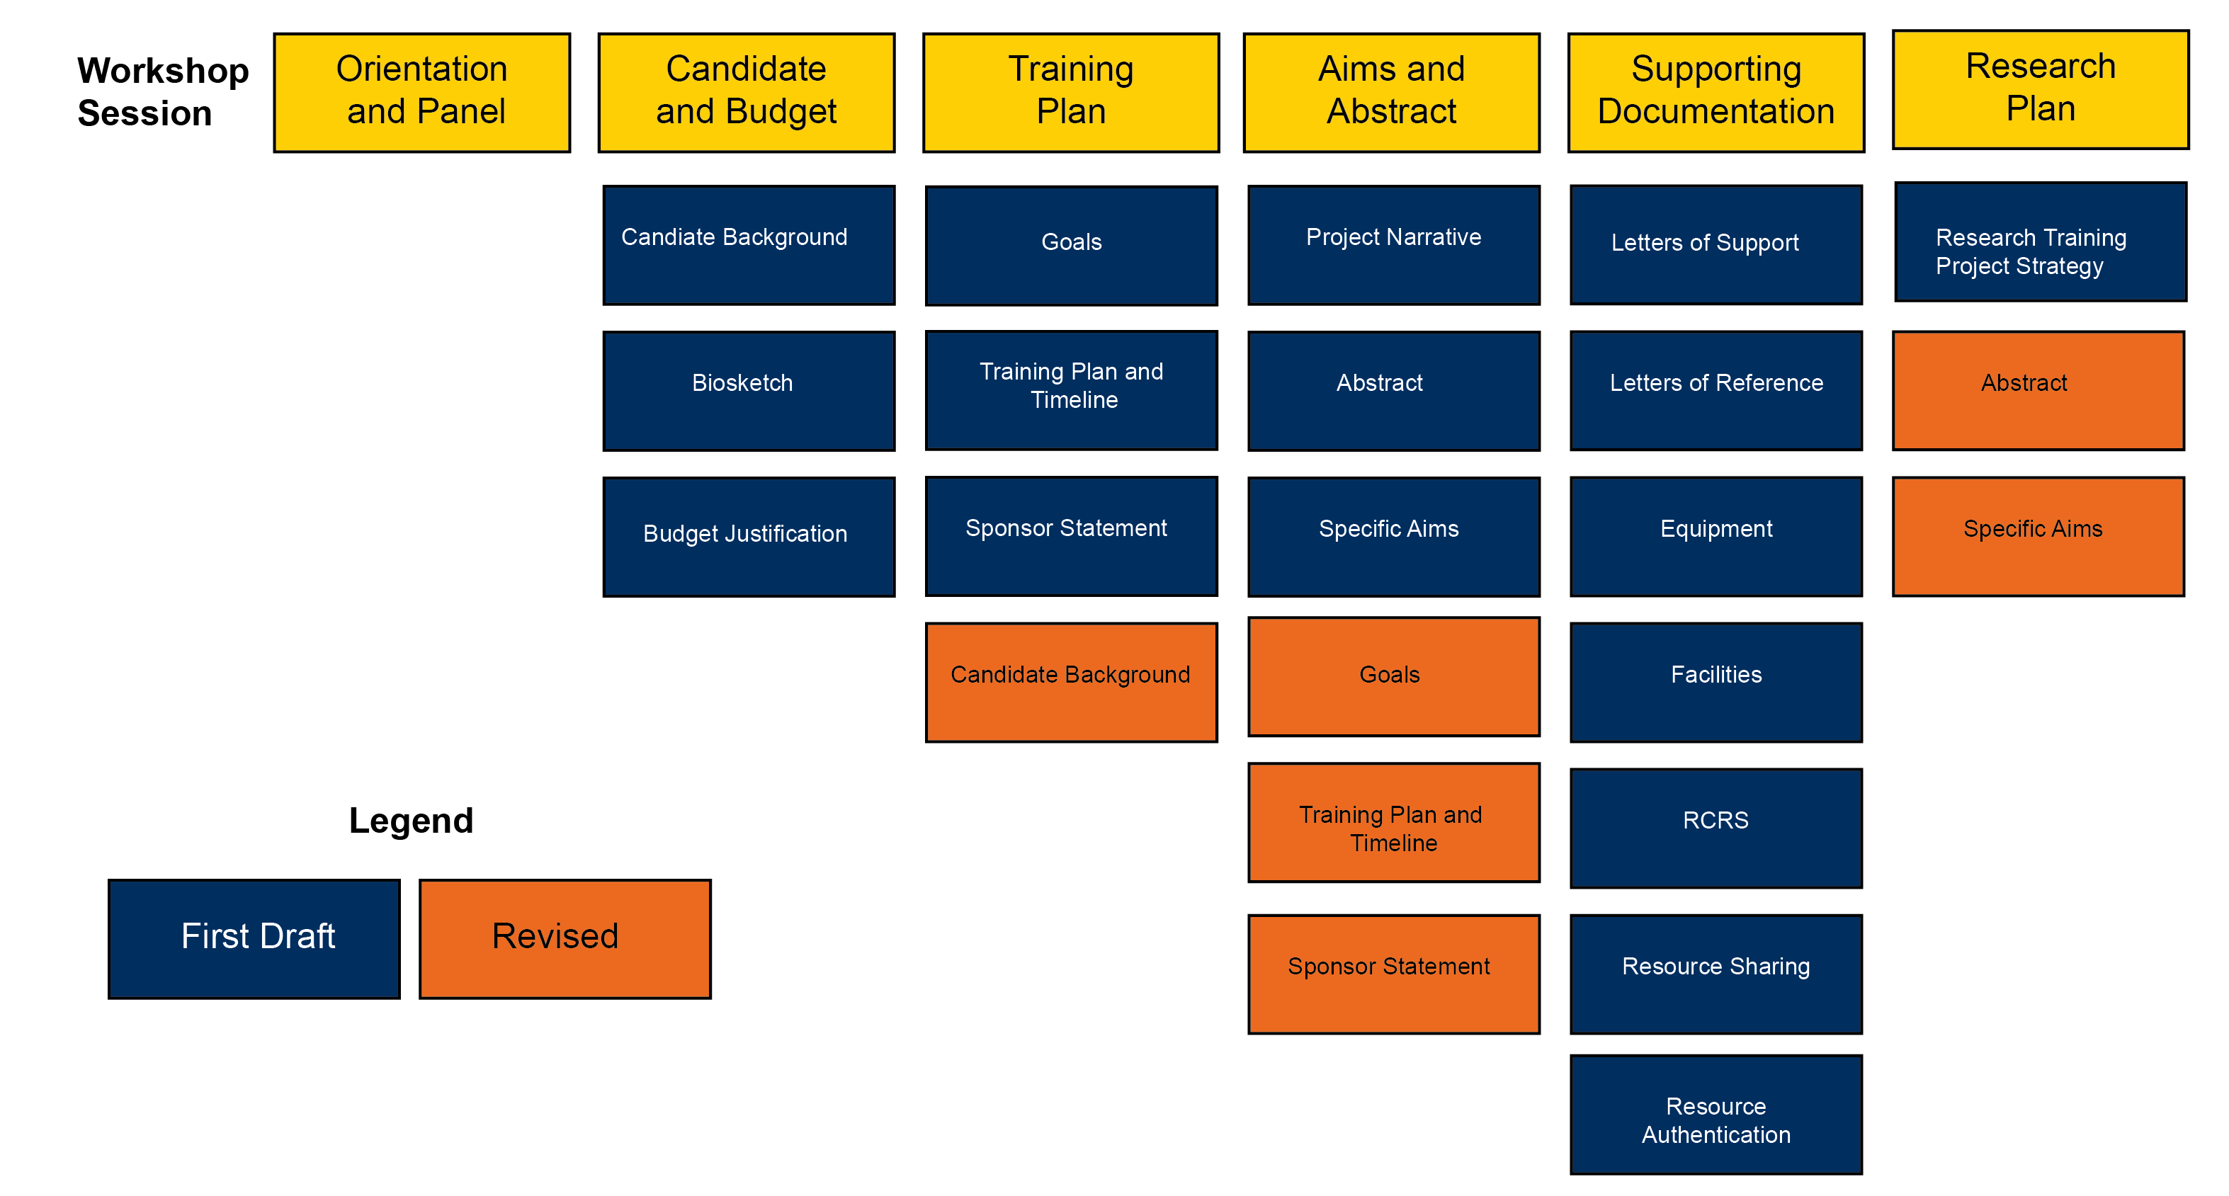
Timeline for Writing and Revising

Slide 9
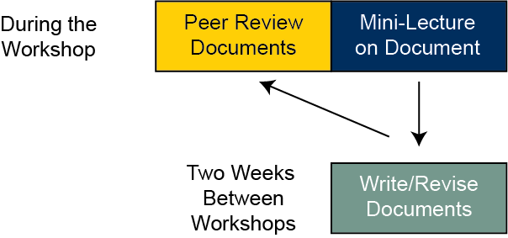
How this workshop series will work

Slide 10
The NIH Review Process
Criteria
I
Also give overall score (10-90)
Specific NRSA Review Criteria here
Three reviewers assigned
Each will score your application
Discussion
Primary will introduce application (~15 minutes_
Secondary, tertiary will add details
Panel (~20-30 people) ask clarifying questions
Restate scores, panel votes

Slide 11
This Week
Budget
Candidate Information
Biosketch

Slide 12
Budget
Fill out this worksheet
Allowable items include
For F31: Use the predoctoral stipend rate (currently $28,788).
Tuition and Fees
Institutional Allowance
Childcare Allowance
For F32: VariesNOT-OD-25-105).

Slide 13
Candidate Information
Key points in this worksheet
Document is Applicant’s Background and Goals for Fellowship Training
Doctoral Dissertation and Research Experience – This week
Training Goals and Objectives – Next week
Activities Planned Under this Award – Next week
Define yourself as of now
Articulate skills, achievements, background. Provide evidence
Define yourself at the end of the fellowship
What is missing, what training is required to get you there (parts B/C)

Slide 14
Who are you? Who will you become
I am a second year Molecular and Integrative Physiology Ph.D. student with an undergraduate degree in cell biology completing a dissertation on the role of SREBP2 in intestinal lipid transport
Current stage
Background
Project
I am requesting F31 fellowship support in order to pursue to an independent research career investigating the physiology of lipid homeostasis and how it relates to primary prevention of cardiovascular disease.
Next stage
Research area
Long term goals

Slide 15
Biosketch
Must be done on MySciENcv
Key sections
Personal statement (another way to introduce/frame your expertise)
Contributions to Science
Research products (papers, conferences, educational materials)
Relevant to application
Other relevant products

Slide 16
Homework for next meeting (in two weeks)
Fill out planning worksheet here
Review candidate worksheet with your sponsor
Write candidate introduction
Write biosketch
Write budget justification
Upload documents to dropbox by May 27th
Review each other’s documents before next meeting

