Slide 1
Fellowship Workshop
Materials at https://bridgeslab.github.io/FellowshipWorkshopDocuments/

Slide 2
Goals and Expectations
Help organize/support writing of competitive F31 applications
Next deadline is August 15 (to NIH)
Peer review each other’s documents, learn from each other’s writing
Do homework, contribute to discussions, be honest with and receptive to feedback

Slide 3
Fellowships and Training Programs (NIH)

Slide 4
Other NIH Fellowship Programs

Slide 5
Award Eligibility
Fellowship | Citizenship | Stage
F31 | US Citizen or Permanent Resident | PhD Program, Candidate when awarded
F32 | US Citizen or Permanent Resident | Postdoc (PhD when awarded)
K01 | US Citizen or Permanent Resident | Postdoc (2-6 years)
K08 | US Citizen or Permanent Resident | Clinical Postdoc (2-6 years)
K23 | US Citizen or Permanent Resident | Clinical Postdoc (2-6 years)
K99 | Any | Postdoc (1-4 years)

Slide 6
Some terms
Principal Investigator (PI) – You
Sponsor – Your mentor
Co-Sponsor – Your co-mentor (if you have one)
Collaborators/Co-Investigators – Support team

Slide 7
What are we working on
Section | Length | Notes
Project Summary/Abstract | 30 lines of text
Project Narrative | Three sentences
Introduction to Resubmission or Revision Application (when applicable) | 1 page | Only if revising
Applicant’s Background and Goals for Fellowship Training | 6 pages | Includes Research Experience, Goals, and Activities
Specific Aims | 1 page
Research Strategy | 6 pages
Respective Contributions | 1 page
Selection of Sponsor and Institution | 1 page
Training in the Responsible Conduct of Research
Sponsor and Co-Sponsor Statements | 6 pages
Letters of Support from Collaborators, Contributors, and Consultants
Description of Institutional Environment and Commitment to Training | 2 pages
Biographical Sketches | 5 pages | Candidate and all key personnel

Slide 8
Timeline for Writing and Revising

Slide 9
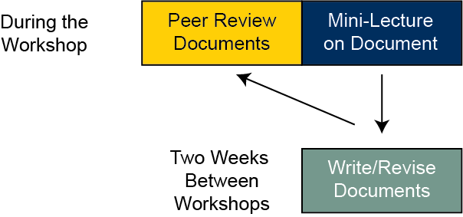
How this workshop series will work

Slide 10
The NIH Review Process
Criteria
Investigator
Mentors
Career Development Plan
Research Plan
Environment
Also give overall score (10-90)
Specific NRSA Review Criteria here
Three reviewers assigned
Each will score your application
Discussion
Primary will introduce application (~15 minutes_
Secondary, tertiary will add details
Panel (~20-30 people) ask clarifying questions
Restate scores, panel votes

Slide 11
This Week
Budget
Candidate Information
Biosketch
Expert Panel

Slide 12
Budget
Fill out this worksheet
Allowable items include
Stipend (see https://grants.nih.gov/grants/guide/notice-files/NOT-OD-24-104.html)
Tuition and Fees (F31 capped, F32 only if courses are in training plan)
Institutional Allowance
Childcare Allowance

Slide 13
Candidate Information
Key points in this worksheet
Document is Applicant’s Background and Goals for Fellowship Training
Doctoral Dissertation and Research Experience – This week
Training Goals and Objectives – Next week
Activities Planned Under this Award – Next week
Define yourself as of now
Articulate skills, achievements, background. Provide evidence
Define yourself at the end of the fellowship
What is missing, what training is required to get you there (parts B/C)

Slide 14
Who are you? Who will you become
I am a second year Molecular and Integrative Physiology Ph.D. student with an undergraduate degree in cell biology completing a dissertation on the role of SREBP2 in intestinal lipid transport
Current stage
Background
Project
I am requesting F31 fellowship support in order to pursue to an independent research career investigating the physiology of lipid homeostasis and how it relates to primary prevention of cardiovascular disease.
Next stage
Research area
Long term goals

Slide 15
Biosketch
Examples at https://grants.nih.gov/grants-process/write-application/forms-directory/biosketch
Key sections
Education/Training
Personal statement (another way to introduce/frame your expertise)
Contributions to Science
NCBI MyBibliography link (e.g. https://www.ncbi.nlm.nih.gov/myncbi/1VgYzYESn3Nke9/bibliography/public/ )
Scholastic Performance (not needed anymore so leave blank or write N/A)

Slide 16
Contributions to Science
Consider arranging
by stage (pre-doctorate, doctoral research, postdoctoral research)
by research topic
For each can provide up to four research products. These can include
Peer reviewed publications
Preprints
Conference proceedings, meeting abstracts, posters, and oral presentations
Patents
Datasets
Educational materials
Software or protocols

Slide 17
Homework for next meeting (in two weeks)
Fill out planning worksheet here
Review candidate worksheet with your sponsor
Write candidate introduction
Write biosketch
Write budget justification
Upload documents to dropbox by May 28th
Review each other’s documents before next meeting

Slide 18
Our Expert Panel
Jessica Muang
Allison Duensing

