Slide 1
Predicting weight gain based on body composition and metabolic rate

Slide 2
Objective
To identify predictors that can estimate the amount of weight gain after a fasting period of 16 hours

Slide 3
Hypothesis
Weight loss during fasting may be a predictor of weight gain after HFD.
Previous cohorts 5-6: there appeared to be a negative relationship
Current cohorts 7-8: there is a positive relationship

Slide 4
Experimental design
C57BL/6J mice
HFD #5 – Born 2013-04-03 (n=24)
HFD #6 – Born 2013-07-02 (n=24
HFD #7 – cohort id is 8 (n=24)
HFD #8 – cohort id is 15 (n=30)
10/17
10/21
10/22
08/11/2014
1/16/2015
NCD
FAST
HFD
11/26
12/01
12/02
09/22/2014
2/24/2015
NCD
FAST
HFD

Slide 5
Available Data
Cohort | Body Weight | Lean & Fat Mass | CLAMS | Hormones | Glucose
5 (n=24) | Yes | no | no | yes | yes
6 (n=24) | yes | no | no | Yes | yes
7 (n=24) | yes | yes | yes | Not yet | Not yet
8 (n=30) | yes | yes | yes | Not yet | Not yet

Slide 6
Body weight
Tukey’s post-hoc of initial weights
Tukey’s post-hoc of fasted weights

Slide 7
HFD weights
Tukey’s post-hoc of after HFD weights

Slide 8
Density plots for weights

Slide 9
Checking normality for WL and WG
Shapiro’s p-values for WL and WG are 0.00307 and 0.0124, respectively.

Slide 10
Relationship between WL and WG

Slide 12
The 95% CI for Kendall’s tau is (0.031, 0.281)

Slide 13
Relationship between Initial weight and WG
The 95% CI for Kendall’s tau is (0.032, 0.315)

Slide 16
Juvenile HFD
JuvHFD # 1 – Born 2014-04-21 (Mice #410-433)
JuvHFD # 2 – Born 2014-07-07
RNAseq – Born 2015-01-21

Slide 18
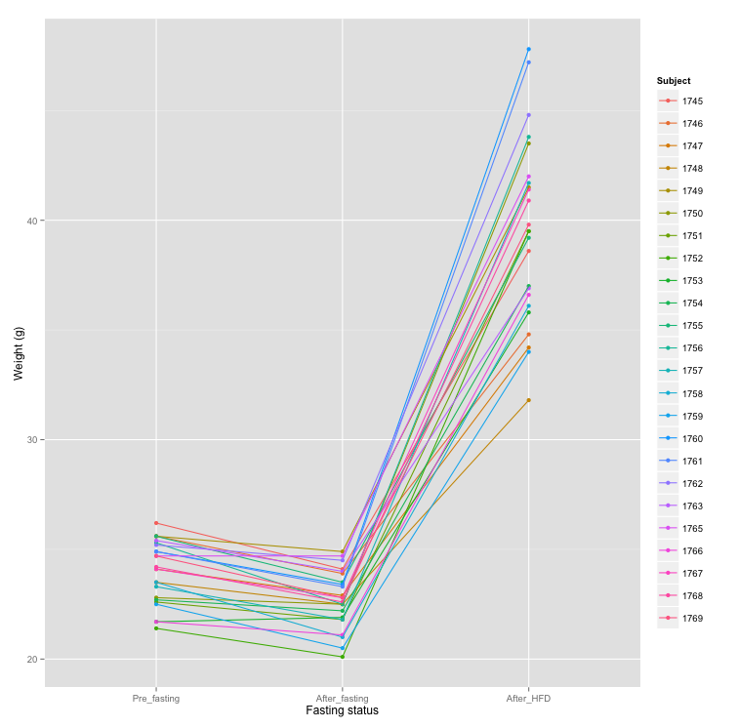

Slide 19
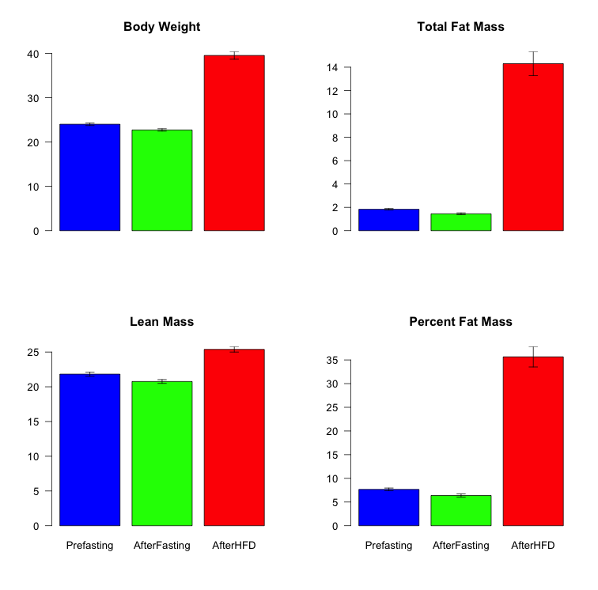
*

Slide 20
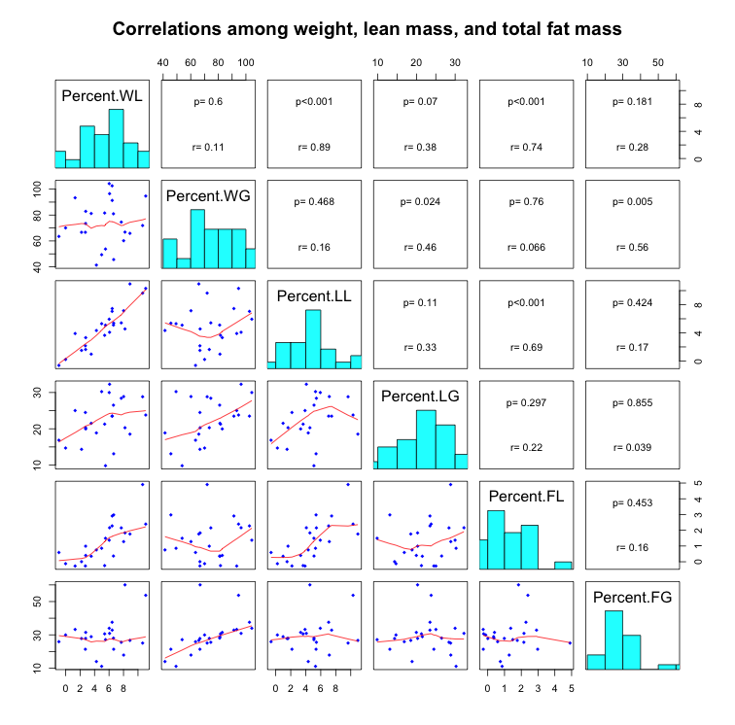

Slide 21
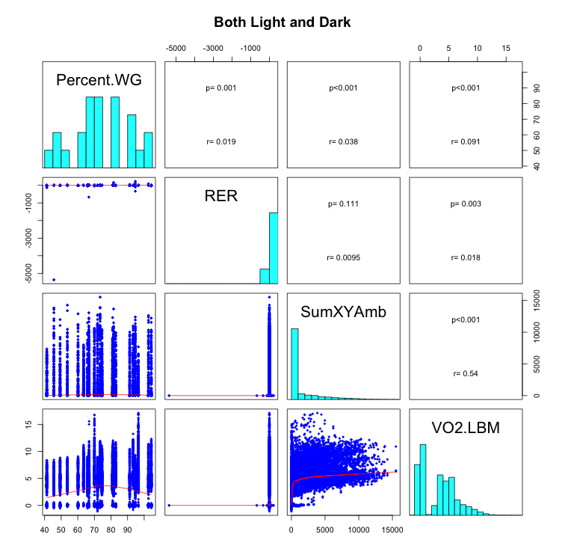

Slide 22
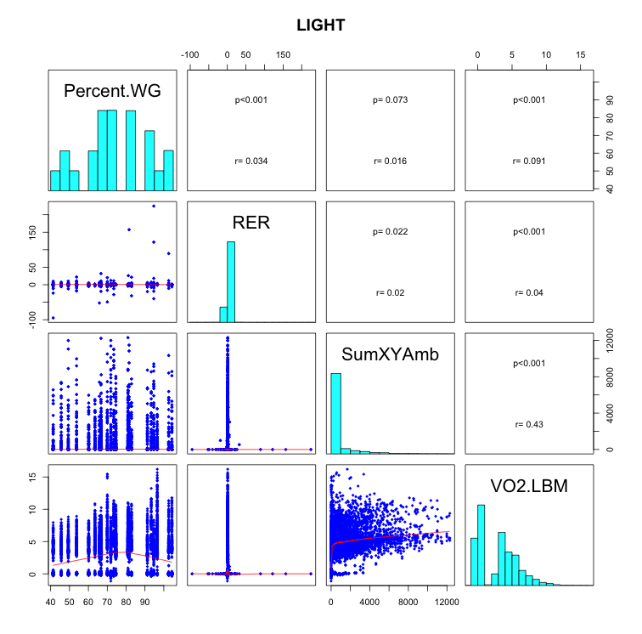

Slide 23
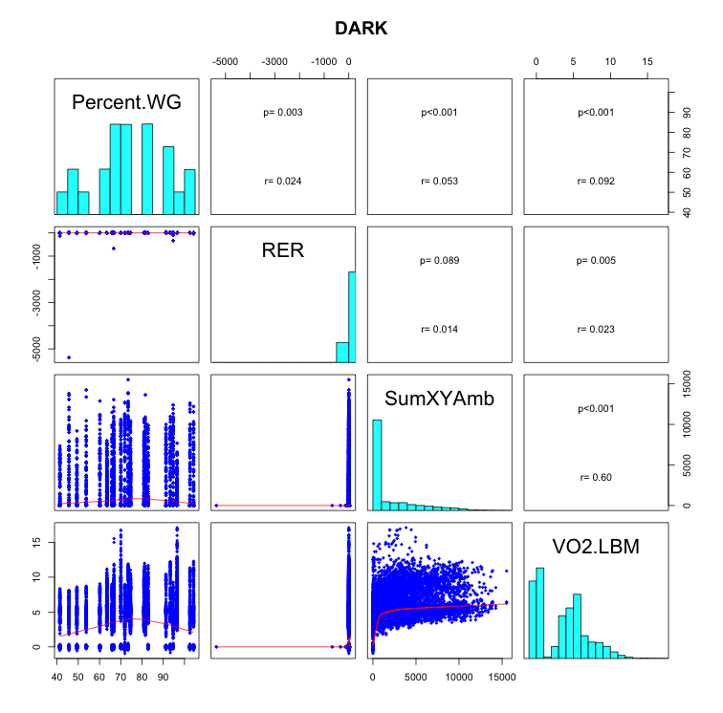

Slide 24
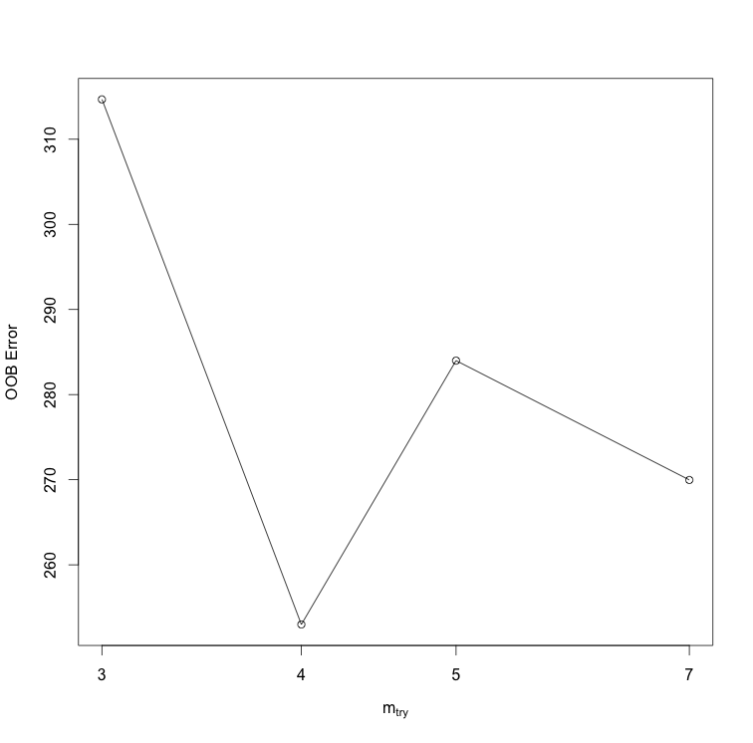
Optimal # of vars to split at each node

Slide 25
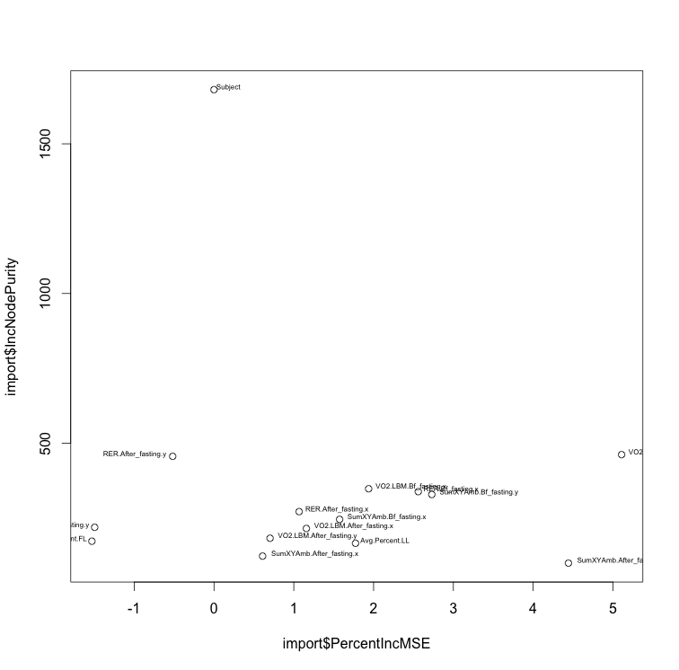
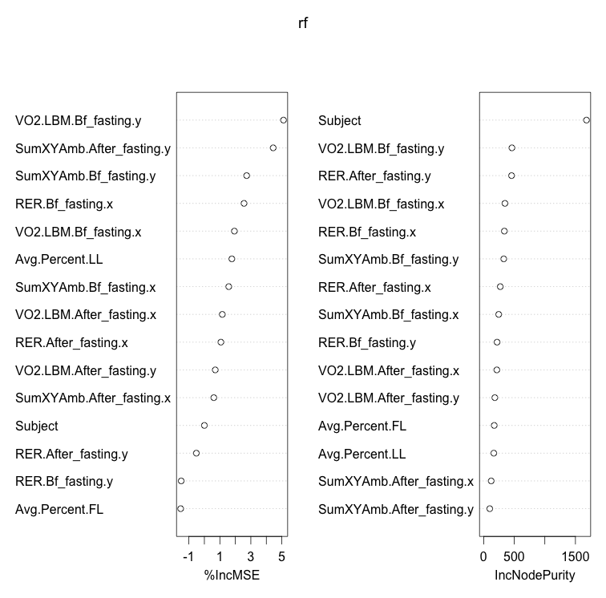

Slide 26
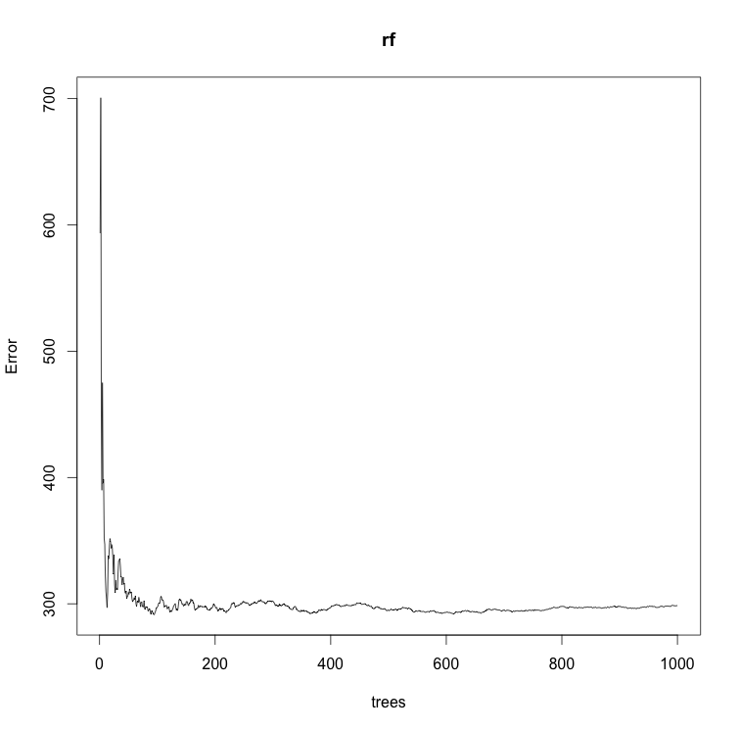

Slide 27
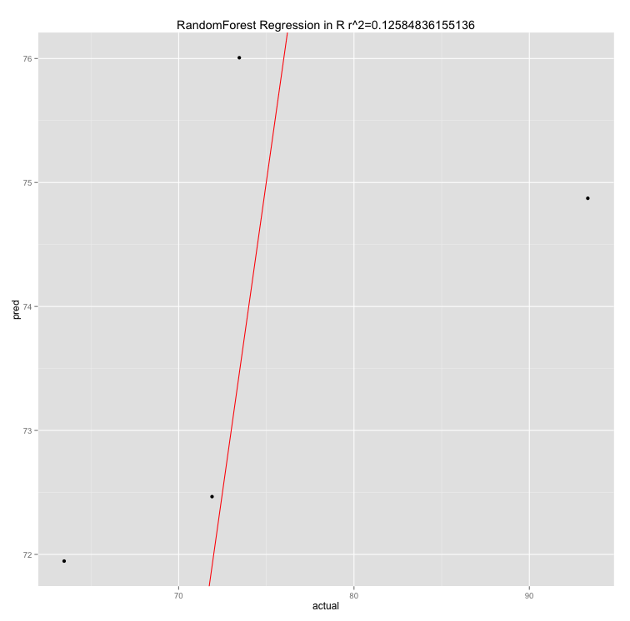

Slide 28
RE-EM tree

Slide 29
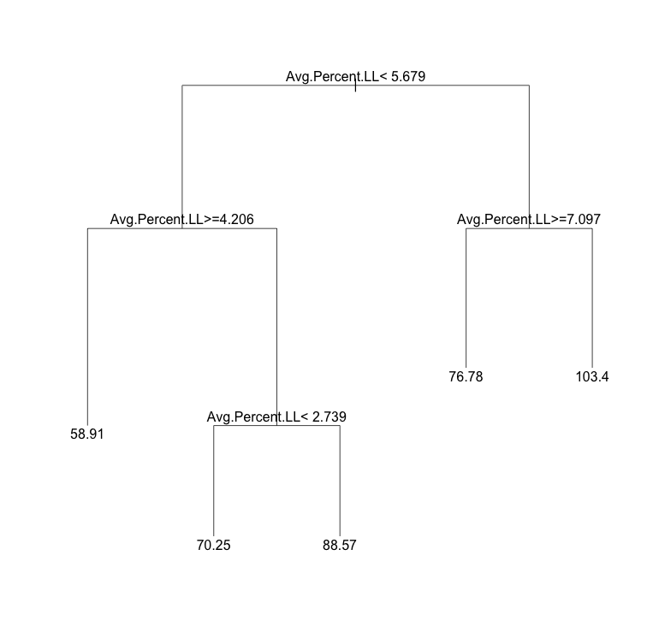

Slide 30
sub <- c(rep(TRUE, 96), rep(FALSE, 62))
weight.rf2 <- REEMtree(Percent.WG~ VO2.LBM + RER + SumXYAmb+
Avg.Percent.FL + Avg.Percent.LL + Light.Dark + Fast
, data=combine.data, random=~1|Subject, subset=sub)
R2 = 0.288
MSE = 190.12

Slide 31
