Slide 1
Predicting weight gain based on body composition and metabolic rate

Slide 2
Objective
To identify predictors that can estimate the amount of weight gain after a fasting period of 16 hours

Slide 3
Experimental design
C57BL/6J mice
HFD#8 – cohort id is 8 (training data set, n=24)
HFD#9 – cohort id is 15 (evaluation data set, n=30)
10/17/2014
1/16/2015
10/21/2014
10/22/2014
11/26/2014
2/24/2015
12/01/2014
12/02/2014

Slide 4
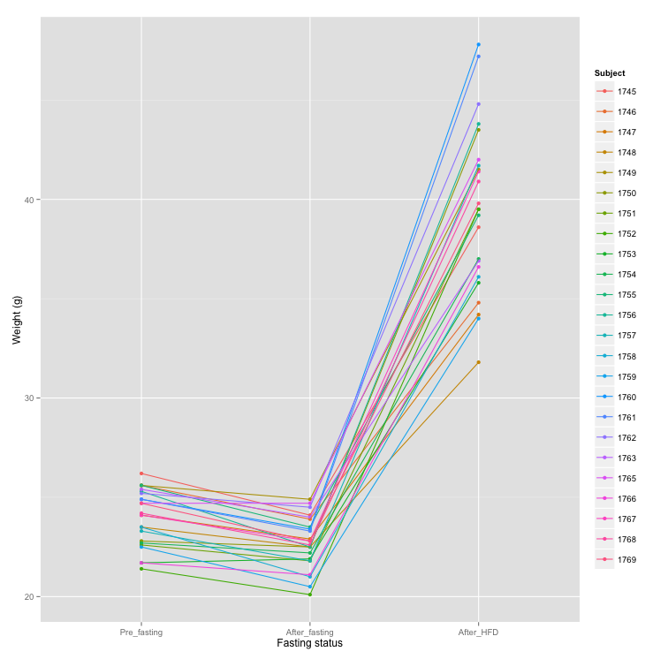

Slide 5
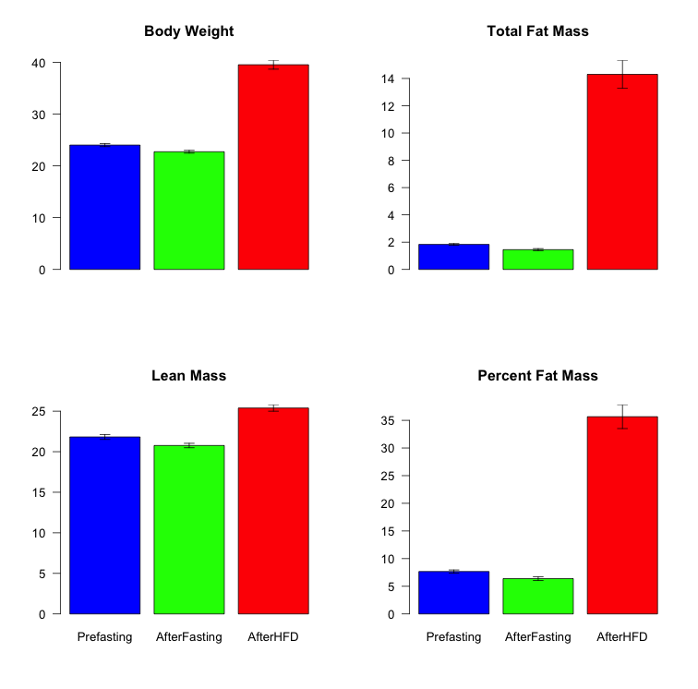
*

Slide 6
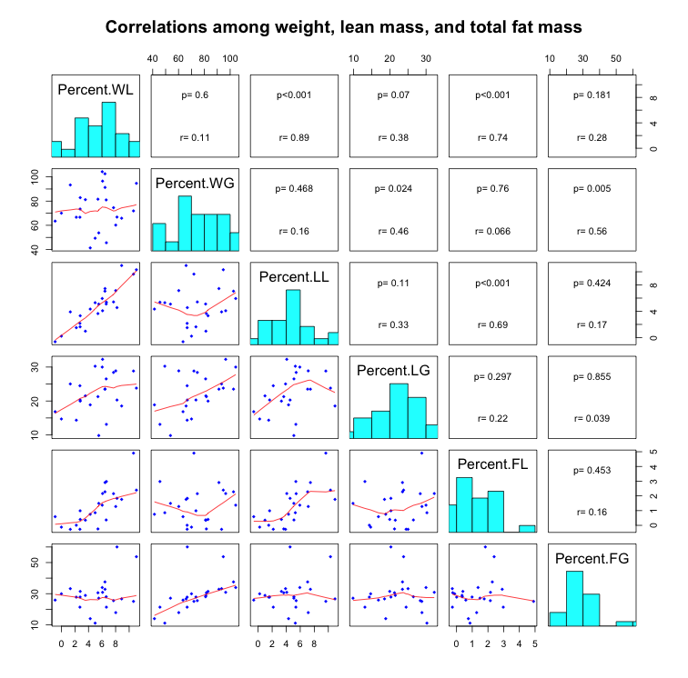

Slide 7
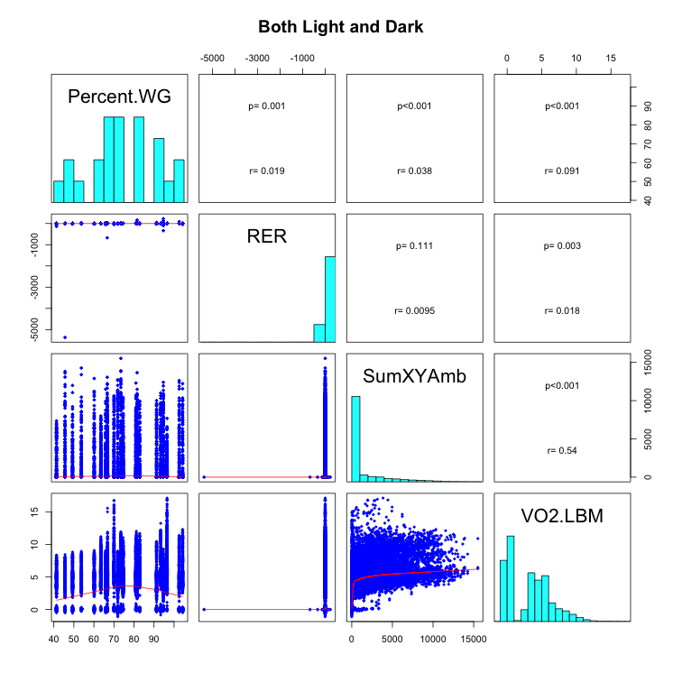

Slide 8
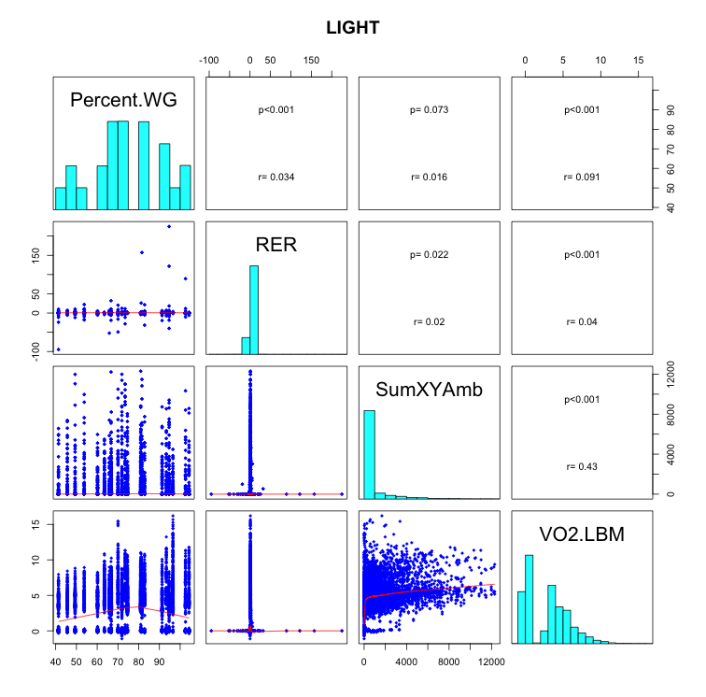

Slide 9
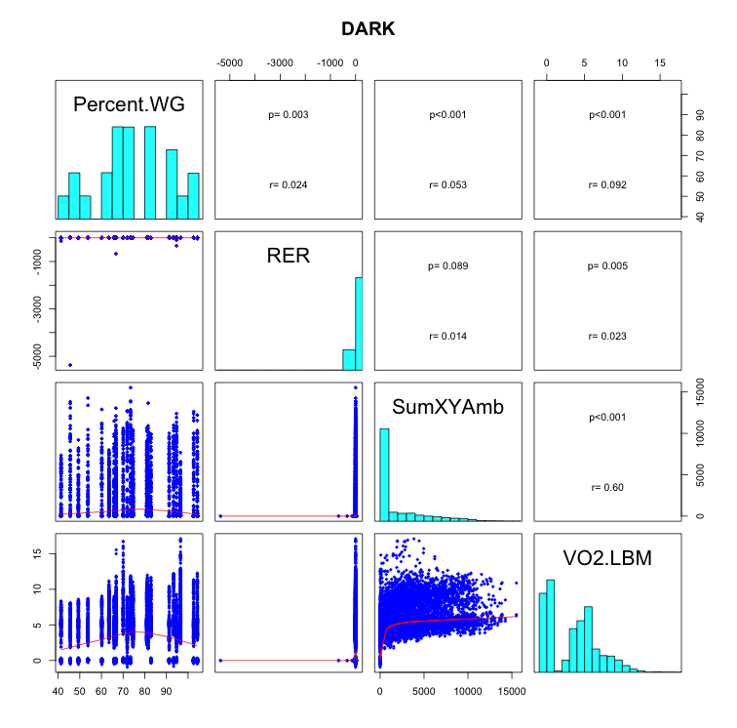

Slide 10
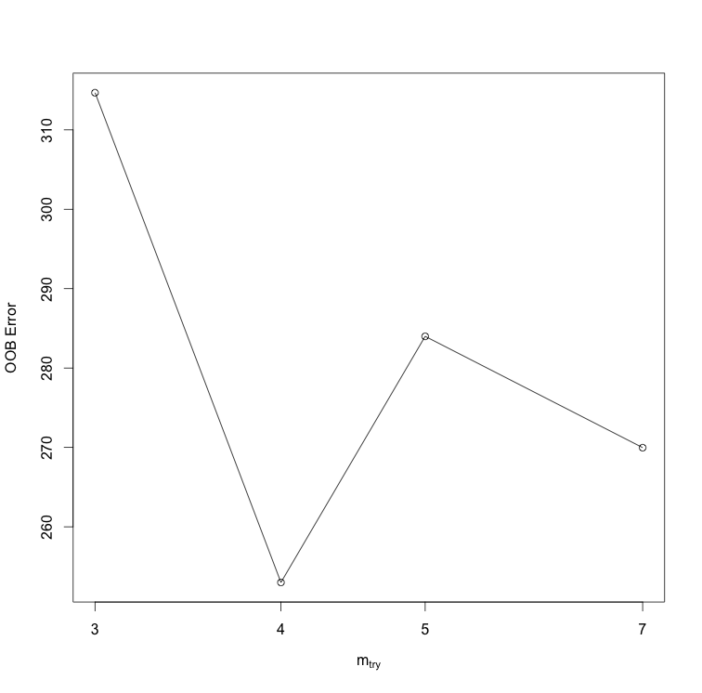
Optimal # of vars to split at each node

Slide 11
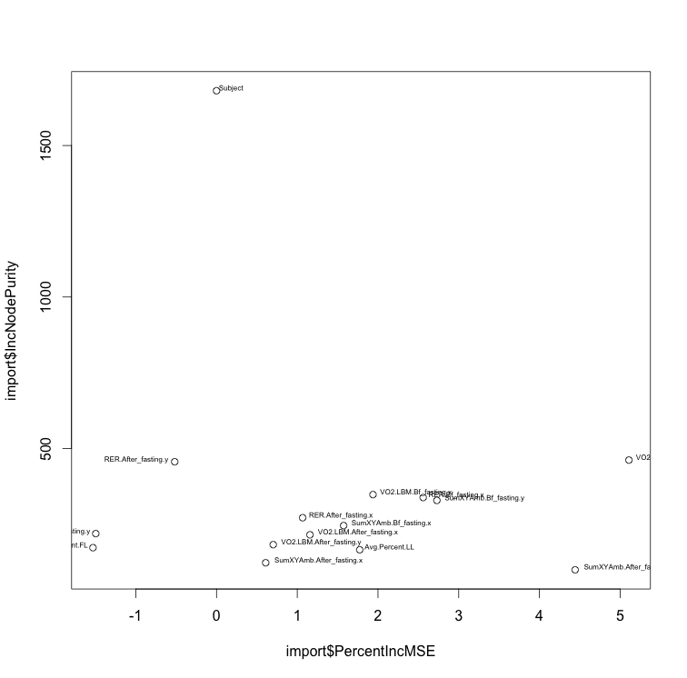
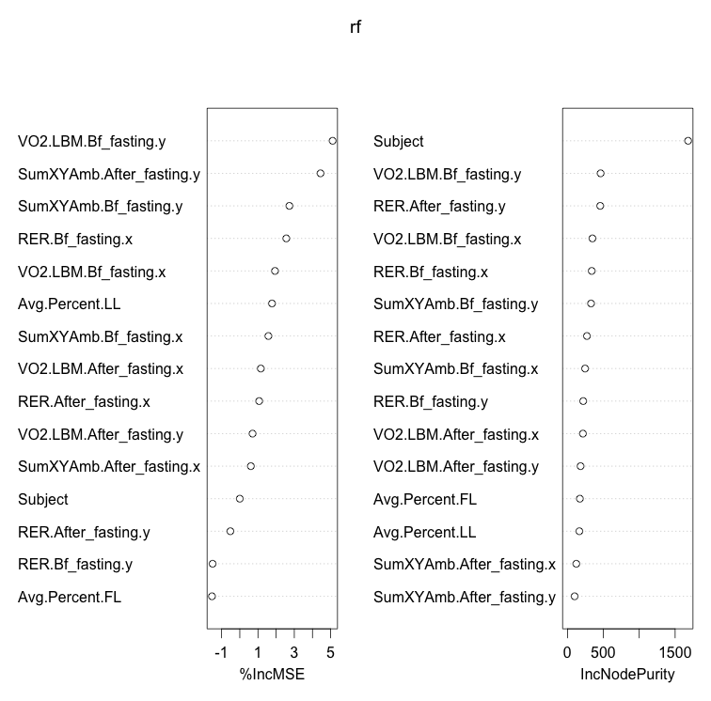

Slide 12
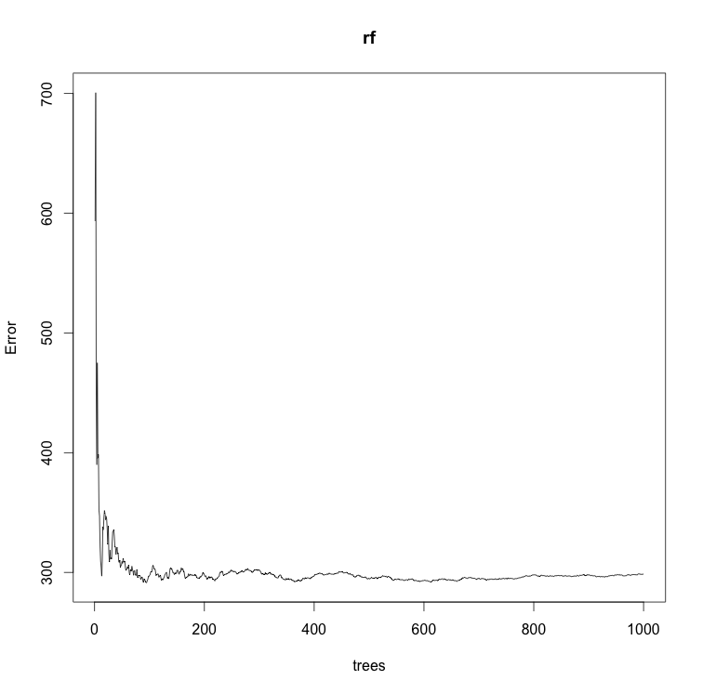

Slide 13
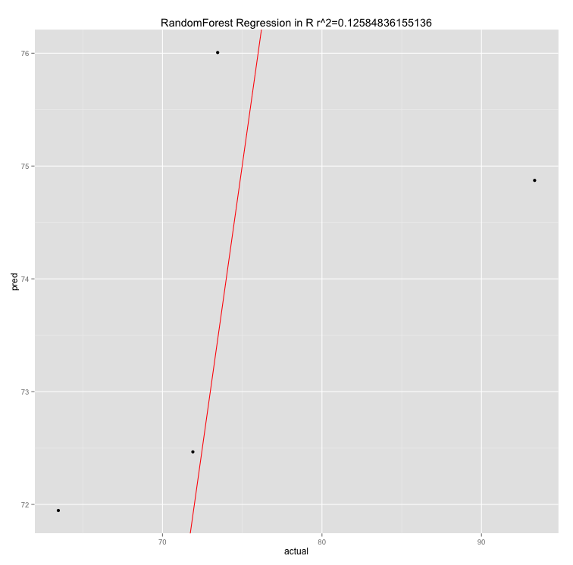

Slide 14
RE-EM tree

Slide 15
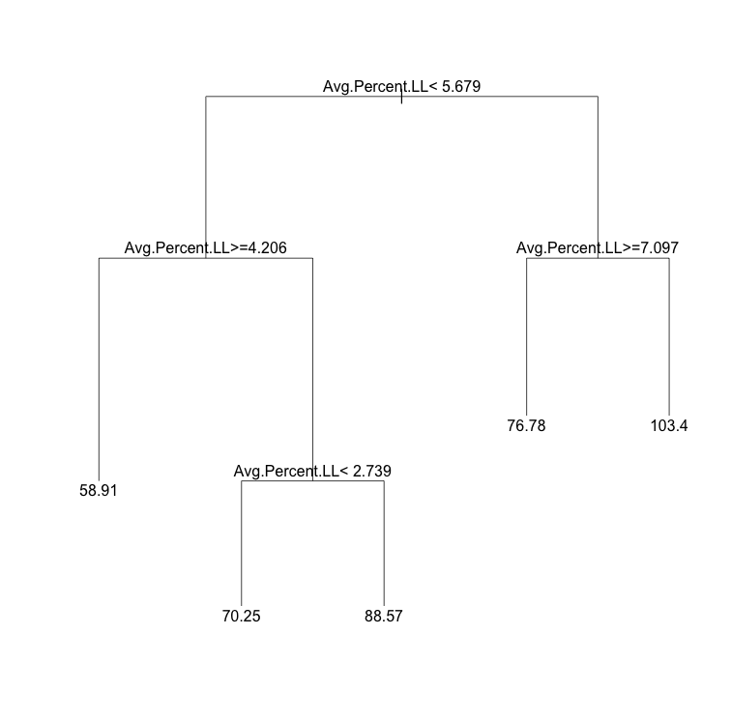

Slide 16
sub <- c(rep(TRUE, 96), rep(FALSE, 62))
weight.rf2 <- REEMtree(Percent.WG~ VO2.LBM + RER + SumXYAmb+
Avg.Percent.FL + Avg.Percent.LL + Light.Dark + Fast
, data=combine.data, random=~1|Subject, subset=sub)
R2 = 0.288
MSE = 190.12

Slide 17
