Slide 1
Predicting weight gain based on body composition and metabolic rate

Slide 2
Objective
To identify predictors that can estimate the amount of weight gain after a fasting period of 16 hours

Slide 3
Experimental design
C57BL/6J mice
HFD#8 – cohort id is 8 (training data set, n=24)
HFD#9 – cohort id is 15 (evaluation data set, n=30)
10/17/2014
1/16/2015
NCD
FAST
HFD
10/21/2014
10/22/2014
11/26/2014
2/24/2015
NCD
FAST
HFD
12/01/2014
12/02/2014

Slide 4
Data summary
Cohort | Body Weight | Lean & Fat Mass | CLAMS | Hormones | Glucose
5 | Yes | no | no | yes | yes
6 | yes | no | no | Yes | yes
8 | yes | yes | yes | Not yet | Not yet
9 | yes | yes | yes | Not yet | Not yet

Slide 5
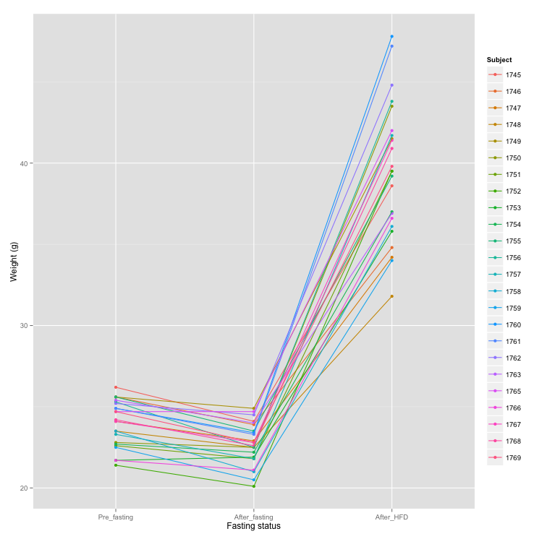

Slide 6
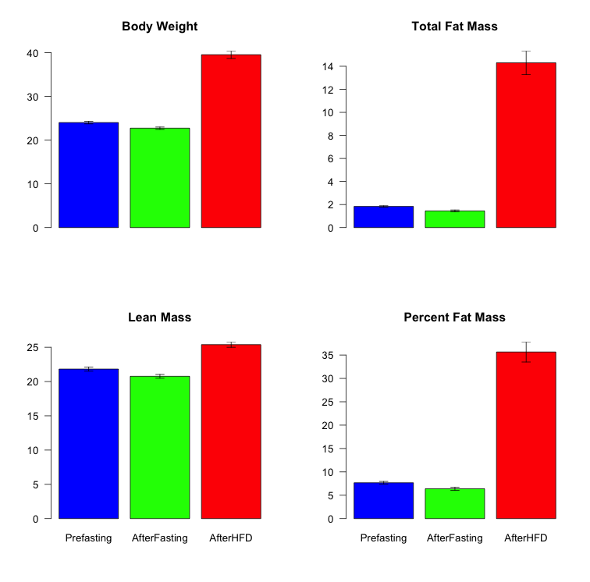
*

Slide 7
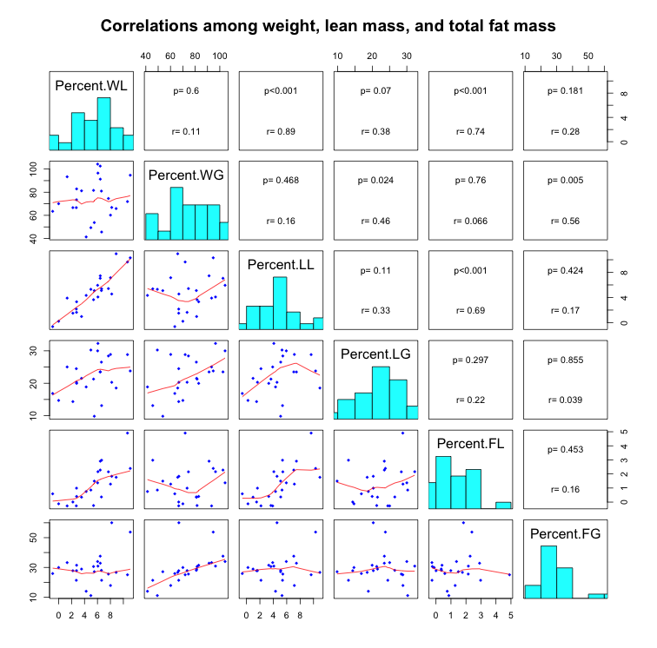

Slide 8
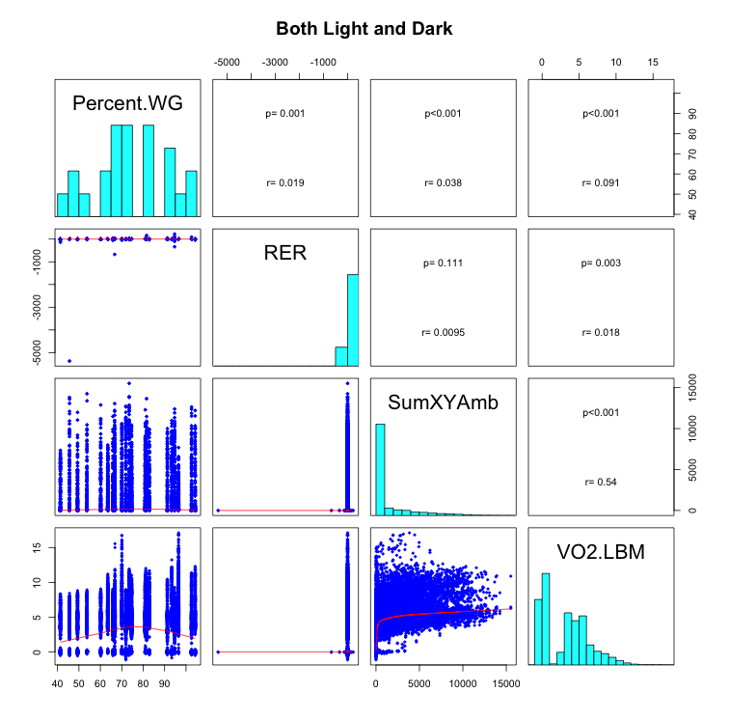

Slide 9
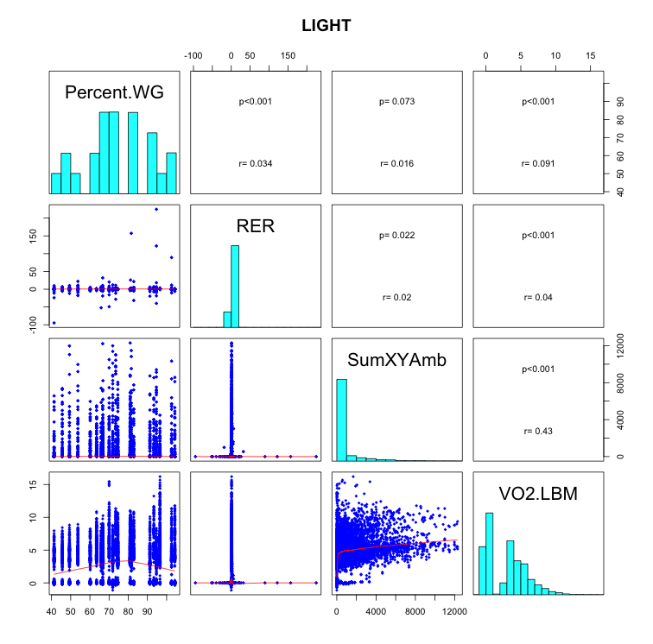

Slide 10
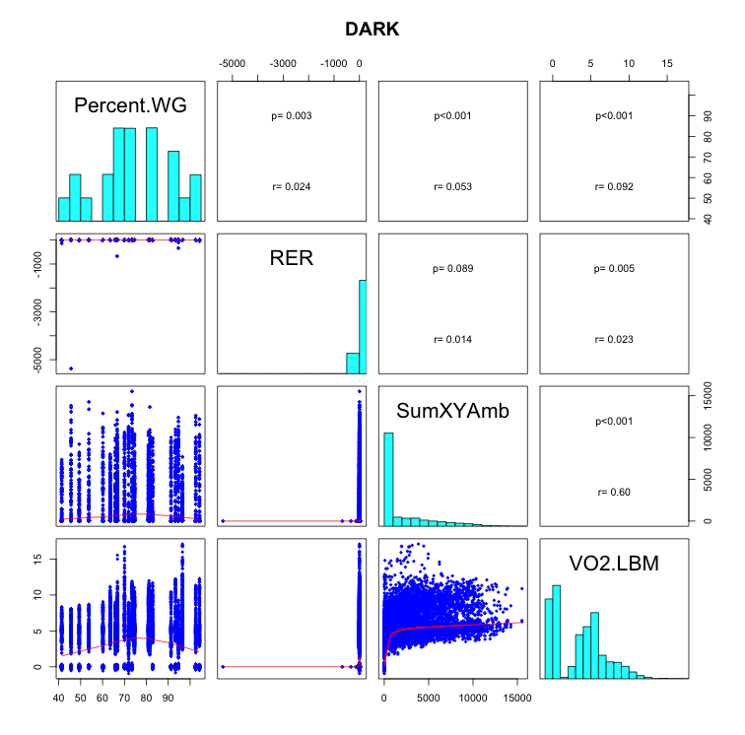

Slide 11
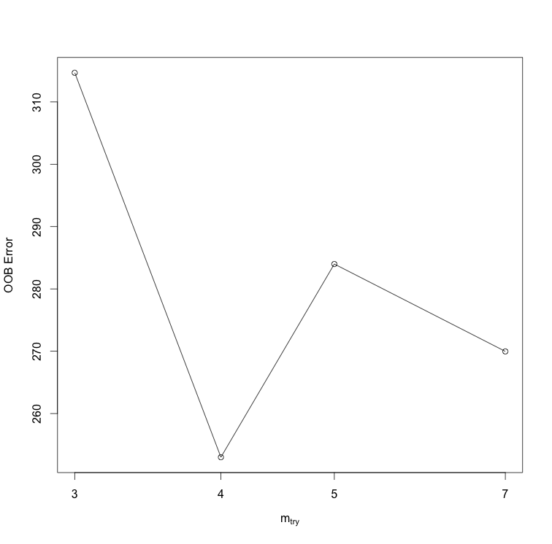
Optimal # of vars to split at each node

Slide 12
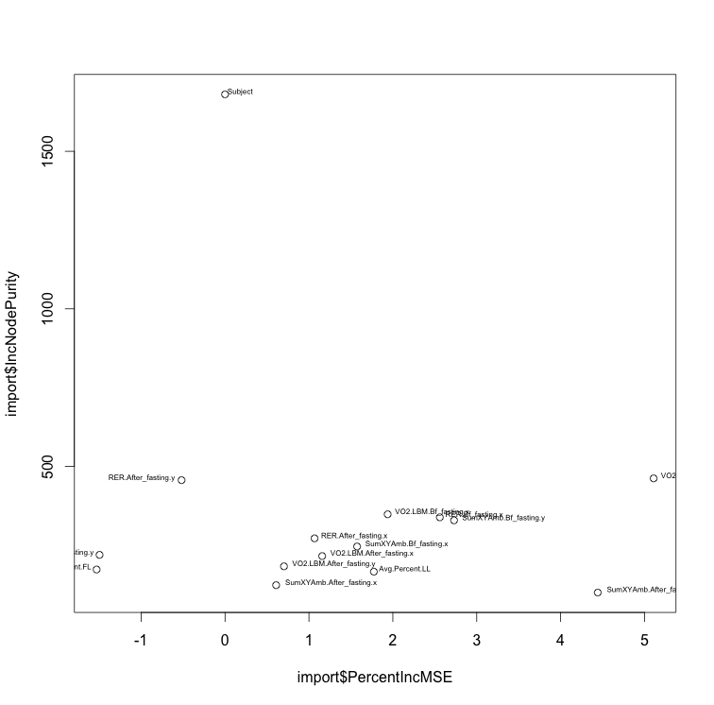
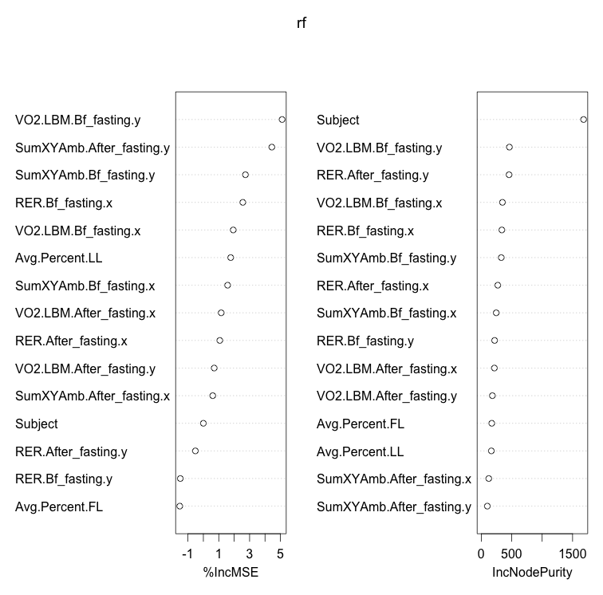

Slide 13
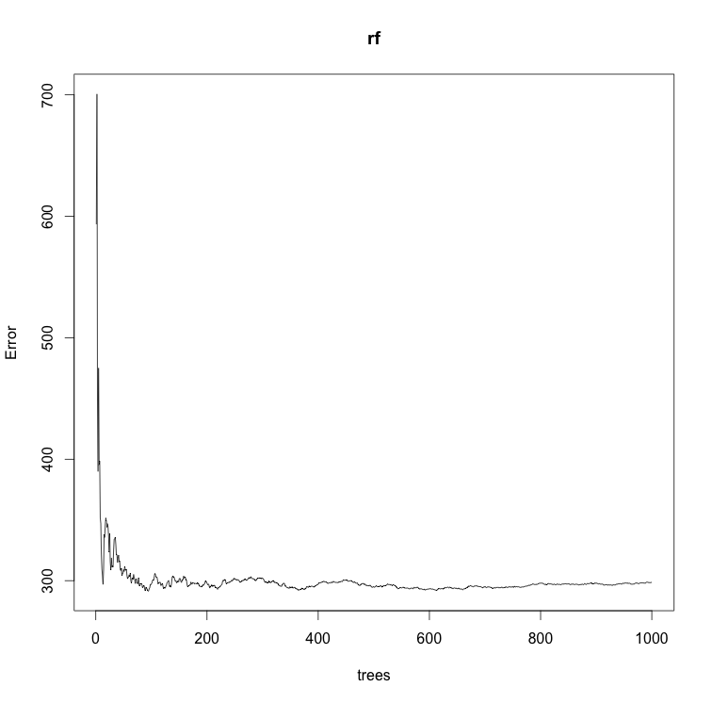

Slide 14
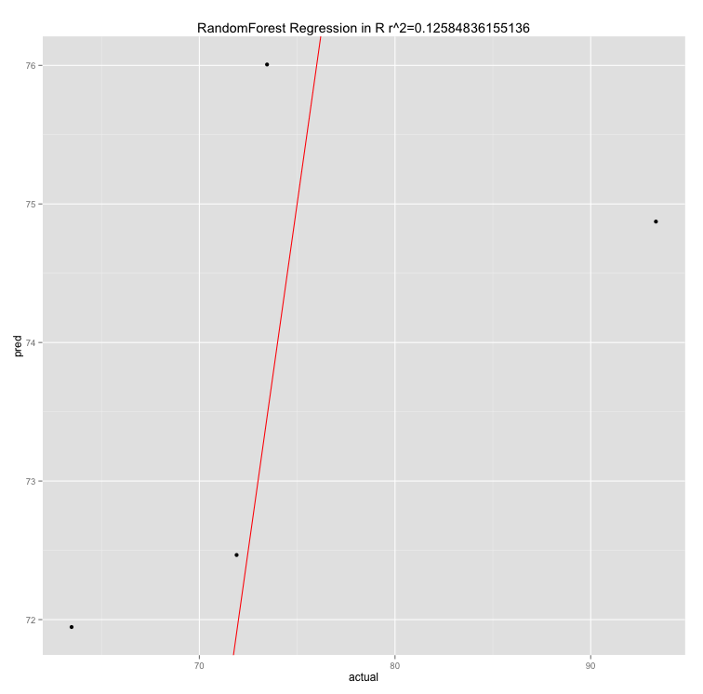

Slide 15
RE-EM tree

Slide 16
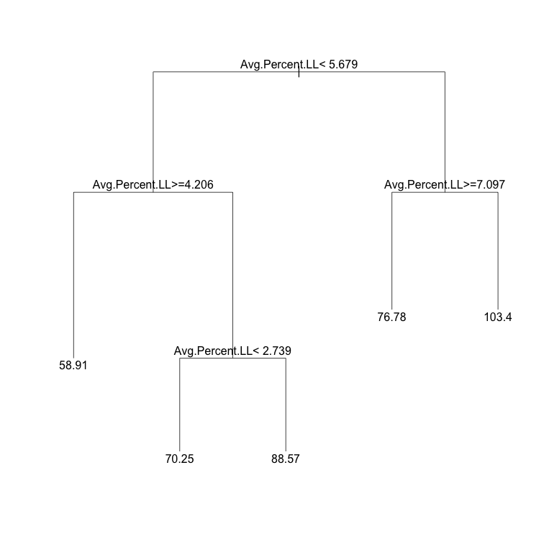

Slide 17
sub <- c(rep(TRUE, 96), rep(FALSE, 62))
weight.rf2 <- REEMtree(Percent.WG~ VO2.LBM + RER + SumXYAmb+
Avg.Percent.FL + Avg.Percent.LL + Light.Dark + Fast
, data=combine.data, random=~1|Subject, subset=sub)
R2 = 0.288
MSE = 190.12

Slide 18
